Slide 1
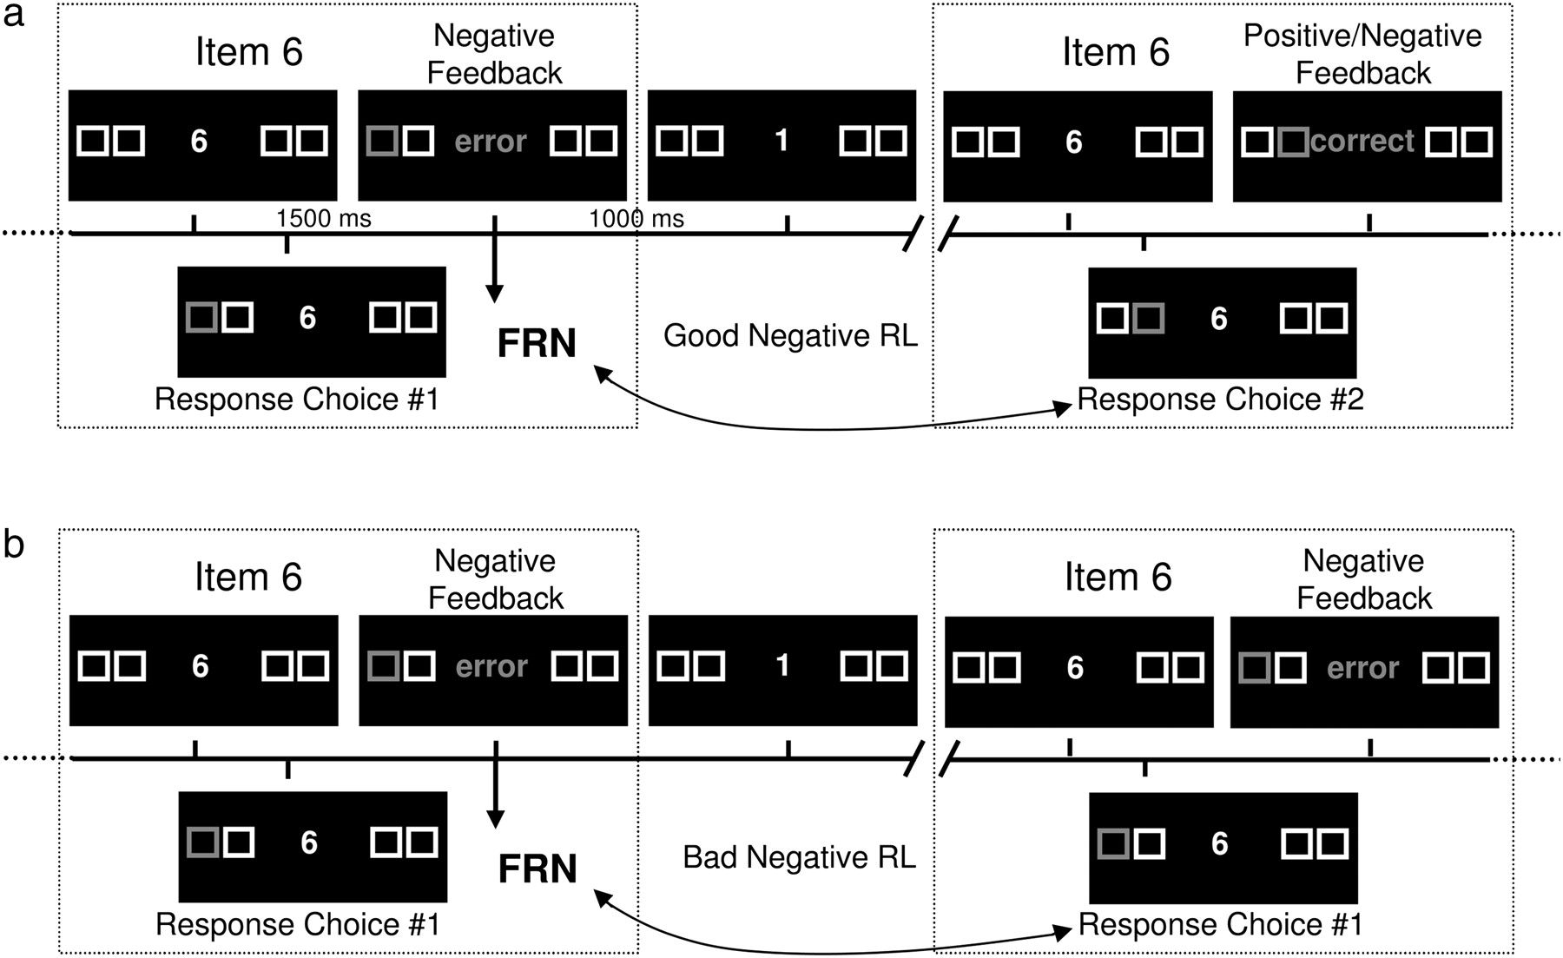
Figure 1. (a) An example of a good negative RL trial. (b) An example of bad negative RL. In both examples, the ...
Notes:
Figure 1. (a) An example of a good negative RL trial. (b) An example of bad negative RL. In both examples, the participant first chooses the leftmost button on item 6. In example (a), the next choice is the second button from the left. This choice is, in this example, followed by positive feedback after which the participant can proceed with item 7 but can also be followed by negative feedback (not shown) after which the participant has to restart with item 1. In both cases, however, this trial is classified as “good learning” because the participant correctly refrained from choosing the same button as on the previous trial. In example (b), the participant's choice is the same as on the first encounter of this item (and for which he/she received negative feedback). This indicates that the subject has not learned from the previous negative feedback and this trial is therefore referred to as a “bad learning” trial.
Unless provided in the caption above, the following copyright applies to the content of this slide: © The Author 2009. Published by Oxford University Press. All rights reserved. For permissions, please e-mail: journals.permissions@oxfordjournals.org

Slide 2
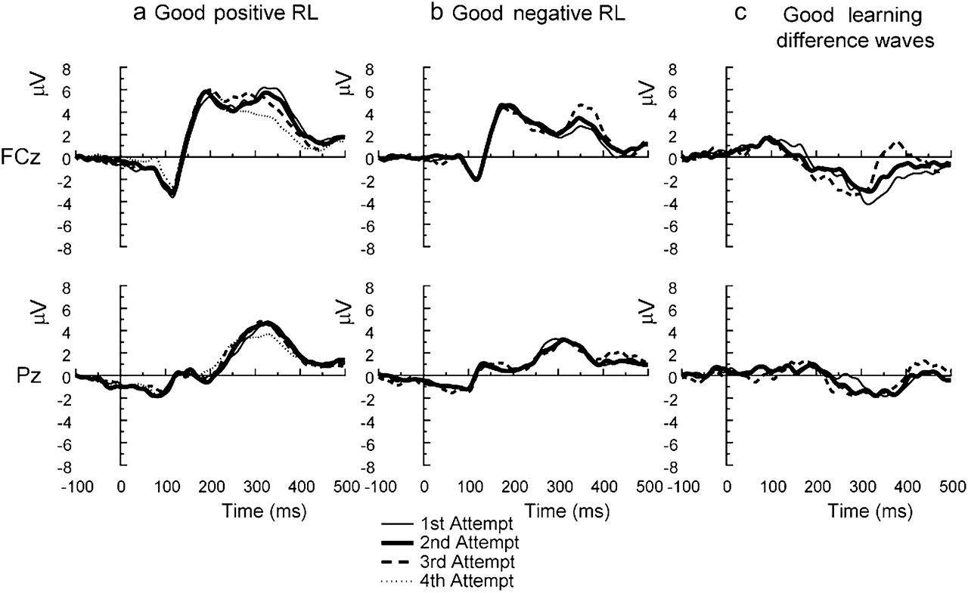
Figure 5. ERP waveforms recorded for the first, second, third, and fourth attempt at a particular item in the sequence, ...
Notes:
Figure 5. ERP waveforms recorded for the first, second, third, and fourth attempt at a particular item in the sequence, for trials associated with (a) good positive RL and (b) good negative RL. The associated good learning difference waves are shown in (c).
Unless provided in the caption above, the following copyright applies to the content of this slide: © The Author 2009. Published by Oxford University Press. All rights reserved. For permissions, please e-mail: journals.permissions@oxfordjournals.org

Slide 3
Figure 4. The topographical distributions of the difference waves are sampled at 280-ms after feedback. (a) ...
Notes:
Figure 4. The topographical distributions of the difference waves are sampled at 280-ms after feedback. (a) Topographical distribution of the difference wave of good negative RL–good positive RL; (b) topographical distribution of the difference wave of bad negative RL–good positive RL; (c) topographical distribution of the difference wave of good negative RL–bad negative RL. In the top and middle graphs, the change in potential between adjacent contours is 0.8 μV. In the lower graph, the change in potential between adjacent contours is 0.4 μV.
Unless provided in the caption above, the following copyright applies to the content of this slide: © The Author 2009. Published by Oxford University Press. All rights reserved. For permissions, please e-mail: journals.permissions@oxfordjournals.org

Slide 4
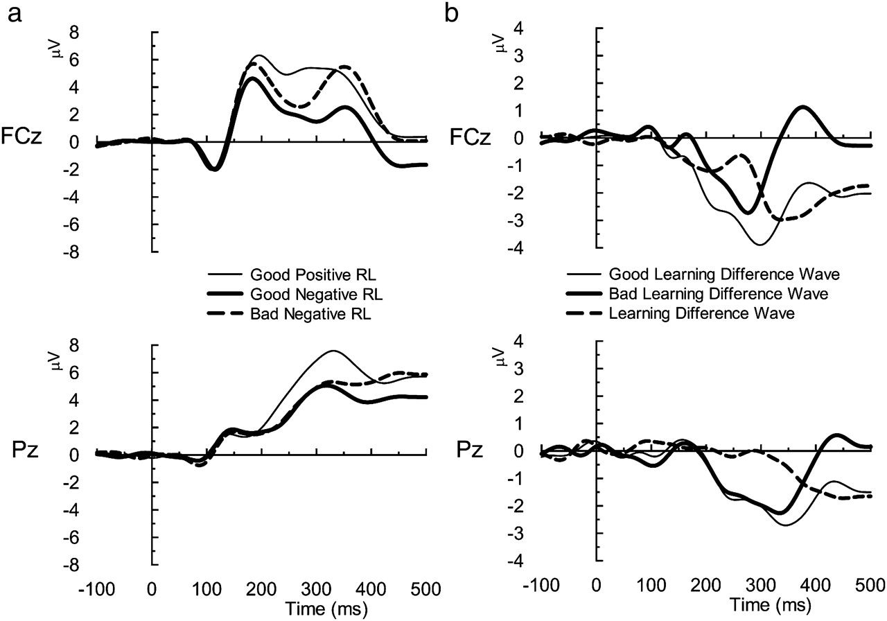
Figure 3. (a) FRN waveforms associated with the different feedback–performance contingencies at channels FCz and Pz. ...
Notes:
Figure 3. (a) FRN waveforms associated with the different feedback–performance contingencies at channels FCz and Pz. The thin line represents good positive RL; the strong line, good negative RL; and the dashed line, bad negative RL. Difference waves are presented in the graphs on the right (b). Here, the thin line (good learning difference wave) represents difference waves obtained by subtracting good positive RL from good negative RL, and the strong line (bad learning difference wave) represents difference waves obtained by subtracting good positive RL from bad negative RL. The dashed line (learning difference wave) represents the difference wave obtained by subtracting bad negative RL from good negative RL. As can be seen in these graphs, negative feedback resulted in more negative-going deflections than positive feedback, particularly on FCz. Furthermore, good negative RL elicited a larger FRN than bad negative RL, only on FCz.
Unless provided in the caption above, the following copyright applies to the content of this slide: © The Author 2009. Published by Oxford University Press. All rights reserved. For permissions, please e-mail: journals.permissions@oxfordjournals.org

Slide 5
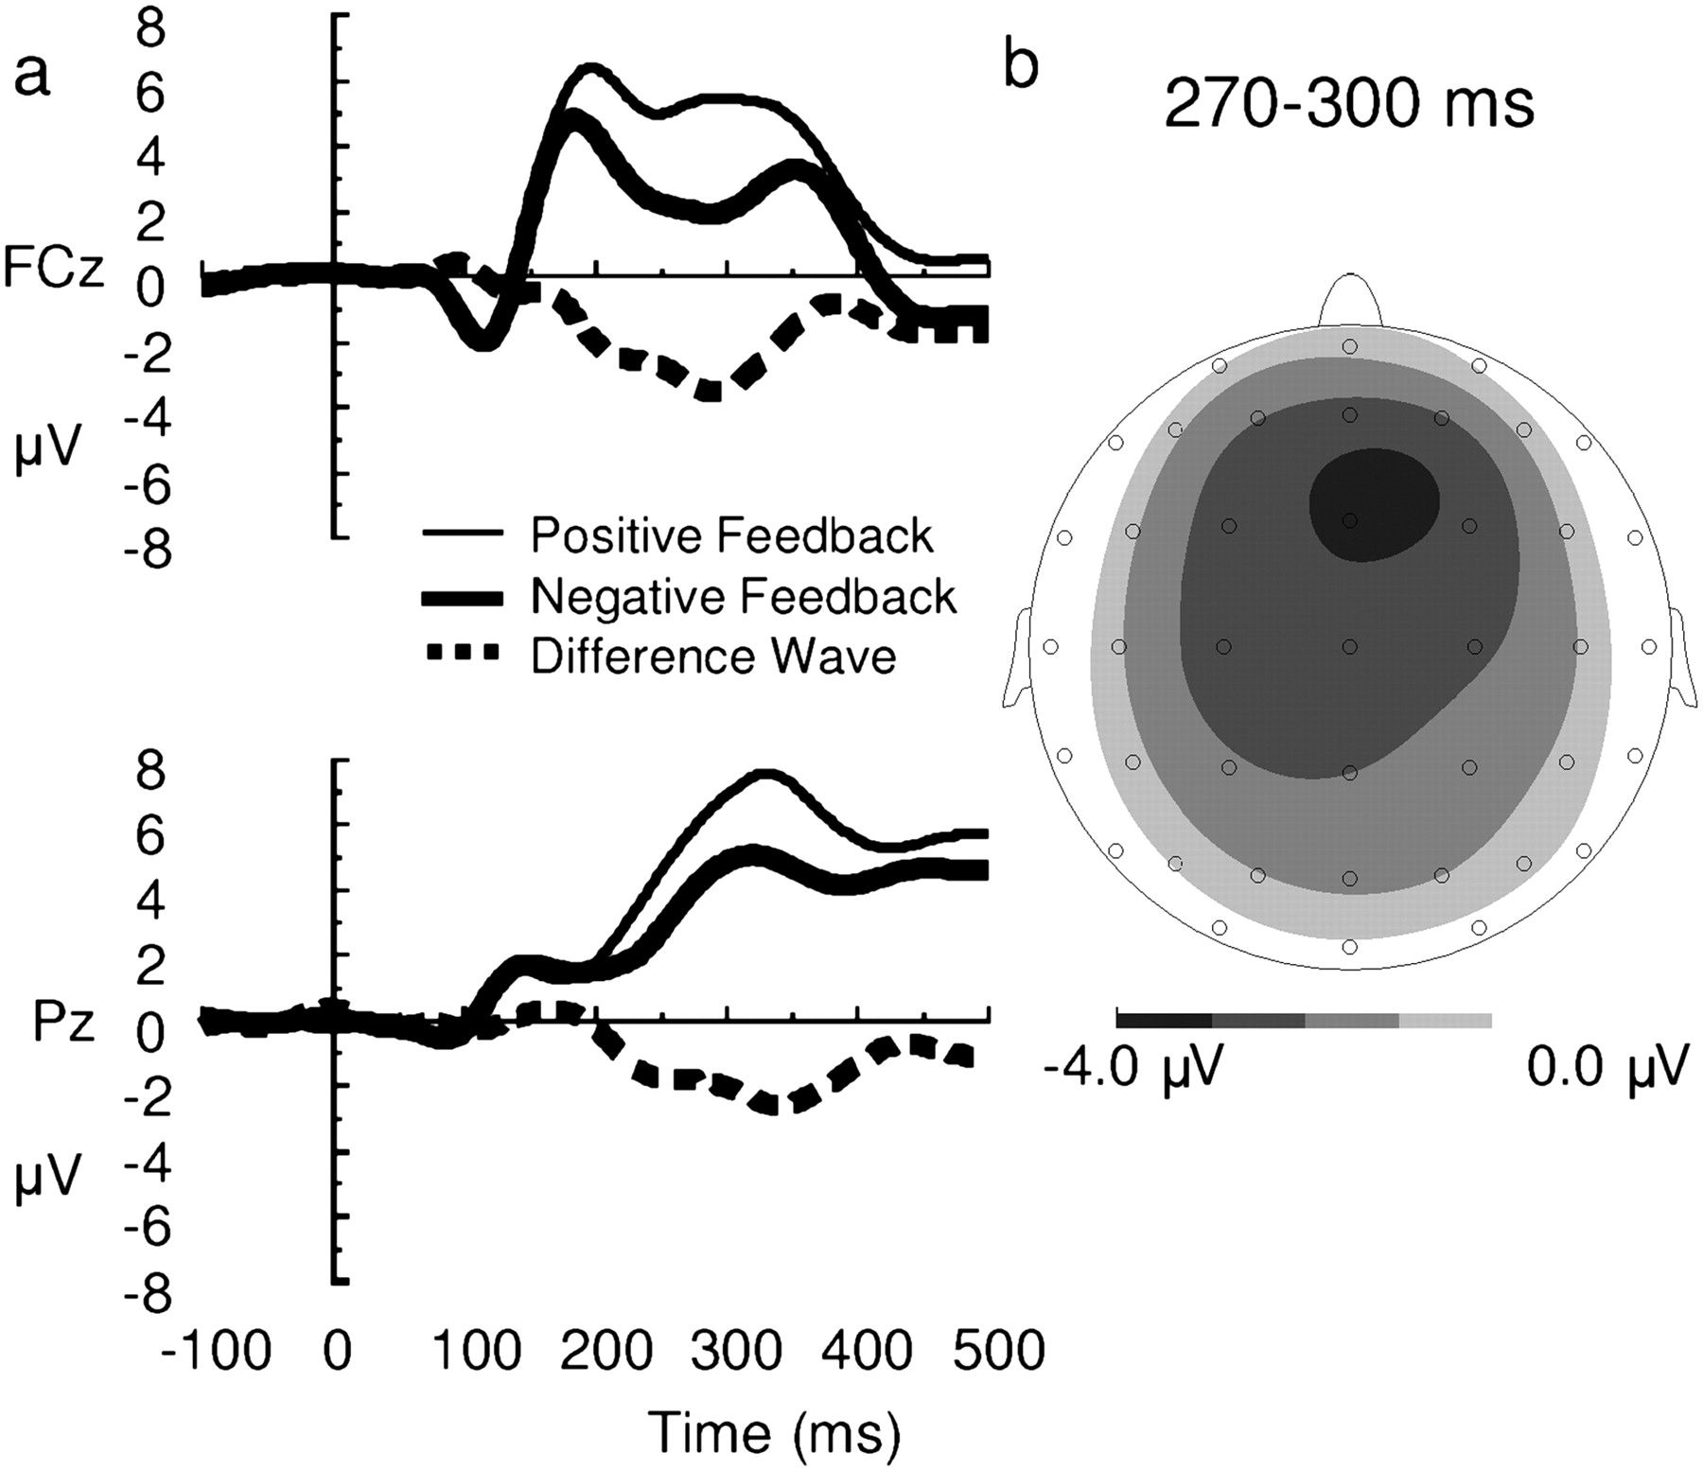
Figure 2. The left graph (a) shows the ERP to positive feedback (thin line), negative feedback (strong line), and the ...
Notes:
Figure 2. The left graph (a) shows the ERP to positive feedback (thin line), negative feedback (strong line), and the associated difference wave (dashed line) on FCz and Pz. In the right graph (b), the topographical distribution of this difference wave in the 270- to 300-ms latency range is presented. As can be seen, negative feedback compared with positive feedback elicits a fronto-central negativity. The change in potential between adjacent contours is 0.8 μV.
Unless provided in the caption above, the following copyright applies to the content of this slide: © The Author 2009. Published by Oxford University Press. All rights reserved. For permissions, please e-mail: journals.permissions@oxfordjournals.org

