Slide 1
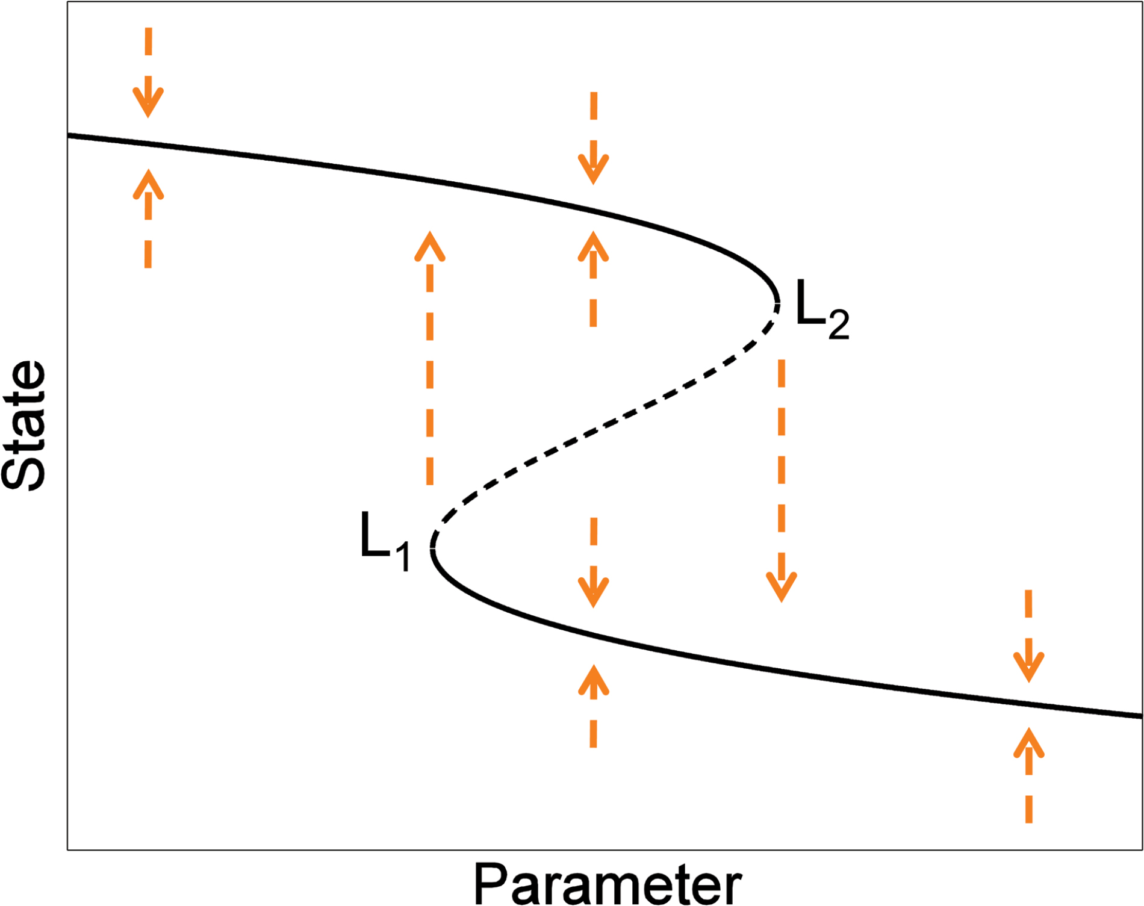
Figure 1. Sketch of the occurrence of multiple states and bifurcation points. The equilibria of the system’s state are ...
Notes:
Figure 1. Sketch of the occurrence of multiple states and bifurcation points. The equilibria of the system’s state are shown as black lines (continuous: stable; dashed: unstable), in dependence on a certain parameter. The flow towards a stable state is shown as dashed orange arrows; L1 and L2 indicate the saddle-node (or fold) bifurcation points, also referred to as limit or turning points.
Unless provided in the caption above, the following copyright applies to the content of this slide: © The Author 2016. Published by Oxford University Press.This is an Open Access article distributed under the terms of the Creative Commons Attribution Non-Commercial License (http://creativecommons.org/licenses/by-nc/4.0/), which permits non-commercial re-use, distribution, and reproduction in any medium, provided the original work is properly cited. For commercial re-use, please contact journals.permissions@oup.com

Slide 2
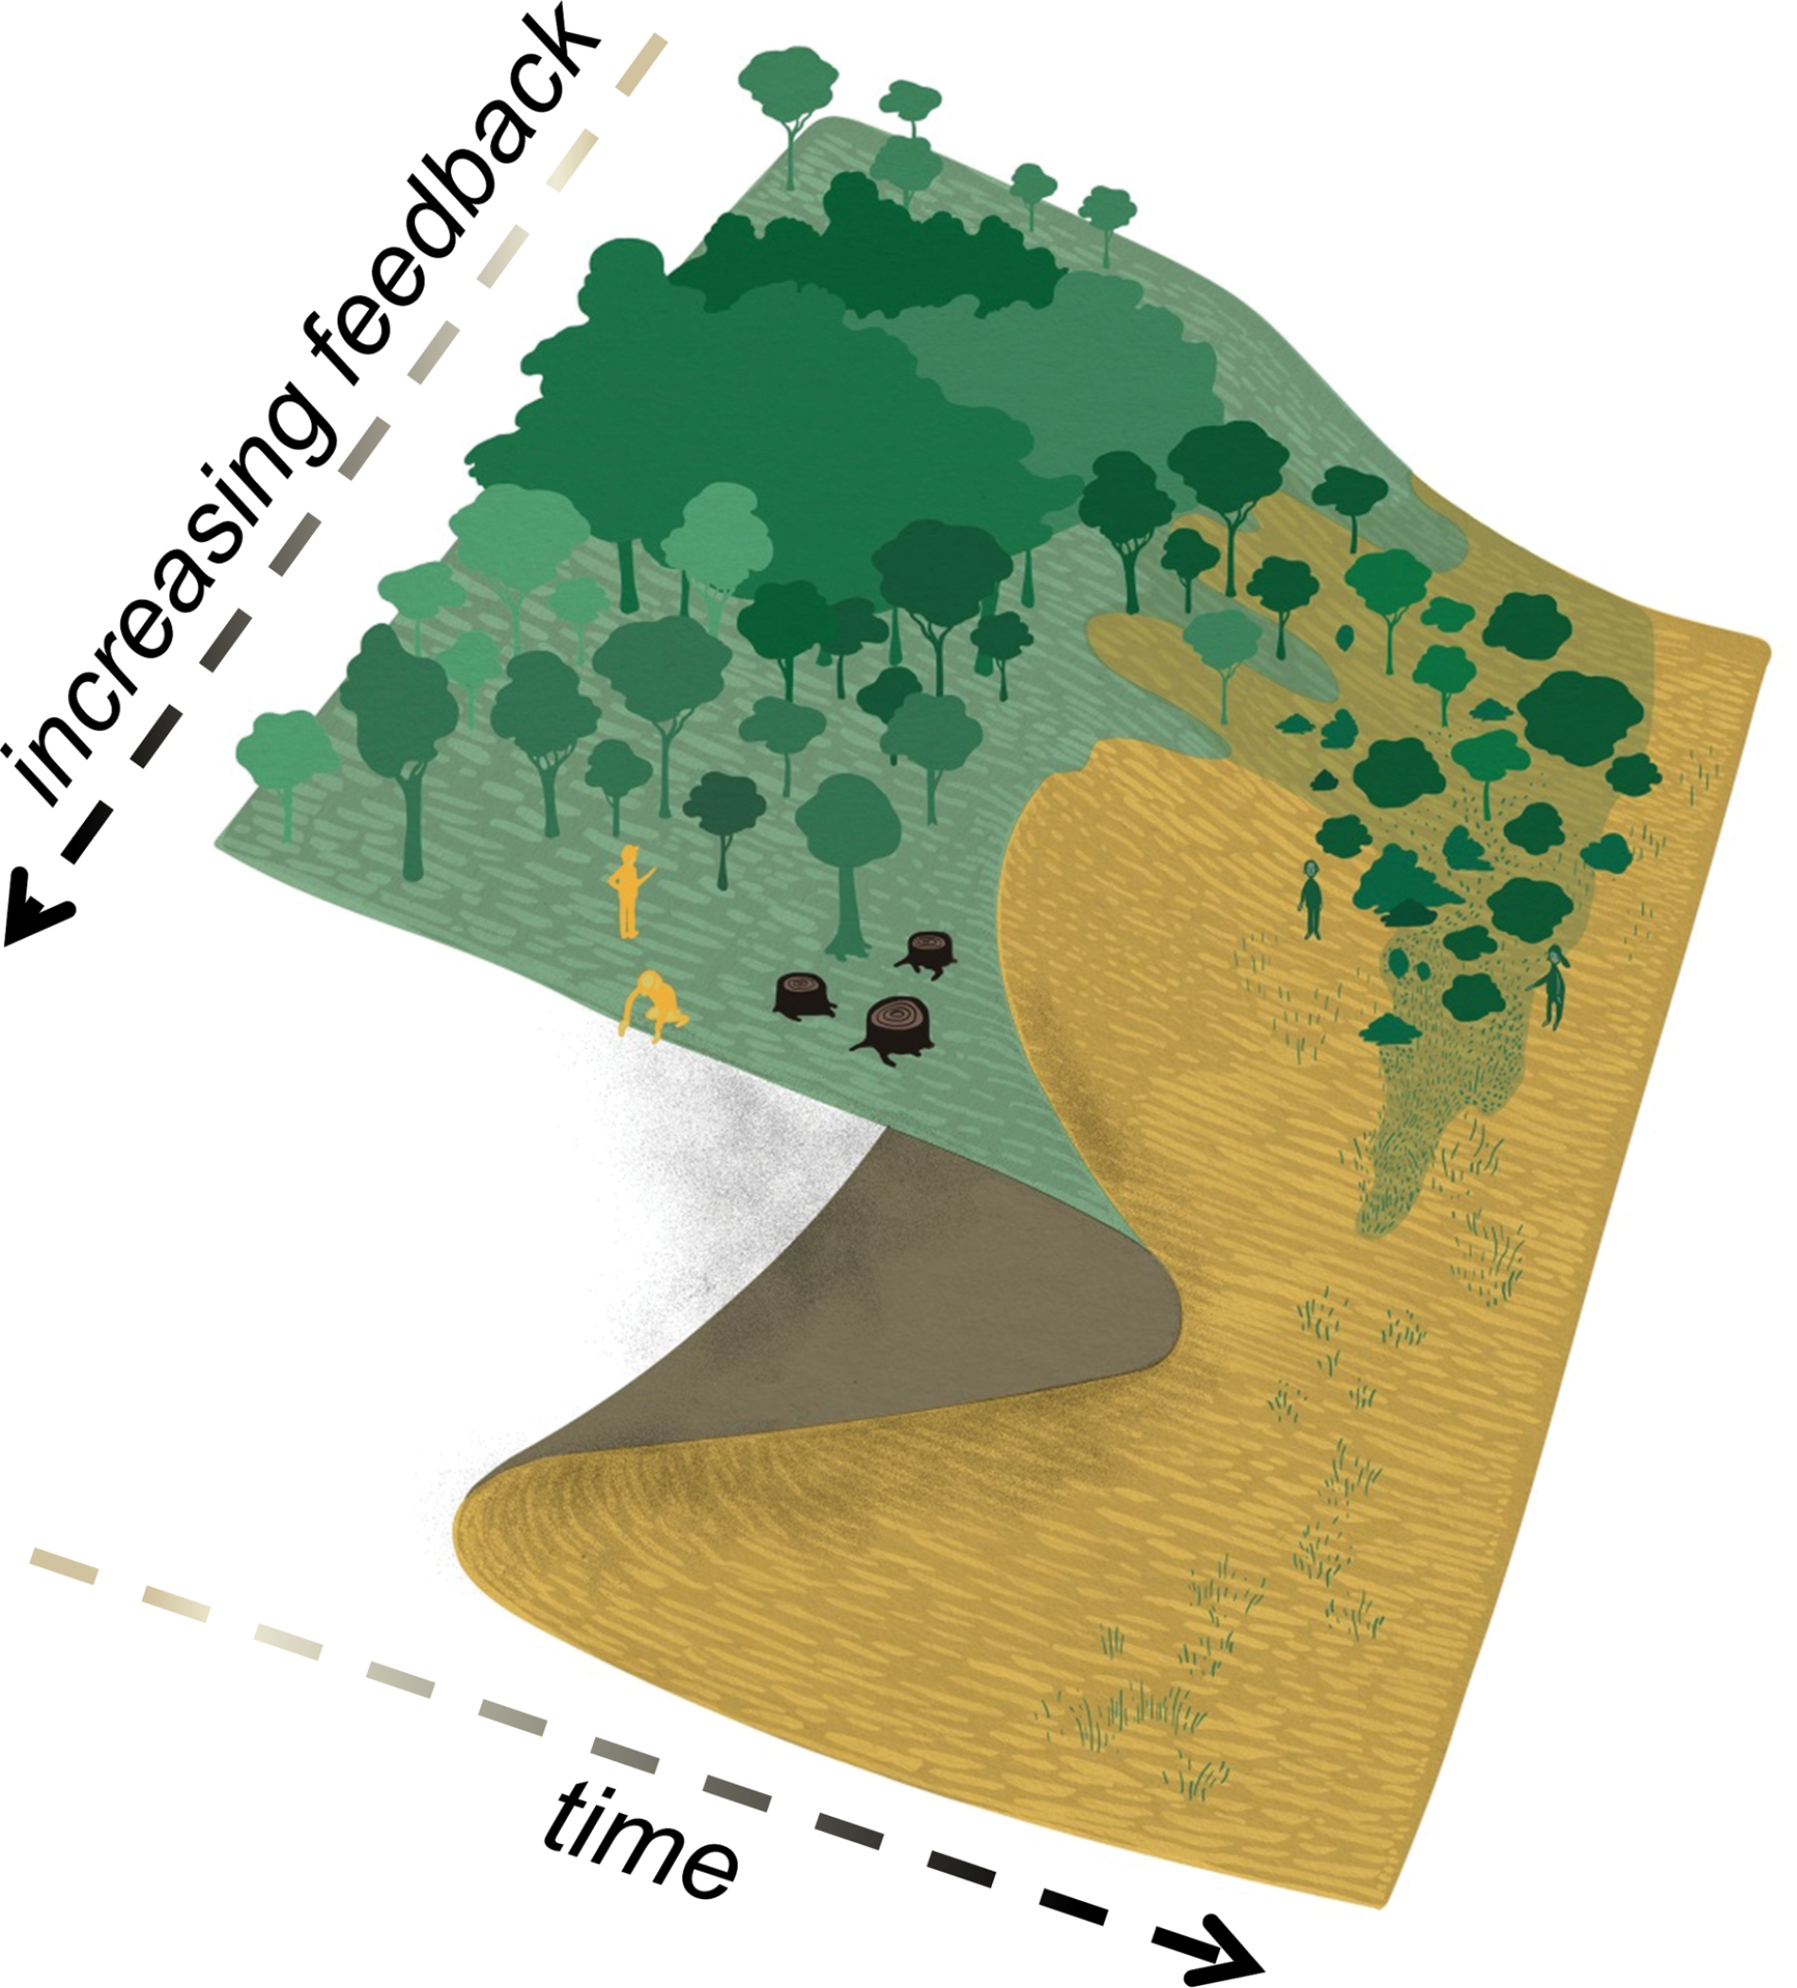
Figure 2. Stability landscape of the Green Sahara and desert. The larger the atmosphere–vegetation feedback (i.e. ...
Notes:
Figure 2. Stability landscape of the Green Sahara and desert. The larger the atmosphere–vegetation feedback (i.e. moving towards the lower left of the figure), the sharper the transition between the two states. (Modified from Model Calendar 2015, designed by Elsa Wikander at Azote, funded by the Beijer Institute of Ecological Economics and the Stockholm Resilience Centre.)
Unless provided in the caption above, the following copyright applies to the content of this slide: © The Author 2016. Published by Oxford University Press.This is an Open Access article distributed under the terms of the Creative Commons Attribution Non-Commercial License (http://creativecommons.org/licenses/by-nc/4.0/), which permits non-commercial re-use, distribution, and reproduction in any medium, provided the original work is properly cited. For commercial re-use, please contact journals.permissions@oup.com

Slide 3
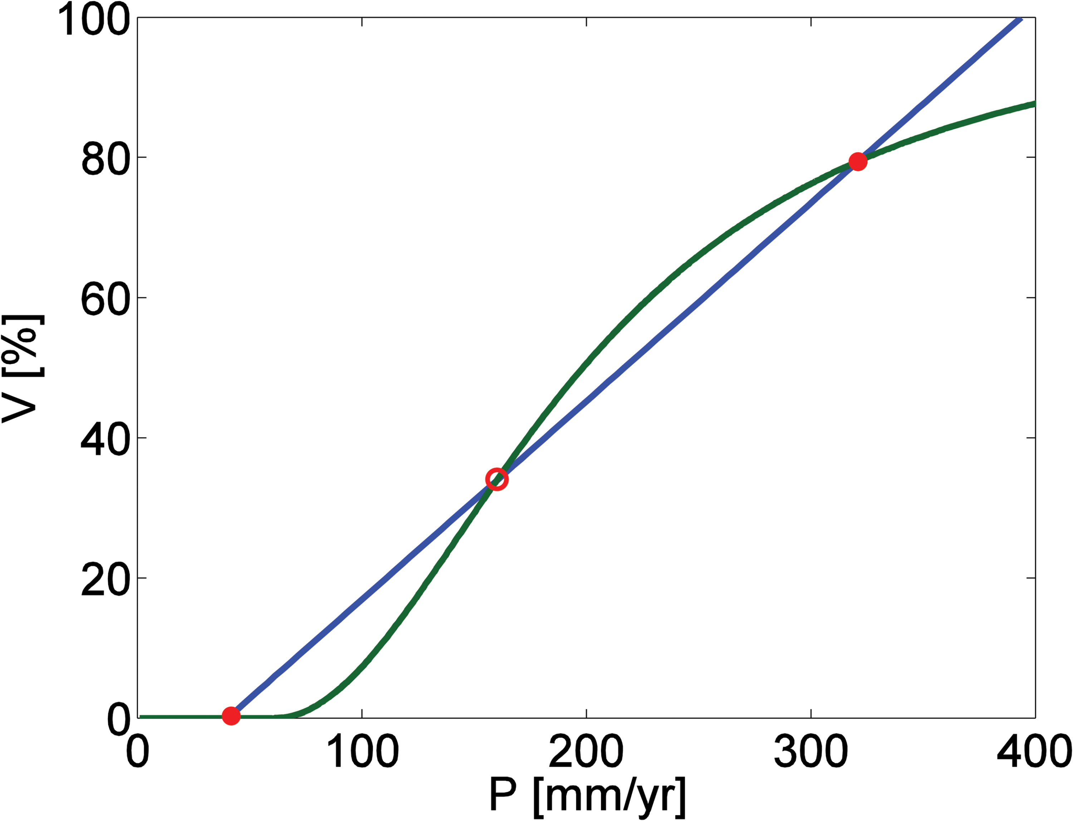
Figure 3. Phase diagram of atmosphere–vegetation interaction in North Africa after Brovkin et al. (1998). The green ...
Notes:
Figure 3. Phase diagram of atmosphere–vegetation interaction in North Africa after Brovkin et al. (1998). The green line shows how vegetation cover depends on rainfall, and the blue line shows how rainfall depends on vegetation cover. Intersection points represent the stable (closed red dots) and unstable (open red dot) equilibria of the system.
Unless provided in the caption above, the following copyright applies to the content of this slide: © The Author 2016. Published by Oxford University Press.This is an Open Access article distributed under the terms of the Creative Commons Attribution Non-Commercial License (http://creativecommons.org/licenses/by-nc/4.0/), which permits non-commercial re-use, distribution, and reproduction in any medium, provided the original work is properly cited. For commercial re-use, please contact journals.permissions@oup.com

Slide 4
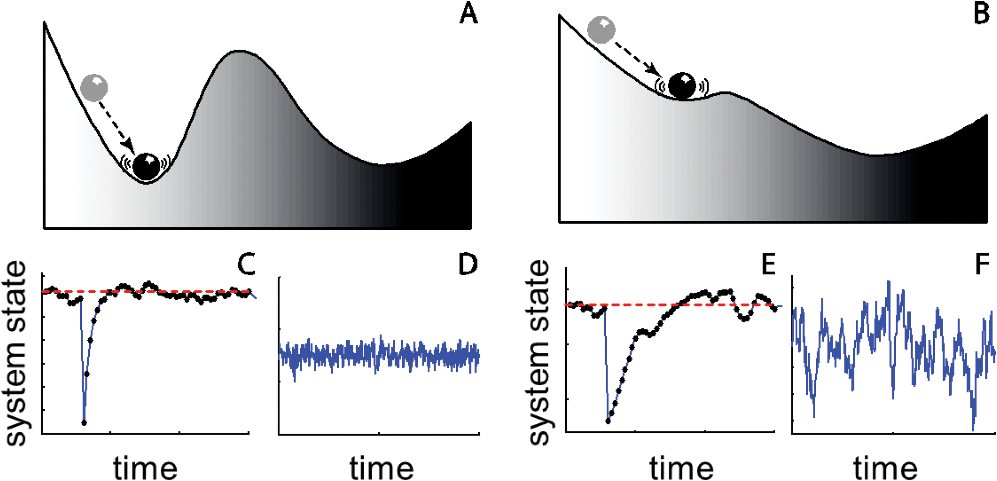
Figure 4. Slowing down and its indicators in a destabilizing system. Here, the position of the ball indicates the state ...
Notes:
Figure 4. Slowing down and its indicators in a destabilizing system. Here, the position of the ball indicates the state of the system which is subject to random perturbations. The minima in the stability landscape are stable states. If the system is far from the bifurcation (A) it is more stable than close to the bifurcation (B). Far from the bifurcation, the system recovers quickly from a perturbation (C), and its variability in the steady state is small and fast (D). Close to the perturbation, the recovery is slow (E), and as a consequence, the variability shows long excursions from the mean and has larger total magnitude (F) (adapted from Scheffer et al., 2012).
Unless provided in the caption above, the following copyright applies to the content of this slide: © The Author 2016. Published by Oxford University Press.This is an Open Access article distributed under the terms of the Creative Commons Attribution Non-Commercial License (http://creativecommons.org/licenses/by-nc/4.0/), which permits non-commercial re-use, distribution, and reproduction in any medium, provided the original work is properly cited. For commercial re-use, please contact journals.permissions@oup.com

Slide 5
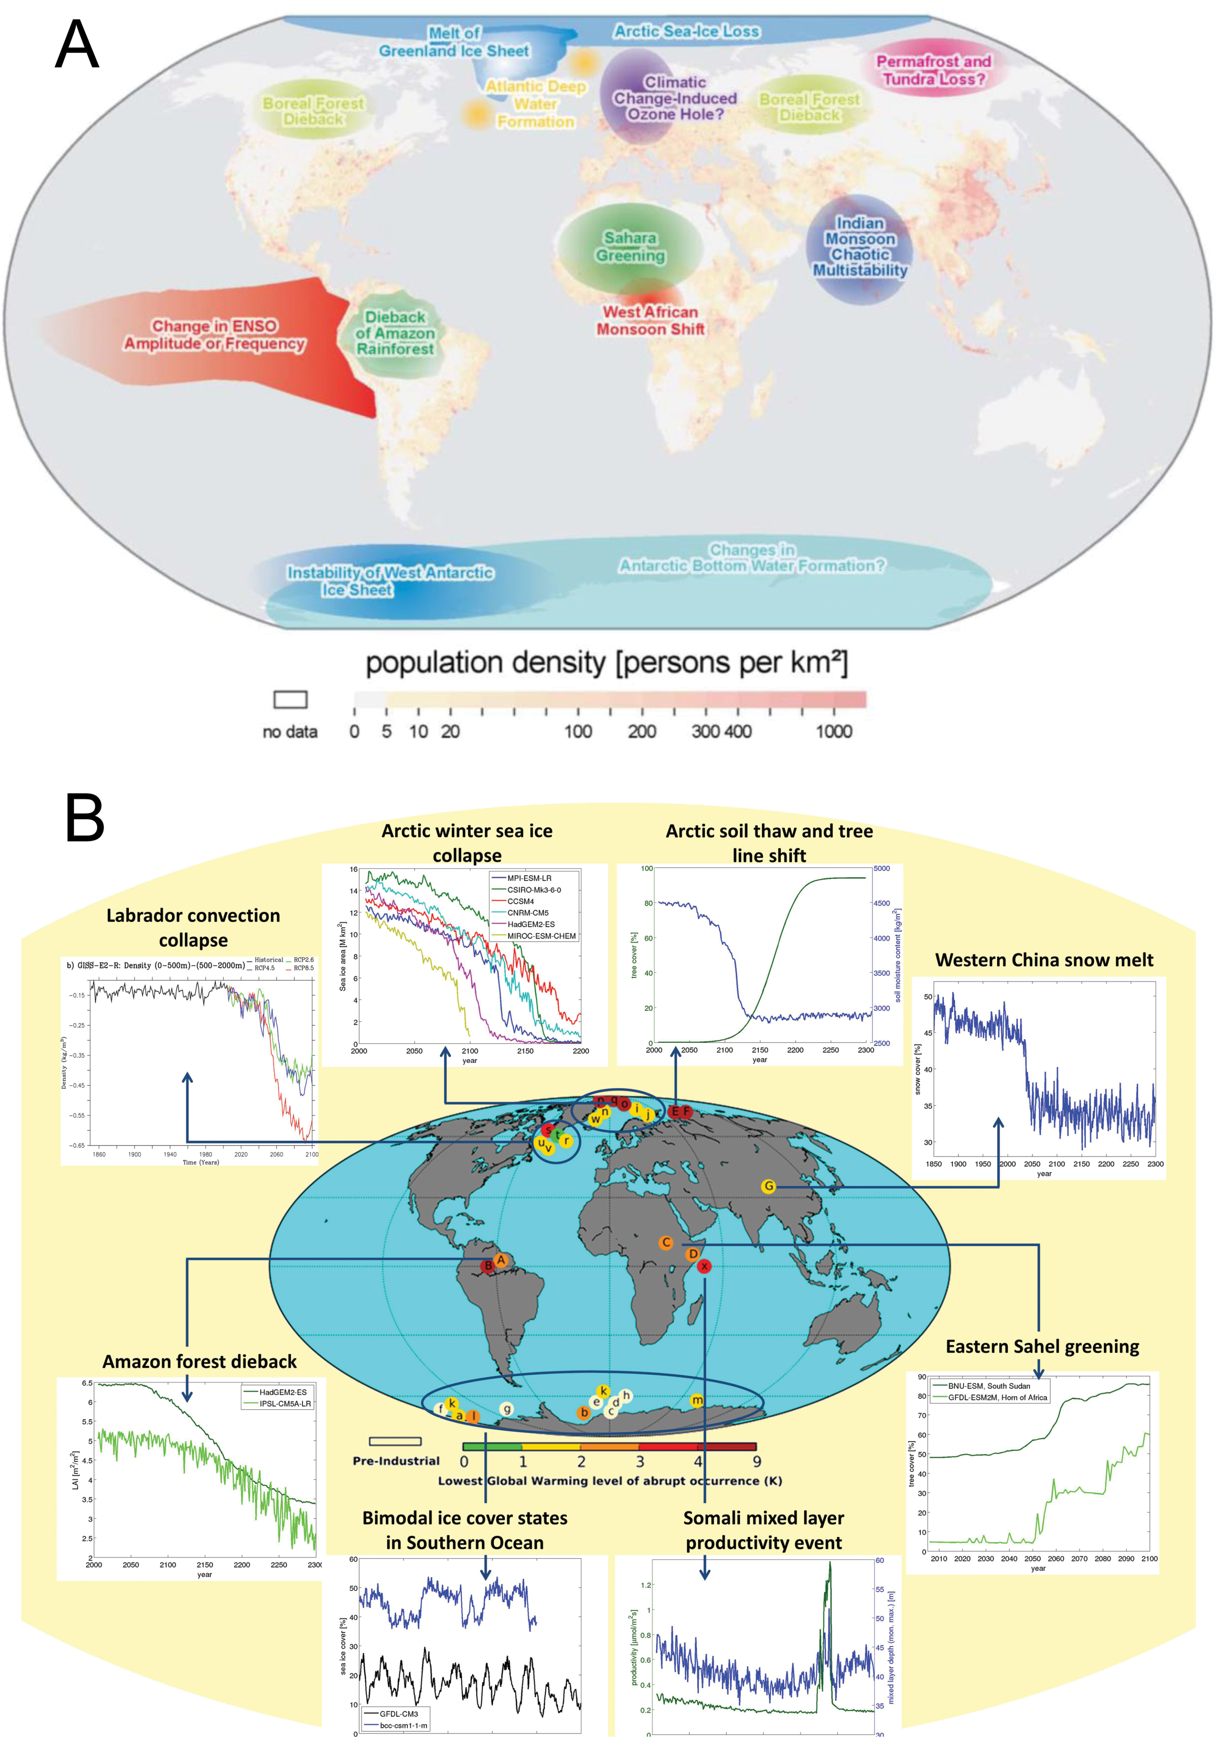
Figure 5. Regions with the potential for abrupt shifts in two previous studies. (A) Potential tipping elements in ...
Notes:
Figure 5. Regions with the potential for abrupt shifts in two previous studies. (A) Potential tipping elements in Lenton et al. (2008) [Copyright (2008) National Academy of Sciences]. (B) Abrupt shifts in complex climate model simulations modified from Drijfhout et al. (2015).
Unless provided in the caption above, the following copyright applies to the content of this slide: © The Author 2016. Published by Oxford University Press.This is an Open Access article distributed under the terms of the Creative Commons Attribution Non-Commercial License (http://creativecommons.org/licenses/by-nc/4.0/), which permits non-commercial re-use, distribution, and reproduction in any medium, provided the original work is properly cited. For commercial re-use, please contact journals.permissions@oup.com

Slide 6
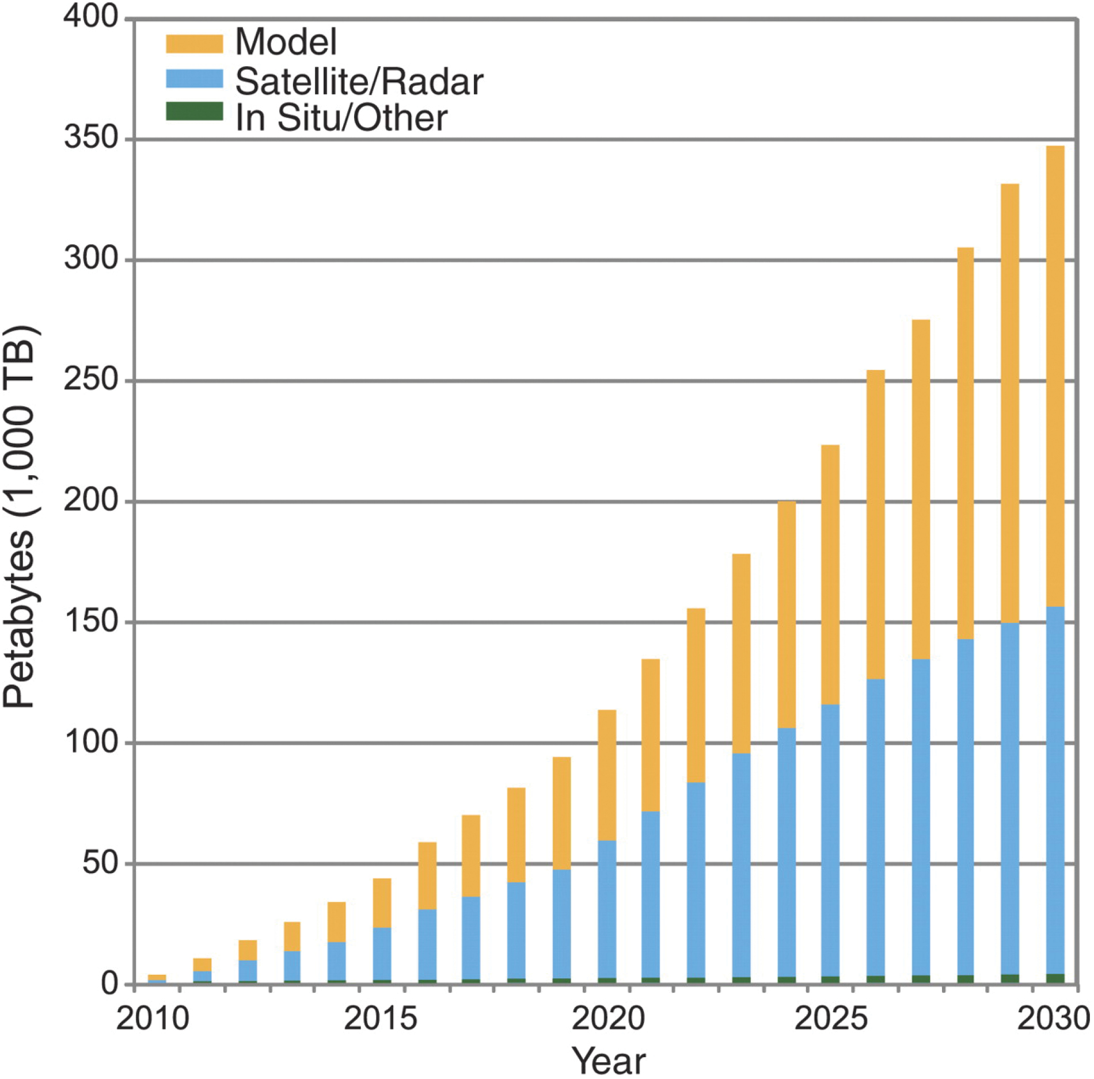
Figure 6. Projected increase in the amount of data from climate models, remote sensing and in situ observations (from ...
Notes:
Figure 6. Projected increase in the amount of data from climate models, remote sensing and in situ observations (from Overpeck et al., 2011).
Unless provided in the caption above, the following copyright applies to the content of this slide: © The Author 2016. Published by Oxford University Press.This is an Open Access article distributed under the terms of the Creative Commons Attribution Non-Commercial License (http://creativecommons.org/licenses/by-nc/4.0/), which permits non-commercial re-use, distribution, and reproduction in any medium, provided the original work is properly cited. For commercial re-use, please contact journals.permissions@oup.com

