Slide 1
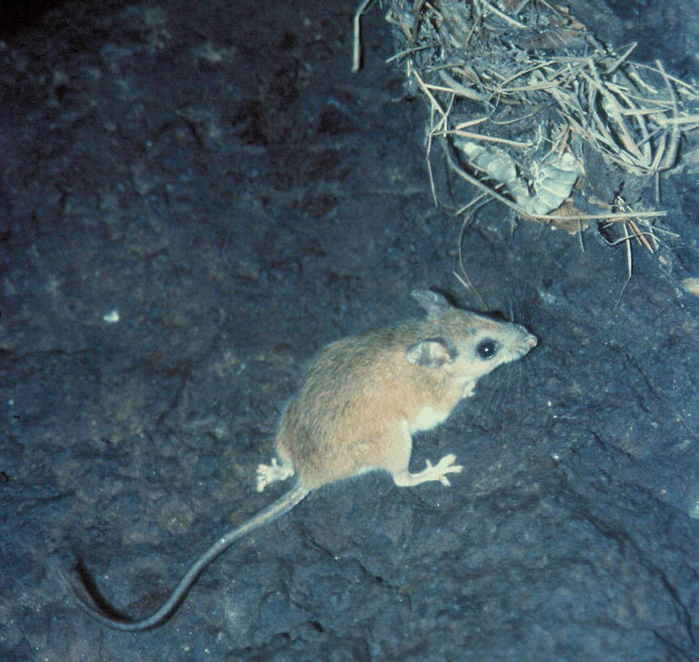
Figure 1 Peromyscus perfulvus approaching nest located just inside entrance to the Tiamaro Mine, 4 km southeast of ...
Notes:
Figure 1 Peromyscus perfulvus approaching nest located just inside entrance to the Tiamaro Mine, 4 km southeast of Lajas del Bosque, Michoacan, Mexico (19°13′43″N, 100°28′39″W, 1,010 m). Photograph by Cornelio Sánchez-Hernández.
Unless provided in the caption above, the following copyright applies to the content of this slide: © 2009 American Society of Mammalogists

Slide 2
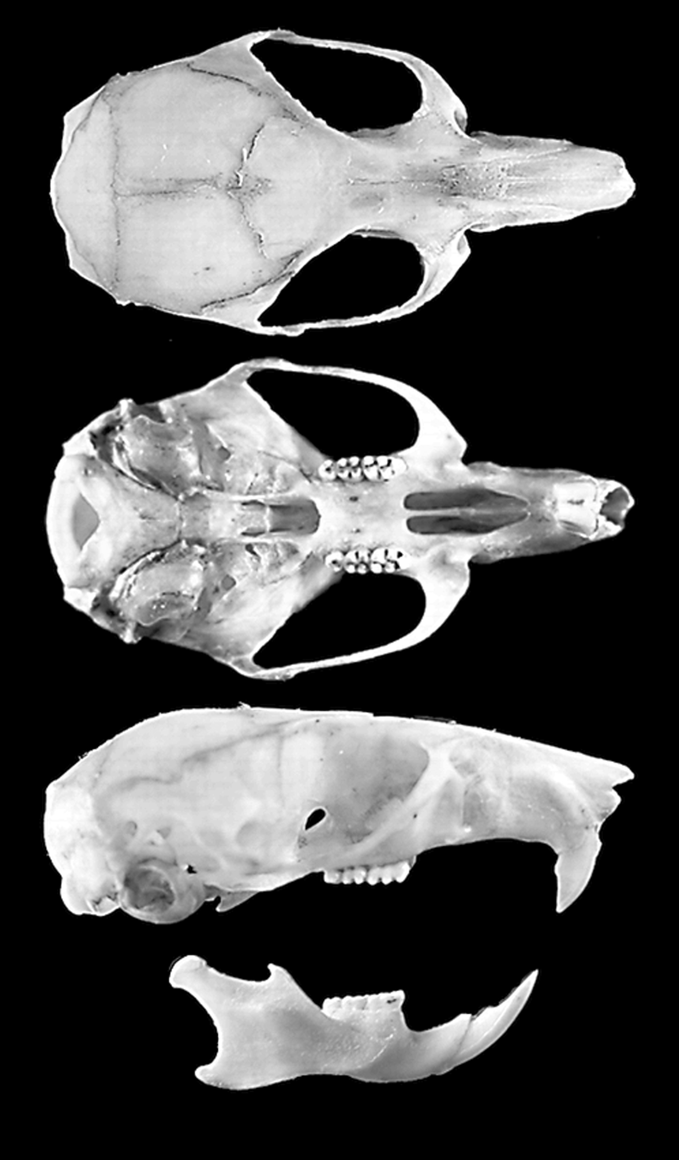
Figure 2 Dorsal, ventral, and lateral views of skull and lateral view of mandible of adult female Peromyscus perfulvus ...
Notes:
Figure 2 Dorsal, ventral, and lateral views of skull and lateral view of mandible of adult female Peromyscus perfulvus from 1.5 km south of Petembo, Michoacan, Mexico (19°06.922′N, 101°29.979′W, 1,227 m; catalog no. 2749, M. L. Romero-Almaraz). Greatest length of skull is 30.45 mm. Photograph by Cornelio Sánchez-Hernández.
Unless provided in the caption above, the following copyright applies to the content of this slide: © 2009 American Society of Mammalogists

Slide 3
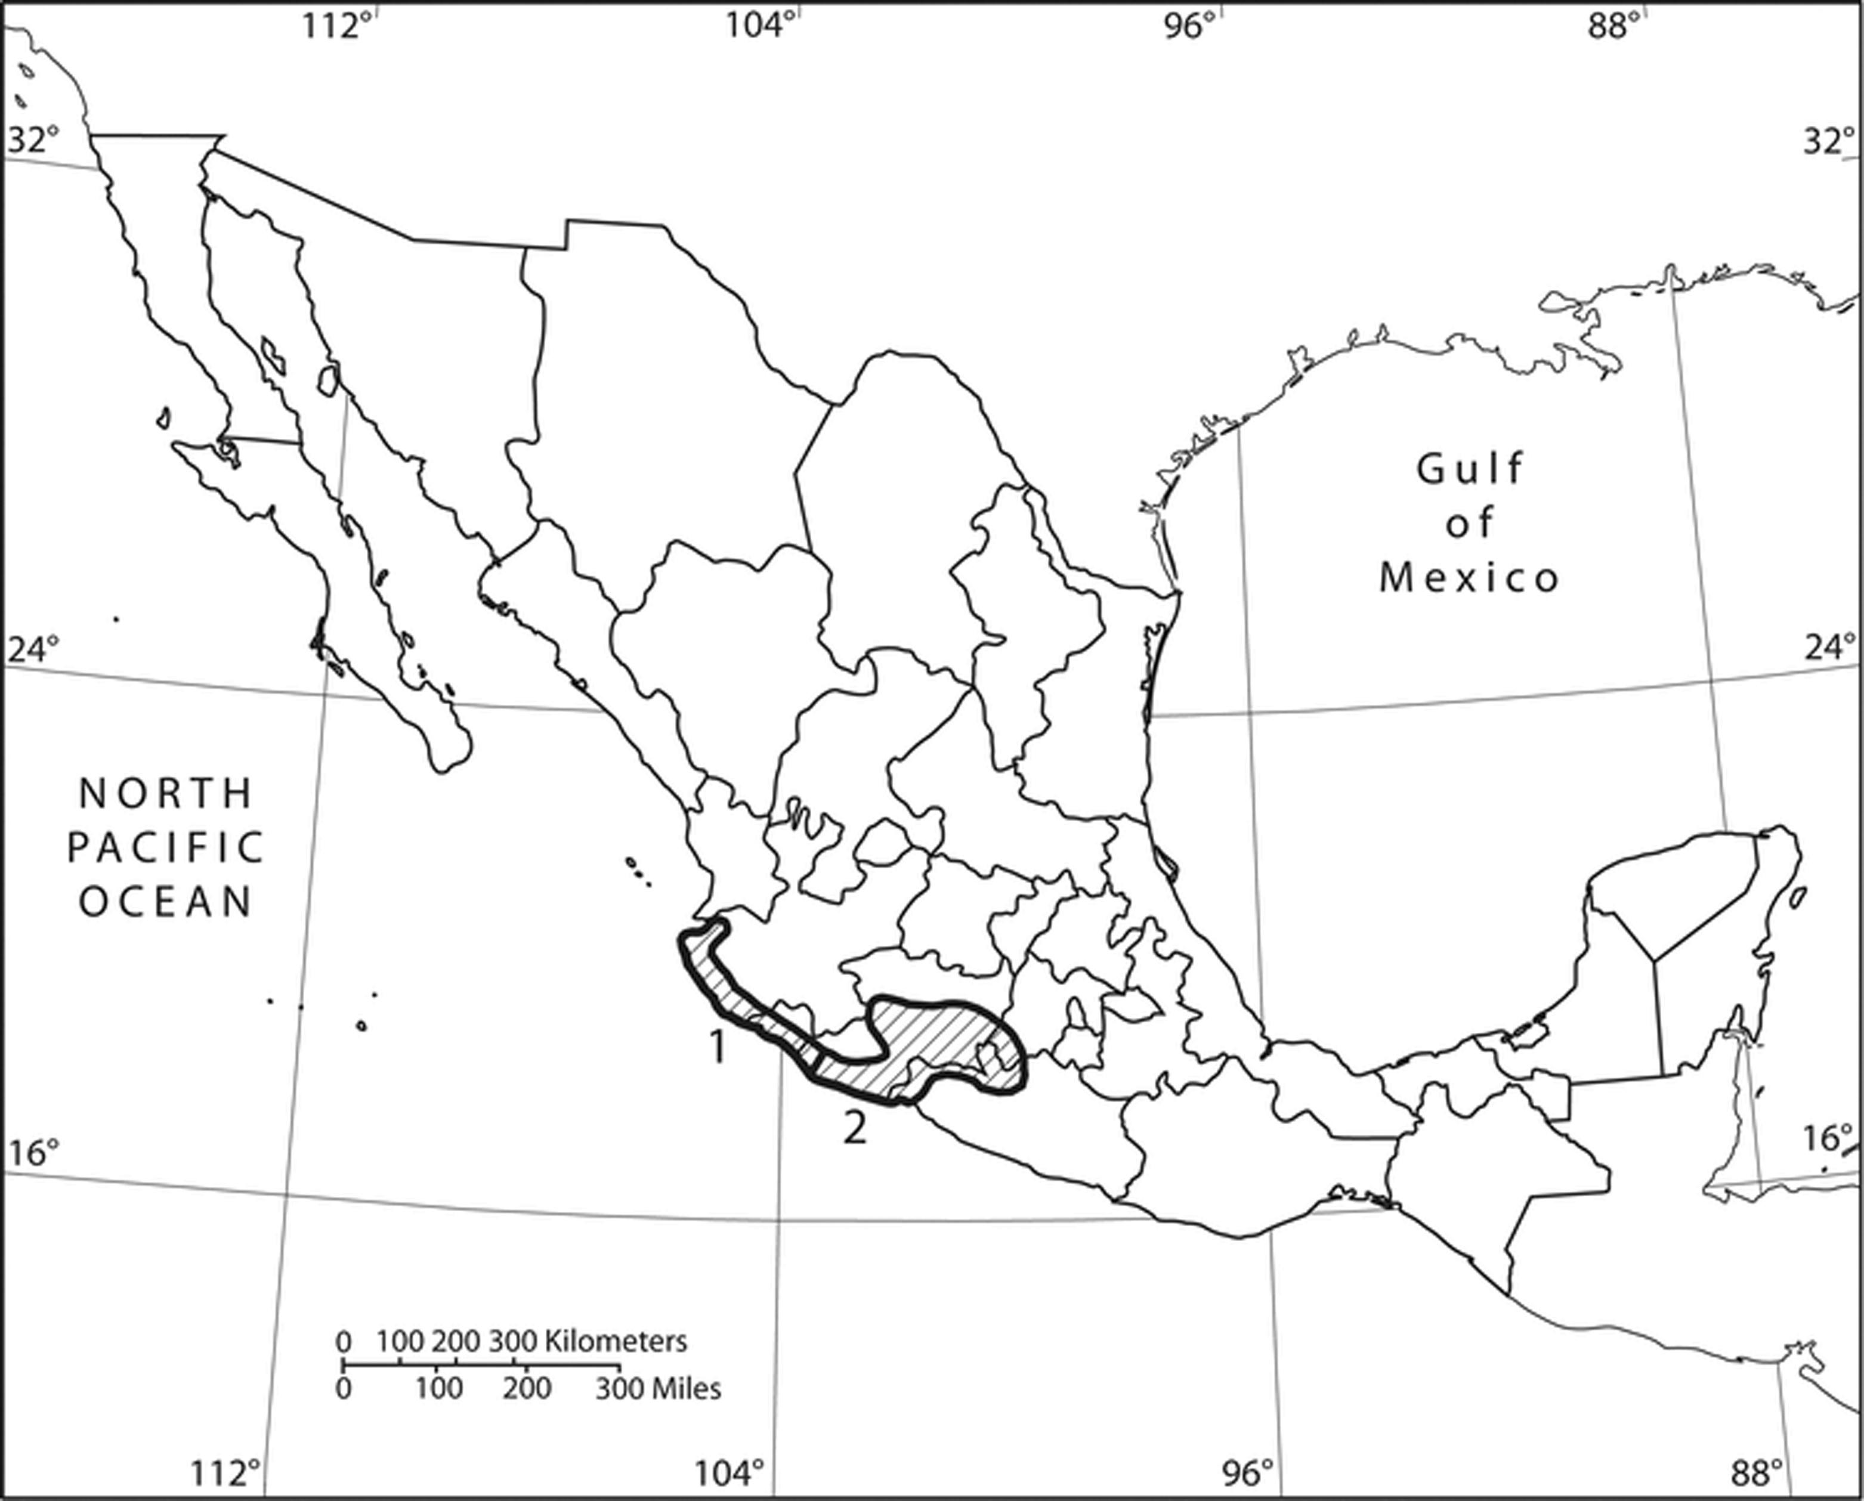
Figure 3 Geographic distribution of Peromyscus perfulvus in Mexico. Subspecies are: 1, P. perfulvus chysopus; and 2, ...
Notes:
Figure 3 Geographic distribution of Peromyscus perfulvus in Mexico. Subspecies are: 1, P. perfulvus chysopus; and 2, P. perfulvus perfulvus. Modified from Hall (1981) and Carleton (1989).
Unless provided in the caption above, the following copyright applies to the content of this slide: © 2009 American Society of Mammalogists

Slide 4
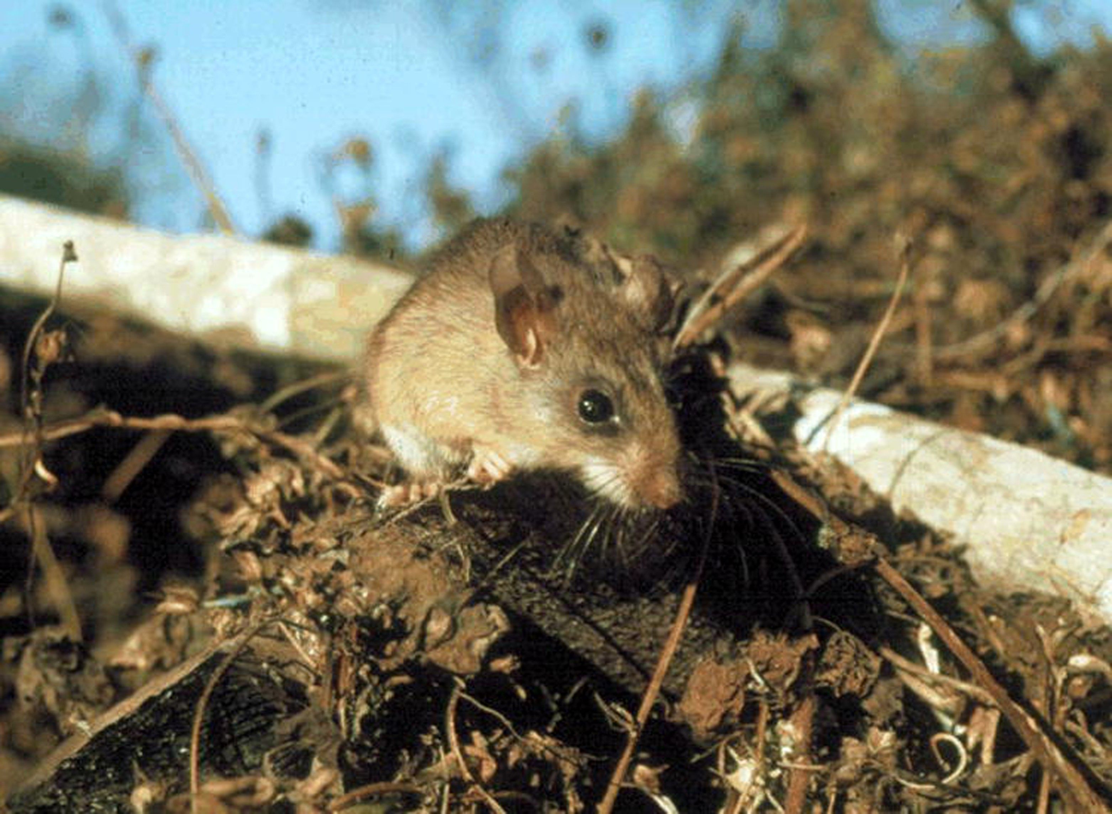
Figure 4 Peromyscus perfulvus in elevated vegetation, which is typical for the species. Photograph taken at the ...
Notes:
Figure 4 Peromyscus perfulvus in elevated vegetation, which is typical for the species. Photograph taken at the Chamela Biological Station, Jalisco, Mexico (19°29′51″N, 105°02′39″W, 106 m) by Cornelio Sánchez-Hernández.
Unless provided in the caption above, the following copyright applies to the content of this slide: © 2009 American Society of Mammalogists

