Slide 1
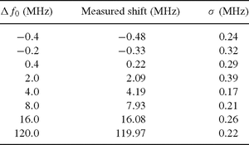
Table 1 Calibration tunability. The offset frequency f₀ of the comb can be varied and a constant shift of ...
Notes:
Table 1 Calibration tunability. The offset frequency f0 of the comb can be varied and a constant shift of all lines will be measured. The measured shifts agree with the set values Δf0 within the statistical uncertainty σ, which itself is close to the photon noise of 0.22 MHz (11 cm s−1), averaged over 10 exposures of 80 s each. Note that Δf0= 1 MHz corresponds to 0.51 cm s−1.
Unless provided in the caption above, the following copyright applies to the content of this slide: © 2010 The Authors. Journal compilation © 2010 RAS

