Slide 1
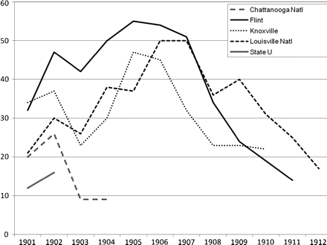
Fig. 1. Enrollments (1901–12) at black medical schools that closed by 1912. Source: J. Am. Med. Assoc. annual reports ...
Notes:
Fig. 1. Enrollments (1901–12) at black medical schools that closed by 1912. Source: J. Am. Med. Assoc. annual reports on medical education.
Unless provided in the caption above, the following copyright applies to the content of this slide: © The Author 2011. Published by Oxford University Press. All rights reserved. For permissions, please e-mail: journals.permissions@oup.com

Slide 2
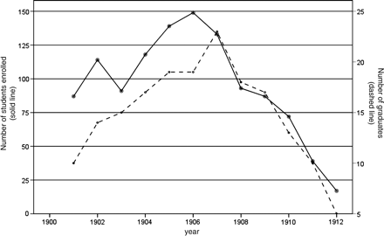
Fig. 2. Total enrollment (left axis, solid line) and number of graduates (right axis, dashed line) at Flint, ...
Notes:
Fig. 2. Total enrollment (left axis, solid line) and number of graduates (right axis, dashed line) at Flint, Louisville National, and Knoxville Medical Colleges, 1901–12. Source: J. Am. Med. Assoc. annual reports on medical education.
Unless provided in the caption above, the following copyright applies to the content of this slide: © The Author 2011. Published by Oxford University Press. All rights reserved. For permissions, please e-mail: journals.permissions@oup.com

Slide 3
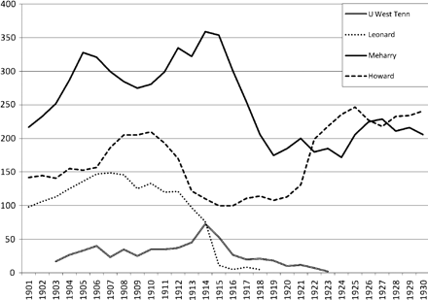
Fig. 3. Enrollments (1901–30) at black medical schools that survived beyond 1912. Enrollment figures for the ...
Notes:
Fig. 3. Enrollments (1901–30) at black medical schools that survived beyond 1912. Enrollment figures for the University of West Tennessee, which opened in 1900, are not available for its first two years of operation. Source: J. Am. Med. Assoc. annual reports on medical education.
Unless provided in the caption above, the following copyright applies to the content of this slide: © The Author 2011. Published by Oxford University Press. All rights reserved. For permissions, please e-mail: journals.permissions@oup.com

Slide 4
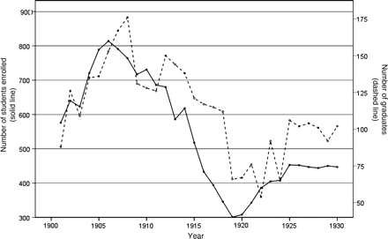
Fig. 4. Total enrollment (left axis, solid line) and number of graduates at black schools (right axis, dashed line), ...
Notes:
Fig. 4. Total enrollment (left axis, solid line) and number of graduates at black schools (right axis, dashed line), 1901–30. Source: J. Am. Med. Assoc. annual reports on medical education.
Unless provided in the caption above, the following copyright applies to the content of this slide: © The Author 2011. Published by Oxford University Press. All rights reserved. For permissions, please e-mail: journals.permissions@oup.com

