Slide 1
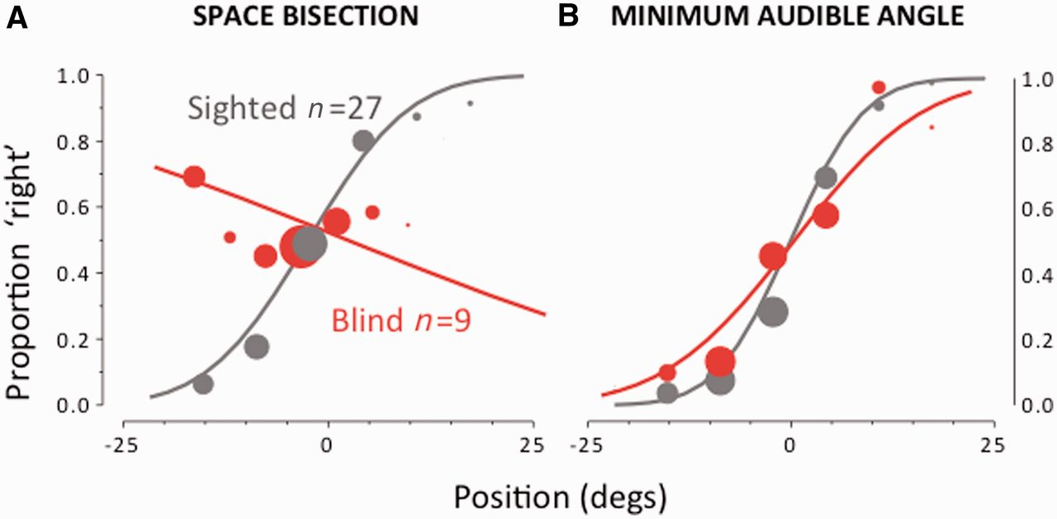
Figure 1 Results of the bisection and minimal audible angle task. (A) Spatial bisection: proportion of trials ...
Notes:
Figure 1 Results of the bisection and minimal audible angle task. (A) Spatial bisection: proportion of trials (averaged over subjects) judged ‘closer to the right sound source’, plotted against speaker position. The area of the dots is the proportion of trials at that position, normalized by the total number of trials performed by all subjects in that group. Both sets of data are fit with the Gaussian error function. (B) Minimal audible angle: proportion of trials where the second of a two-sound sequence was reported to the right of the first, plotted against difference in speaker position. Again the fits are the Gaussian error function.
Unless provided in the caption above, the following copyright applies to the content of this slide: © The Author (2013). Published by Oxford University Press on behalf of the Guarantors of Brain.This is an Open Access article distributed under the terms of the Creative Commons Attribution Non-Commercial License (http://creativecommons.org/licenses/by-nc/3.0/), which permits non-commercial re-use, distribution, and reproduction in any medium, provided the original work is properly cited. For commercial re-use, please contact journals.permissions@oup.com

Slide 2
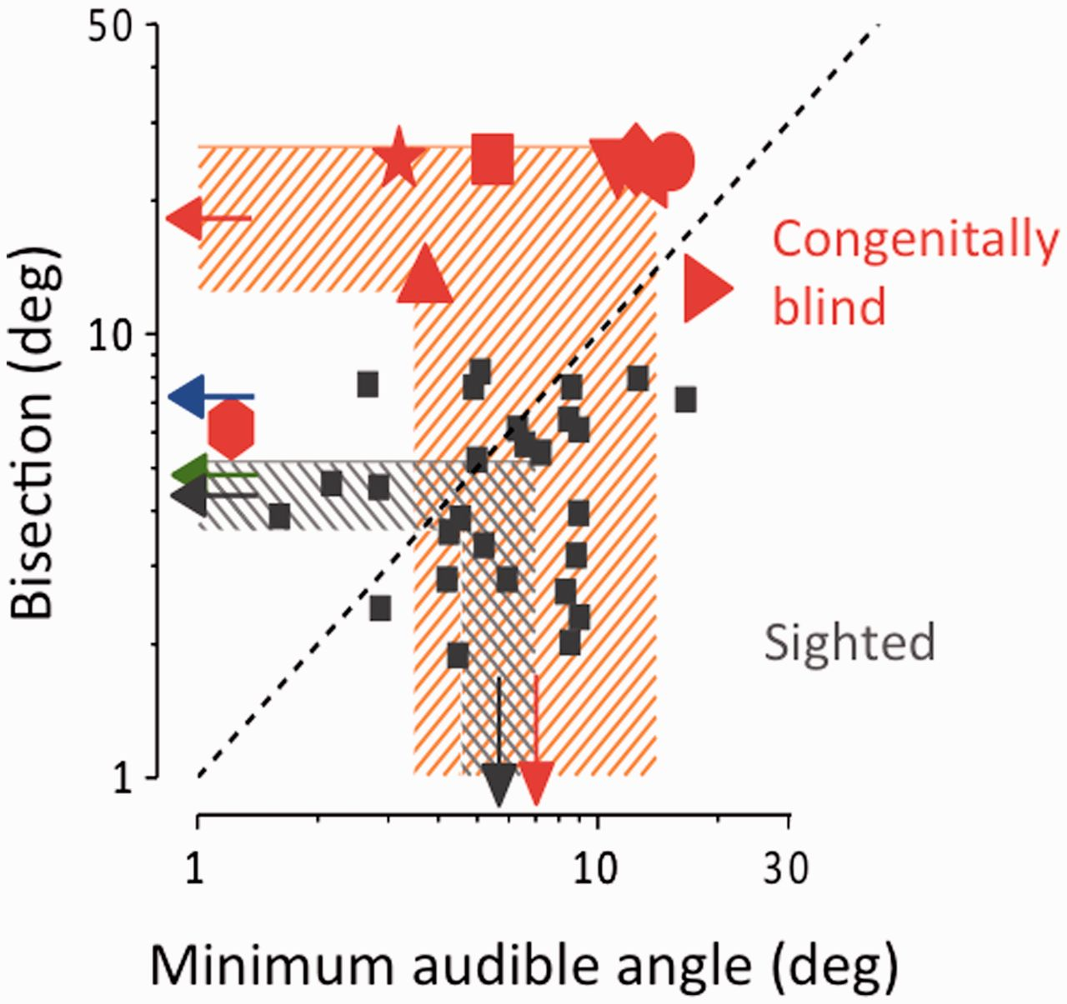
Figure 2 Individual data, plotting bisection thresholds against minimal audible angle, calculated from the width of ...
Notes:
Figure 2 Individual data, plotting bisection thresholds against minimal audible angle, calculated from the width of individual psychometric functions (Supplementary Figs 1 and Supplementary Data). When no fit was plausible, they were assigned a value of 25° (50% the total spacing of the display). Arrows at the margin show the geometric means of each group and the shaded areas the 95% confidence intervals. The blue and green arrows show the average thresholds for 7- and 10-year-old children, respectively, taken from a previous study (Gori et al., 2012a). The dashed diagonal line is the equality line: whereas the thresholds of the sighted subjects are scattered around this line, all except one non-sighted subject is above it. Indeed, the only non-sighted subject with bisection thresholds falling within the control range (Subject 8) had a threshold for minimal audible angle threshold 6-fold lower than the mean of the controls, so her data point falls well above the bisection line.
Unless provided in the caption above, the following copyright applies to the content of this slide: © The Author (2013). Published by Oxford University Press on behalf of the Guarantors of Brain.This is an Open Access article distributed under the terms of the Creative Commons Attribution Non-Commercial License (http://creativecommons.org/licenses/by-nc/3.0/), which permits non-commercial re-use, distribution, and reproduction in any medium, provided the original work is properly cited. For commercial re-use, please contact journals.permissions@oup.com

Slide 3
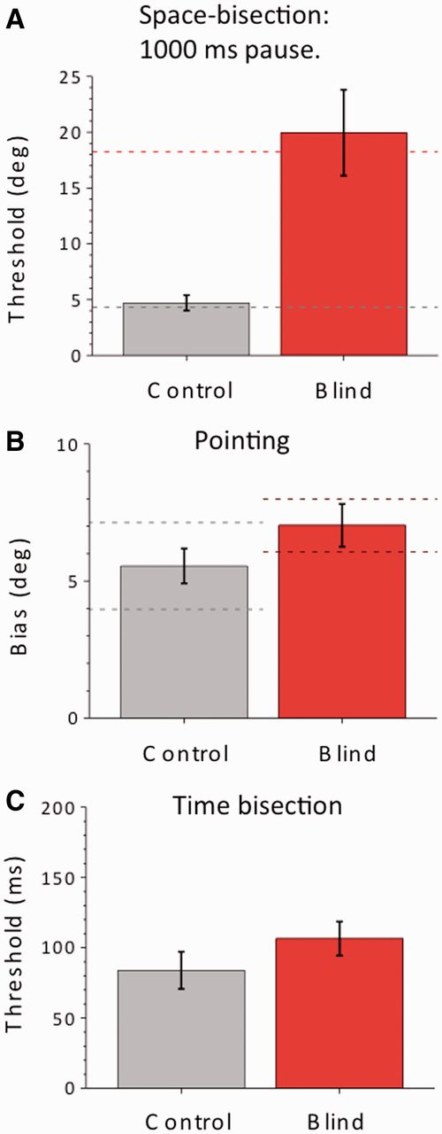
Figure 3 Average thresholds in three additional tasks, for a subset of non-sighted patients and the same number of ...
Notes:
Figure 3 Average thresholds in three additional tasks, for a subset of non-sighted patients and the same number of age- and gender-matched group of blindfolded sighted controls. The bars indicate ±1 standard error of the mean. (A) Space bisection with 1000 ms separation between the sounds. The impairment of the patient group remains highly significant (Bootstrap sign-test: P < 10−5). The test was performed in six non-sighted and six sighted individuals. Dashed red and grey lines refer to the average performance of subjects for the bisection task with the 500 ms separation. (B) Average error in laser-pointing to a single sound. The error measure (which comprises both accuracy, bars; and precision, dashed lines) is the average absolute distance between real and pointed values. The performance of the patient group is not significantly different from the sighted group (t-test, P = 0.07). The test was performed in seven non-sighted and seven sighted individuals. (C) Thresholds in the temporal bisection task, determined separately for each subject, then averaged. The performance of the patient group is not significantly different from the sighted group (t-test, P = 0.14). The test was performed in eight non-sighted and eight sighted individuals.
Unless provided in the caption above, the following copyright applies to the content of this slide: © The Author (2013). Published by Oxford University Press on behalf of the Guarantors of Brain.This is an Open Access article distributed under the terms of the Creative Commons Attribution Non-Commercial License (http://creativecommons.org/licenses/by-nc/3.0/), which permits non-commercial re-use, distribution, and reproduction in any medium, provided the original work is properly cited. For commercial re-use, please contact journals.permissions@oup.com

