Slide 1
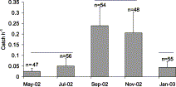
Figure 1 Mean number of juvenile gadoids (<12 cm) caught per hour at Caol Scotnish (data combined for maerl, rocky, ...
Notes:
Figure 1 Mean number of juvenile gadoids (<12 cm) caught per hour at Caol Scotnish (data combined for maerl, rocky, and gravel substrata) using fykenets at bi-monthly sampling events. Error bars = s.d. Horizontal lines at the same level indicate substrata that did not differ significantly from each other.
Unless provided in the caption above, the following copyright applies to the content of this slide: © 2004 International Council for the Exploration of the Sea

Slide 2
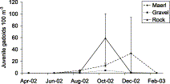
Figure 2 Mean number of juvenile gadoids observed associated with maerl, gravel, and rocky substrata in Caol Scotnish ...
Notes:
Figure 2 Mean number of juvenile gadoids observed associated with maerl, gravel, and rocky substrata in Caol Scotnish using scuba during bi-monthly sampling events. Error bars = s.d. Straight lines do not indicate linear progressions between data points, but are given to aid trend determination.
Unless provided in the caption above, the following copyright applies to the content of this slide: © 2004 International Council for the Exploration of the Sea

Slide 3
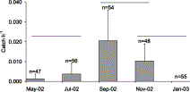
Figure 3 Mean number of gadoids of the larger size classes (>32 cm) caught per hour at Caol Scotnish (data combined ...
Notes:
Figure 3 Mean number of gadoids of the larger size classes (>32 cm) caught per hour at Caol Scotnish (data combined for maerl, rocky, and gravel substrata) using fykenets at bi-monthly sampling events. Error bars = s.d. Horizontal lines at the same level indicate substrata that did not differ significantly from each other.
Unless provided in the caption above, the following copyright applies to the content of this slide: © 2004 International Council for the Exploration of the Sea

Slide 4
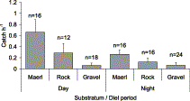
Figure 4 Mean number of juvenile gadoids (<12 cm) caught over maerl, rock, and gravel using fykenets by day and by ...
Notes:
Figure 4 Mean number of juvenile gadoids (<12 cm) caught over maerl, rock, and gravel using fykenets by day and by night, September–November. Error bars = 95% C.I.
Unless provided in the caption above, the following copyright applies to the content of this slide: © 2004 International Council for the Exploration of the Sea

Slide 5
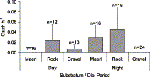
Figure 5 Mean number of gadoids of the larger size classes (>32 cm) caught over maerl, rock, and gravel using fykenets ...
Notes:
Figure 5 Mean number of gadoids of the larger size classes (>32 cm) caught over maerl, rock, and gravel using fykenets by day and by night, September–November. Error bars = s.d.
Unless provided in the caption above, the following copyright applies to the content of this slide: © 2004 International Council for the Exploration of the Sea

Slide 6
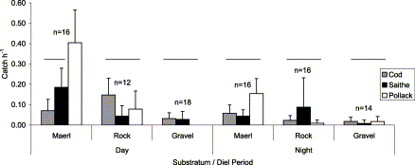
Figure 6 Mean number of juvenile cod, saithe, and pollack (<12 cm) caught over maerl, rock, and gravel using fykenets ...
Notes:
Figure 6 Mean number of juvenile cod, saithe, and pollack (<12 cm) caught over maerl, rock, and gravel using fykenets by day and by night, September–November. Error bars = s.d. Horizontal lines indicate fish densities that did not differ significantly within each substratum/diel period group.
Unless provided in the caption above, the following copyright applies to the content of this slide: © 2004 International Council for the Exploration of the Sea

