Slide 1
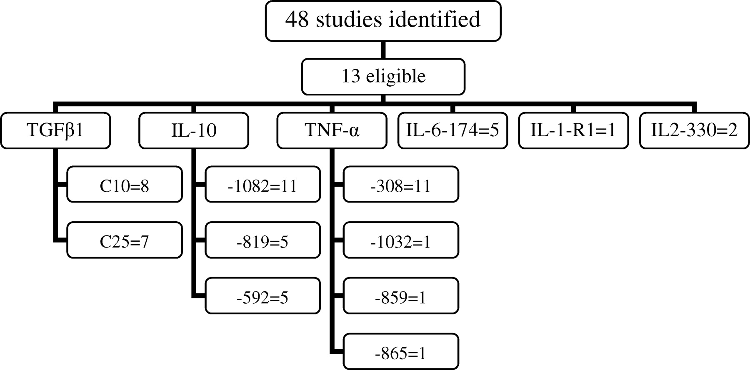
Fig. 1 Flowchart indicating studies included in this review.
Notes:
Fig. 1 Flowchart indicating studies included in this review.
Unless provided in the caption above, the following copyright applies to the content of this slide: © Oxford University Press 2008

