Slide 1
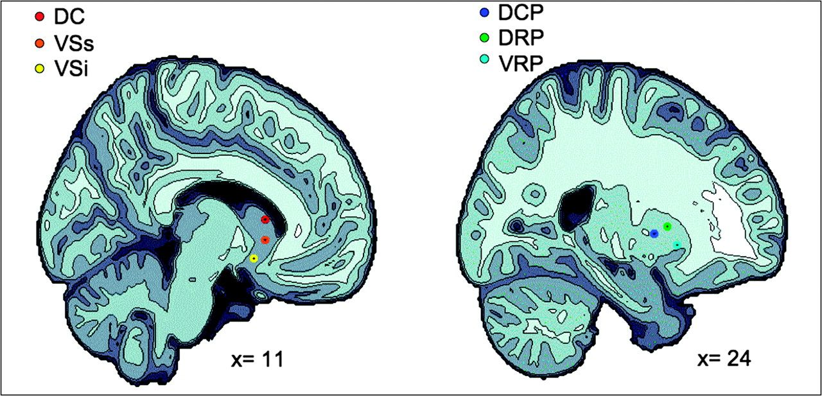
Figure 1. Representation of the 6 striatal regions of interest. The left and the right panels show the projection of ...
Notes:
Figure 1. Representation of the 6 striatal regions of interest. The left and the right panels show the projection of the 3 caudate regions (i.e., DC; VSs; VSi), and the 3 putamen regions (i.e., DCP; DRP; VRP), respectively, onto sagittal brain views for x = 11 and x = 24.
Unless provided in the caption above, the following copyright applies to the content of this slide: © The Author 2008. Published by Oxford University Press. All rights reserved. For permissions, please e-mail: journals.permissions@oxfordjournals.org

Slide 2
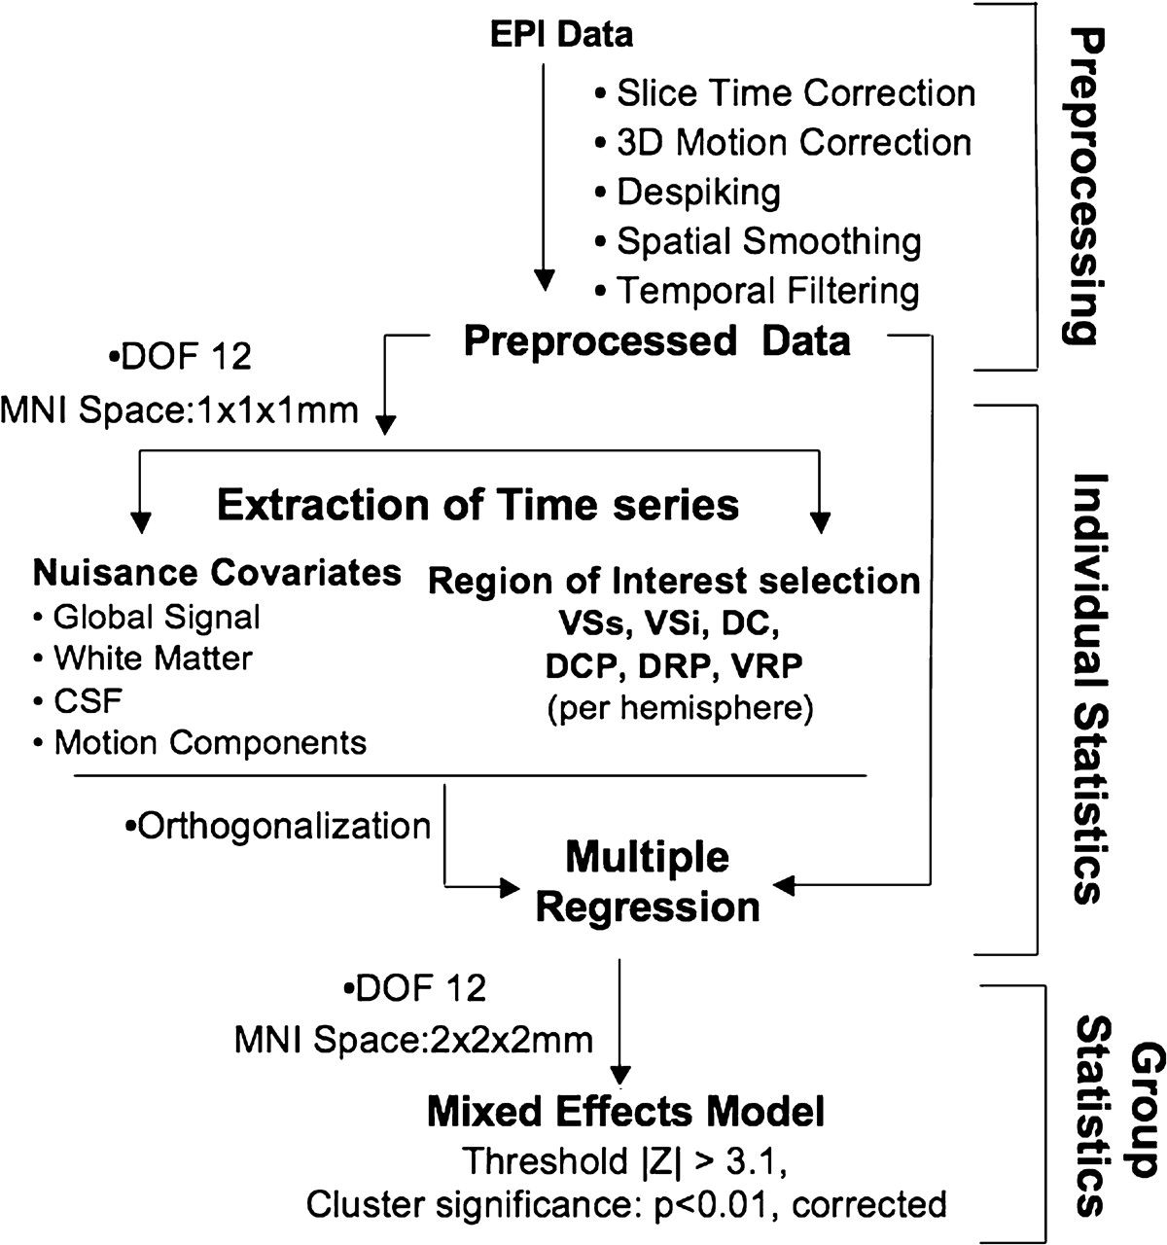
Figure 2. Data analysis overview. Summary sketch of the data analysis steps included in preprocessing, and individual ...
Notes:
Figure 2. Data analysis overview. Summary sketch of the data analysis steps included in preprocessing, and individual and group statistics. Abbreviations from the top: DOF- degrees of freedom.
Unless provided in the caption above, the following copyright applies to the content of this slide: © The Author 2008. Published by Oxford University Press. All rights reserved. For permissions, please e-mail: journals.permissions@oxfordjournals.org

Slide 3
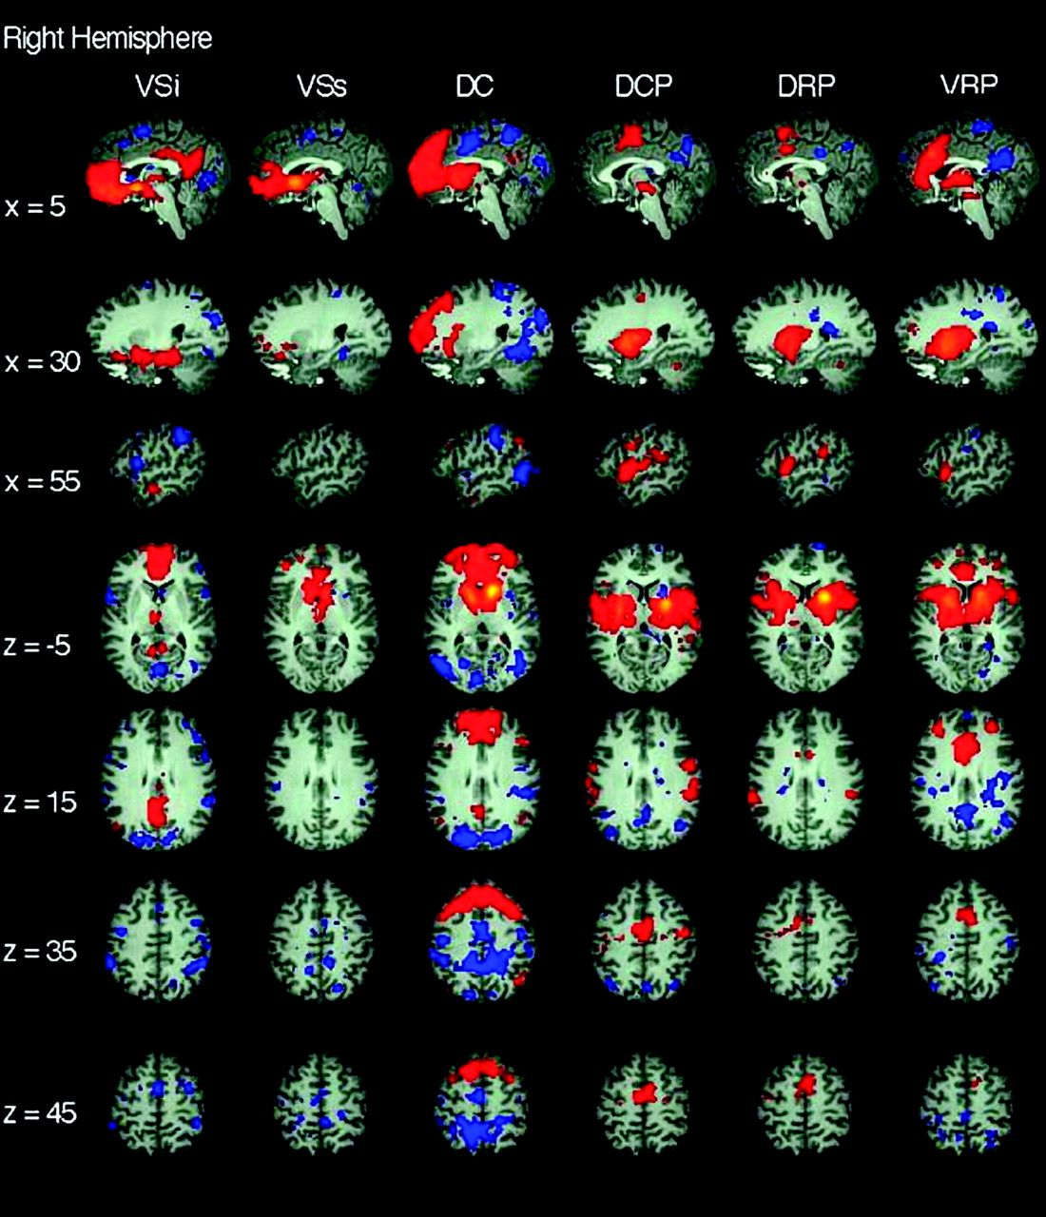
Figure 3. Functional connectivity of right hemisphere striatal seeds. Pattern of significantly positive (red) and ...
Notes:
Figure 3. Functional connectivity of right hemisphere striatal seeds. Pattern of significantly positive (red) and negative (blue) relationships for right VSi (x = 9, y = 9, z = −8), VSs (x = 10, y = 15, z = 0), DC (x = 13, y = 15, z = 9), DCP (x = 28, y = 1, z = 3), DRP (x = 25, y = 8, z = 6), and VRP (x = 20, y = 12, z = −3), from left to right columns, respectively (Z score > |3.1|, cluster significance: P < 0.01, corrected). The 1st 3 rows are sagittal views (at x = 5, 30, and 55 from top to bottom, respectively), the last 4 rows are axial views (at z = −5, 15, 35, 45 from top to bottom, respectively). See text for details.
Unless provided in the caption above, the following copyright applies to the content of this slide: © The Author 2008. Published by Oxford University Press. All rights reserved. For permissions, please e-mail: journals.permissions@oxfordjournals.org

Slide 4
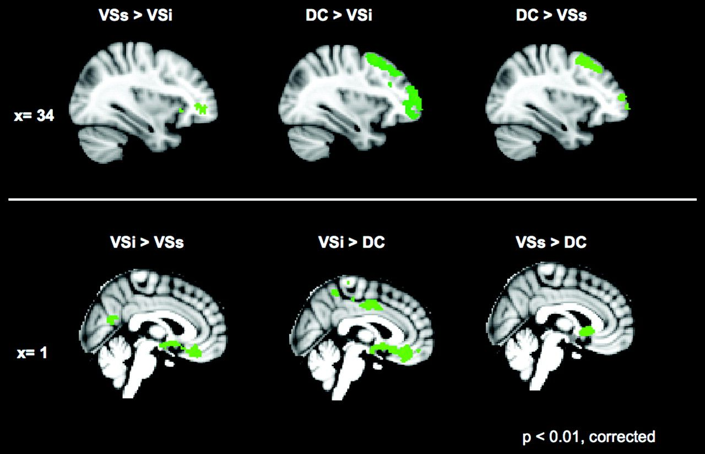
Figure 4. Direct comparisons for caudate seeds. The 1st 2 columns depict comparisons of the VSi with DC and VSs. The ...
Notes:
Figure 4. Direct comparisons for caudate seeds. The 1st 2 columns depict comparisons of the VSi with DC and VSs. The 3rd column represents the comparison between DC and VSs. The top row shows the regions in which the 1st seed has significantly greater positive correlations than the 2nd seed tested at x = 34. The lower row shows the reverse comparisons at x = 0. Z score > |3.1|; cluster significance: P < 0.01, corrected. See text for details.
Unless provided in the caption above, the following copyright applies to the content of this slide: © The Author 2008. Published by Oxford University Press. All rights reserved. For permissions, please e-mail: journals.permissions@oxfordjournals.org

Slide 5
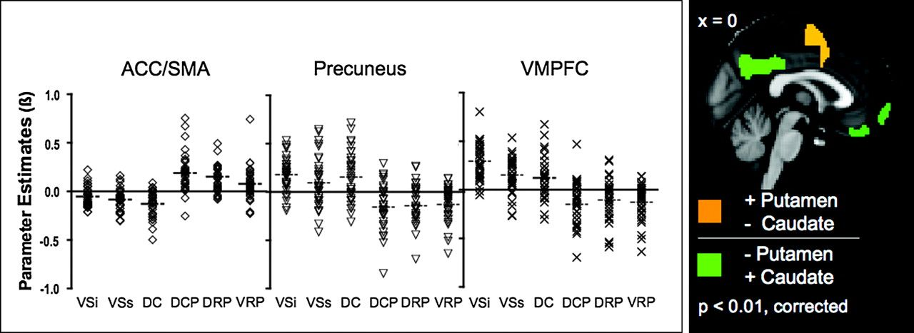
Figure 5. Brain regions correlated with both putamen and caudate but in opposite directions. On the left panel the ...
Notes:
Figure 5. Brain regions correlated with both putamen and caudate but in opposite directions. On the left panel the scatter plots represent the mean parameter estimates (regression coefficients) of striatal seed connectivity (VSi, VSs, DC, DCP, DRP, and VRP, from left to right, respectively) with ACC/supplementary motor area (SMA), precuneus, and with ventromedial prefrontal cortex (VMPFC), from the left to right, respectively. Outlier β values not included in the scatter plot were as follow: β = 1.07 and −1.30 for DRP connectivity with ACC/SMA and precuneus, respectively; β = −1.11 for DCP connectivity with VMPFC. On the right panel the brain regions exhibiting positive correlations with the putamen seeds (i.e., DCP + DRP + VRP) but negative correlation with caudate seeds (i.e., VSi + VSs + DC) and vice versa (orange and green, respectively) are shown.
Unless provided in the caption above, the following copyright applies to the content of this slide: © The Author 2008. Published by Oxford University Press. All rights reserved. For permissions, please e-mail: journals.permissions@oxfordjournals.org

