Slide 1
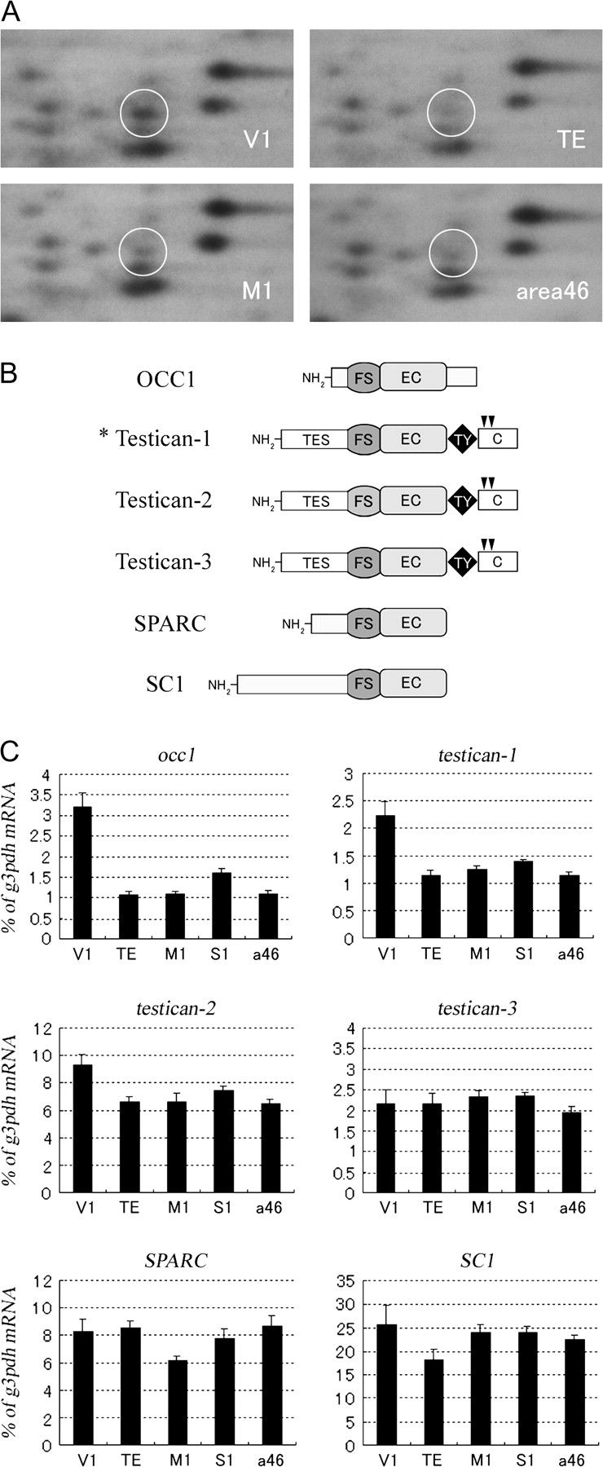
Figure 1. (A) The 2D electrophoresis in RLCS analysis in V1, TE, M1, and area 46. A more intense spot of the testican-1 ...
Notes:
Figure 1. (A) The 2D electrophoresis in RLCS analysis in V1, TE, M1, and area 46. A more intense spot of the testican-1 gene was observed in V1 than in the other 3 areas (shown by a circle). (B) Schematic domain structures of occ1-related proteins. Testican-1 (*), which was identified as a V1-enriched gene, has a domain structure partially homologous to this group of proteins. They are characterized by one FS domain (FS) and a following EC domain (EC). Testicans have their unique domain both in the N-terminal (TES) and the C-terminal (C). TY denotes a thyroglobulin-like domain. Black arrowheads indicate the site of the glycosylated serine in Testicans (Alliel et al. 1993). SPARC has the highest homology to SC1 (ca. 70%) (Soderling et al. 1997). Open bars represent unidentified unique domains for each protein (Maurer et al. 1995). (C) Quantification of area difference in mRNA expression of occ1-related genes among V1, TE, M1, S1, and area 46 by real-time RT-PCR analysis. The amount of each mRNA was normalized as a ratio to the amount of the internal standard, g3pdh mRNA. occ1, testican-1, and testican-2 mRNAs were most abundant in V1 among these 5 areas.
Unless provided in the caption above, the following copyright applies to the content of this slide: © 2008 The AuthorsThis is an Open Access article distributed under the terms of the Creative Commons Attribution Non-Commercial License (http://creativecommons.org/licenses/by-nc/2.0/uk/) which permits unrestricted non-commercial use, distribution, and reproduction in any medium, provided the original work is properly cited.

Slide 2
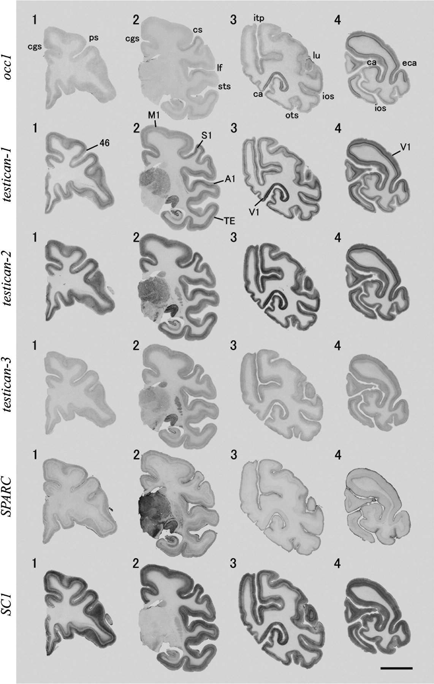
Figure 2. Expression patterns of occ1-related genes in coronal sections of adult monkey neocortex. For occ1, ...
Notes:
Figure 2. Expression patterns of occ1-related genes in coronal sections of adult monkey neocortex. For occ1, testican-1, and testican-2, note that the strongest signals were observed in V1, and moderate signals were observed in S1 and A1 as well (see the annotation in sections for testican-1 ISH). Conversely, the expression of SPARC mRNA was strong in higher-order association areas, such as in TE, whereas weak in V1, S1, and A1. These sections corresponded to Bregma levels 8.5 (section 1), −14.4 (section 2), −32.8 (section 3), and −45.5 mm (section 4). ca/calcarine sulcus, cgs/cingulate sulcus, cs/central sulcus, eca/external calcarine sulcus, ios/inferior occipital sulcus, itp/intraparietal sulcus, lf/lateral fissure, lu/lunate sulcus, ots/occipitotemporal sulcus, and sts/superior temporal sulcus; scale bar = 10 mm.
Unless provided in the caption above, the following copyright applies to the content of this slide: © 2008 The AuthorsThis is an Open Access article distributed under the terms of the Creative Commons Attribution Non-Commercial License (http://creativecommons.org/licenses/by-nc/2.0/uk/) which permits unrestricted non-commercial use, distribution, and reproduction in any medium, provided the original work is properly cited.

Slide 3
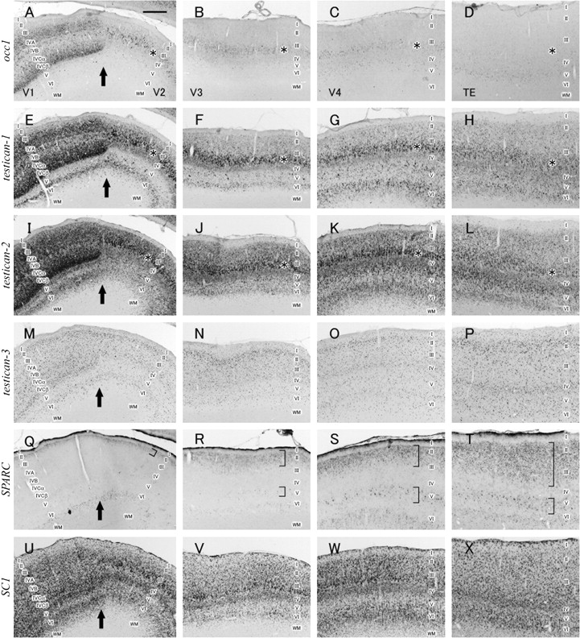
Figure 3. Higher magnification of coronal ISH sections for occ1-related genes in the visual cortices. The mRNA signals ...
Notes:
Figure 3. Higher magnification of coronal ISH sections for occ1-related genes in the visual cortices. The mRNA signals of occ1, testican-1, and testican-2 were strongest in V1. Their signals in deeper layer III of the extrastriate cortices gradually decreased along the visual pathway (asterisks). Conversely, the SPARC mRNA expression was weak in V1 and gradually broadened in superficial layers and layer V along the visual pathway (brackets). WM/white matter; scale bar = 1.0 mm.
Unless provided in the caption above, the following copyright applies to the content of this slide: © 2008 The AuthorsThis is an Open Access article distributed under the terms of the Creative Commons Attribution Non-Commercial License (http://creativecommons.org/licenses/by-nc/2.0/uk/) which permits unrestricted non-commercial use, distribution, and reproduction in any medium, provided the original work is properly cited.

Slide 4
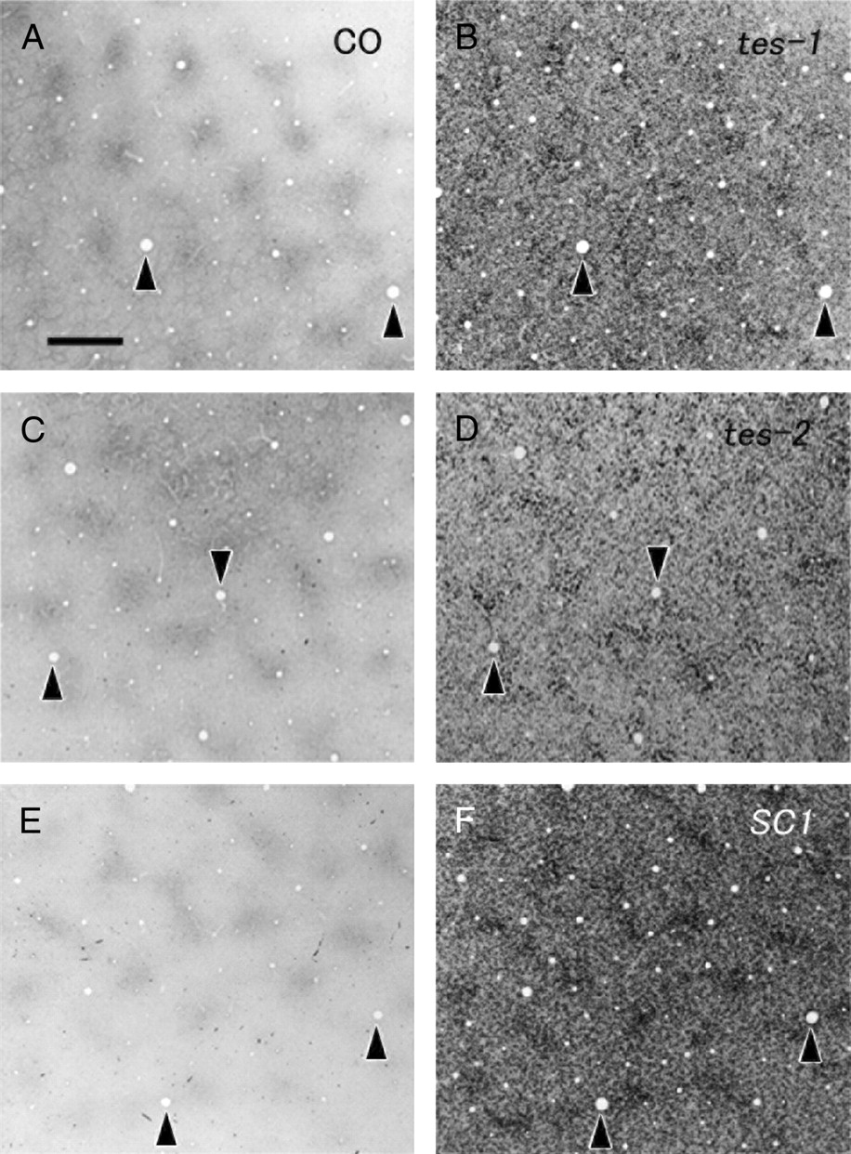
Figure 4. Tangential sections of ISH for testican-1 (B), testican-2 (D), and SC1 (F) and adjacent sections reacted for ...
Notes:
Figure 4. Tangential sections of ISH for testican-1 (B), testican-2 (D), and SC1 (F) and adjacent sections reacted for CO enzymatic activity (A, C, E) in layers II/III of V1. Note that their expression patterns, particularly that of SC1, coincide with the CO-dense blobs of each respective panel on the left. Arrowheads indicate the same blood vessels. Scale bar = 500 μm.
Unless provided in the caption above, the following copyright applies to the content of this slide: © 2008 The AuthorsThis is an Open Access article distributed under the terms of the Creative Commons Attribution Non-Commercial License (http://creativecommons.org/licenses/by-nc/2.0/uk/) which permits unrestricted non-commercial use, distribution, and reproduction in any medium, provided the original work is properly cited.

Slide 5
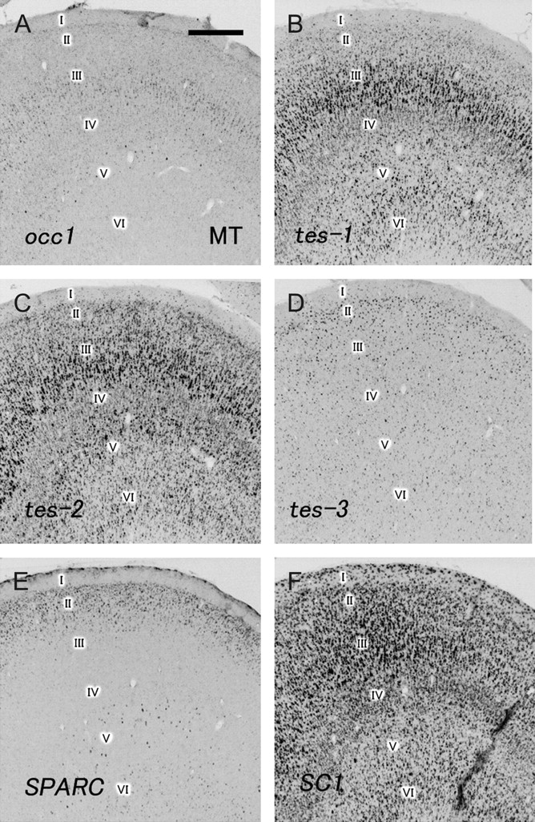
Figure 5. Expression patterns of occ1-related genes in coronal sections of MT. Their expression patterns were similar ...
Notes:
Figure 5. Expression patterns of occ1-related genes in coronal sections of MT. Their expression patterns were similar to those of the extrastriate cortex. Scale bar = 500 μm.
Unless provided in the caption above, the following copyright applies to the content of this slide: © 2008 The AuthorsThis is an Open Access article distributed under the terms of the Creative Commons Attribution Non-Commercial License (http://creativecommons.org/licenses/by-nc/2.0/uk/) which permits unrestricted non-commercial use, distribution, and reproduction in any medium, provided the original work is properly cited.

Slide 6
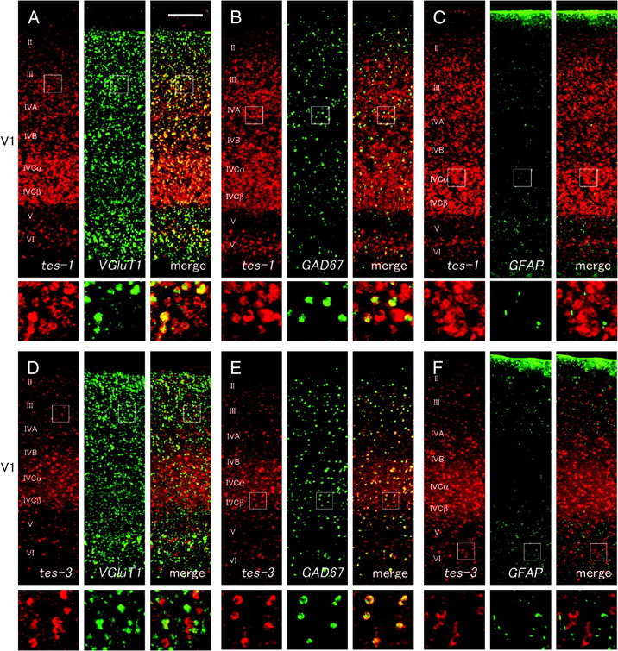
Figure 6. Coronal sections for double-labeling fluorescence ISH for occ1-related genes (red) and cell-type marker genes ...
Notes:
Figure 6. Coronal sections for double-labeling fluorescence ISH for occ1-related genes (red) and cell-type marker genes (green) in V1. (A–C) The testican-1 mRNA signals colocalized well with both VGluT1 (A) and GAD67 (B) mRNA signals but not with GFAP mRNA signals (C). (D–F) The testican-3 mRNA signals more predominantly colocalized with GAD67 mRNA signals (E) than with VGluT1 mRNA signals (D). They did not colocalize with GFAP mRNA signals (F). Small squares indicate the region where higher magnification photos, which are shown under each panel, were taken. Scale bar = 200 μm.
Unless provided in the caption above, the following copyright applies to the content of this slide: © 2008 The AuthorsThis is an Open Access article distributed under the terms of the Creative Commons Attribution Non-Commercial License (http://creativecommons.org/licenses/by-nc/2.0/uk/) which permits unrestricted non-commercial use, distribution, and reproduction in any medium, provided the original work is properly cited.

Slide 7
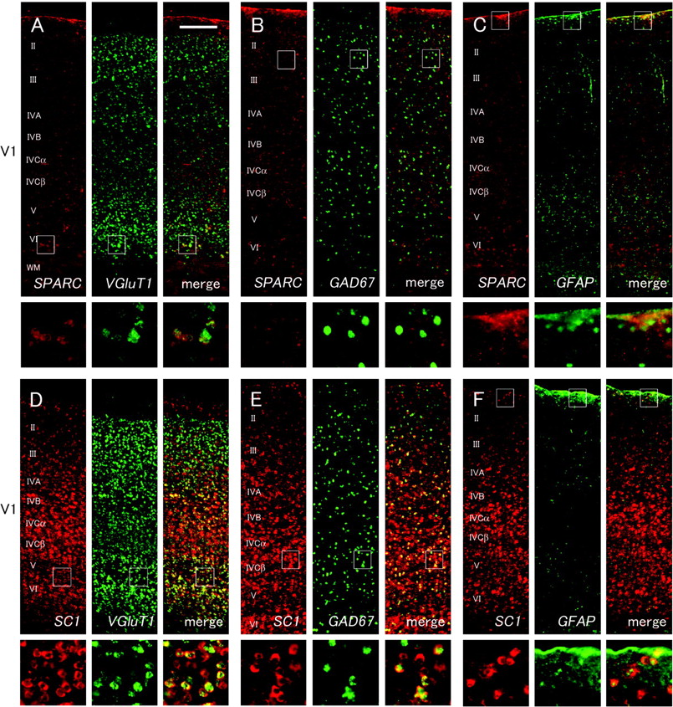
Figure 7. Continuation of Figure 6. (A–C) As SPARC mRNA signals were scarce in V1, they rarely colocalized with VGluT1 ...
Notes:
Figure 7. Continuation of Figure 6. (A–C) As SPARC mRNA signals were scarce in V1, they rarely colocalized with VGluT1 (A) and GAD67 (B) mRNA signals, except for the deepest layer (VIb), where colocalization between SPARC and VGluT1 mRNA signals was observed. SPARC mRNA signals colocalized well with GFAP mRNA signals on the pial surface (C). (D–F) SC1 mRNA signals colocalized well with both VGluT1 and GAD67 mRNA signals. They also colocalized with GFAP mRNA signals in superficial layers. Scale bar = 200 μm.
Unless provided in the caption above, the following copyright applies to the content of this slide: © 2008 The AuthorsThis is an Open Access article distributed under the terms of the Creative Commons Attribution Non-Commercial License (http://creativecommons.org/licenses/by-nc/2.0/uk/) which permits unrestricted non-commercial use, distribution, and reproduction in any medium, provided the original work is properly cited.

Slide 8
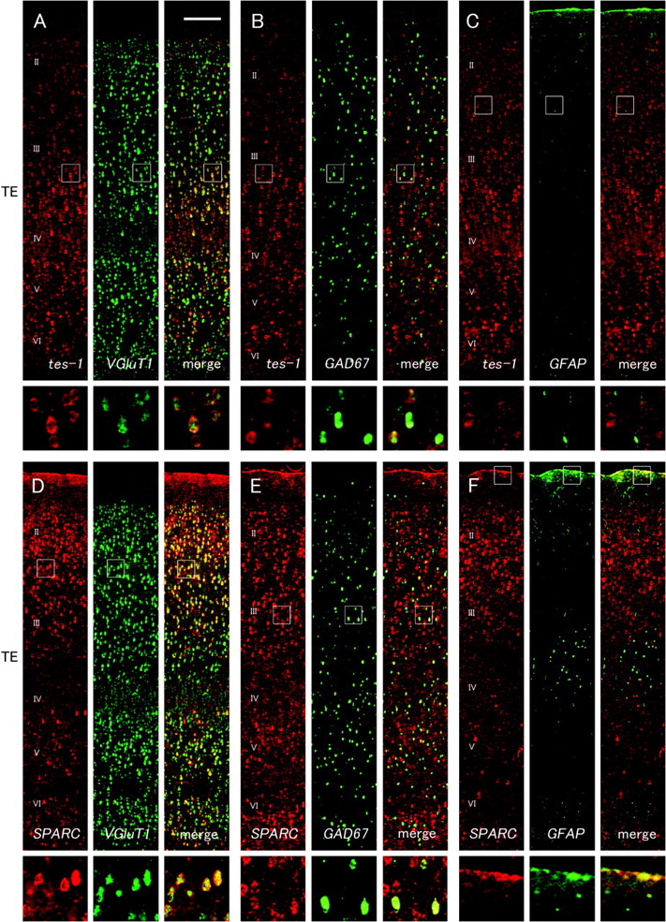
Figure 8. Coronal sections for double-labeling fluorescence ISH for occ1-related genes (red) and cell-type marker genes ...
Notes:
Figure 8. Coronal sections for double-labeling fluorescence ISH for occ1-related genes (red) and cell-type marker genes (green) in TE. (A–C) testican-1 mRNA signals colocalized well with both VGluT1 (A) and GAD67 (B) mRNA signals but not with GFAP mRNA signals (C). (D–F) SPARC mRNA signals also colocalized with both VGluT1 (D) and GAD67 (E) mRNA signals. SPARC mRNA signals colocalized well with GFAP mRNA signals on the pial surface (F) as well as in V1. Scale bar = 200 μm.
Unless provided in the caption above, the following copyright applies to the content of this slide: © 2008 The AuthorsThis is an Open Access article distributed under the terms of the Creative Commons Attribution Non-Commercial License (http://creativecommons.org/licenses/by-nc/2.0/uk/) which permits unrestricted non-commercial use, distribution, and reproduction in any medium, provided the original work is properly cited.

Slide 9
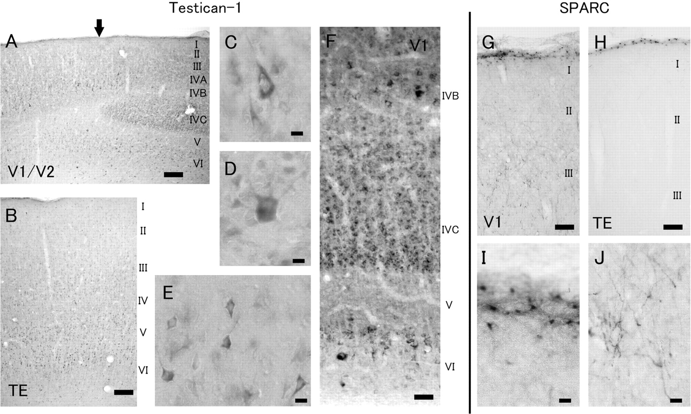
Figure 9. Immunohistochemical analysis of Testican-1 (A–F) and SPARC (G–J) expression in the monkey neocortex. (A, B) ...
Notes:
Figure 9. Immunohistochemical analysis of Testican-1 (A–F) and SPARC (G–J) expression in the monkey neocortex. (A, B) IHC for Testican-1 in V1 (A) and TE (B) showed patterns very similar to those obtained by ISH at a glance. The arrow in (A) shows the V1/V2 boundary. (C–E) High power images of Testican-1-positive neurons in layer III of V2 (C) and layer V of V2 (D) and TE (E). The immunoreactivity was mainly observed in the cell body and proximal neurite. (F) Immunostaining with anti-Testican-1-antiserum in V1. (G, H) IHC for SPARC in V1 (G) and TE (H). In this staining, SPARC signals were only observed in the astrocyte-like cells. (I, J) High power images of SPARC immunoreactivity in the pial surface (I) and layer III (J) of V1. Scale bar in (A, B) = 400 μm, scale bar in (C–E) = 10 μm, scale bar in (F) = 80 μm, scale bar in (G, H) = 80 μm, and scale bar in (I, J) = 10 μm.
Unless provided in the caption above, the following copyright applies to the content of this slide: © 2008 The AuthorsThis is an Open Access article distributed under the terms of the Creative Commons Attribution Non-Commercial License (http://creativecommons.org/licenses/by-nc/2.0/uk/) which permits unrestricted non-commercial use, distribution, and reproduction in any medium, provided the original work is properly cited.

Slide 10
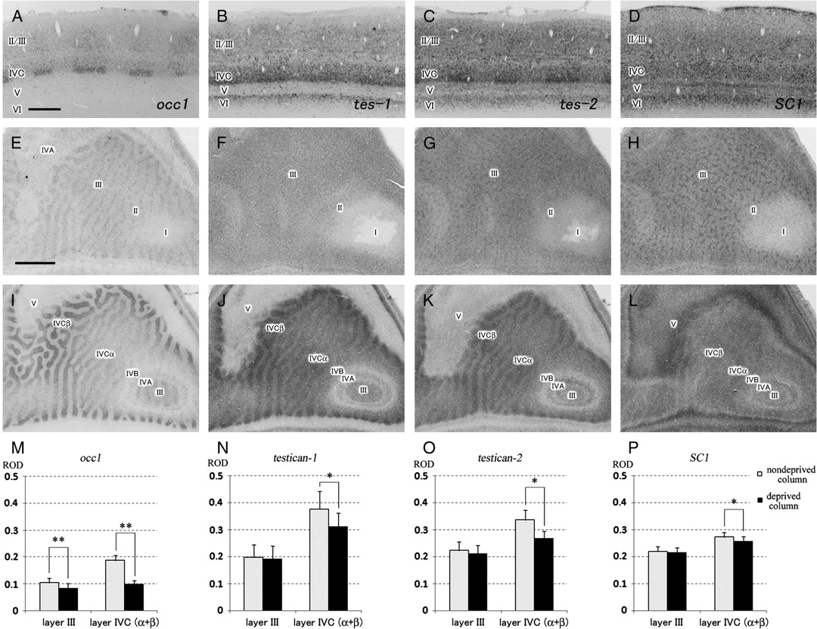
Figure 10. Coronal (A–D) and tangential (E–L) sections of ISH for occ1-related genes in the MD monkey V1. (E–H) are from ...
Notes:
Figure 10. Coronal (A–D) and tangential (E–L) sections of ISH for occ1-related genes in the MD monkey V1. (E–H) are from layer III, and (I–L) are from layer IVC. The expressions of occ1 (A, I), testican-1 (B, J), testican-2 (C, K), and SC1 (D, L) mRNA were significantly downregulated in the deprived columns by MD in layer IVC. In layer III, whereas occ1 mRNA expression was significantly downregulated (E), the expressions of testican-1 (F), testican-2 (G), and SC1 (H) were not affected. (M–P) Measurement of RODs for each gene in deprived and nondeprived columns in layers III and IVC. */P < 0.05; **/P < 0.01 (n = 4, each data); scale bar in (A) = 500 μm for (A–D), scale bar in (E) = 1.0 mm for (E–L).
Unless provided in the caption above, the following copyright applies to the content of this slide: © 2008 The AuthorsThis is an Open Access article distributed under the terms of the Creative Commons Attribution Non-Commercial License (http://creativecommons.org/licenses/by-nc/2.0/uk/) which permits unrestricted non-commercial use, distribution, and reproduction in any medium, provided the original work is properly cited.

