Slide 1
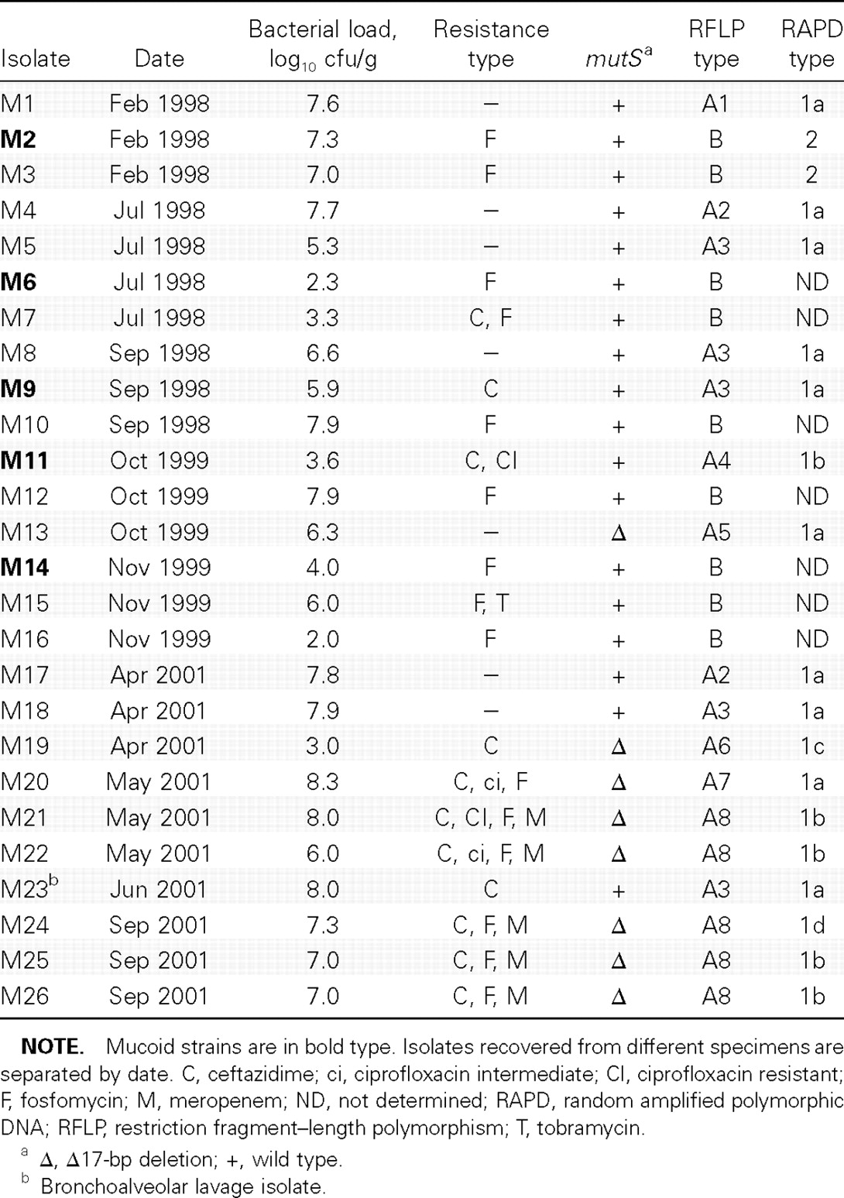
Table 1 Pseudomonas aeruginosa isolates from patient M
Notes:
Table 1 Pseudomonas aeruginosa isolates from patient M
Unless provided in the caption above, the following copyright applies to the content of this slide: © 2007 by the Infectious Diseases Society of America

Slide 2
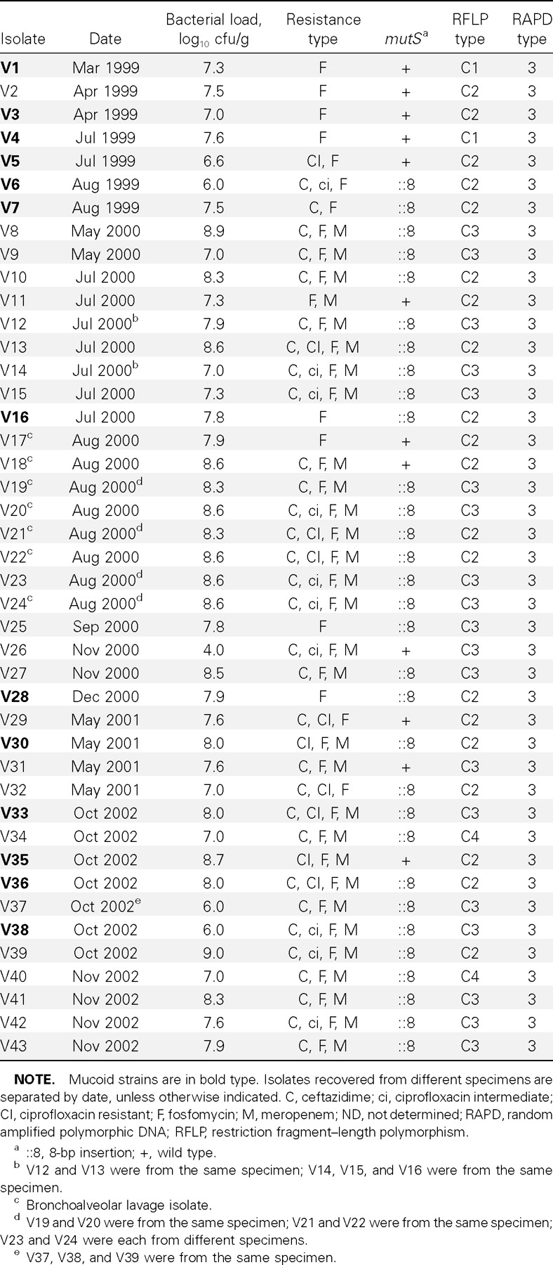
Table 2 Pseudomonas aeruginosa isolates from patient V
Notes:
Table 2 Pseudomonas aeruginosa isolates from patient V
Unless provided in the caption above, the following copyright applies to the content of this slide: © 2007 by the Infectious Diseases Society of America

Slide 3
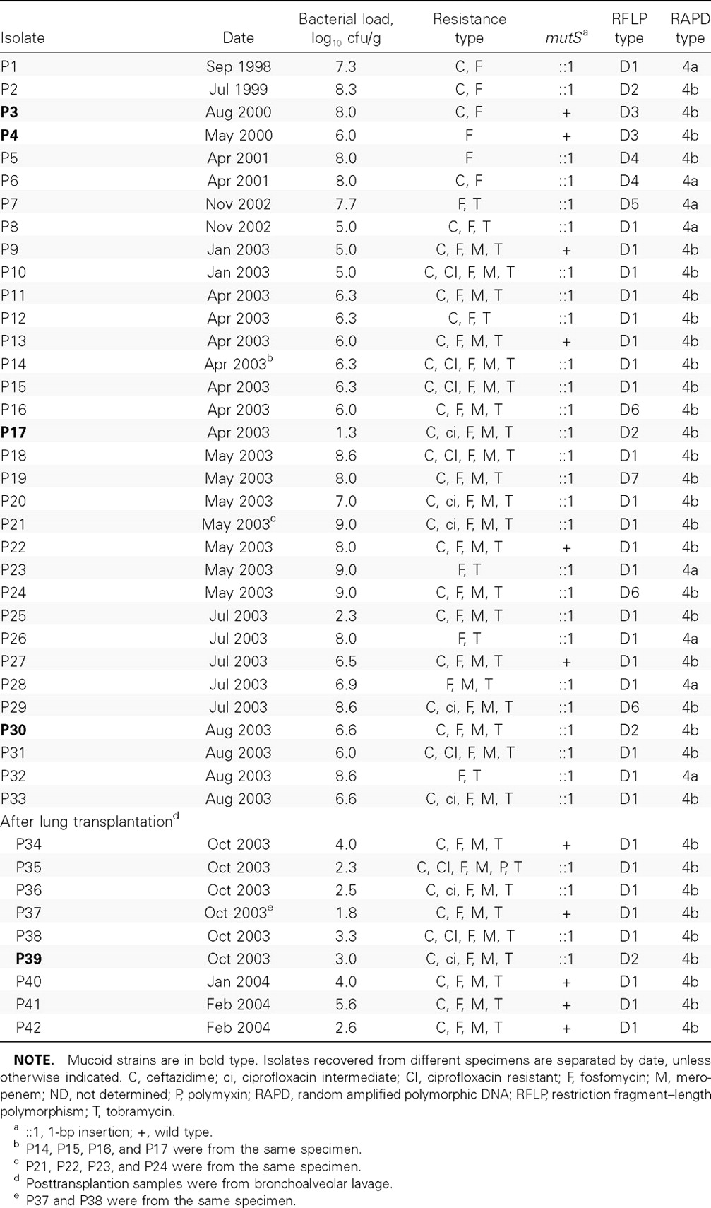
Table 3 Pseudomonas aeruginosa isolates from patient P
Notes:
Table 3 Pseudomonas aeruginosa isolates from patient P
Unless provided in the caption above, the following copyright applies to the content of this slide: © 2007 by the Infectious Diseases Society of America

Slide 4
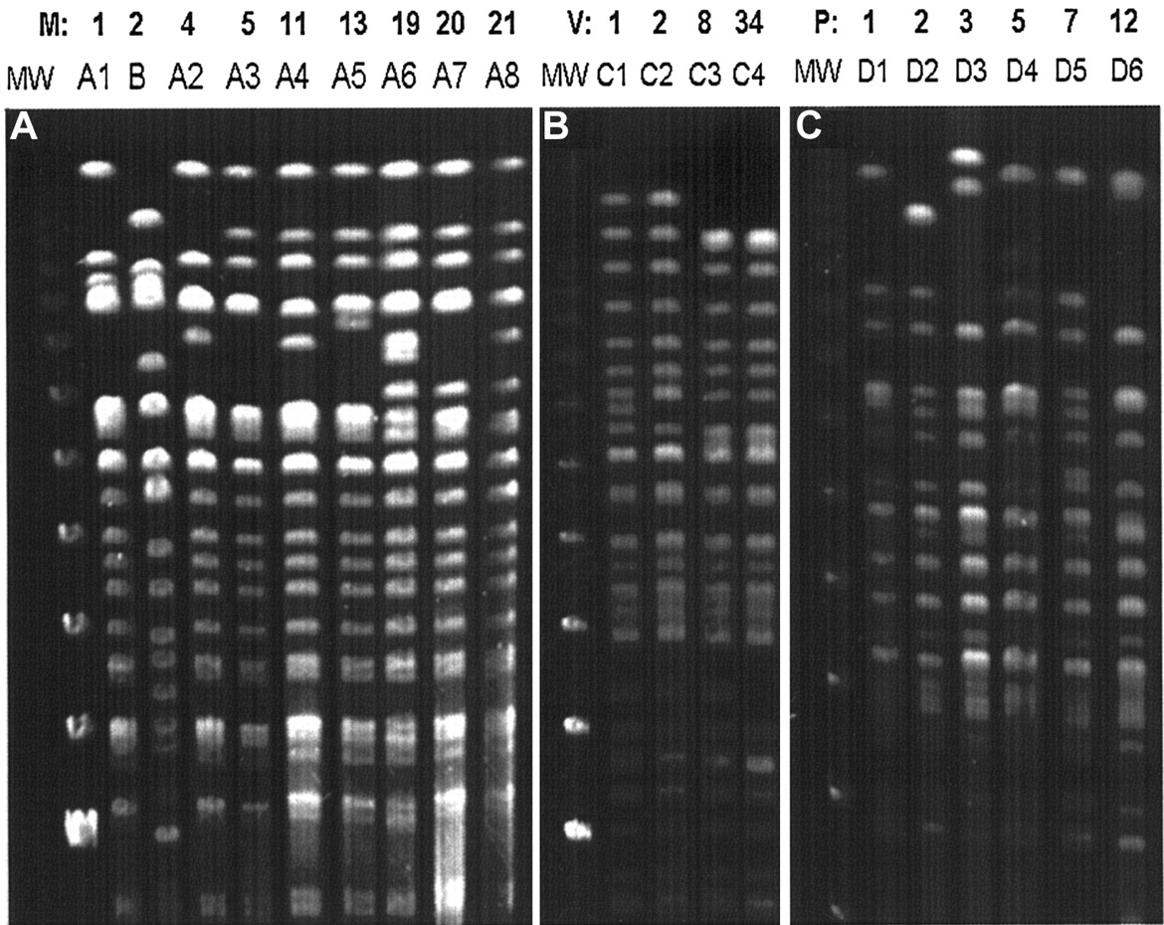
Figure 1 Pulsed-field gel electrophoresis analysis of sequential Pseudomonas aeruginosa (PA) isolates from patients M ...
Notes:
Figure 1 Pulsed-field gel electrophoresis analysis of sequential Pseudomonas aeruginosa (PA) isolates from patients M (A) V (B) and P (C). SpeI macrorestriction patterns of isolates M2 (belonging to clone B), M1, M4, M5, M11, M13, M19, M20, and M21 (belonging to clone A) of patient M; isolates V1, V2, V8, and V34 of patient V; and isolates P1, P2, P3, P5, P7, and P12 of patient P belonging to clone C and D, respectively, are shown. The denotation of different PA subclones of clones A, C, and D is indicated above. Molecular weight marker (MW), λ-ladder, size 1018.5–48.5 kb (Bio-Rad)
Unless provided in the caption above, the following copyright applies to the content of this slide: © 2007 by the Infectious Diseases Society of America

Slide 5
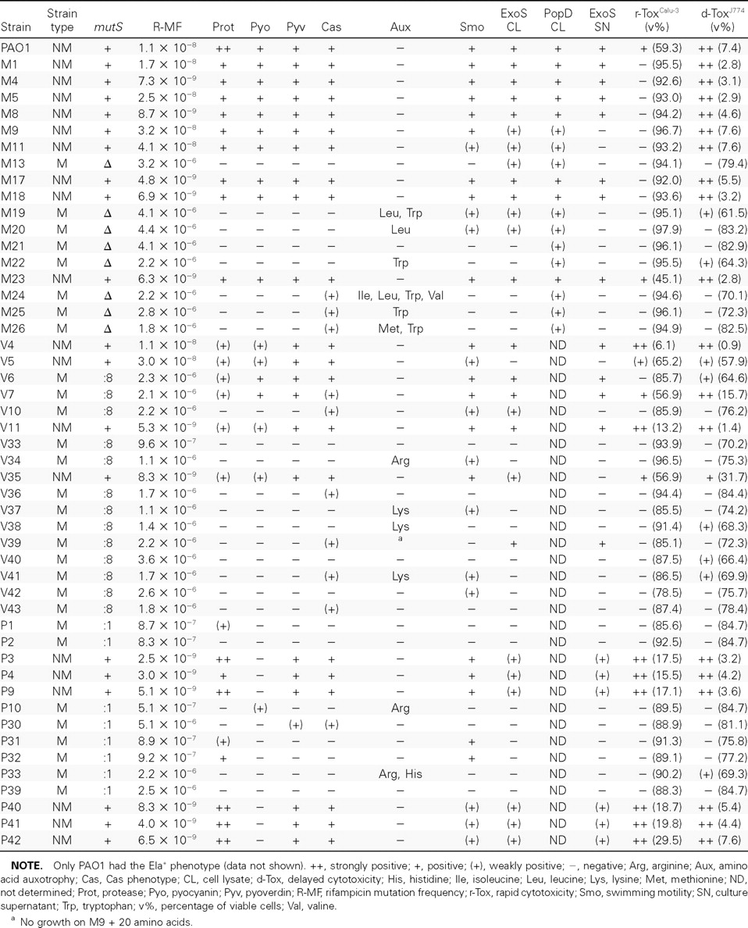
Table 4 Phenotypic characteristics of Pseudomonas aeruginosa (PA) nonmutator (NM) and mutator (M) isolates from ...
Notes:
Table 4 Phenotypic characteristics of Pseudomonas aeruginosa (PA) nonmutator (NM) and mutator (M) isolates from patients with cystic fibrosis
Unless provided in the caption above, the following copyright applies to the content of this slide: © 2007 by the Infectious Diseases Society of America

Slide 6
Figure 2 Exotoxin (Exo)–S and Pseudomonas outer protein (Pop)–D immunoblot analysis in whole cell lysate (CL) and ...
Notes:
Figure 2 Exotoxin (Exo)–S and Pseudomonas outer protein (Pop)–D immunoblot analysis in whole cell lysate (CL) and supernatant (SN) of PA clone A isolates of patient M using monoclonal anti-ExoS or anti-PopD. The blots were developed using enhanced chemiluminescence (Amersham)
Unless provided in the caption above, the following copyright applies to the content of this slide: © 2007 by the Infectious Diseases Society of America

Slide 7
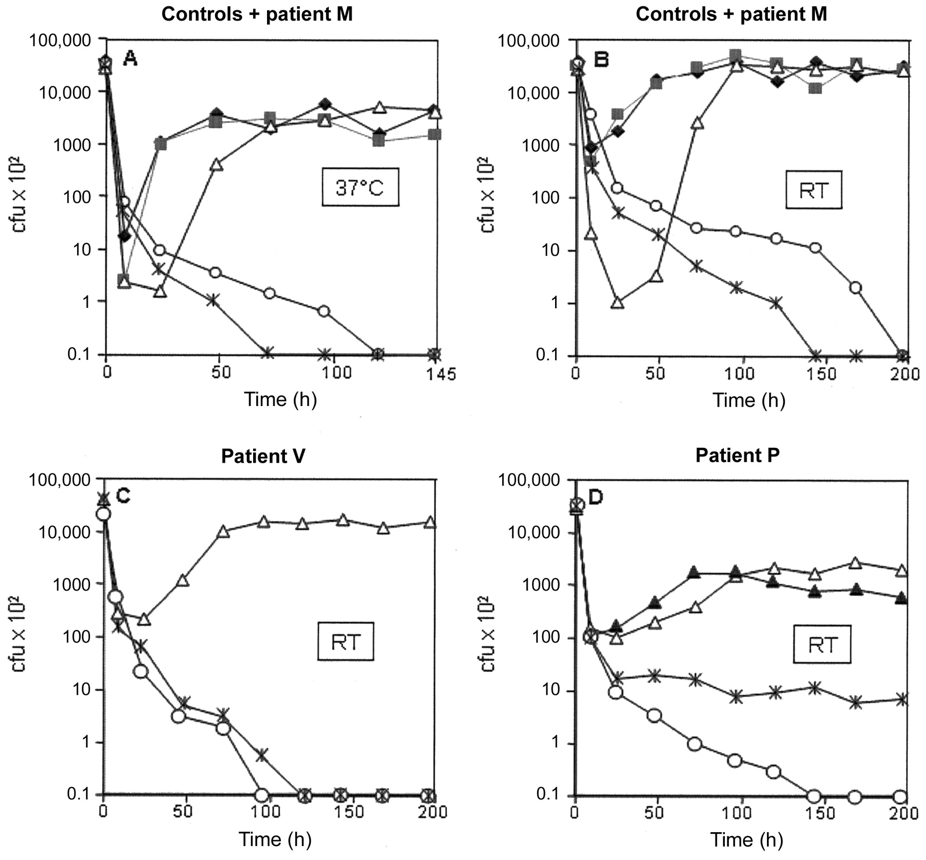
Figure 3 Survival of isogenic Pseudomonas aeruginosa (PA) mutator and nonmutator isolates in sterile-filtered tap ...
Notes:
Figure 3 Survival of isogenic Pseudomonas aeruginosa (PA) mutator and nonmutator isolates in sterile-filtered tap water at 37°C (A) and room temperature (RT) (B–D). Luria-Bertani–grown bacterial cells were harvested by centrifugation, washed with PBS, inoculated in 200 mL of tap water, and slightly shaken at 50 rpm in 500-mL Erlenmeyer flasks. A and B PAO1 (black diamonds) and PAO1 (mutS) (black squares) as controls and CF isolates from patient M: M1 (white triangles) M25 (mutS) (white circles) and M26 (mutS) (asterisks). C Isolates from patient V: V11 (white triangles) V37 (mutS) (asterisks) and V43 (mutS) (white circles). D Isolates from patient P: P9 (white triangles) P30 (mutS) (white circles) P39 (mutS) (asterisks) and P42 (black triangles)
Unless provided in the caption above, the following copyright applies to the content of this slide: © 2007 by the Infectious Diseases Society of America

