Slide 1
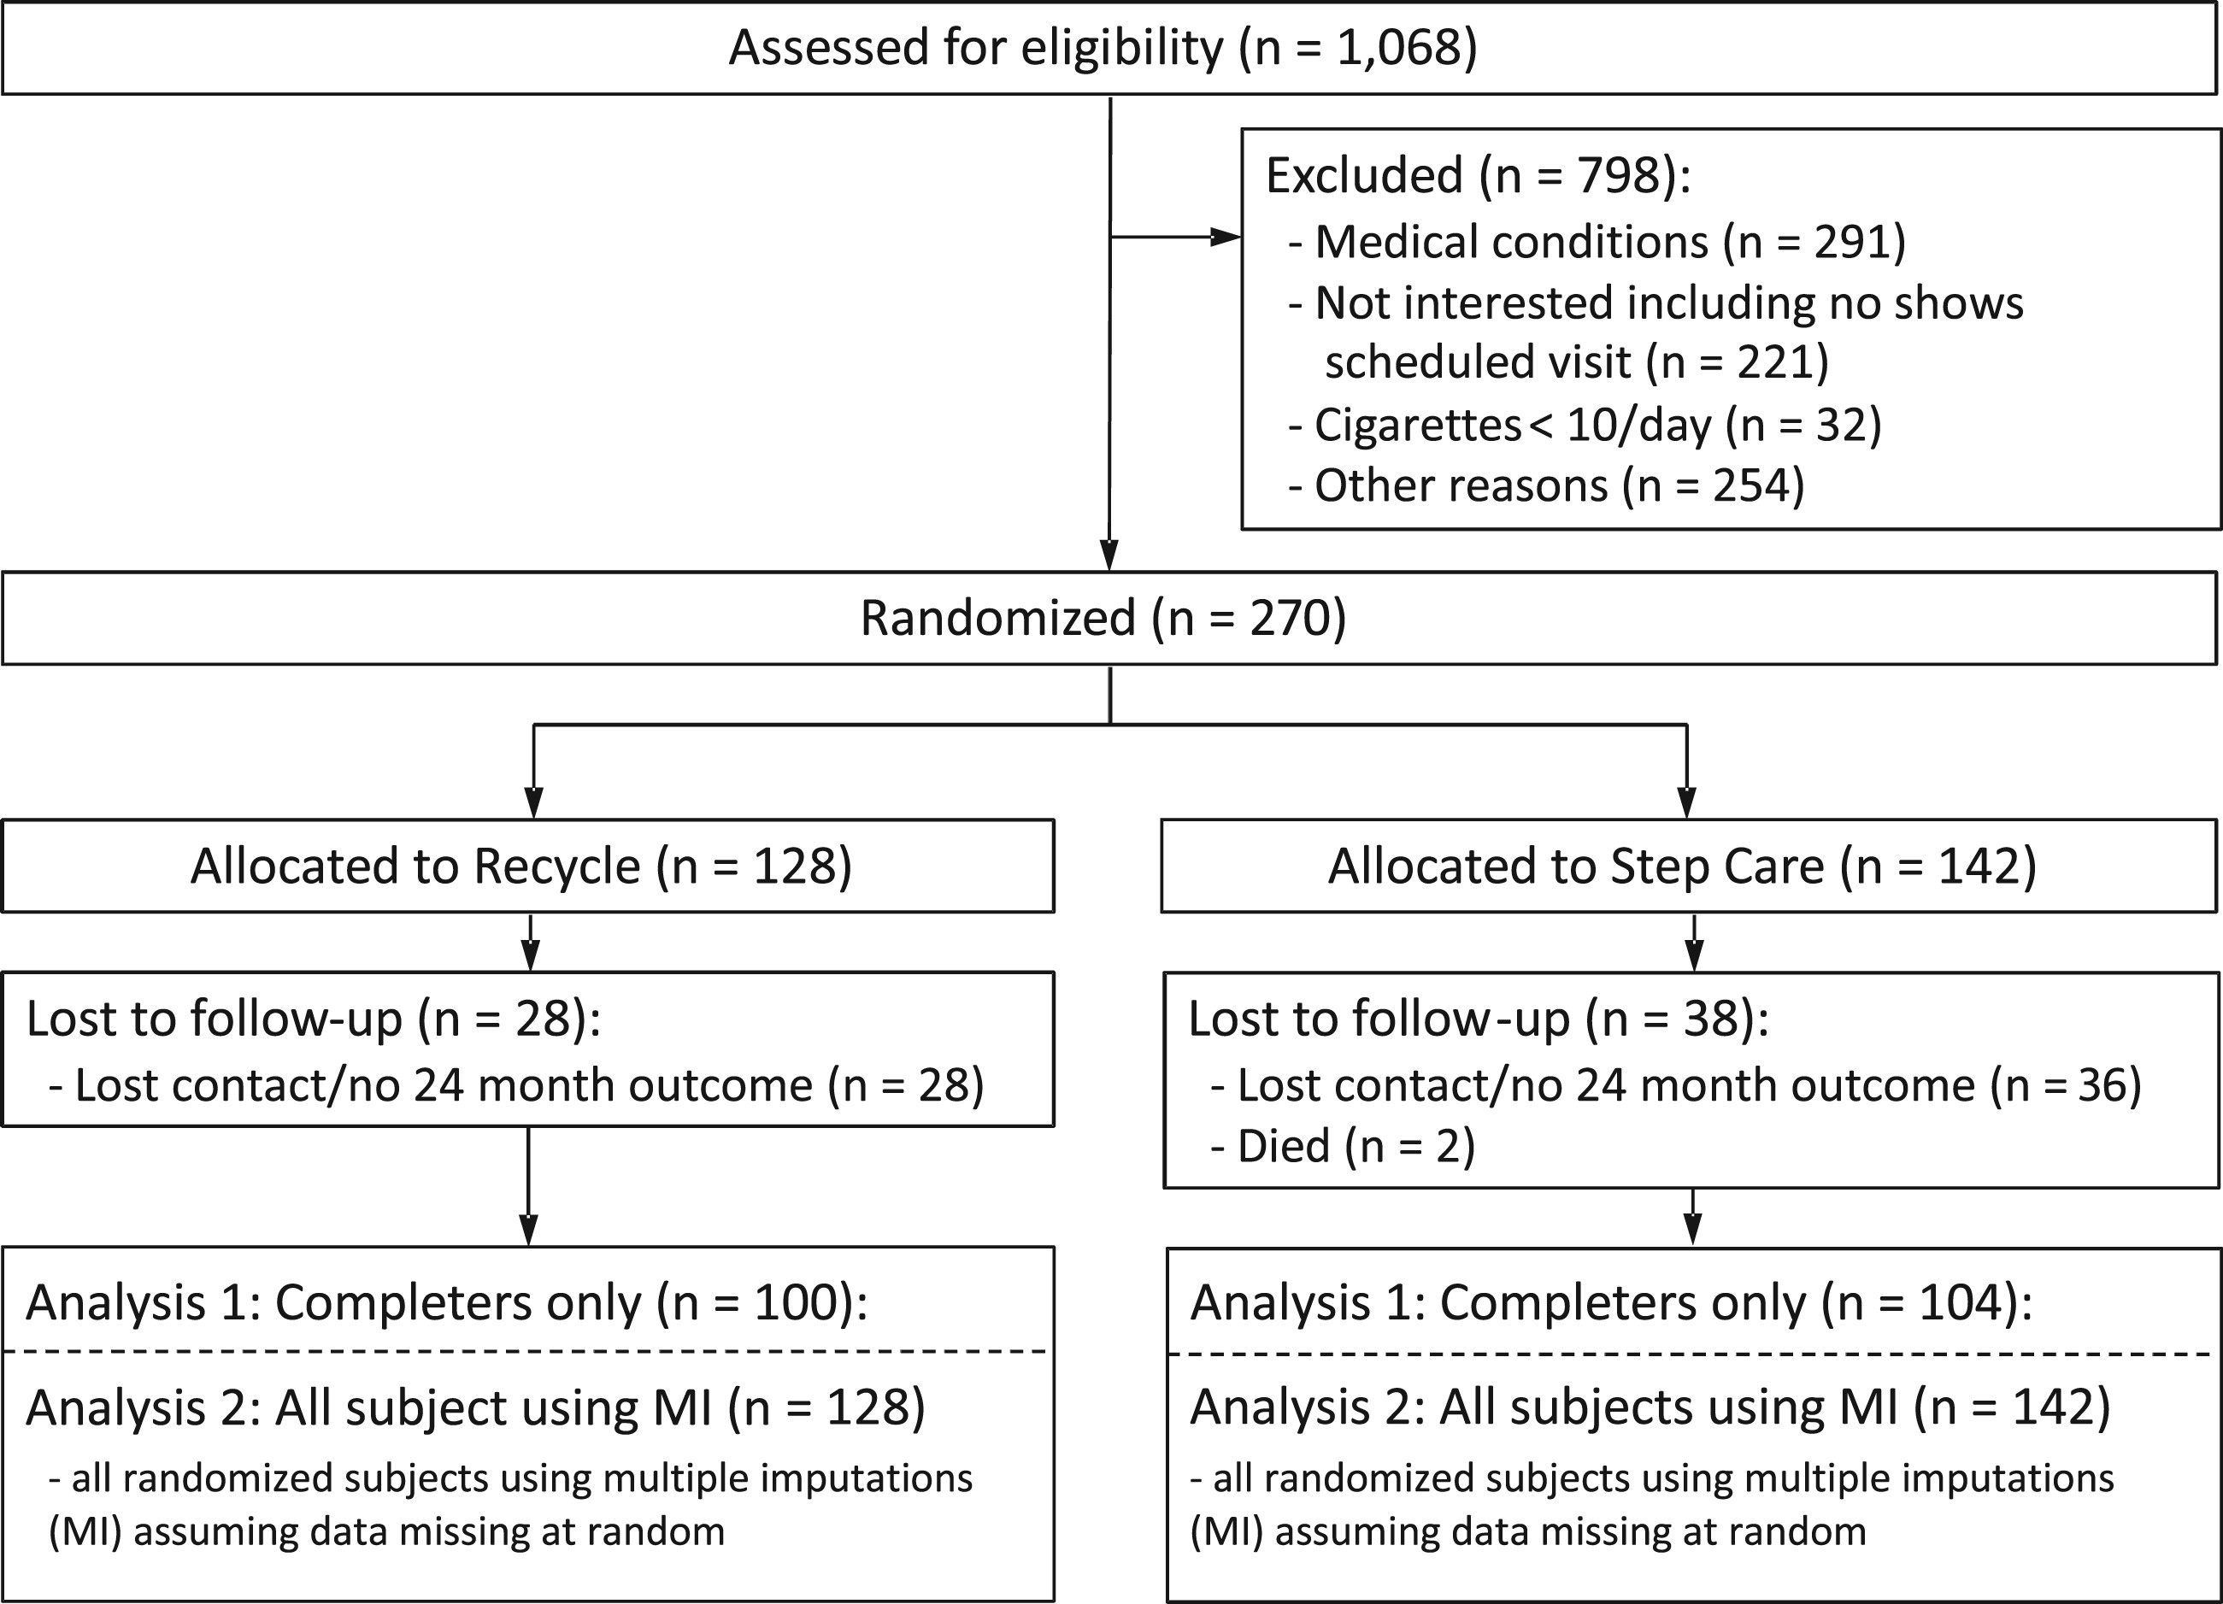
Table I. Baseline demographics among all participants Abbreviations: CPD, cigarettes per day; FTND, Fagerstr�m Test ...
Notes:
Table I. Baseline demographics among all participants Abbreviations: CPD, cigarettes per day; FTND, Fagerstr�m Test for Nicotine Dependence; HS, High School; GED, General Education Degree. Fig. 1.CONSORT Diagram.
Unless provided in the caption above, the following copyright applies to the content of this slide: � The Author 2017. Published by Oxford University Press. All rights reserved. For permissions, please email: journals.permissions@oup.com

