Slide 1
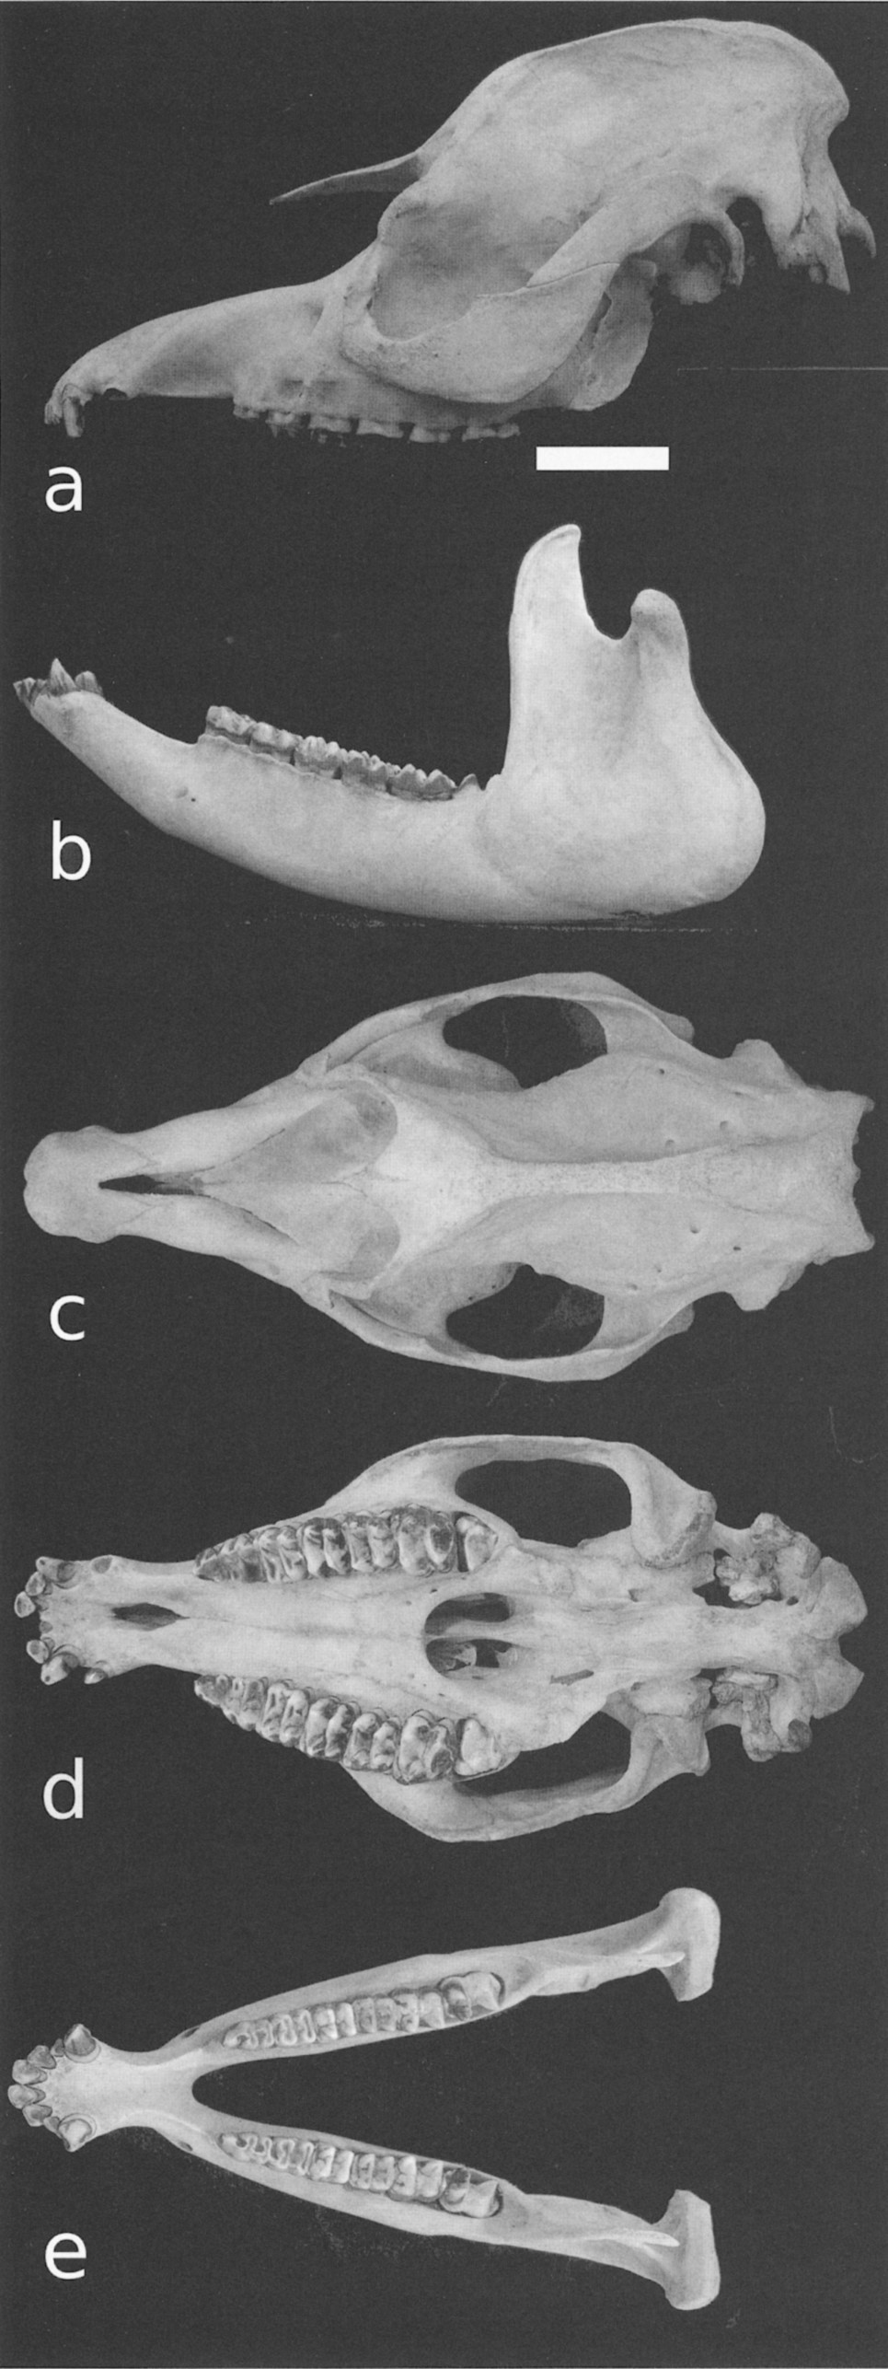
Fig. 1 Skull and mandible of the holotype of Tapirus kabomani sp. nov., UFMG 3177. a) Skull, left lateral view; b) ...
Notes:
Fig. 1 Skull and mandible of the holotype of Tapirus kabomani sp. nov., UFMG 3177. a) Skull, left lateral view; b) mandible, left lateral view; c) skull, dorsal view; d) skull, ventral view; e) mandible, occlusal view. White bar = 5 cm.
Unless provided in the caption above, the following copyright applies to the content of this slide: © 2013 American Society of MammalogistsThis is an Open Access article distributed under the terms of the Creative Commons Attribution-NonCommercial-NoDerivs licence (http://creativecommons.org/licenses/by-nc-nd/3.0/) which permits non-commercial reproduction and distribution of the work, in any medium, provided the original work is not altered or transformed in any way, and that the work is properly cited. For commercial re-use, please contact journals.permissions@oup.com

Slide 2
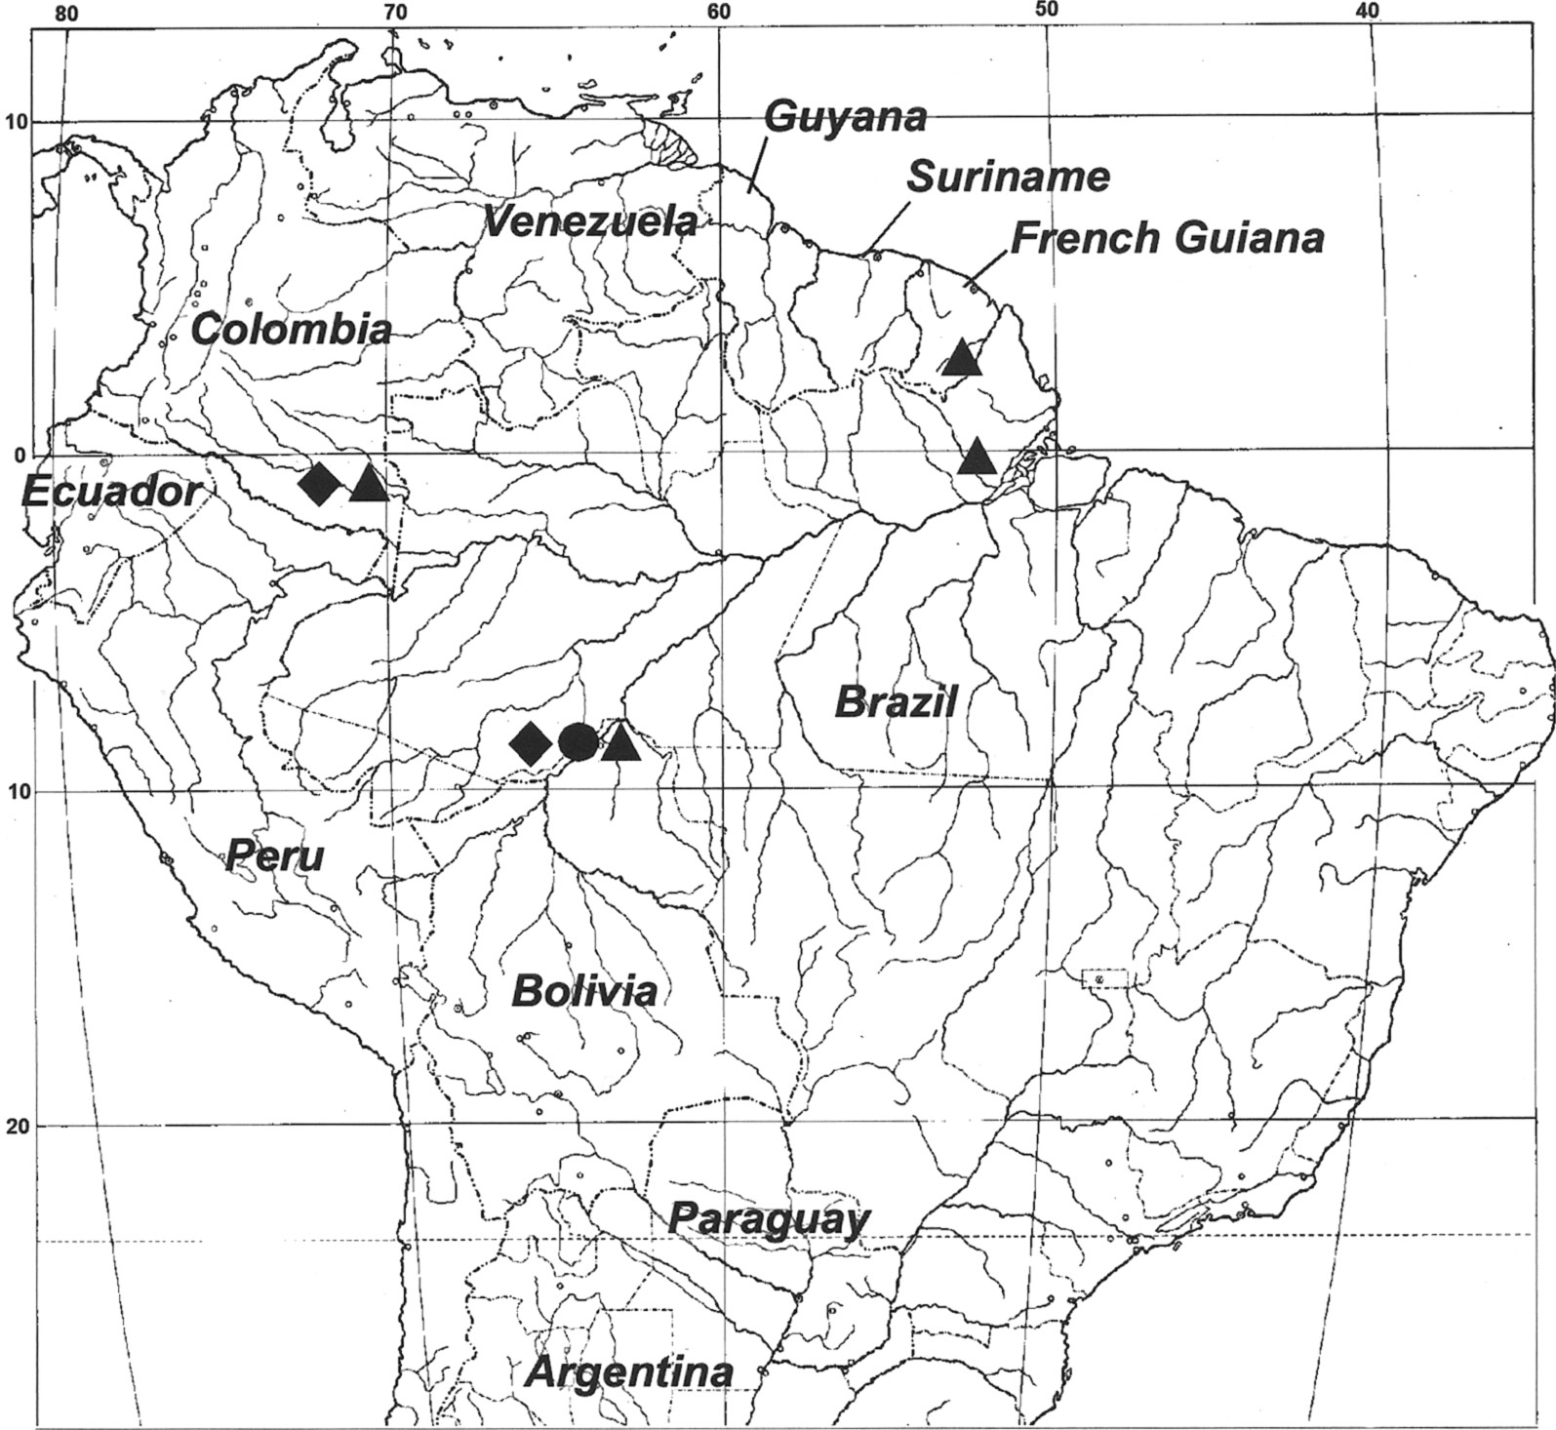
Fig. 2 Map for the known localities of Tapirus kabomani sp. nov. Circle = collected specimens; diamond = DNA ...
Notes:
Fig. 2 Map for the known localities of Tapirus kabomani sp. nov. Circle = collected specimens; diamond = DNA inference; triangle = photographs.
Unless provided in the caption above, the following copyright applies to the content of this slide: © 2013 American Society of MammalogistsThis is an Open Access article distributed under the terms of the Creative Commons Attribution-NonCommercial-NoDerivs licence (http://creativecommons.org/licenses/by-nc-nd/3.0/) which permits non-commercial reproduction and distribution of the work, in any medium, provided the original work is not altered or transformed in any way, and that the work is properly cited. For commercial re-use, please contact journals.permissions@oup.com

Slide 3
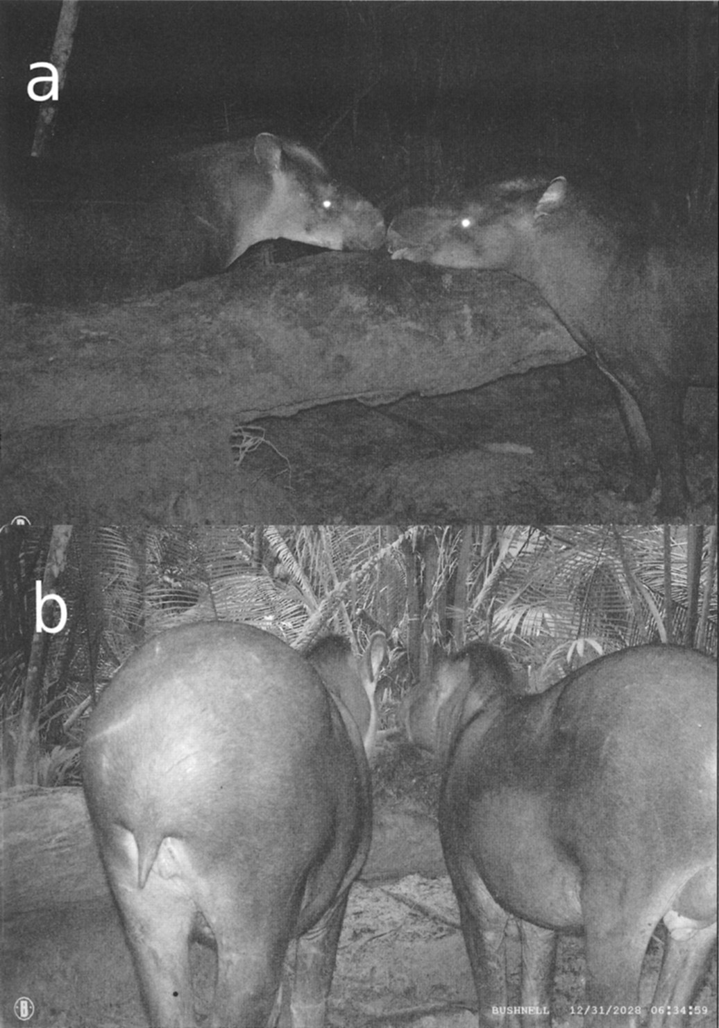
Fig. 3 Camera-trap photos of 2 specimens of Tapirus kabomani in the type locality (southern Amazonas State from ...
Notes:
Fig. 3 Camera-trap photos of 2 specimens of Tapirus kabomani in the type locality (southern Amazonas State from Brazil), a) Lateral view of the head and anterior body of a male (right) and female (left) specimens, b) Posterior view of the same specimens in the same locality and day, female (left) and male (right). Note the lighter colored patch on lower head and neck of the female.
Unless provided in the caption above, the following copyright applies to the content of this slide: © 2013 American Society of MammalogistsThis is an Open Access article distributed under the terms of the Creative Commons Attribution-NonCommercial-NoDerivs licence (http://creativecommons.org/licenses/by-nc-nd/3.0/) which permits non-commercial reproduction and distribution of the work, in any medium, provided the original work is not altered or transformed in any way, and that the work is properly cited. For commercial re-use, please contact journals.permissions@oup.com

Slide 4
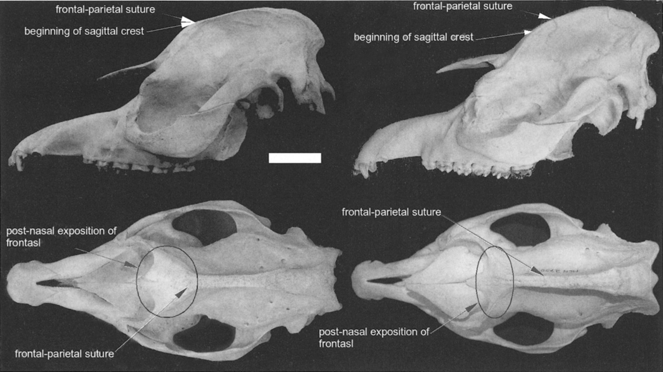
Fig. 4 Comparison of the skull of Tapirus kabomani (left, holotype) and T. terrestris (right, Museu de Ciências ...
Notes:
Fig. 4 Comparison of the skull of Tapirus kabomani (left, holotype) and T. terrestris (right, Museu de Ciências Naturais, Pontifícia Universidade Católica de Minas Gérais, Belo Horizonte, Minas Gerais, Brazil, MCN 2750). Left lateral view (above), dorsal view (below). The most significant differences described in text are indicated. White bar = 5 cm.
Unless provided in the caption above, the following copyright applies to the content of this slide: © 2013 American Society of MammalogistsThis is an Open Access article distributed under the terms of the Creative Commons Attribution-NonCommercial-NoDerivs licence (http://creativecommons.org/licenses/by-nc-nd/3.0/) which permits non-commercial reproduction and distribution of the work, in any medium, provided the original work is not altered or transformed in any way, and that the work is properly cited. For commercial re-use, please contact journals.permissions@oup.com

Slide 5
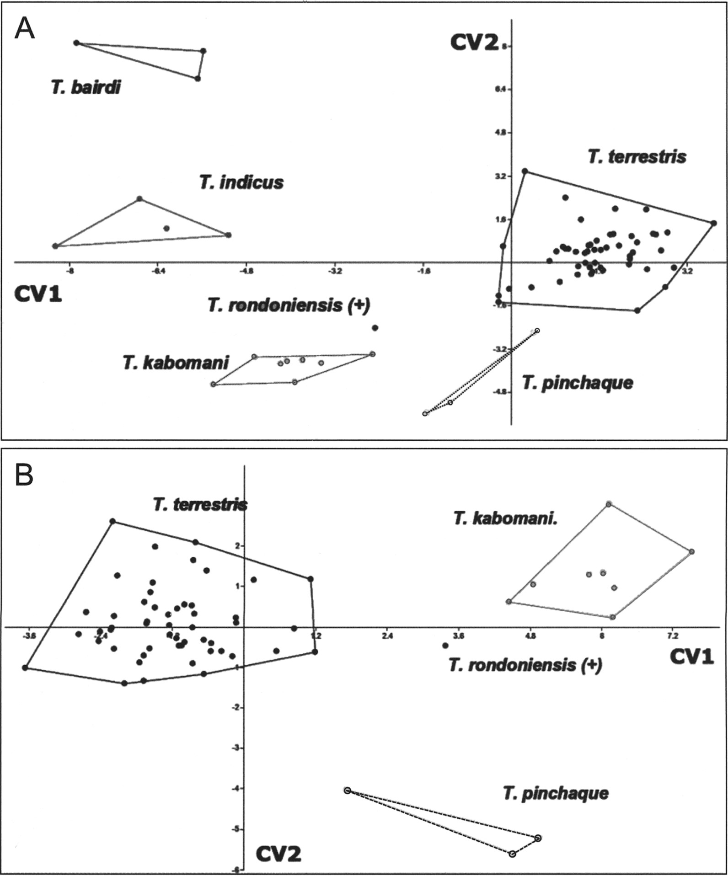
Fig. 5 Canonical variate analysis scatter-plot for 21 cranial measures of all living Tapirus species and T. ...
Notes:
Fig. 5 Canonical variate analysis scatter-plot for 21 cranial measures of all living Tapirus species and T. rondoniensis. A) All species, B) South American species.
Unless provided in the caption above, the following copyright applies to the content of this slide: © 2013 American Society of MammalogistsThis is an Open Access article distributed under the terms of the Creative Commons Attribution-NonCommercial-NoDerivs licence (http://creativecommons.org/licenses/by-nc-nd/3.0/) which permits non-commercial reproduction and distribution of the work, in any medium, provided the original work is not altered or transformed in any way, and that the work is properly cited. For commercial re-use, please contact journals.permissions@oup.com

Slide 6
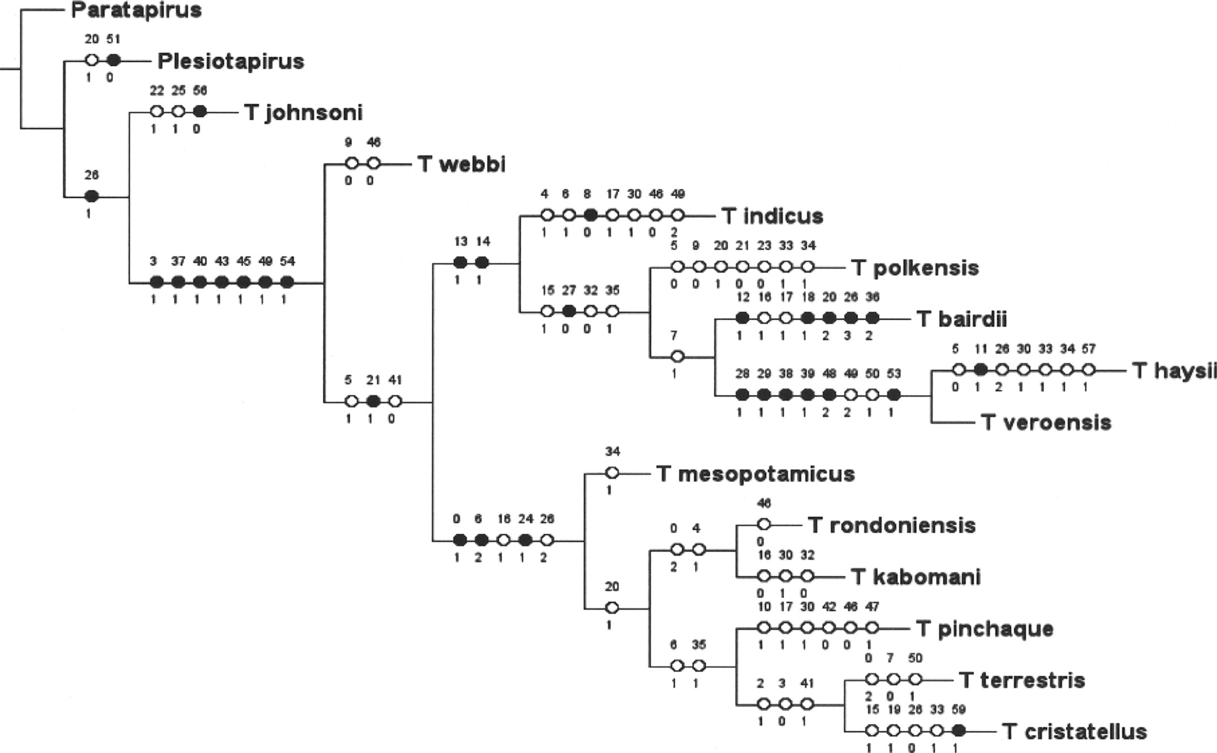
Fig. 6 Morphological maximum-parsimony tree including all living species and selected fossils of Tapirus. The ...
Notes:
Fig. 6 Morphological maximum-parsimony tree including all living species and selected fossils of Tapirus. The numbers above hash marks correspond to character numbers and, above them, character states.
Unless provided in the caption above, the following copyright applies to the content of this slide: © 2013 American Society of MammalogistsThis is an Open Access article distributed under the terms of the Creative Commons Attribution-NonCommercial-NoDerivs licence (http://creativecommons.org/licenses/by-nc-nd/3.0/) which permits non-commercial reproduction and distribution of the work, in any medium, provided the original work is not altered or transformed in any way, and that the work is properly cited. For commercial re-use, please contact journals.permissions@oup.com

Slide 7
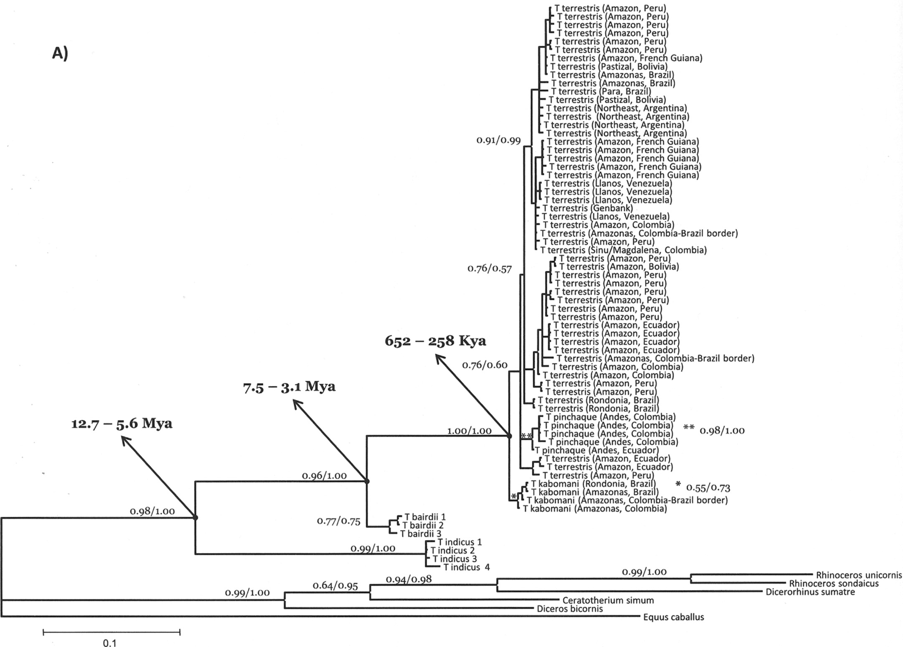
Fig. 7 A) Bayesian inference phylogenetic tree of cytochrome-b sequences for all tapir species. The same topology ...
Notes:
Fig. 7 A) Bayesian inference phylogenetic tree of cytochrome-b sequences for all tapir species. The same topology was found using a maximum-likelihood approach, excluding identical haplotypes in the analysis. All branches with support statistics < 0.50 were collapsed. Support values shown only for main nodes are approximate likelihood-ratio (aLRT) statistics for maximum-likelihood-Bayesian posterior probabilities. Support values for the Tapirus kabomani (*) and T. pinchaque (**) clades are shown as asterisks. Arrows show nodes where the divergence times were calculated. B) A detail of the above tree showing all branch support values for the South American tapir clade.
Unless provided in the caption above, the following copyright applies to the content of this slide: © 2013 American Society of MammalogistsThis is an Open Access article distributed under the terms of the Creative Commons Attribution-NonCommercial-NoDerivs licence (http://creativecommons.org/licenses/by-nc-nd/3.0/) which permits non-commercial reproduction and distribution of the work, in any medium, provided the original work is not altered or transformed in any way, and that the work is properly cited. For commercial re-use, please contact journals.permissions@oup.com

Slide 8
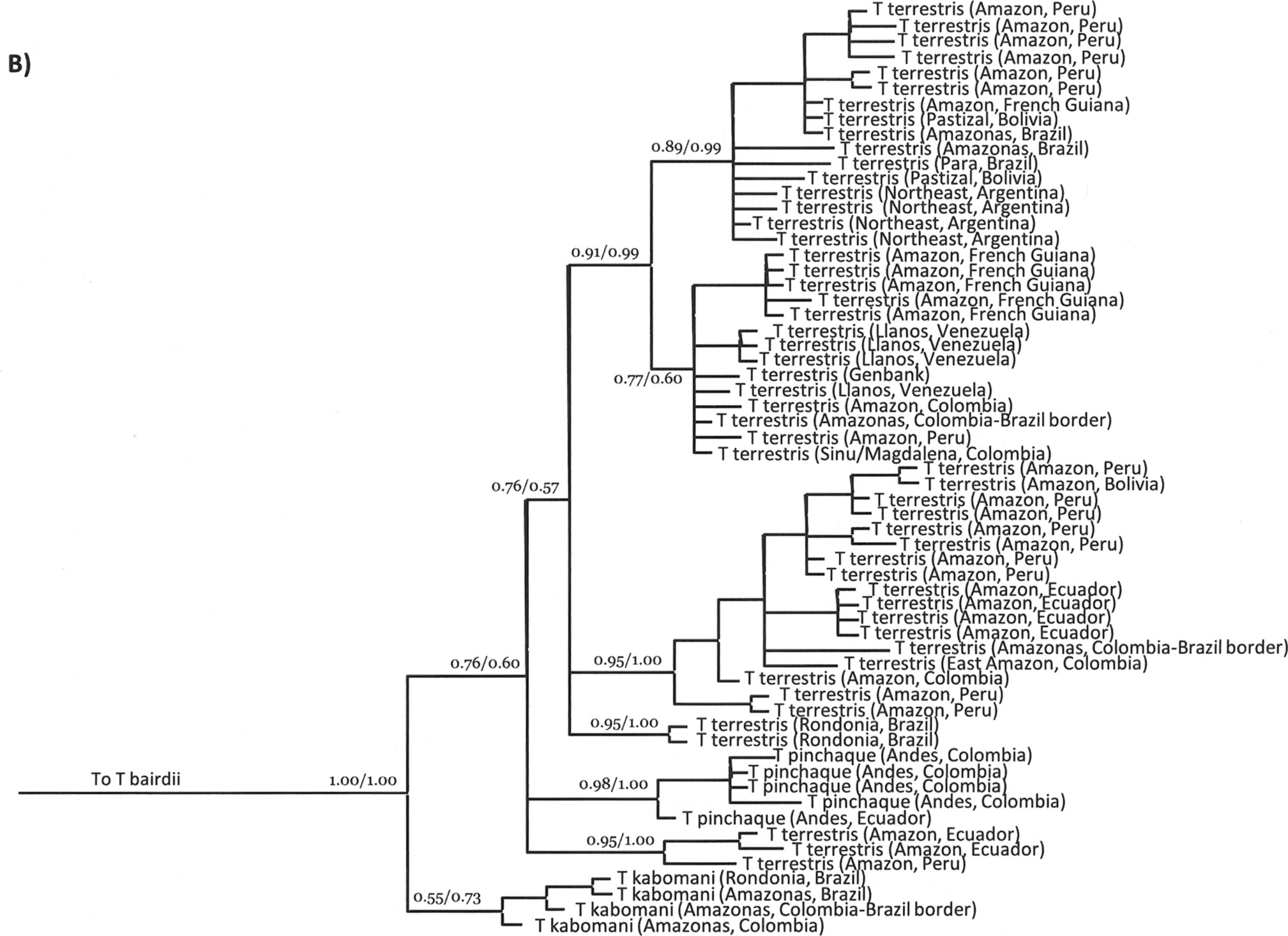
Fig. 7 A) Bayesian inference phylogenetic tree of cytochrome-b sequences for all tapir species. The same topology ...
Notes:
Fig. 7 A) Bayesian inference phylogenetic tree of cytochrome-b sequences for all tapir species. The same topology was found using a maximum-likelihood approach, excluding identical haplotypes in the analysis. All branches with support statistics < 0.50 were collapsed. Support values shown only for main nodes are approximate likelihood-ratio (aLRT) statistics for maximum-likelihood-Bayesian posterior probabilities. Support values for the Tapirus kabomani (*) and T. pinchaque (**) clades are shown as asterisks. Arrows show nodes where the divergence times were calculated. B) A detail of the above tree showing all branch support values for the South American tapir clade.
Unless provided in the caption above, the following copyright applies to the content of this slide: © 2013 American Society of MammalogistsThis is an Open Access article distributed under the terms of the Creative Commons Attribution-NonCommercial-NoDerivs licence (http://creativecommons.org/licenses/by-nc-nd/3.0/) which permits non-commercial reproduction and distribution of the work, in any medium, provided the original work is not altered or transformed in any way, and that the work is properly cited. For commercial re-use, please contact journals.permissions@oup.com

Slide 9
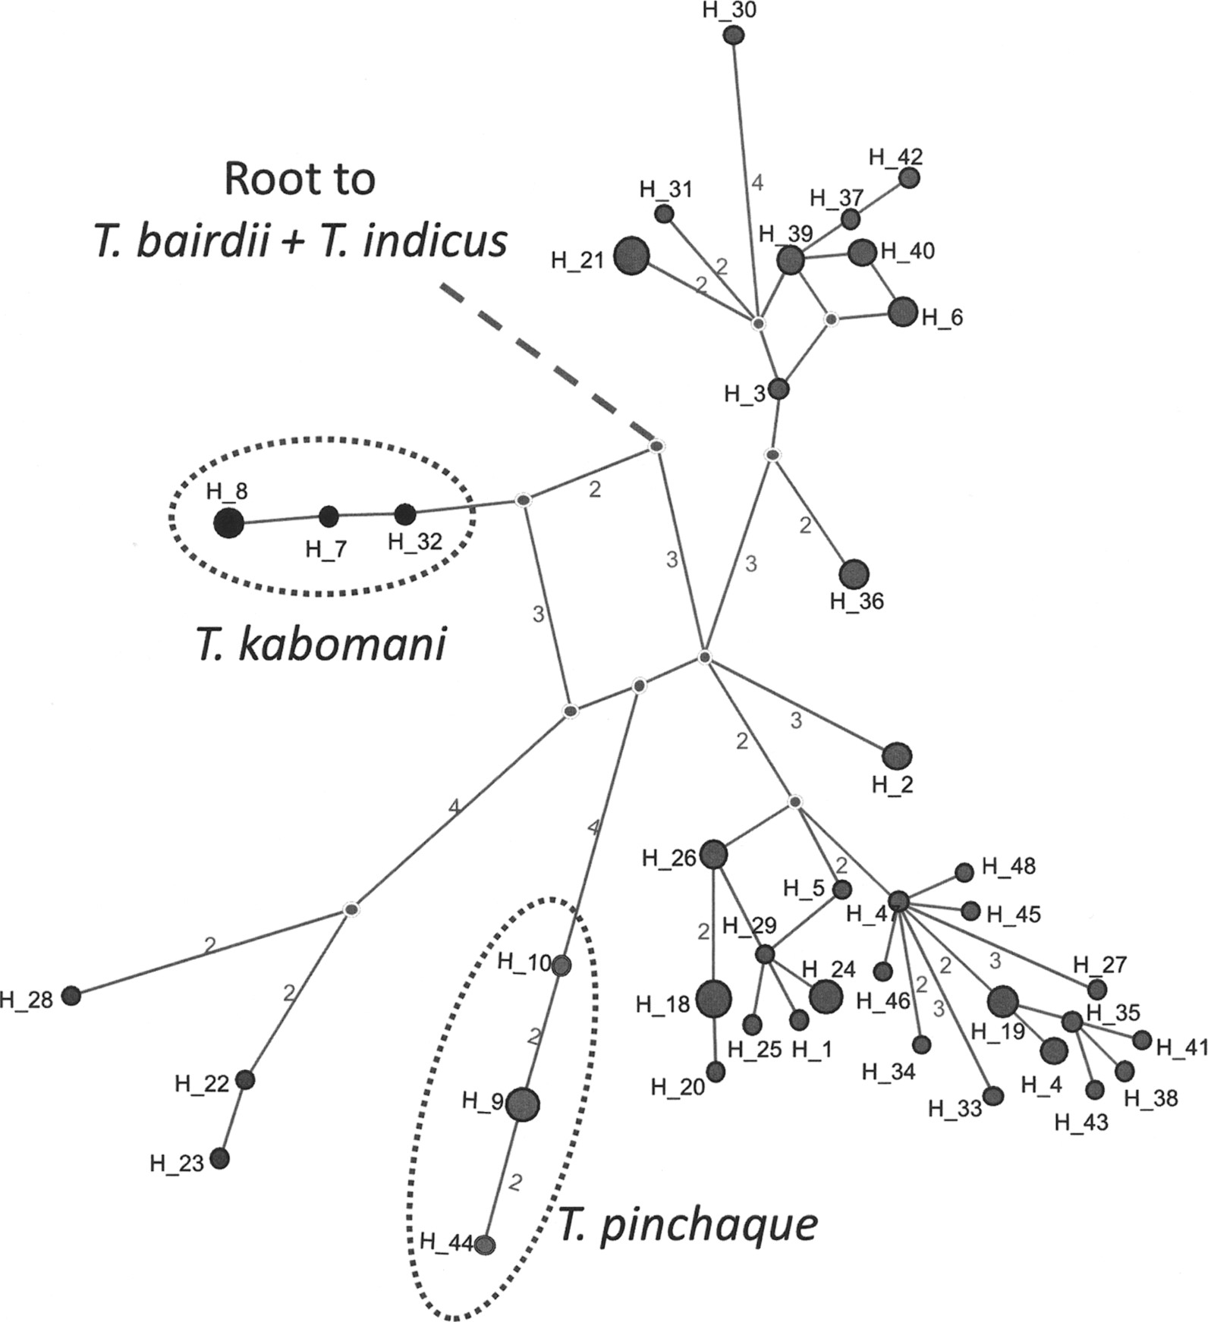
Fig. 8 Median-joining network of cytochrome-b (Cytb) sequences of Tapirus terrestris, T. kabomani, and T. pinchaque. ...
Notes:
Fig. 8 Median-joining network of cytochrome-b (Cytb) sequences of Tapirus terrestris, T. kabomani, and T. pinchaque. Numbers of mutational steps larger than 1 are shown for each branch connecting haplotypes. The circle size of each haplotype is proportional to the number of individuals found, and the monophyletic clades belonging to T. kabomani and T. pinchaque are indicated, as well as the out-group root (T. bairdii + T. indicus). See list of Cytb haplotypes, access numbers, population distribution, and other results for molecular analyses in Supporting Information S5 and S11–S15.
Unless provided in the caption above, the following copyright applies to the content of this slide: © 2013 American Society of MammalogistsThis is an Open Access article distributed under the terms of the Creative Commons Attribution-NonCommercial-NoDerivs licence (http://creativecommons.org/licenses/by-nc-nd/3.0/) which permits non-commercial reproduction and distribution of the work, in any medium, provided the original work is not altered or transformed in any way, and that the work is properly cited. For commercial re-use, please contact journals.permissions@oup.com

