Slide 1
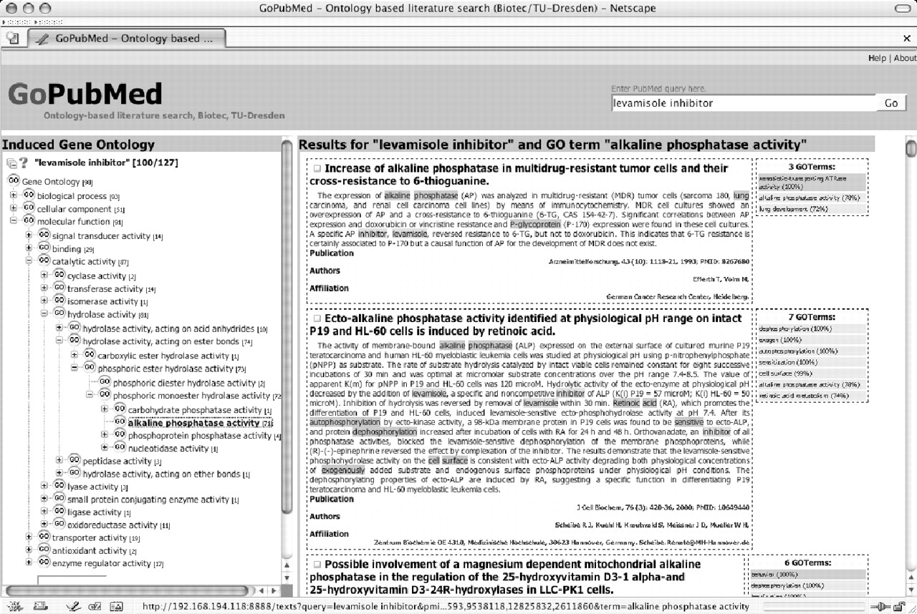
Figure 1 User interface of GoPubMed. The screen-shot of GoPubMed displays the results for the query ‘levamisole ...
Notes:
Figure 1 User interface of GoPubMed. The screen-shot of GoPubMed displays the results for the query ‘levamisole inhibitor’ limited to 100 papers. On the left, part of the GO relevant to the query is shown and on the right the abstracts for a selected GO term. The search terms are highlighted online in orange and the GO terms in green. Right of each abstract is a list with all the GO terms for that abstract ordered by an accuracy percentage. For example, the term ‘P-glycoprotein’, which is a synonym for the GO term ‘xenobiotec transporting ATPase’, is found with 100% accuracy, while ‘lung development’ matches only with 72%, as only the word ‘lung’ occurs in the abstract. Synonyms, such as the term ‘P-glycoprotein’ above, are displayed in dark grey and the synonymous term is given in a tool-tip (please note that Mozilla-based browsers do not currently break lines in tool-tips). Moving the mouse over the term displays the definition of the term in a tool-tip. The ontology on the left shows the paths from the root of the ontology—‘cellular component’, ‘biological process’ and ‘molecular function’—to the currently selected GO term. The number in brackets behind each GO term in the ontology is the number of papers the GO term or any of its children occur in. In the figure, the path from ‘molecular function’ to ‘alkaline phosphatase’ is shown and the number 71 behind the term ‘alkaline phosphatase’ indicates that there are 71 papers mentioning alkaline phosphatase. Clicking on the term displays the relevant abstracts, which confirm that levamisole inhibits alkaline phosphatase. Overall, the number of papers containing a term and its children is a very good indicator to let users select the most frequent terms and, thus, best representatives. Instead of using the ontology to browse through abstracts, users can also display all the abstracts in the same order as in PubMed with the additional benefit of displaying the GO terms and search keywords. Users can also search within the ontology using the input field at the bottom of the ontology. GoPubMed searches are currently limited to 100 papers per query. Answering a query takes ∼20 s.
Unless provided in the caption above, the following copyright applies to the content of this slide: © The Author 2005. Published by Oxford University Press. All rights reserved The online version of this article has been published under an open access model. Users are entitled to use, reproduce, disseminate, or display the open access version of this article for non-commercial purposes provided that: the original authorship is properly and fully attributed; the Journal and Oxford University Press are attributed as the original place of publication with the correct citation details given; if an article is subsequently reproduced or disseminated not in its entirety but only in part or as a derivative work this must be clearly indicated. For commercial re-use, please contact journals.permissions@oupjournals.org

Slide 2
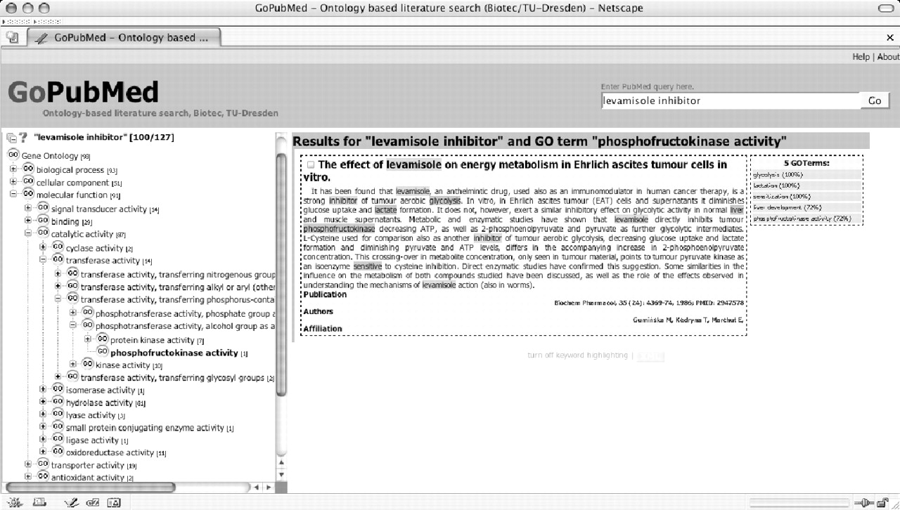
Figure 2 GoPubMed displaying the results for ‘levamisole inhibitor’ that contain the GO term phosphofructokinase.
Notes:
Figure 2 GoPubMed displaying the results for ‘levamisole inhibitor’ that contain the GO term phosphofructokinase.
Unless provided in the caption above, the following copyright applies to the content of this slide: © The Author 2005. Published by Oxford University Press. All rights reserved The online version of this article has been published under an open access model. Users are entitled to use, reproduce, disseminate, or display the open access version of this article for non-commercial purposes provided that: the original authorship is properly and fully attributed; the Journal and Oxford University Press are attributed as the original place of publication with the correct citation details given; if an article is subsequently reproduced or disseminated not in its entirety but only in part or as a derivative work this must be clearly indicated. For commercial re-use, please contact journals.permissions@oupjournals.org

