Slide 1
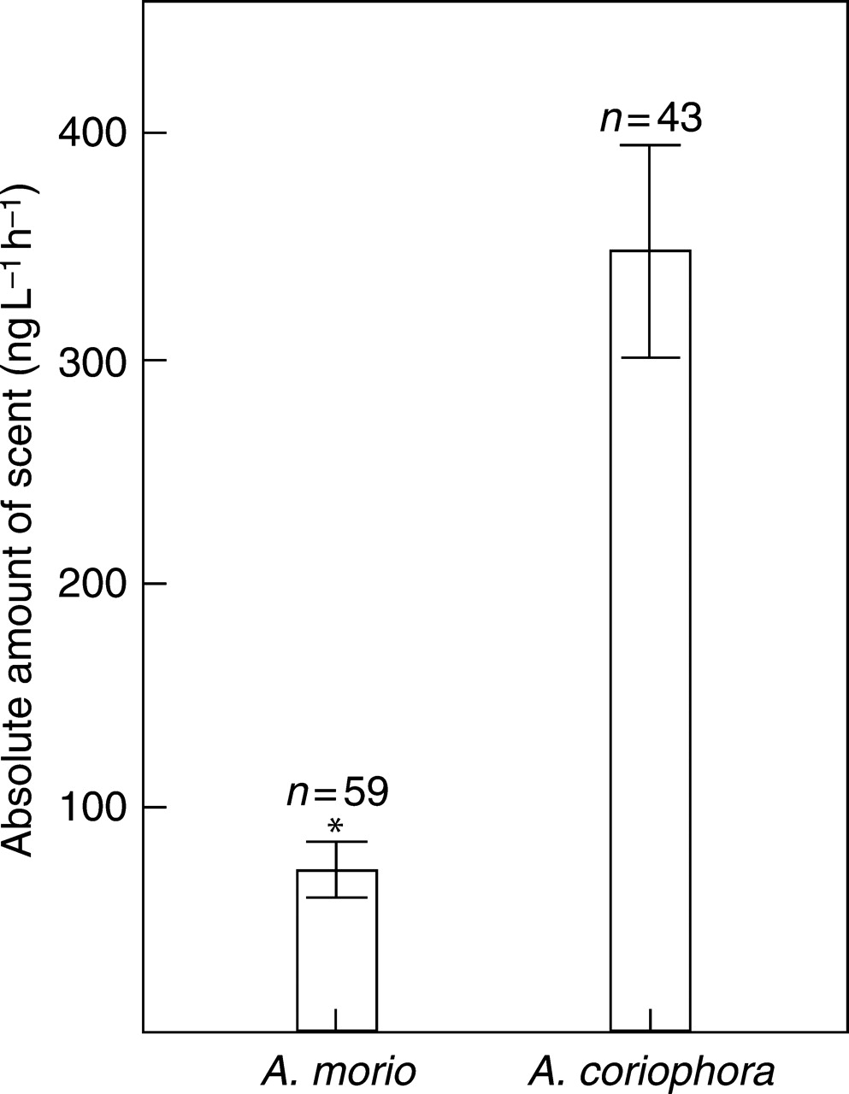
Fig. 1. Absolute amount of scent emitted by inflorescences of Anacamptis morio and A. coriophora Mann–Whitney U-test, ...
Notes:
Fig. 1. Absolute amount of scent emitted by inflorescences of Anacamptis morio and A. coriophora Mann–Whitney U-test, *P < 0·001. Bars show mean ± s.e.
Unless provided in the caption above, the following copyright applies to the content of this slide: © The Author 2007. Published by Oxford University Press on behalf of the Annals of Botany Company. All rights reserved. For Permissions, please email: journals.permissions@oxfordjournals.org

Slide 2
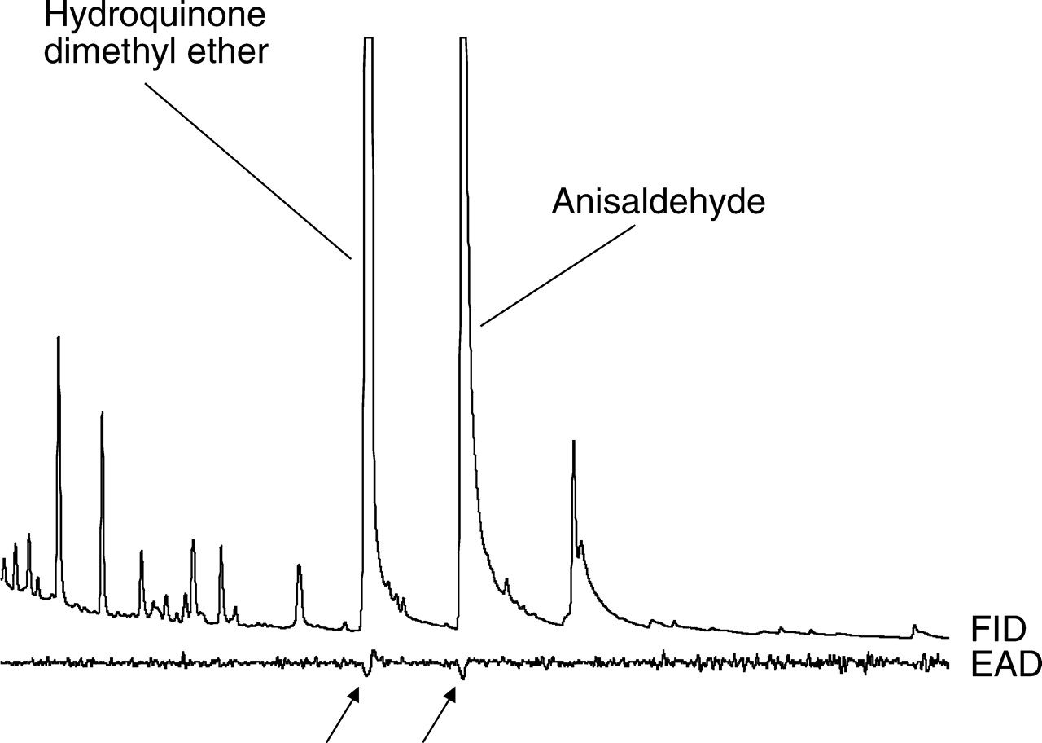
Fig. 2. Gas chromatographic analysis and electroantennographic detection (GC-EAD) of ten pooled headspace samples of ...
Notes:
Fig. 2. Gas chromatographic analysis and electroantennographic detection (GC-EAD) of ten pooled headspace samples of Anacamptis coriophora using an antenna of a Bombus terrestris queen. Two compounds, hydroquinone dimethyl ether and anisaldehyde, showed a consistent physiological response (arrows) in antennae of Bombus terrestris and Apis mellifera. FID: flame ionization detector trace from the gas chromatograph; EAD: electroantennographic detection trace from the antenna.
Unless provided in the caption above, the following copyright applies to the content of this slide: © The Author 2007. Published by Oxford University Press on behalf of the Annals of Botany Company. All rights reserved. For Permissions, please email: journals.permissions@oxfordjournals.org

Slide 3
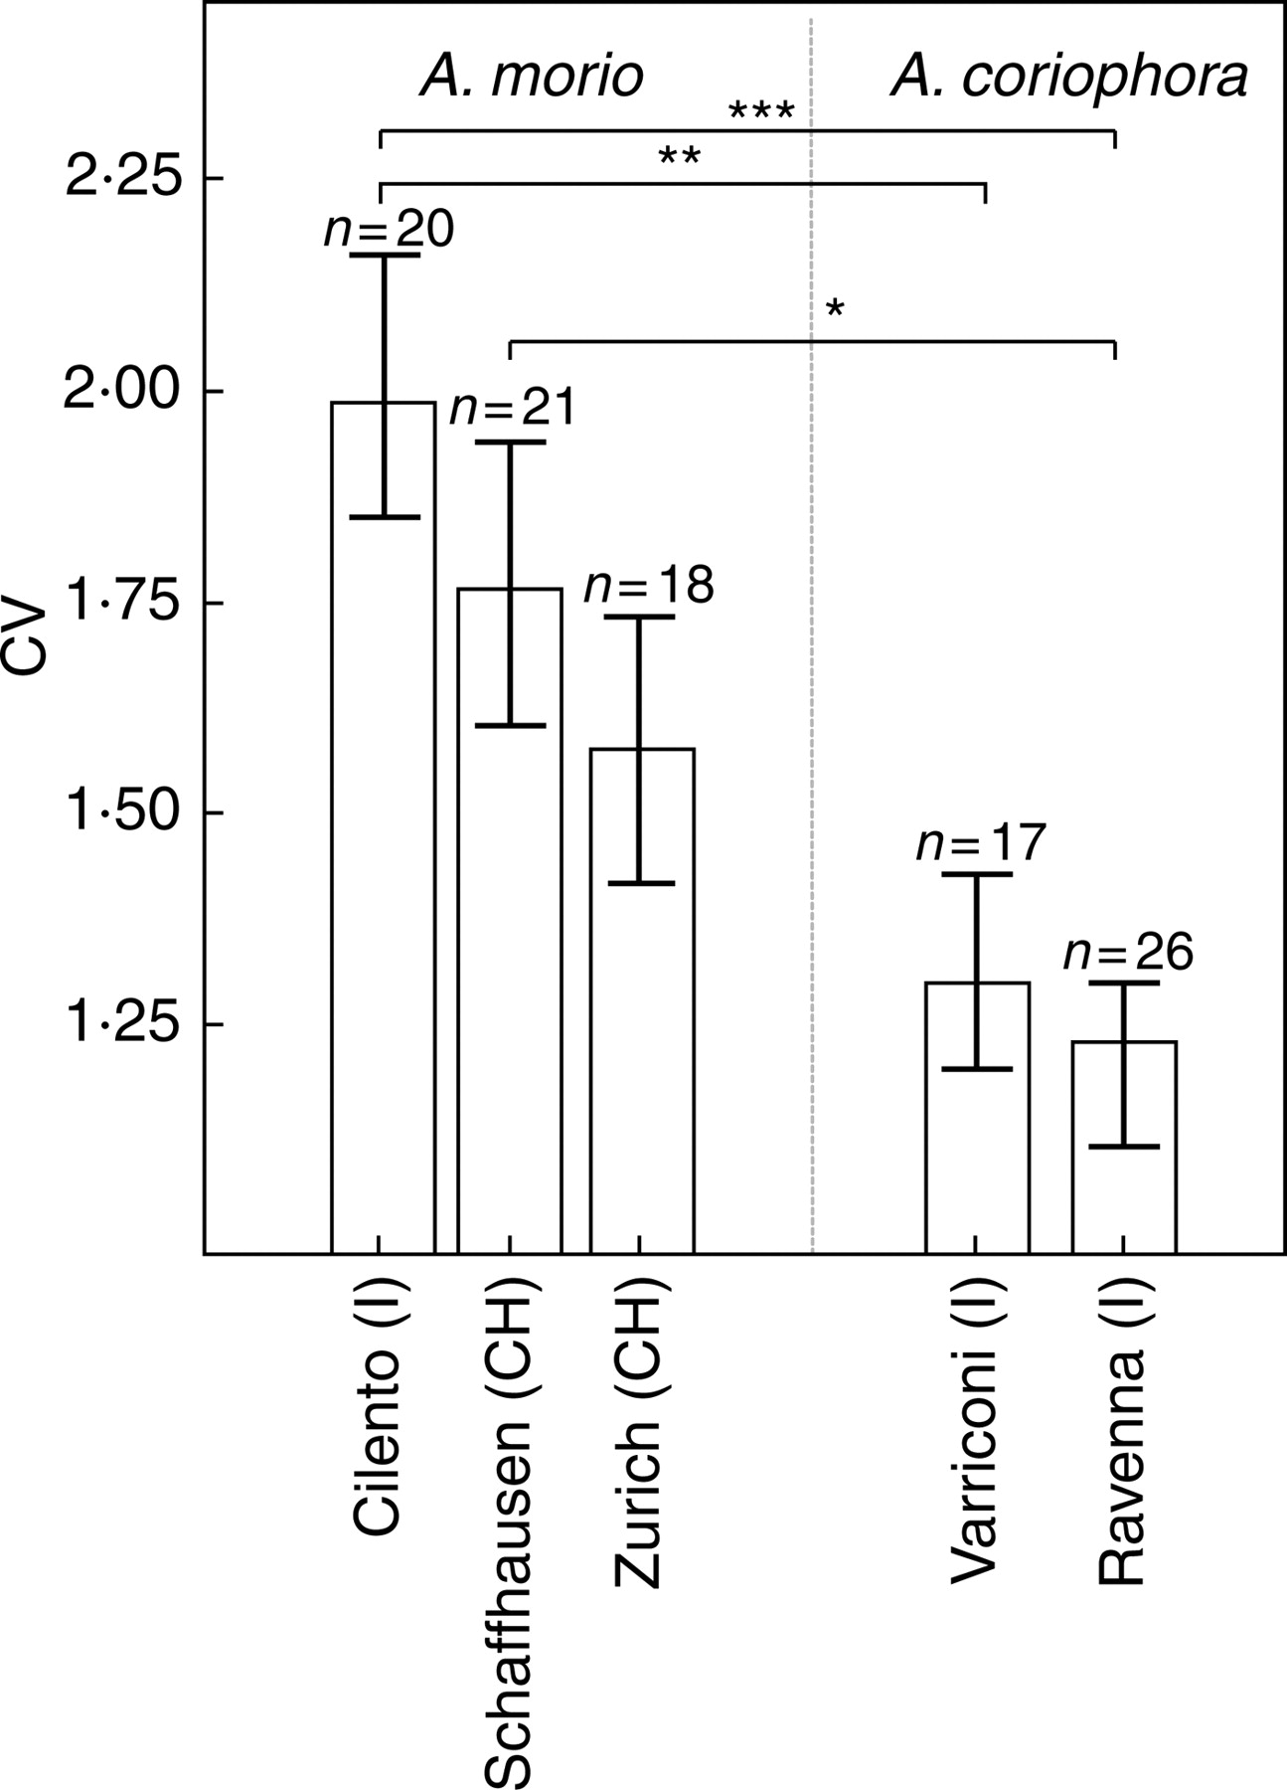
Fig. 3. Comparison of the coefficient of variance (CV = standard deviation/mean) between populations of Anacamptis ...
Notes:
Fig. 3. Comparison of the coefficient of variance (CV = standard deviation/mean) between populations of Anacamptis morio (‘Cilento’, ‘Schaffhausen’, ‘Zurich’) and A. coriophora (‘Varriconi’, ‘Ravenna’). Mann–Whitney U-test and subsequent Bonferroni correction, ***P < 0·001, **P < 0·01, *P < 0·05. Bars show mean ± s.e.
Unless provided in the caption above, the following copyright applies to the content of this slide: © The Author 2007. Published by Oxford University Press on behalf of the Annals of Botany Company. All rights reserved. For Permissions, please email: journals.permissions@oxfordjournals.org

Slide 4
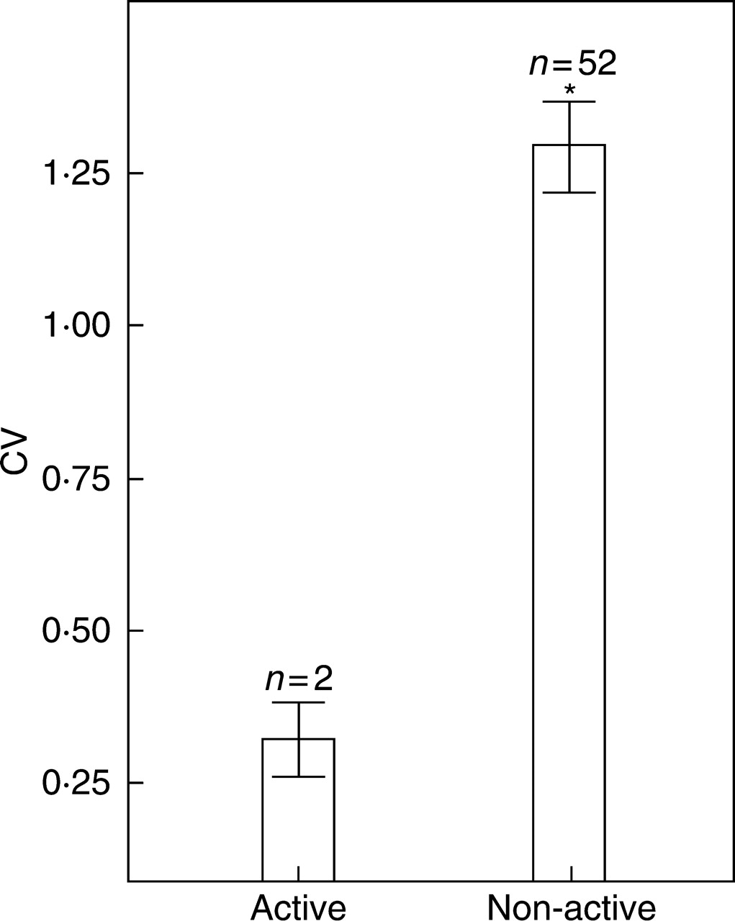
Fig. 4. Comparison of the coefficient of variance (CV = standard deviation/mean) between the physiologically active ...
Notes:
Fig. 4. Comparison of the coefficient of variance (CV = standard deviation/mean) between the physiologically active and non-active compounds in Anacamptis coriophora. Mann–Whitney U-test, *P < 0·001). Bars show mean ± s.e.
Unless provided in the caption above, the following copyright applies to the content of this slide: © The Author 2007. Published by Oxford University Press on behalf of the Annals of Botany Company. All rights reserved. For Permissions, please email: journals.permissions@oxfordjournals.org

Slide 5
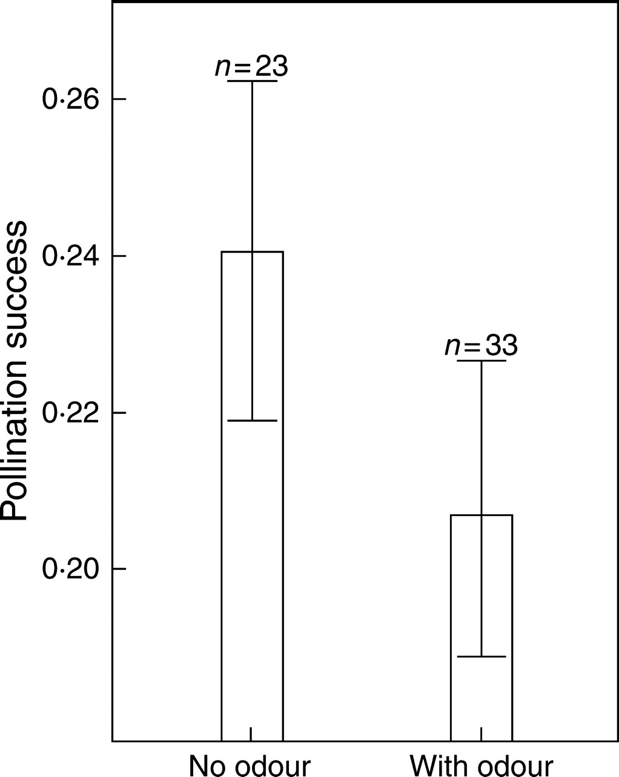
Fig. 5. Difference in pollination success (= sum of flowers pollinated or pollinia removed/total amount of flowers) ...
Notes:
Fig. 5. Difference in pollination success (= sum of flowers pollinated or pollinia removed/total amount of flowers) between untreated and odour-treated plants across all plots (ANOVA, F1,44 = 1·307, P = 0·259). Bars show mean ± s.e.
Unless provided in the caption above, the following copyright applies to the content of this slide: © The Author 2007. Published by Oxford University Press on behalf of the Annals of Botany Company. All rights reserved. For Permissions, please email: journals.permissions@oxfordjournals.org

