Slide 1
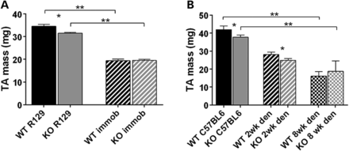
Figure 1. Reduced atrophy of muscle in Actn3 KO TA in response to immobilization and denervation. (A) At baseline, TA ...
Notes:
Figure 1. Reduced atrophy of muscle in Actn3 KO TA in response to immobilization and denervation. (A) At baseline, TA muscle mass is significantly reduced in Actn3 KO mice compared with WT. Following 2 weeks immobilization, there is a significant reduction in TA muscle mass in both WT and KO mice—however, the atrophied Actn3 KO immobilized muscles no longer weigh significantly less than WT immobilized. (B) TA mass is significantly reduced in both WT and Actn3 KO mice in response to 2 weeks of denervation. With a longer period of denervation (8 weeks), the atrophied Actn3 KO denervated muscles no longer weigh significantly less than denervated WT muscles.
Unless provided in the caption above, the following copyright applies to the content of this slide: © The Author 2013. Published by Oxford University Press. All rights reserved. For Permissions, please email: journals.permissions@oup.com

Slide 2
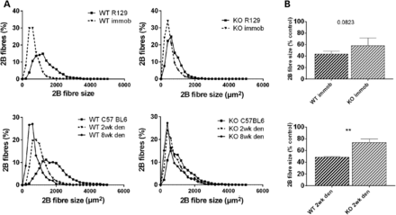
Figure 2. 2B fibre size in the TA muscle of immobilized and denervated WT and Actn3 KO mice. (A) Fibre size histograms; ...
Notes:
Figure 2. 2B fibre size in the TA muscle of immobilized and denervated WT and Actn3 KO mice. (A) Fibre size histograms; 2B fibre size distribution curve of WT mice is shifted to the left in response to both immobilization and denervation. The Actn3 KO 2B fibre size curve does not shift to the same extent. (B) 2B fibre size expressed as a percentage (%) of fibre size in control WT and Actn3 KO mice. Following immobilization and 2 weeks denervation. Actn3 KO fast fibres undergo less atrophy compared to WT. In each group n = 5–7. **P < 0.01.
Unless provided in the caption above, the following copyright applies to the content of this slide: © The Author 2013. Published by Oxford University Press. All rights reserved. For Permissions, please email: journals.permissions@oup.com

Slide 3
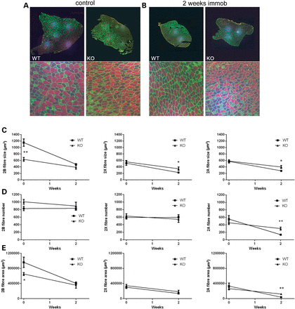
Figure 3. Muscle fibre analysis in response to immobilization shows altered adaptation in Actn3 KO mouse muscle. (A) ...
Notes:
Figure 3. Muscle fibre analysis in response to immobilization shows altered adaptation in Actn3 KO mouse muscle. (A) Whole TA muscle cross-sections from WT and Actn3 KO controls were immunostained with dystrophin (to demonstrate the sarcolemma) and MyHC (fibre type) for quantitation. Images are representative cross-section images—dystrophin is stained green, type 2B fibres (red), 2A (green) and type 1 (blue). (B) Whole TA muscle cross-sections from immobilized WT and Actn3 KO mice were similarly stained, measured and counted. (C) Fibre size in controls and immobilized groups from left to right (2B, 2X, 2A). (D) Fibre number. (E) Fibre area. Significant results using the Mann–Whitney-U t-test to compare WT vs. KO groups have been marked; *P < 0.05, **P < 0.001.
Unless provided in the caption above, the following copyright applies to the content of this slide: © The Author 2013. Published by Oxford University Press. All rights reserved. For Permissions, please email: journals.permissions@oup.com

Slide 4
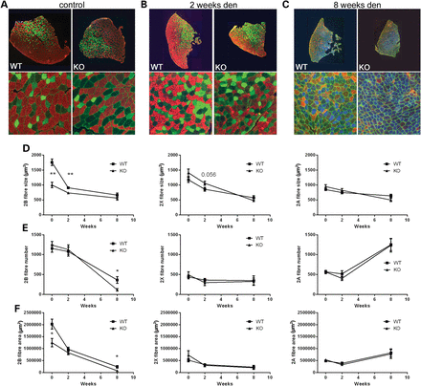
Figure 4. Muscle fibre analysis in response to denervation shows altered adaptation in Actn3 KO mouse. (A) WT and Actn3 ...
Notes:
Figure 4. Muscle fibre analysis in response to denervation shows altered adaptation in Actn3 KO mouse. (A) WT and Actn3 KO TA muscle cross-sections are mostly made up of fast fibres (in order of prevalence) 2B (red), 2X (unstained), 2A (green) with no detectable type 1 fibres (blue). Sarcolemma is stained with dystrophin (green). (B) In response to 2 weeks denervation, the TA muscle cross-sectional area and fibre size are smaller compared with controls but overall fast fibres predominance is maintained. (C) With 8 weeks denervation, the muscle cross-sectional area is smaller, fibres have atrophied and there is significant changes in fibre-type proportion, with greatest frequency of 2A fibres (labelled blue), followed by 2X (unstained) and type 1 (green). (D) Total cross-sectional area of each fibre type (2B, 2X, 2A) in control and denervated groups. (E) Percentage cross-sectional area of each fibre type (2B, 2X, 2A) in control and denervated groups. (F) Surface area of each fibre type (2B, 2X, 2A) in control and denervated groups.
Unless provided in the caption above, the following copyright applies to the content of this slide: © The Author 2013. Published by Oxford University Press. All rights reserved. For Permissions, please email: journals.permissions@oup.com

Slide 5
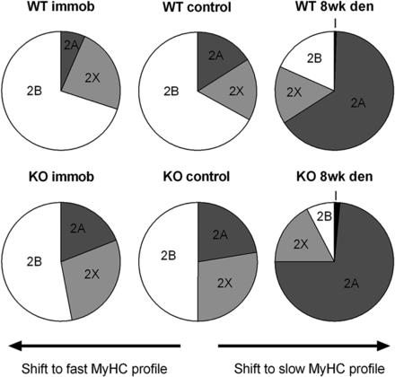
Figure 5. Summary of muscle adaptation response to immobilization and denervation. Muscle fibre-type CSA of MyHC 2B, 2X ...
Notes:
Figure 5. Summary of muscle adaptation response to immobilization and denervation. Muscle fibre-type CSA of MyHC 2B, 2X and 2A (%) is shown for immobilized, controls and denervated groups of WT and Actn3 KO mice. Immobilization results in an adaptive shift in fibre type towards a fast MyHC profile in WT mice and this shift is less pronounced in Actn3 KO mice. Denervation results in an adaptive shift in fibre type towards a slow MyHC profile and this shift is more pronounced in Actn3 KO mice.
Unless provided in the caption above, the following copyright applies to the content of this slide: © The Author 2013. Published by Oxford University Press. All rights reserved. For Permissions, please email: journals.permissions@oup.com

Slide 6
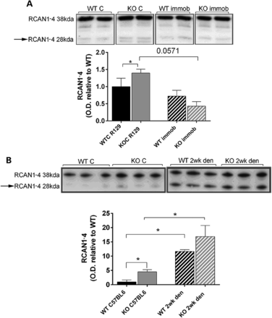
Figure 6. Regulator of calcineurin (RCAN1) response to immobilization and denervation in WT and Actn3 KO mice. (A) ...
Notes:
Figure 6. Regulator of calcineurin (RCAN1) response to immobilization and denervation in WT and Actn3 KO mice. (A) Western blot analysis (top) and densitometry quantification of the endogenous calcineurin-responsive 28 kDa RCAN1-4 isoform that reflects calcineurin activity. At baseline, RCAN1-4 is increased in Actn3 KO mice compared with WT. Following immobilization, there is a reduction in RCAN1-4 in Actn3 KO mouse muscle with no significant difference compared with WT mouse muscle. (B) Western blot analysis and quantification of RCAN1-4 at baseline and following denervation. Denervated mouse muscle shows a marked increase in the levels of RCAN1-4 after 2 weeks denervation in both WT and Actn3 KO mice.
Unless provided in the caption above, the following copyright applies to the content of this slide: © The Author 2013. Published by Oxford University Press. All rights reserved. For Permissions, please email: journals.permissions@oup.com

Slide 7
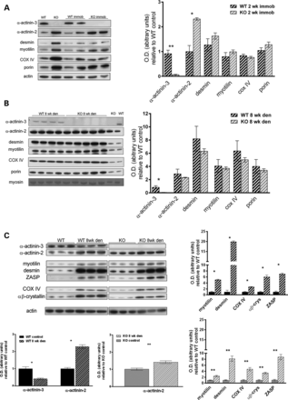
Figure 7. Structural and metabolic response to atrophy in WT and KO mice. (A) Western blot analysis (top) and ...
Notes:
Figure 7. Structural and metabolic response to atrophy in WT and KO mice. (A) Western blot analysis (top) and densitometry quantification of proteins in WT and Actn3 KO muscle following immobilization. As previously shown, at baseline, α-actinin-2, the structural proteins desmin and myotilin, and the mitochondrial proteins cytochrome oxidase and porin are increased in Actn3 KO mice compared with WT. Following immobilization, α-actinin-2 remains significantly increased compared with WT, but the structural and mitochondrial proteins are decreased in the Actn3 KO and are not significantly different to WT. (B) Western blot analysis and densitometry quantification of proteins in WT and Actn3 KO muscle following 8 weeks denervation. α-Actinin-2, the structural proteins desmin and myotilin, and the mitochondrial proteins, cytochrome oxidase and porin are all up-regulated well above baseline values in both WT and Actn3 KO mice, with no significant differences between genotype. (C) In response to 8 weeks denervation, there were significant protein changes in compared with genotype controls. Reduced fold changes were detected in Actn3 KO muscle in α-actinin-2, desmin, myotilin and αB-crystallin compared with WT mice.
Unless provided in the caption above, the following copyright applies to the content of this slide: © The Author 2013. Published by Oxford University Press. All rights reserved. For Permissions, please email: journals.permissions@oup.com

