Slide 1
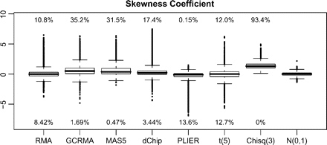
Fig. 1. Skewness box plots. The percentage of genes greater than (smaller than) the 99% (1%) of the empirical normal ...
Notes:
Fig. 1. Skewness box plots. The percentage of genes greater than (smaller than) the 99% (1%) of the empirical normal is written above (below) each nonnormal box plot. PLIER produces more genes which are skewed left while the other transformations seem to produce more skewed right genes.
Unless provided in the caption above, the following copyright applies to the content of this slide: © The Author 2009. Published by Oxford University Press. All rights reserved. For permissions, please e-mail: journals.permissions@oxfordjournals.org.

Slide 2
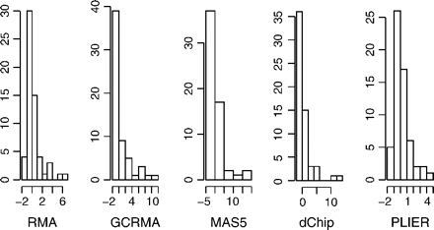
Fig. 2. Nonnormal gene. As an example of a gene that is not consistent with normality under any of the 5 ...
Notes:
Fig. 2. Nonnormal gene. As an example of a gene that is not consistent with normality under any of the 5 transformations, we give the empirical distributions for the same gene under each of the transformations.
Unless provided in the caption above, the following copyright applies to the content of this slide: © The Author 2009. Published by Oxford University Press. All rights reserved. For permissions, please e-mail: journals.permissions@oxfordjournals.org.

