Slide 1
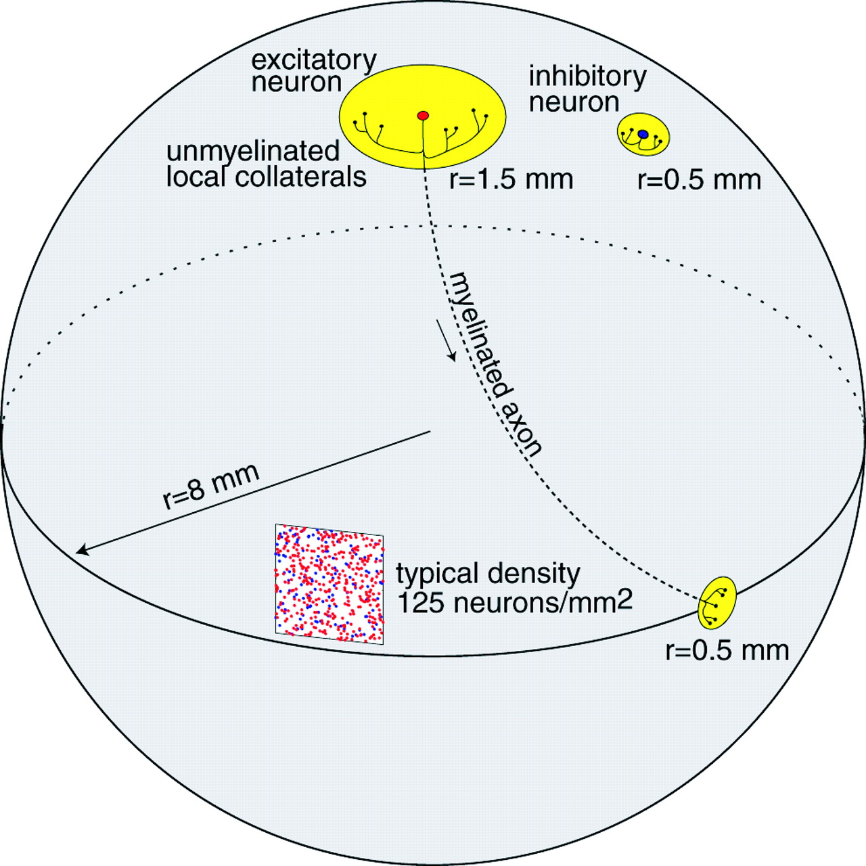
Figure 1. Summary of the gross properties of anatomical connections in the model. 80 000 excitatory neurons ...
Notes:
Figure 1. Summary of the gross properties of anatomical connections in the model. 80 000 excitatory neurons (red) and 20 000 inhibitory neurons (blue) are randomly distributed on a surface of a sphere of radius 8 mm. The total number of excitatory synaptic connections is 8 000 000 and of inhibitory synaptic connections is 500 000.
Unless provided in the caption above, the following copyright applies to the content of this slide:

Slide 2
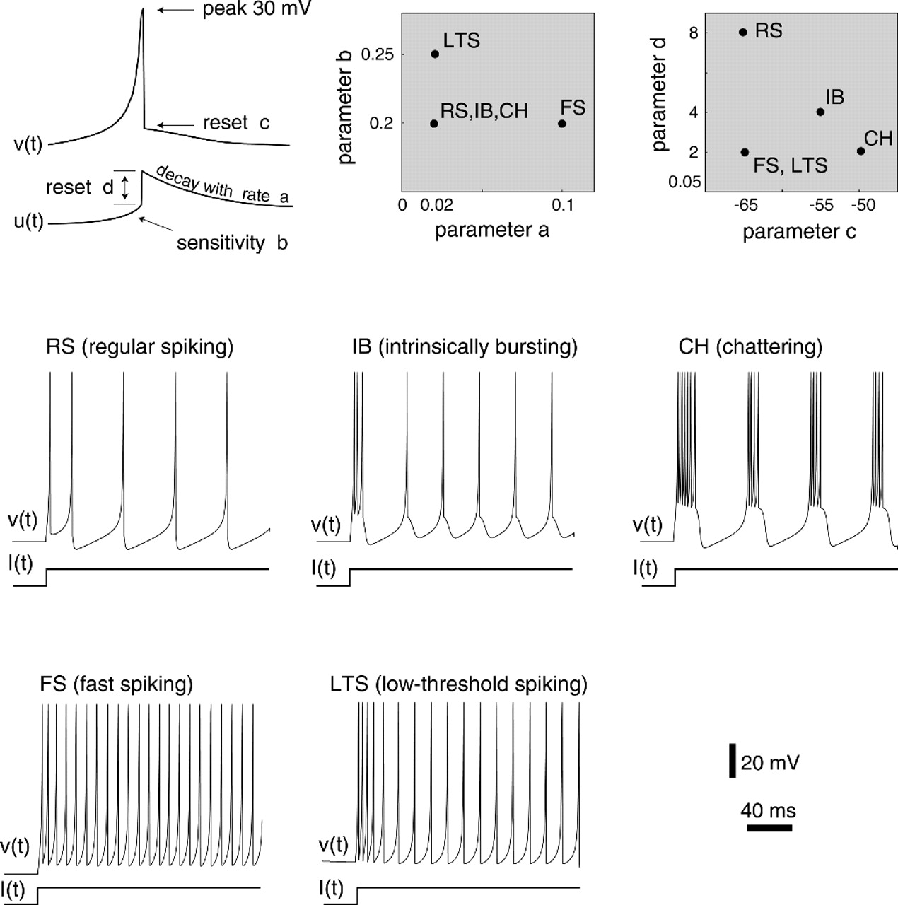
Figure 2. Top left: Graphical illustration of the meaning of the parameters a, b, c, d in the model ...
Notes:
Figure 2. Top left: Graphical illustration of the meaning of the parameters a, b, c, d in the model (equations 1 and 2). Top right: Different values of the parameters depicted in yellow squares result in firing patterns (lower part) that correspond to known types found in neocortical neurons. Excitatory neurons: RS, IB, CH. Inhibitory interneurons: FS and LTS.
Unless provided in the caption above, the following copyright applies to the content of this slide:

Slide 3
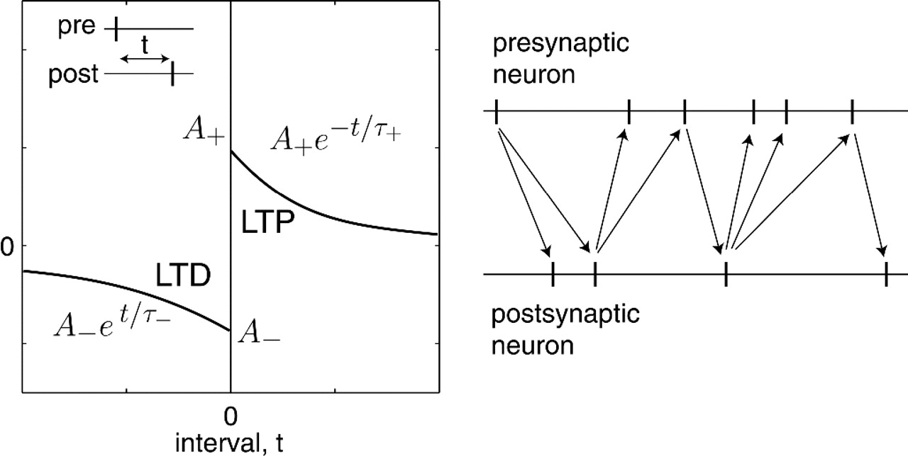
Figure 3. Spike-timing-dependent-plasticity (STDP) with parameters A₊ = 0.004, A– = ...
Notes:
Figure 3. Spike-timing-dependent-plasticity (STDP) with parameters A+ = 0.004, A– = 0.004, τ+ = 15 ms and τ– = 20 ms. Only spike pairs connected by arrows (right) contribute to plasticity. If the postsynaptic neuron fires after the presynaptic neuron (downward arrow, t > 0), the synapse is potentiated. The reverse order of firing (upward arrow, t < 0) results in depression.
Unless provided in the caption above, the following copyright applies to the content of this slide:

Slide 4
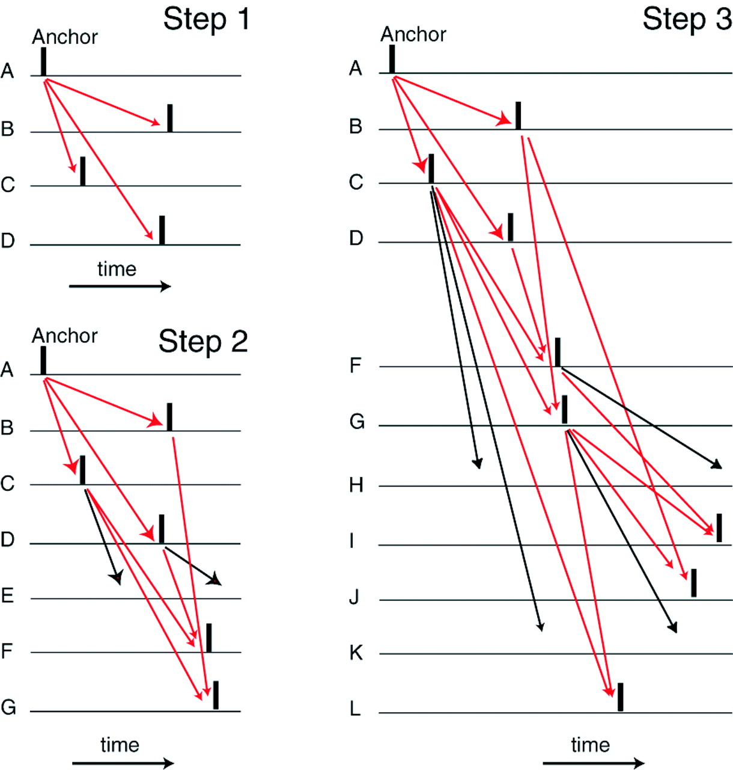
Figure 4. Identification of neuronal groups. Step 1: Find an excitatory anchor neuron A having two or more ...
Notes:
Figure 4. Identification of neuronal groups. Step 1: Find an excitatory anchor neuron A having two or more strong connections to other excitatory neurons (B, C, D). Black vertical bars indicate spike occurrence. Step 2: Determine common postsynaptic targets of B, C and D, which here are E, F and G. Those targets that have matching or convergent delays (shown by red arrows) resulting in the superthreshold input, i.e. F and G, are in the group. The remaining target having non-matching delays (black arrows), i.e. E, is not in the group. Step 3 is similar to step 2: Determine common postsynaptic targets of B, C, D, F and G, which are H–L. Those targets that have matching delays and superthreshold input, i.e. I, J, L, are part of the group. The rest, i.e. H and K, are not. Repeat this step until no more common targets with matching delays are found.
Unless provided in the caption above, the following copyright applies to the content of this slide:

Slide 5
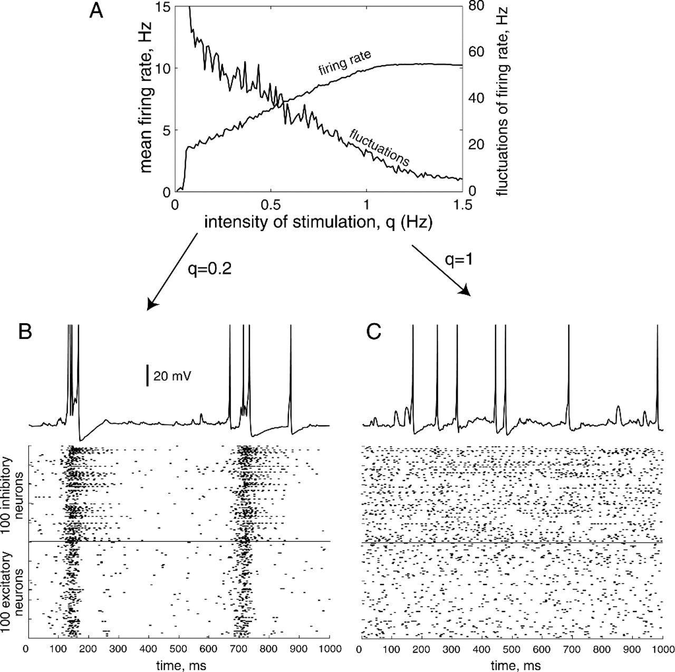
Figure 5. (A) Mean firing rate of excitatory neurons and its fluctuation as a function of the Poissonian ...
Notes:
Figure 5. (A) Mean firing rate of excitatory neurons and its fluctuation as a function of the Poissonian drive with rate q. In (B) and (C), the membrane potential of a typical neuron and spike raster of randomly selected 100 excitatory and 100 inhibitory neurons are displayed. Two regimes of activity of the network are shown: synchronized bursting (B) and asynchronous firing (C).
Unless provided in the caption above, the following copyright applies to the content of this slide:

Slide 6
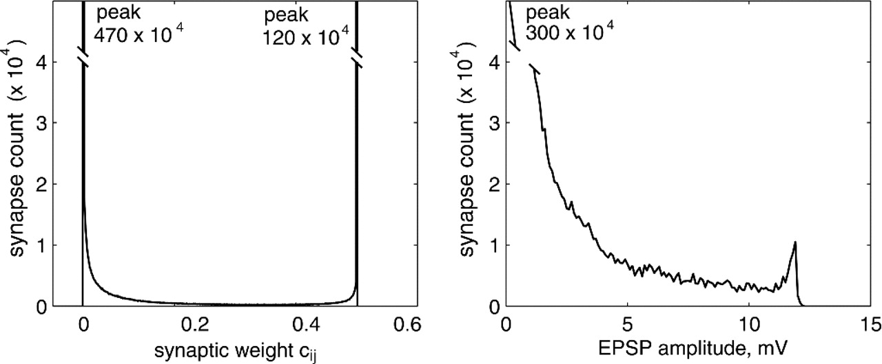
Figure 6. Left: Distribution of steady-state excitatory → excitatory synaptic weights c_{ij} for all ...
Notes:
Figure 6. Left: Distribution of steady-state excitatory → excitatory synaptic weights cij for all i and j. Right: Distribution of corresponding EPSP amplitudes, i.e. transient deviations of post-synaptic membrane potentials in response to firings of pre-synaptic cells. The total number of excitatory synapses in the model was 800 × 104.
Unless provided in the caption above, the following copyright applies to the content of this slide:

Slide 7
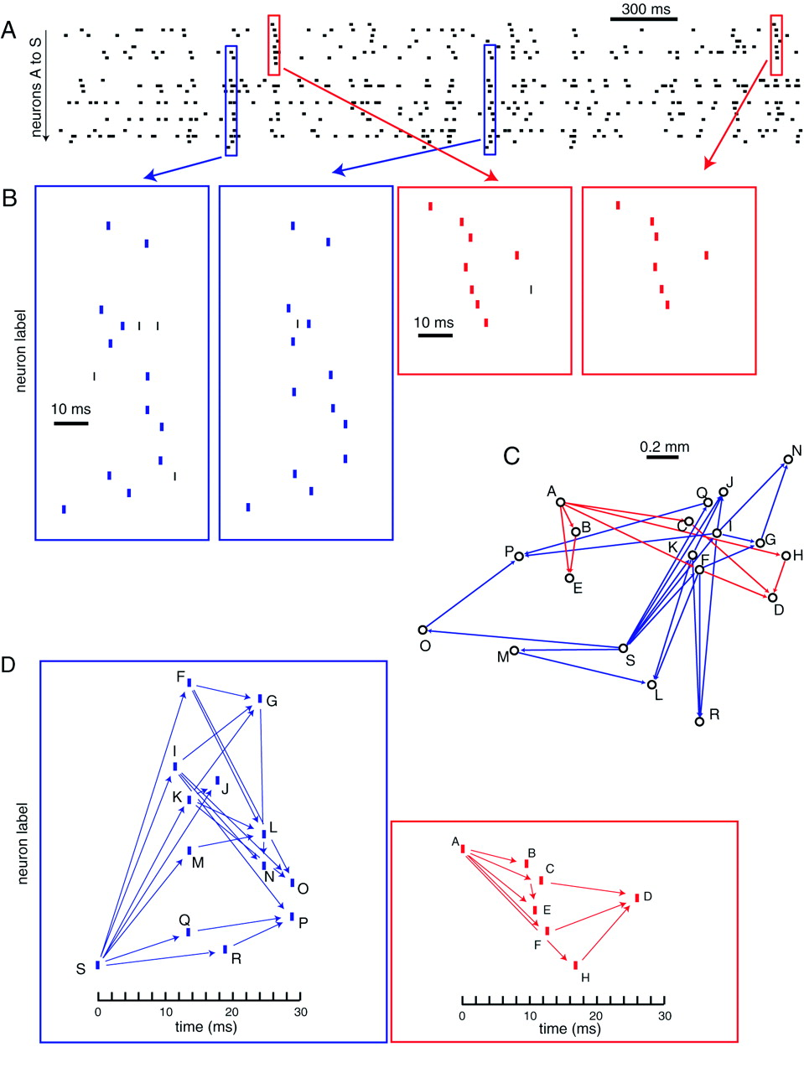
Figure 7. Spike timing in neuronal groups. The spike raster diagram (A) depicts the firing patterns of 19 ...
Notes:
Figure 7. Spike timing in neuronal groups. The spike raster diagram (A) depicts the firing patterns of 19 excitatory neurons during a 3 s period that included repeated firing patterns characteristic of two neuronal groups that had self-organized in the simulation. These patterns are enlarged in (B) to demonstrate the temporal precision of spike occurrence (vertical bars). The spatial arrangement and strong synaptic connections among these neurons is diagramed in (C). D illustrates the connectivity and synaptic delays that gave rise to these spike patterns.
Unless provided in the caption above, the following copyright applies to the content of this slide:

Slide 8
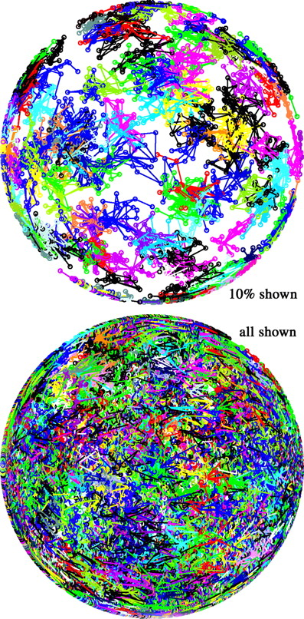
Figure 8. Distribution of groups on the simulated ‘cortical’ surface. Neurons within each group are marked by ...
Notes:
Figure 8. Distribution of groups on the simulated ‘cortical’ surface. Neurons within each group are marked by the same color.
Unless provided in the caption above, the following copyright applies to the content of this slide:

Slide 9
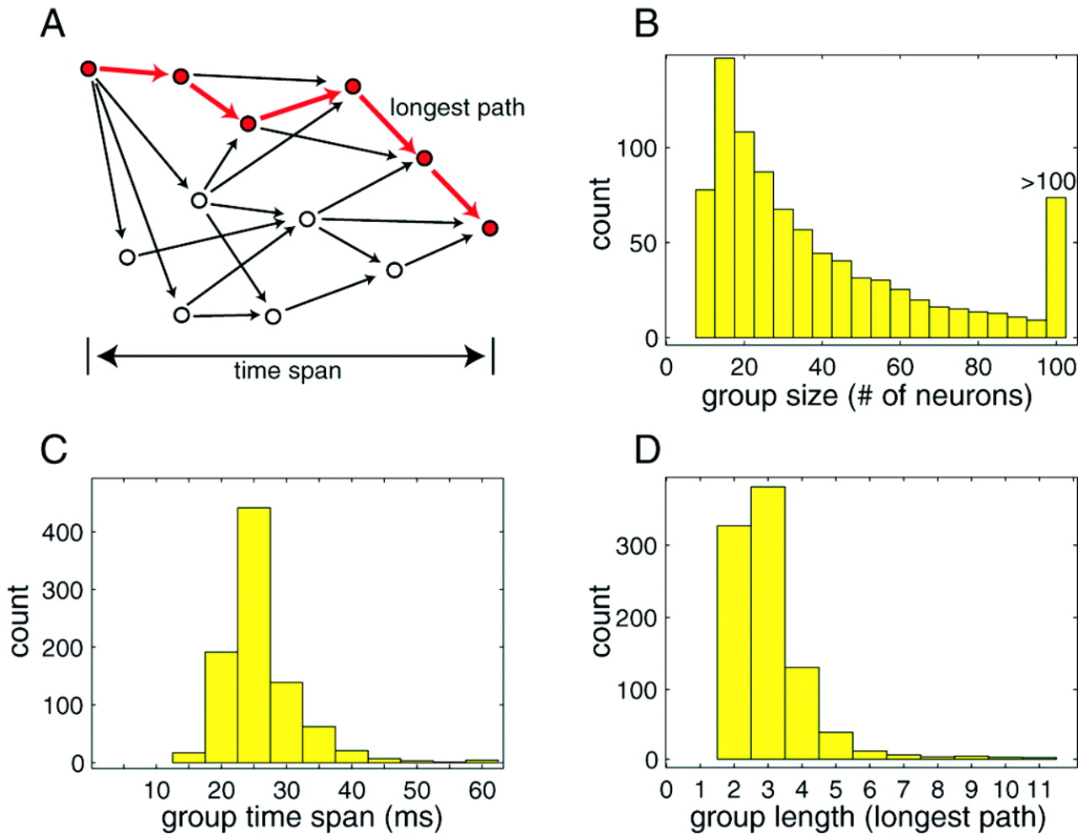
Figure 9. Steady-state size distribution of neuronal groups characteristics. (A) Representation of a neuronal ...
Notes:
Figure 9. Steady-state size distribution of neuronal groups characteristics. (A) Representation of a neuronal group as a space-time graph similar to the one in Figure 7D. (B) Group size is the number of neurons comprising the group. (C) Group time span is defined as the time interval between firing of the first (anchor) and the last neuron in the group. (D) Group length is defined as the length of the longest path in the group.
Unless provided in the caption above, the following copyright applies to the content of this slide:

Slide 10
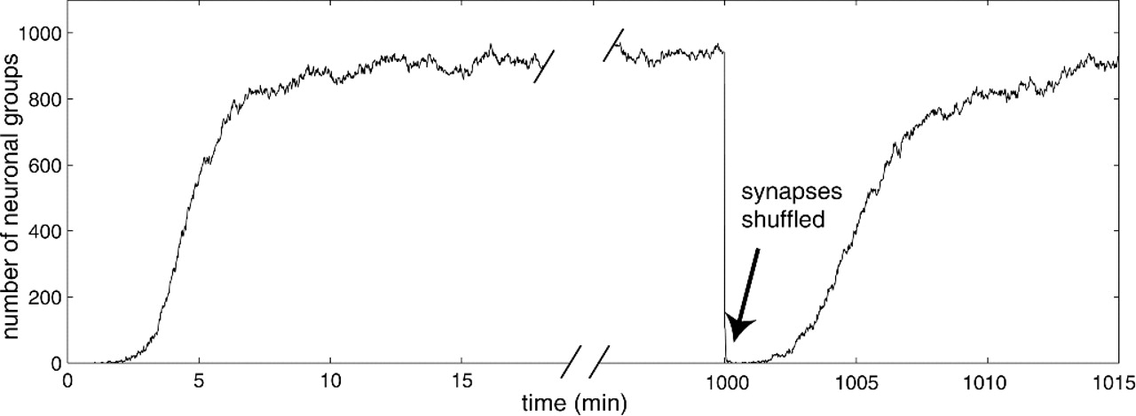
Figure 10. The number of neuronal groups in the model as a function of time. At time 1000 min, all synaptic ...
Notes:
Figure 10. The number of neuronal groups in the model as a function of time. At time 1000 min, all synaptic weights were randomly shuffled.
Unless provided in the caption above, the following copyright applies to the content of this slide:

Slide 11
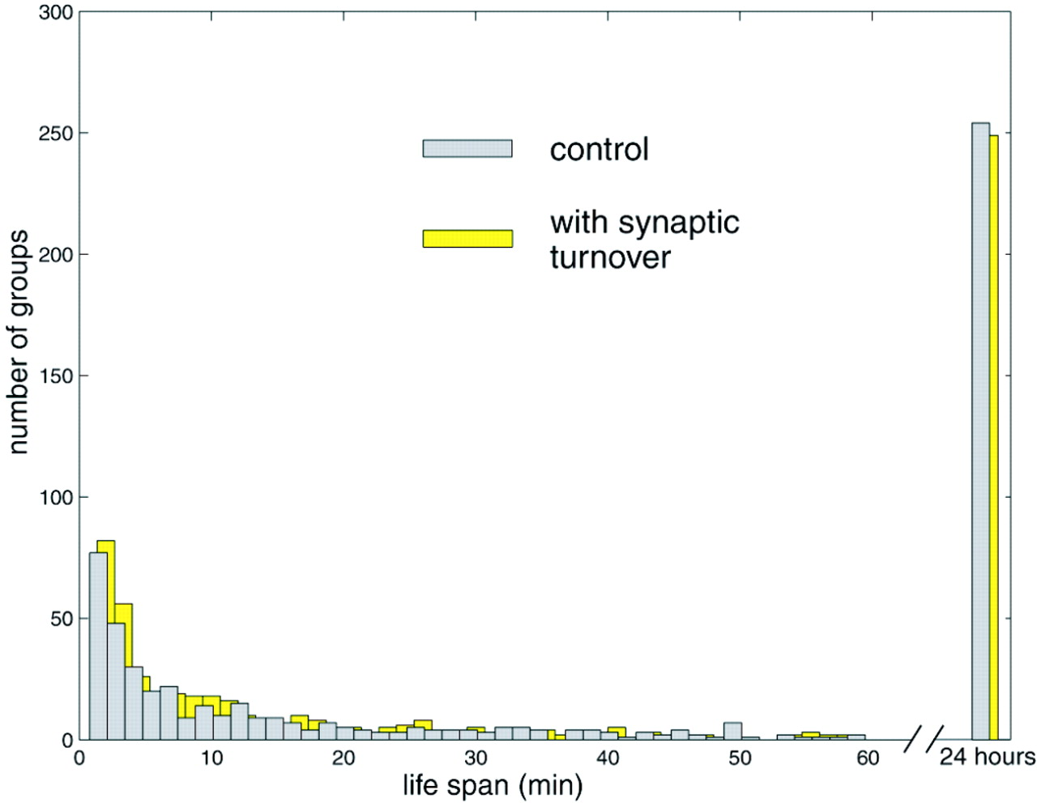
Figure 11. Distribution of lifespans of neuronal groups. The existence of each group was monitored during a ...
Notes:
Figure 11. Distribution of lifespans of neuronal groups. The existence of each group was monitored during a 24 h simulation of the model under normal conditions (control) or in the presence of recurrent synaptic turnover (see text).
Unless provided in the caption above, the following copyright applies to the content of this slide:

Slide 12
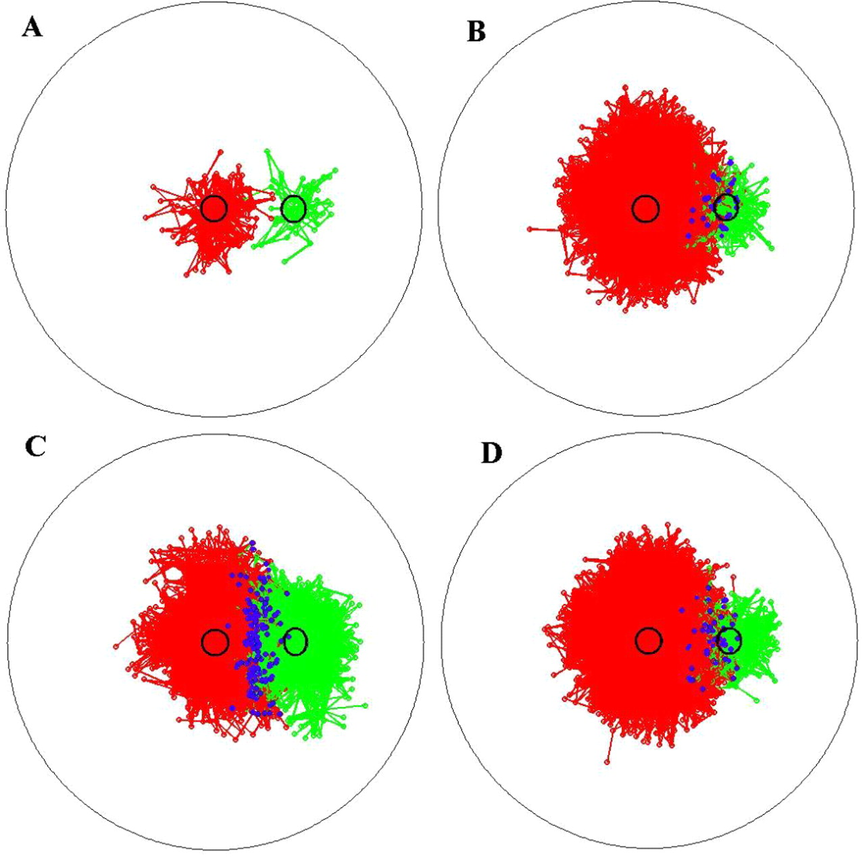
Figure 12. Change of projective fields due to continuous coherent stimulation of neurons inside the black ...
Notes:
Figure 12. Change of projective fields due to continuous coherent stimulation of neurons inside the black circles. Before stimulation (A) the projective fields, consisting of neuronal groups originating from the circles, are relatively small. Five minutes of repetitive 2 Hz superthreshold stimulation are applied only to the left circle (B), to both circles synchronously (C) or to both circles asynchronously (D). Blue dots denote neurons shared by the projective fields.
Unless provided in the caption above, the following copyright applies to the content of this slide:

Slide 13
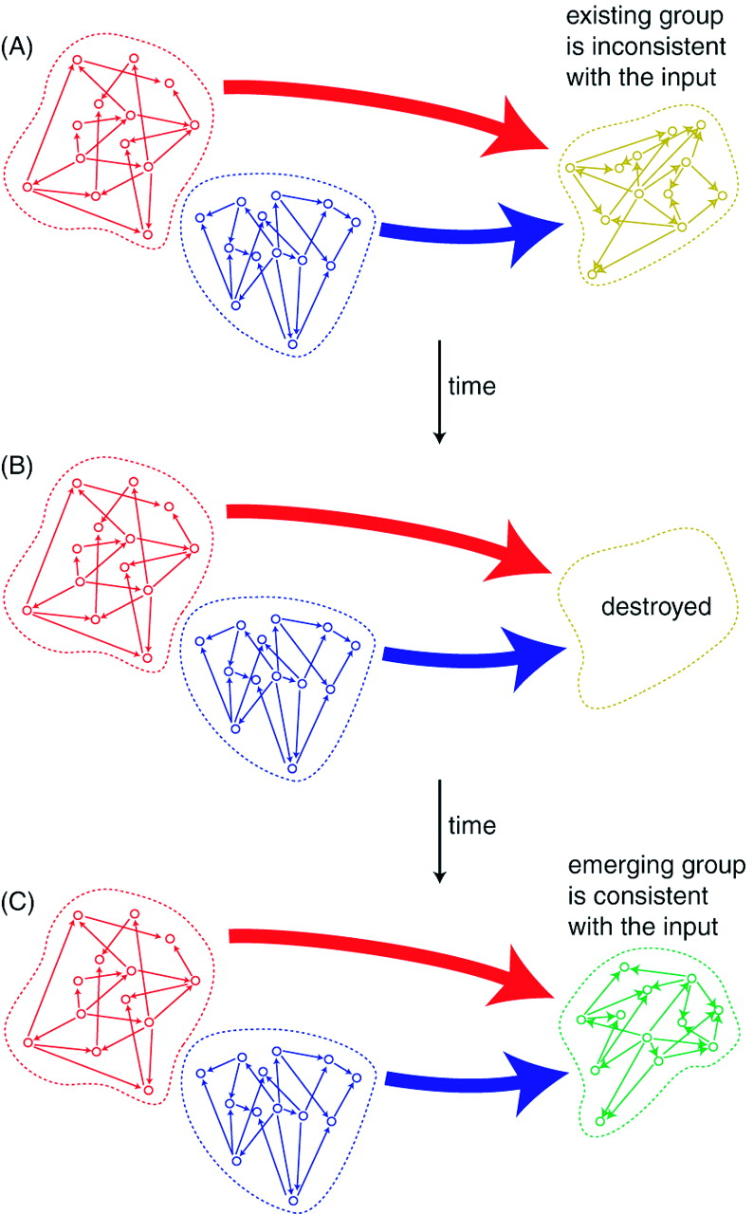
Figure 13. Competition and cooperation between groups. (A) Simultaneous or time-locked coactivation of red ...
Notes:
Figure 13. Competition and cooperation between groups. (A) Simultaneous or time-locked coactivation of red and blue neuronal groups project input to the yellow group and make neurons fire in an order inconsistent with its intrinsic synaptic organization. (B) As a result of STDP, the yellow neuronal group is destroyed. (C) Coactivation of the red and blue groups promotes birth of a green neuronal group whose synaptic organization is consistent with the pattern of spatiotemporal input coming from both groups.
Unless provided in the caption above, the following copyright applies to the content of this slide:

