Slide 1
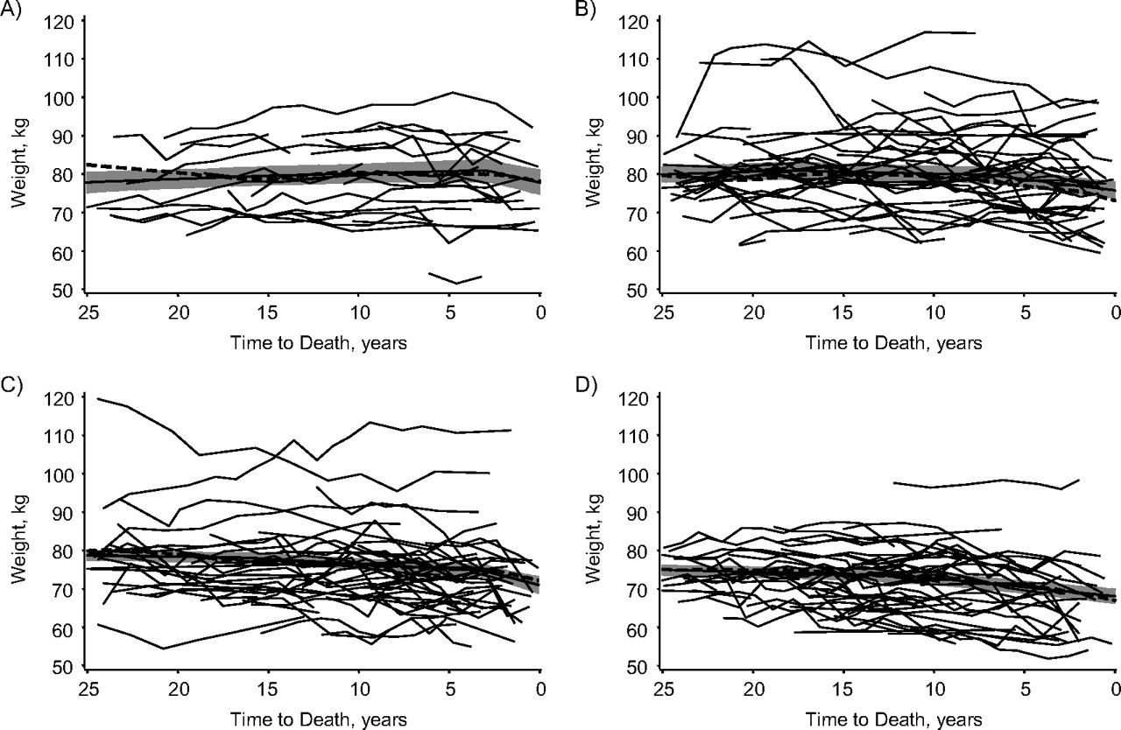
Figure 1. Weight (in kilograms) by time to death for male decedents from the Baltimore Longitudinal Study of Aging, ...
Notes:
Figure 1. Weight (in kilograms) by time to death for male decedents from the Baltimore Longitudinal Study of Aging, Maryland, 1958–2005. Thin solid lines: weight by time to death for a randomly selected male decedent; thick dashed lines: mean weight by time to death for all male decedents (N = 800); thick solid lines: predicted mean weight from model 5 (refer to the Statistical Analysis portion of the text) with 95% confidence interval (shaded region). Participants who died at A) age 60–69 years, B) age 70–79 years, C) age 80–89 years, D) age ≥90 years.
Unless provided in the caption above, the following copyright applies to the content of this slide: American Journal of Epidemiology © The Author 2010. Published by Oxford University Press on behalf of the Johns Hopkins Bloomberg School of Public Health. All rights reserved. For permissions, please e-mail: journals.permissions@oxfordjournals.org.

Slide 2
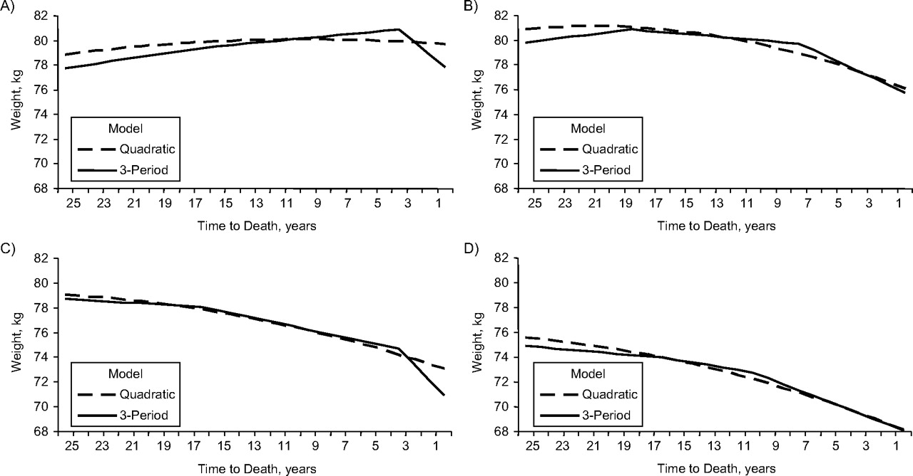
Figure 2. Predicted weight (in kilograms) by time to death and age at death for male decedents from the Baltimore ...
Notes:
Figure 2. Predicted weight (in kilograms) by time to death and age at death for male decedents from the Baltimore Longitudinal Study of Aging, Maryland, 1958–2005. Participants who died at A) age 60–69 years (n = 87), B) age 70–79 years (n = 211), C) age 80–89 years (n = 320), D) age ≥90 years (n = 182). Refer to the Statistical Analysis portion of the text for a description of the models.
Unless provided in the caption above, the following copyright applies to the content of this slide: American Journal of Epidemiology © The Author 2010. Published by Oxford University Press on behalf of the Johns Hopkins Bloomberg School of Public Health. All rights reserved. For permissions, please e-mail: journals.permissions@oxfordjournals.org.

Slide 3
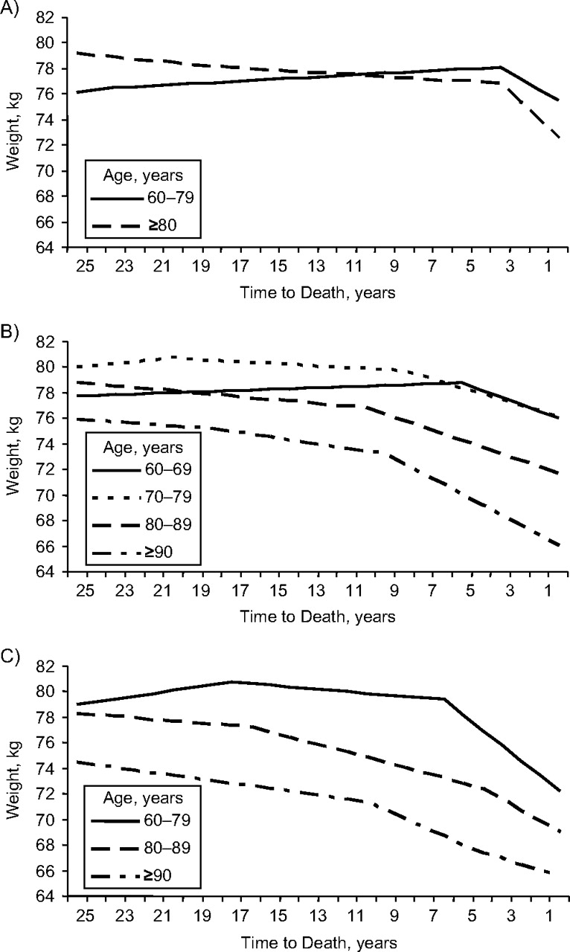
Figure 3. Predicted weight (in kilograms) by time to death, age at death, and cause of death for male decedents from ...
Notes:
Figure 3. Predicted weight (in kilograms) by time to death, age at death, and cause of death for male decedents from the Baltimore Longitudinal Study of Aging, Maryland, 1958–2005. Shown are A) cancer deaths (n = 143), B) cardiovascular disease deaths (n = 349), C) other deaths (n = 211).
Unless provided in the caption above, the following copyright applies to the content of this slide: American Journal of Epidemiology © The Author 2010. Published by Oxford University Press on behalf of the Johns Hopkins Bloomberg School of Public Health. All rights reserved. For permissions, please e-mail: journals.permissions@oxfordjournals.org.

