Slide 1
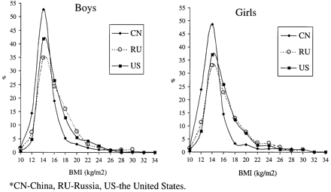
Figure 1 Body mass index (BMI) distribution among children (6–9 years) in the US, Russia and China: by sex
Notes:
Figure 1 Body mass index (BMI) distribution among children (6–9 years) in the US, Russia and China: by sex
Unless provided in the caption above, the following copyright applies to the content of this slide: © International Epidemiological Association 2001

Slide 2
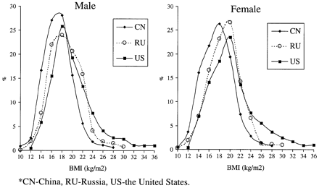
Figure 2 Body mass index (BMI) distribution among adolescents (10–18 years) in the US, Russia and China: by sex
Notes:
Figure 2 Body mass index (BMI) distribution among adolescents (10–18 years) in the US, Russia and China: by sex
Unless provided in the caption above, the following copyright applies to the content of this slide: © International Epidemiological Association 2001

Slide 3
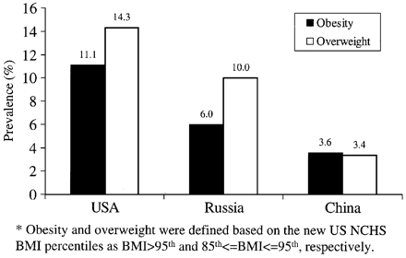
Figure 3 Overall prevalence of obesity and overweight in the US, Russia and China
Notes:
Figure 3 Overall prevalence of obesity and overweight in the US, Russia and China
Unless provided in the caption above, the following copyright applies to the content of this slide: © International Epidemiological Association 2001

