Slide 1
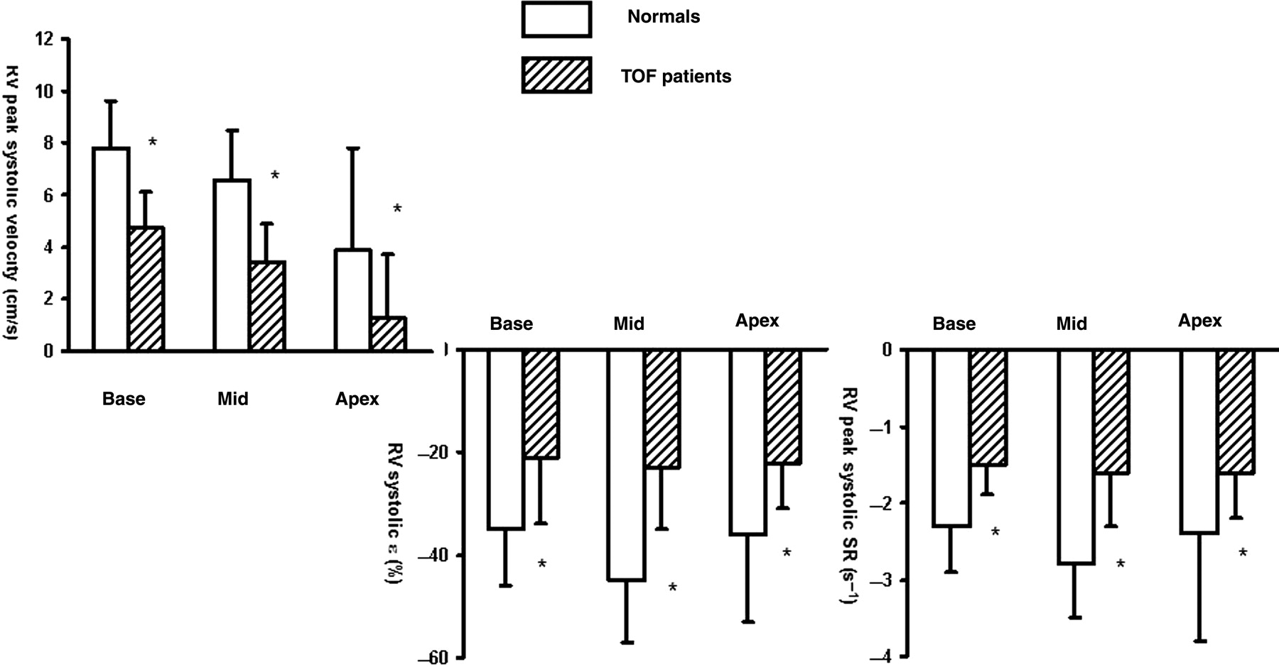
Figure 1 Longitudinal peak systolic velocities, peak systolic SR, and systolic ε of the right ventricular free wall ...
Notes:
Figure 1 Longitudinal peak systolic velocities, peak systolic SR, and systolic ε of the right ventricular free wall in patients with repaired TOF and normal controls. Note the reduction in peak systolic velocities, peak systolic SR, and systolic ε in the TOF patients. In contrast, there is base-apex gradient for velocities in the TOF patients as well as in normal controls. * P < 0.01 TOF patients vs. normal controls.
Unless provided in the caption above, the following copyright applies to the content of this slide: Published on behalf of the European Society of Cardiology. All rights reserved. © The Author 2010. For permissions please email: journals.permissions@oxfordjournals.org

Slide 2
Figure 2 Pearson's correlation between PRF and right ventricular deformation indices systolic ε and peak systolic SR ...
Notes:
Figure 2 Pearson's correlation between PRF and right ventricular deformation indices systolic ε and peak systolic SR measured at the right ventricular base.
Unless provided in the caption above, the following copyright applies to the content of this slide: Published on behalf of the European Society of Cardiology. All rights reserved. © The Author 2010. For permissions please email: journals.permissions@oxfordjournals.org

