Slide 1
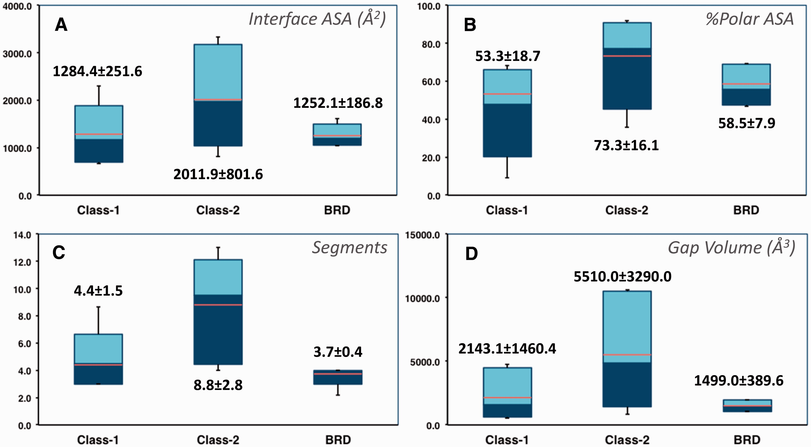
Figure 1 Selected characteristics of protein–protein interfaces for the three classes of protein–protein complexes. ( ...
Notes:
Figure 1 Selected characteristics of protein–protein interfaces for the three classes of protein–protein complexes. ( A ) Buried accessible surface area in Å 2 (corresponding to the size of the interface). ( B ) Percentage of polar accessible surface area. ( C ) Total number of segments at the interface. ( D ) Gap volume at the interface in Å 3 (corresponding to the volume enclosed between the two protein partners). The thin bars represent the complete range distribution for a given property (from minimum to maximum values) and boxes correspond to 90% of the complexes (from 5% to 95% of the distribution). Median values are shown through a color change from dark to light blue, whereas average values are indicated as orange lines. Average values and standard deviations are also shown explicitly for each distribution.
Unless provided in the caption above, the following copyright applies to the content of this slide: © The Author(s) 2016. Published by Oxford University Press. This is an Open Access article distributed under the terms of the Creative Commons Attribution License ( http://creativecommons.org/licenses/by/4.0/ ), which permits unrestricted reuse, distribution, and reproduction in any medium, provided the original work is properly cited.

Slide 2
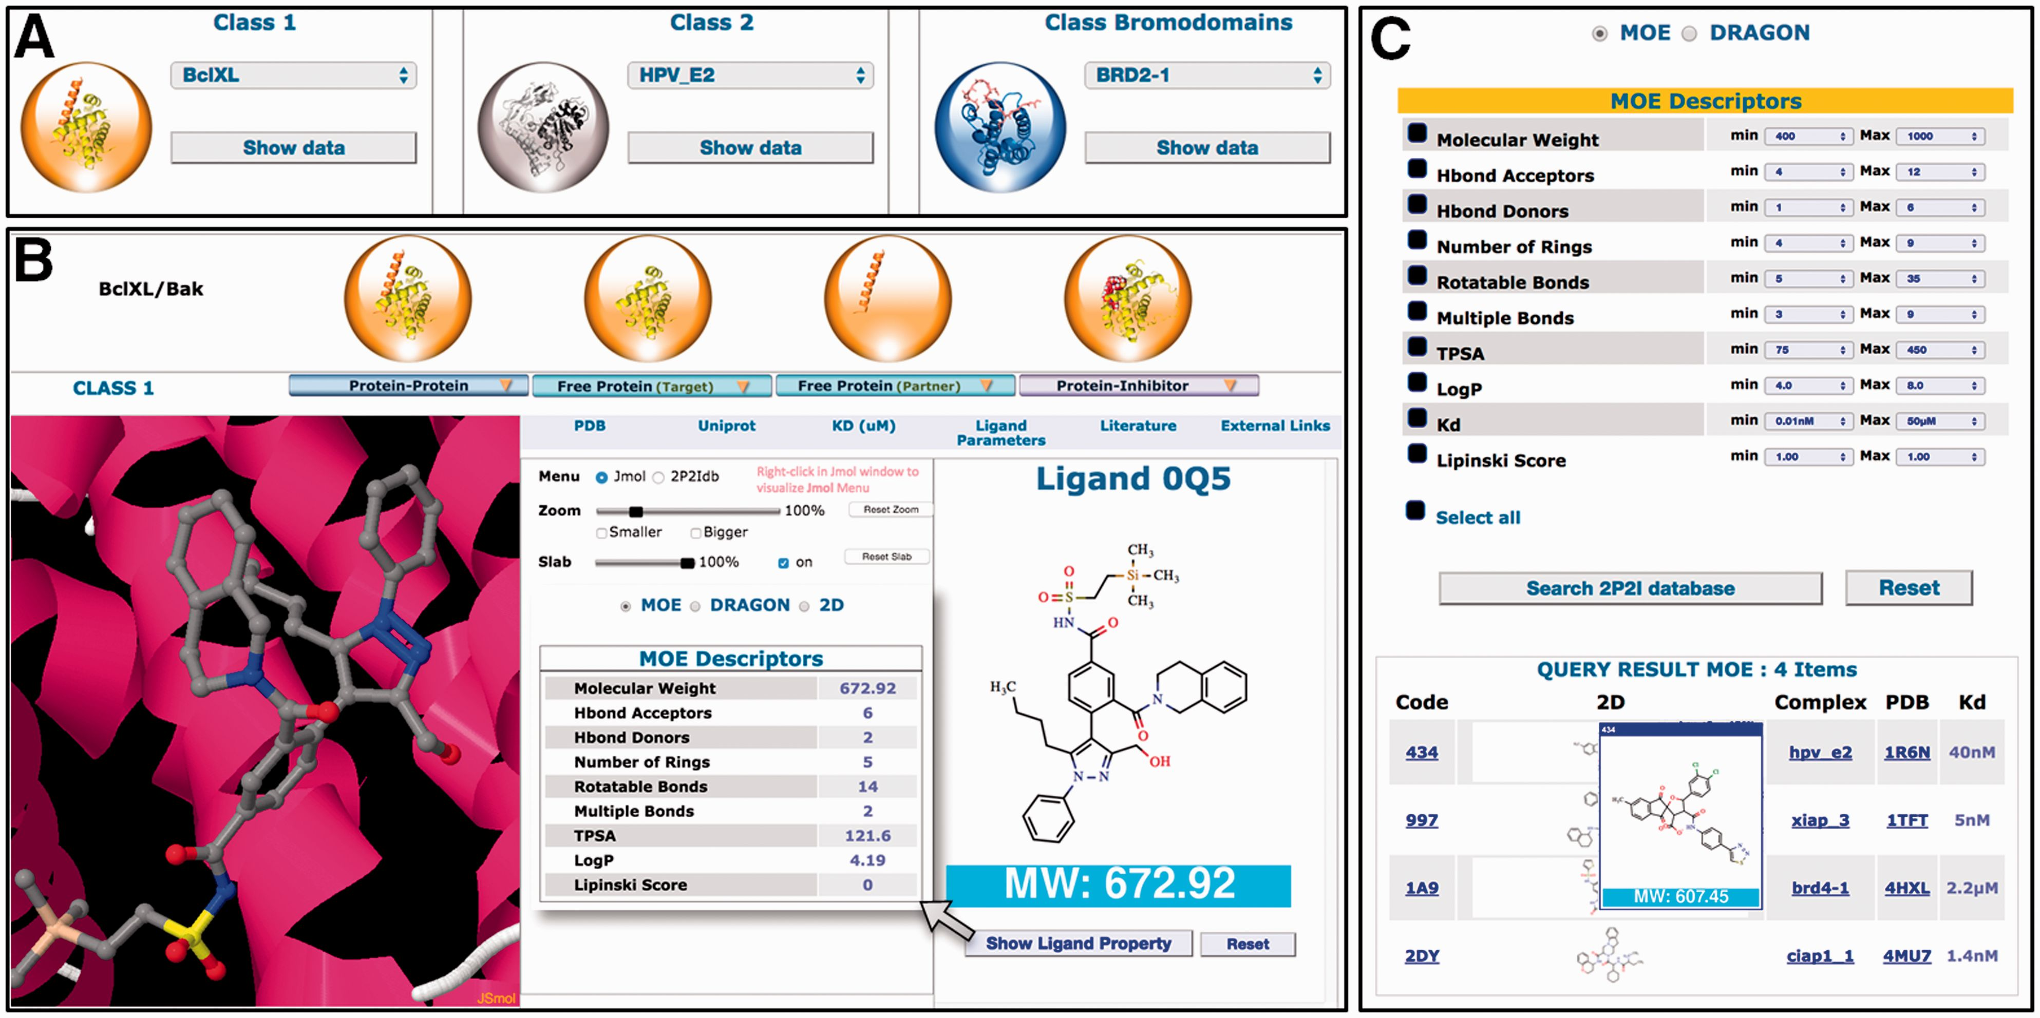
Figure 2 Overview of the 2P2Idb interface. ( A ) Protein–protein complexes divided into three subclasses can be ...
Notes:
Figure 2 Overview of the 2P2Idb interface. ( A ) Protein–protein complexes divided into three subclasses can be selected using dropdown menus. ( B ) PDB structures corresponding to protein–protein complexes, free forms and protein–inhibitor complexes can be easily selected and visualized in a JSmol applet. All information included in the database including pre-calculated interface parameters, small compounds molecular descriptors and links to various websites of interest can be accessed. ( C ) Ligands in the 2P2I database can been searched by chemical properties. The range values of standard molecular descriptors can be defined to retrieve compounds from the database with matching properties.
Unless provided in the caption above, the following copyright applies to the content of this slide: © The Author(s) 2016. Published by Oxford University Press. This is an Open Access article distributed under the terms of the Creative Commons Attribution License ( http://creativecommons.org/licenses/by/4.0/ ), which permits unrestricted reuse, distribution, and reproduction in any medium, provided the original work is properly cited.

