Slide 1
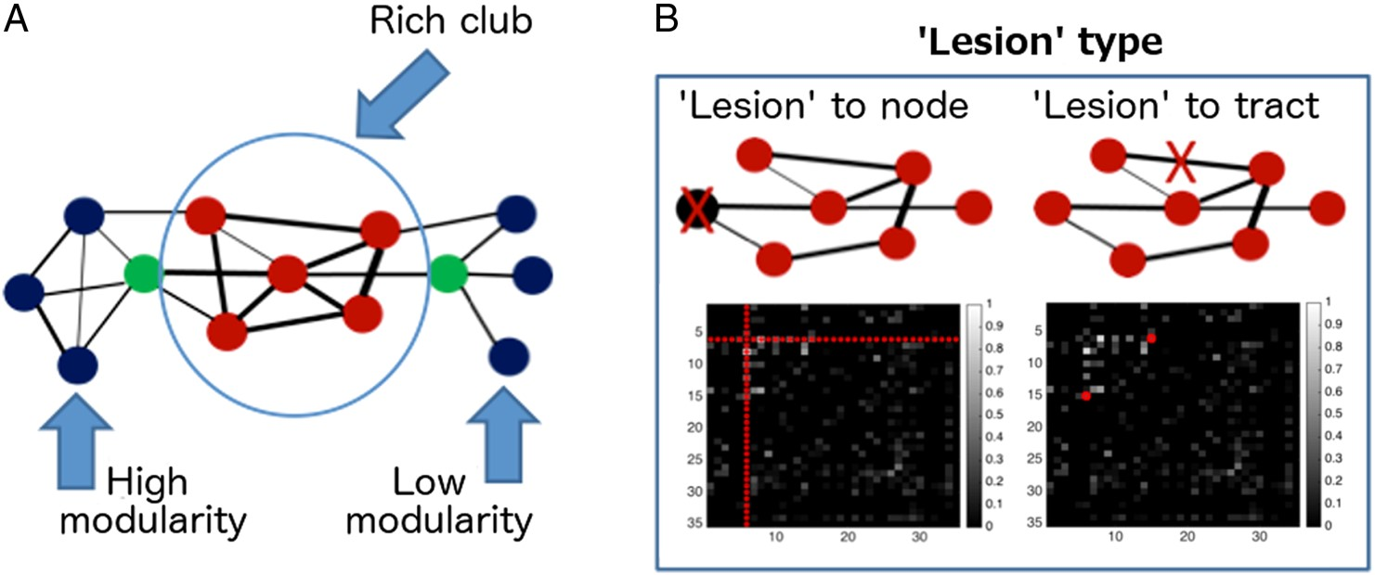
Figure 1. Graph-theoretical concepts utilized in this study. (A) Modularity and rich club. Red circles refer to nodes ...
Notes:
Figure 1. Graph-theoretical concepts utilized in this study. (A) Modularity and rich club. Red circles refer to nodes that are likely candidates for the rich club. Blue circles refer to peripheral nodes. Green circles refer to nodes that, despite being well connected, are expected to contribute less to rich-club index than red nodes, as a large proportion of their connections are shared with peripheral nodes (blue circles). (B) Simulated “lesions.” The black boxes represent connectivity matrices, where the intensity of a point indicates the strength of connection between 2 nodes. Red markers in connectivity matrices show the entries that would be assigned zero values in order to simulate a “lesion” to a network; left—simulation of the “lesion” to a node, with all its connection assigned zero values; right—simulation of the “lesion” to a tract.
Unless provided in the caption above, the following copyright applies to the content of this slide: © The Author 2016. Published by Oxford University PressThis is an Open Access article distributed under the terms of the Creative Commons Attribution Non-Commercial License (http://creativecommons.org/licenses/by-nc/4.0/), which permits non-commercial re-use, distribution, and reproduction in any medium, provided the original work is properly cited. For commercial re-use, please contact journals.permissions@oup.com

Slide 2
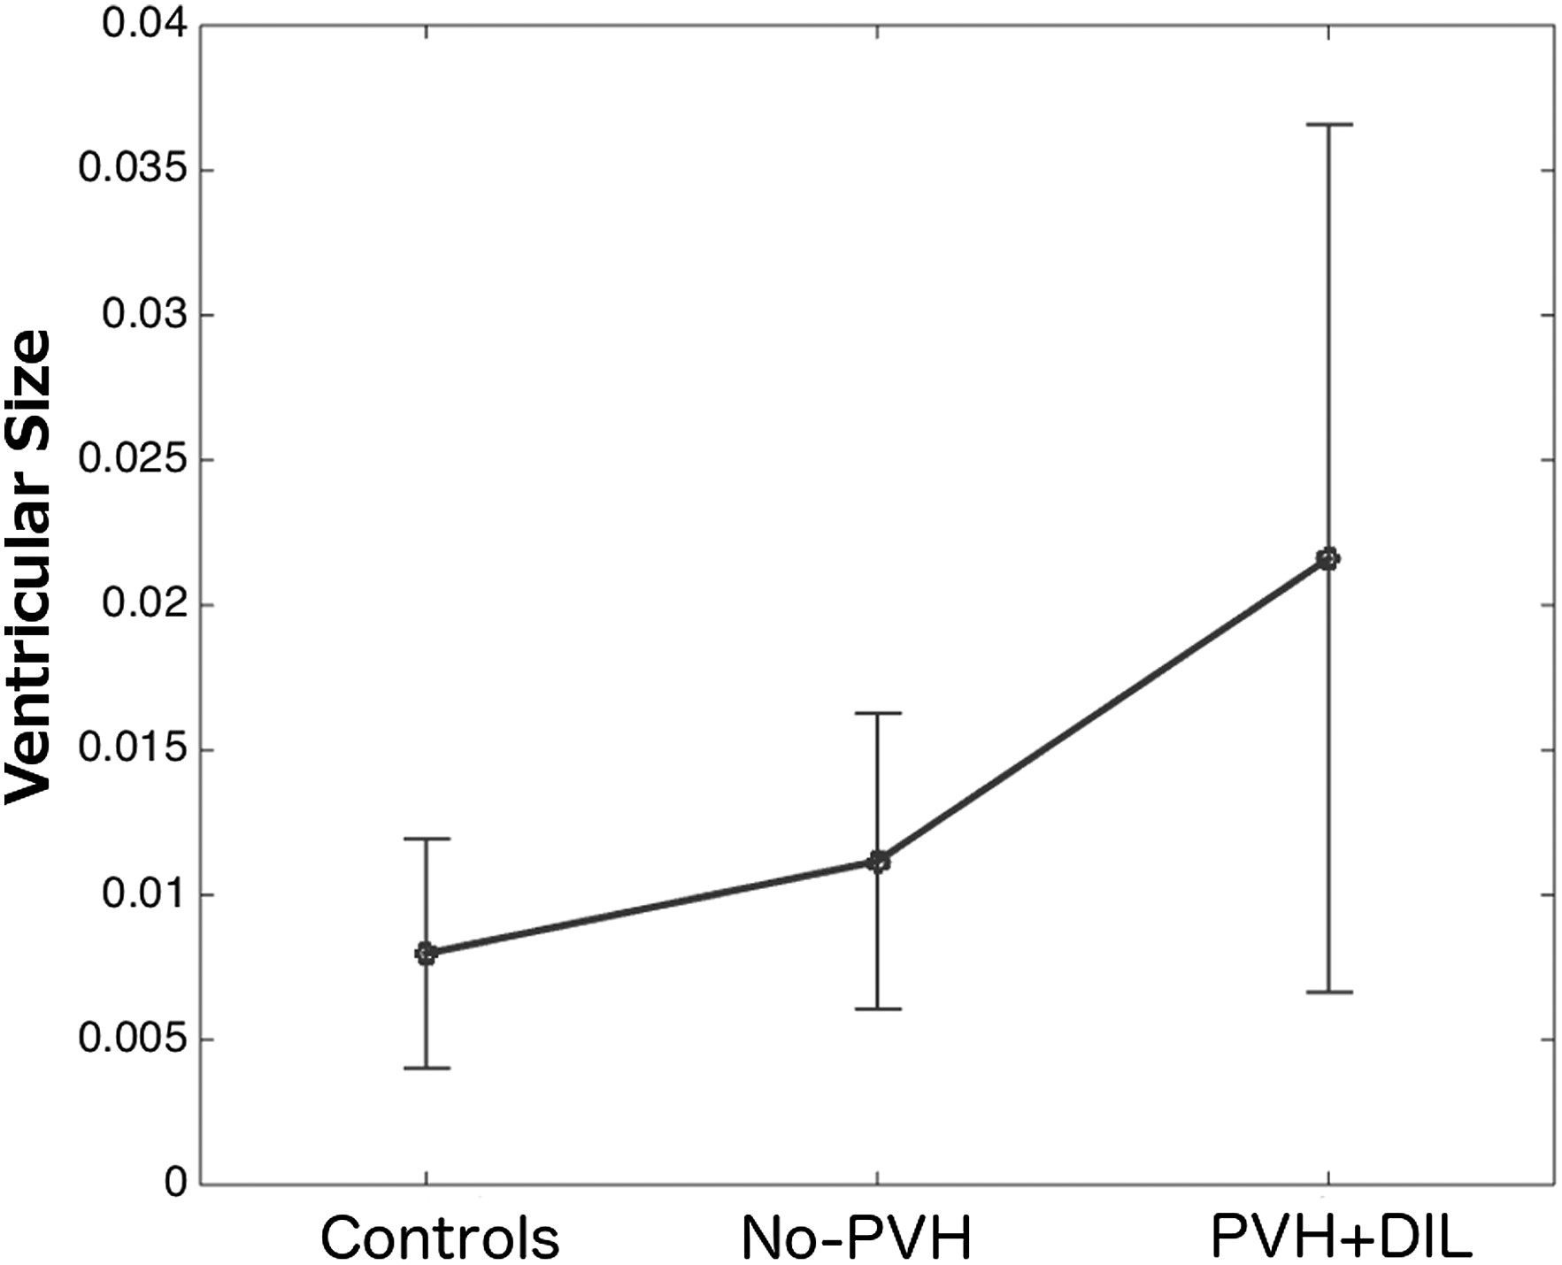
Figure 2. Ventricular size as a proportion of intracranial volume.
Notes:
Figure 2. Ventricular size as a proportion of intracranial volume.
Unless provided in the caption above, the following copyright applies to the content of this slide: © The Author 2016. Published by Oxford University PressThis is an Open Access article distributed under the terms of the Creative Commons Attribution Non-Commercial License (http://creativecommons.org/licenses/by-nc/4.0/), which permits non-commercial re-use, distribution, and reproduction in any medium, provided the original work is properly cited. For commercial re-use, please contact journals.permissions@oup.com

Slide 3
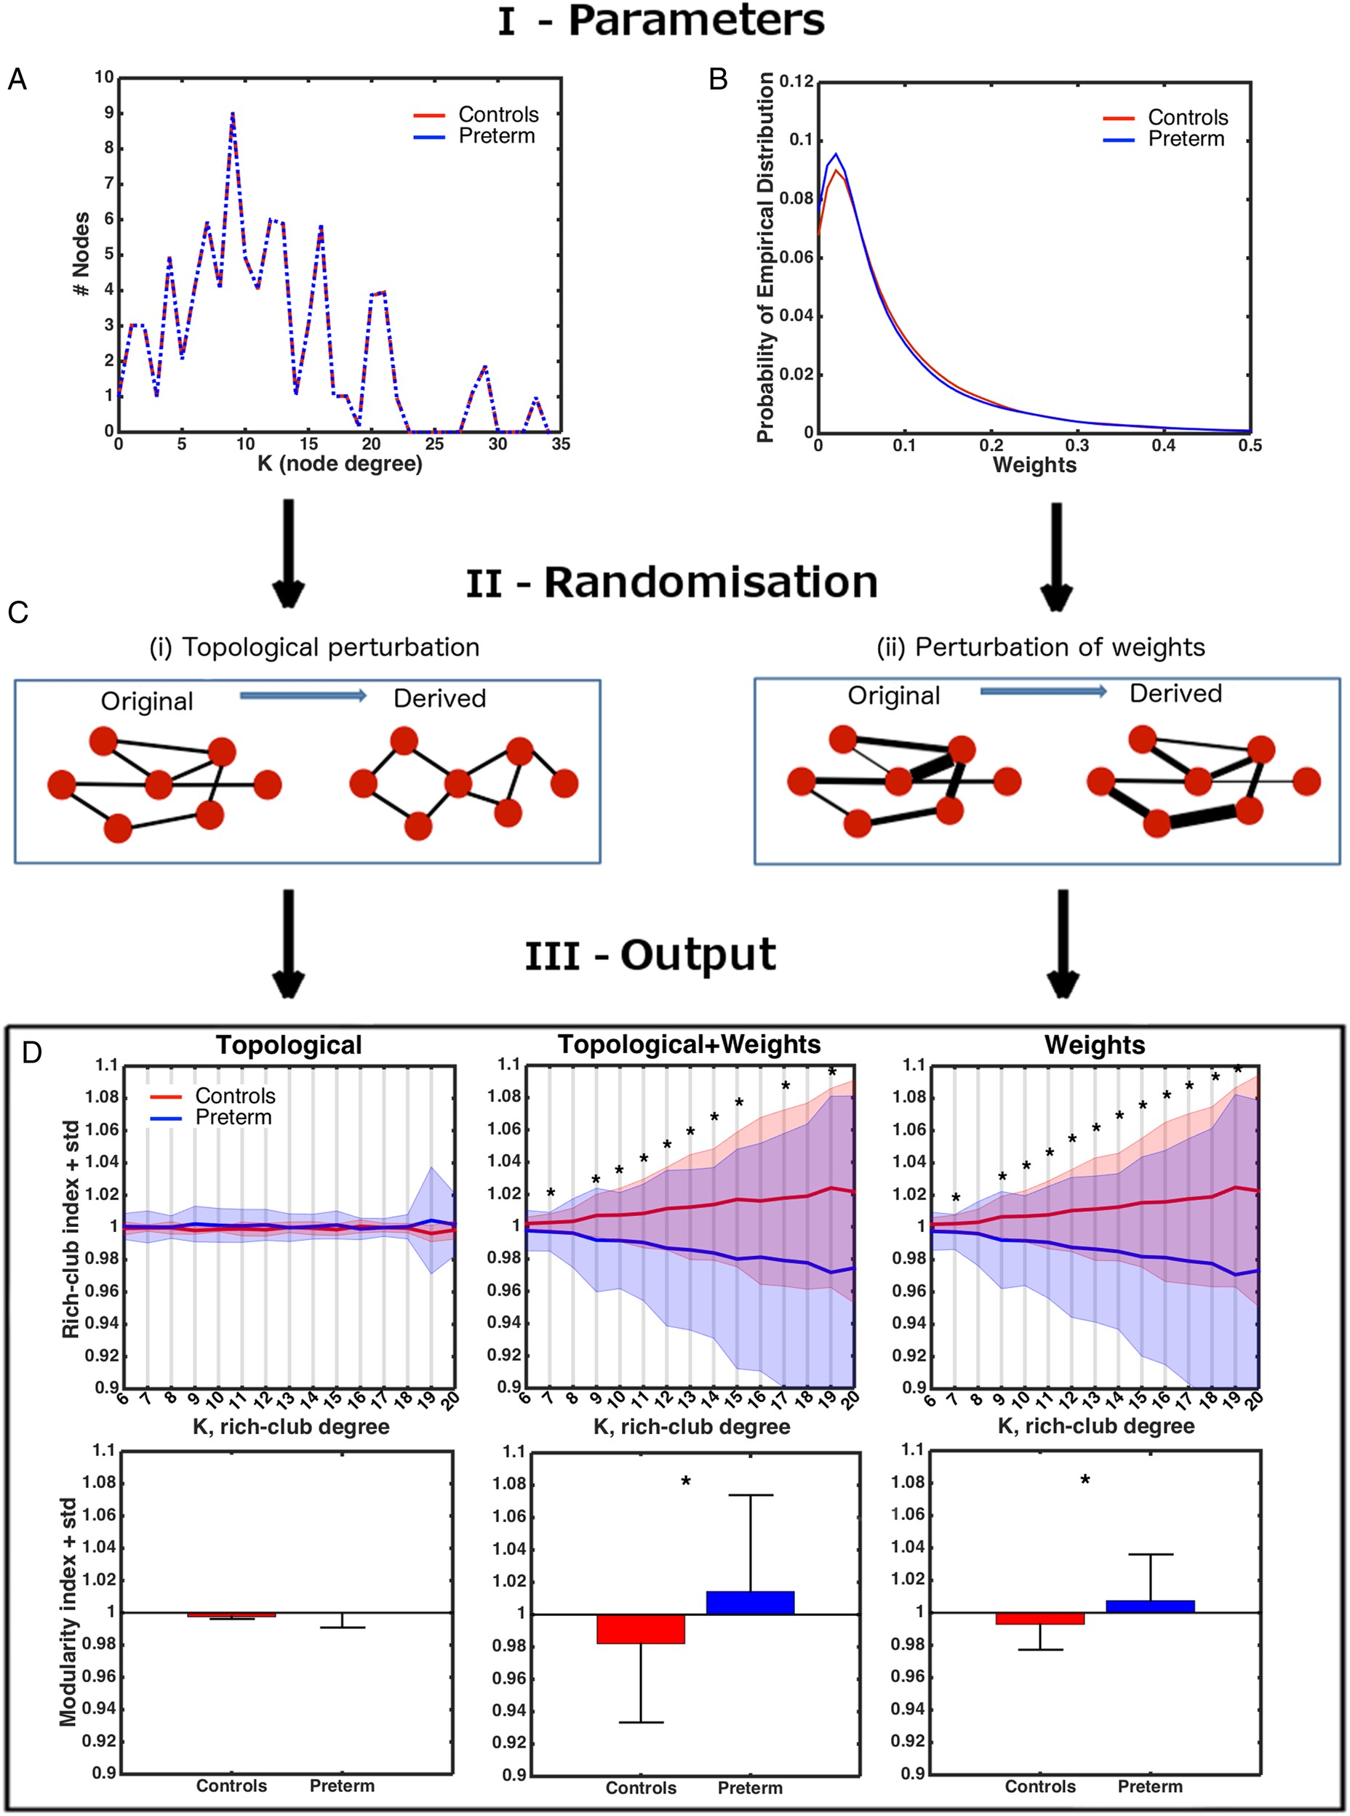
Figure 3. Perturbation analysis. (A) Average distribution of the degree nodes in the real networks. (B) Consensus ...
Notes:
Figure 3. Perturbation analysis. (A) Average distribution of the degree nodes in the real networks. (B) Consensus distribution (smoothed) for the connection weights in the real networks of each group. (C) Factorizing the process of network randomization into 2 operations. (D) Top row: Average baseline rich-club indices (±SD of a group) as a result of topological, simultaneous topological + weights, and weights-only perturbations. The data are scaled by the grand average across all subjects. Bottom row: same for modularity indices. Asterisks—significant group differences (Bonferroni-corrected).
Unless provided in the caption above, the following copyright applies to the content of this slide: © The Author 2016. Published by Oxford University PressThis is an Open Access article distributed under the terms of the Creative Commons Attribution Non-Commercial License (http://creativecommons.org/licenses/by-nc/4.0/), which permits non-commercial re-use, distribution, and reproduction in any medium, provided the original work is properly cited. For commercial re-use, please contact journals.permissions@oup.com

Slide 4
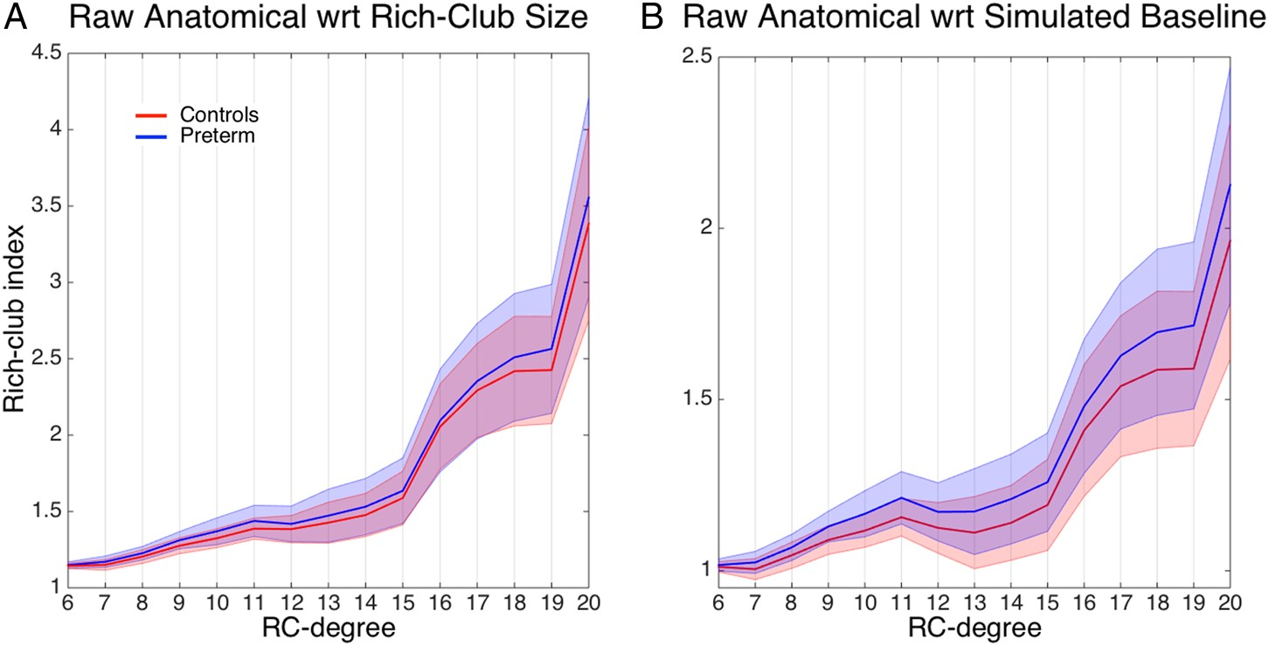
Figure 4. Rich-club indices. (A) Raw anatomical index (±SD). (B) The ratio (±SD) between raw anatomical and averaged ...
Notes:
Figure 4. Rich-club indices. (A) Raw anatomical index (±SD). (B) The ratio (±SD) between raw anatomical and averaged simulated baseline indices (following topology + weight perturbation). Values above 1 indicate a rich-club regime.
Unless provided in the caption above, the following copyright applies to the content of this slide: © The Author 2016. Published by Oxford University PressThis is an Open Access article distributed under the terms of the Creative Commons Attribution Non-Commercial License (http://creativecommons.org/licenses/by-nc/4.0/), which permits non-commercial re-use, distribution, and reproduction in any medium, provided the original work is properly cited. For commercial re-use, please contact journals.permissions@oup.com

Slide 5
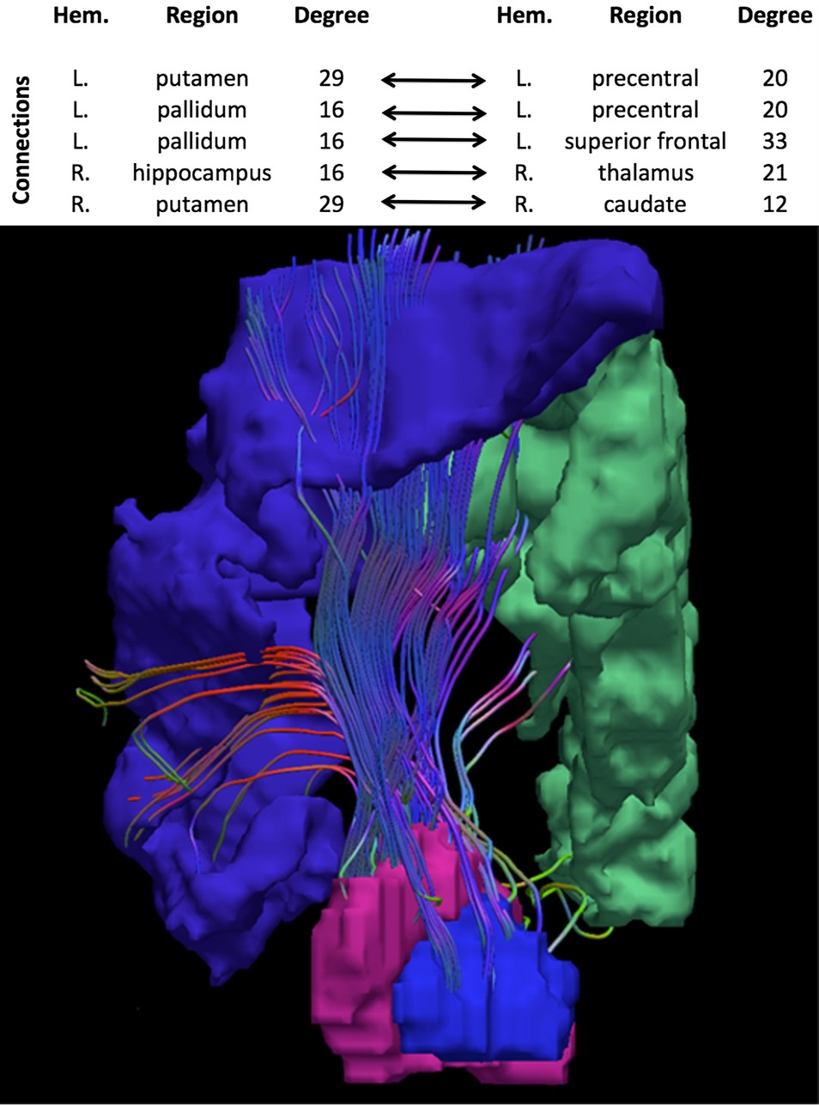
Figure 5. Basal ganglia connections with precentral and superior frontal gyri in the left hemisphere, showing an ...
Notes:
Figure 5. Basal ganglia connections with precentral and superior frontal gyri in the left hemisphere, showing an altered role in very preterm brain network. Table presents the complete list of connections associated with the principal component that improved classifier performance.
Unless provided in the caption above, the following copyright applies to the content of this slide: © The Author 2016. Published by Oxford University PressThis is an Open Access article distributed under the terms of the Creative Commons Attribution Non-Commercial License (http://creativecommons.org/licenses/by-nc/4.0/), which permits non-commercial re-use, distribution, and reproduction in any medium, provided the original work is properly cited. For commercial re-use, please contact journals.permissions@oup.com

Slide 6
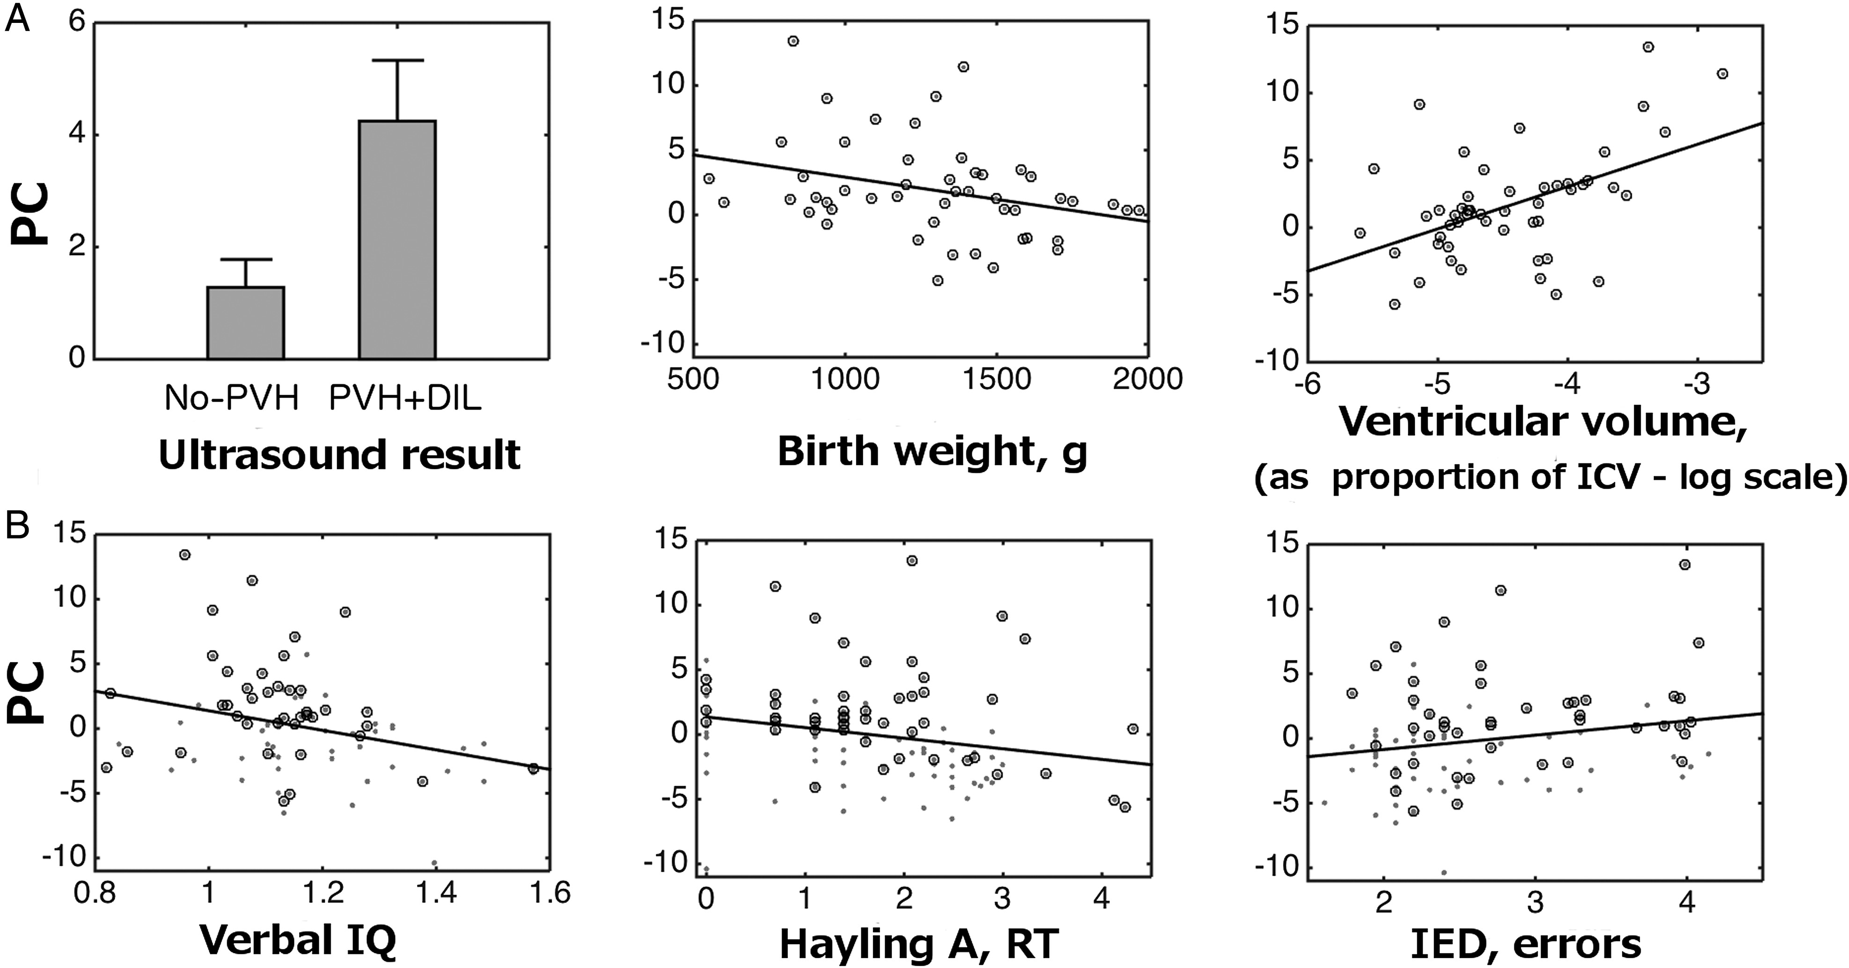
Figure 6. Correlations of altered connectivity (principal component values—PC) with neonatal, anatomical, and cognitive ...
Notes:
Figure 6. Correlations of altered connectivity (principal component values—PC) with neonatal, anatomical, and cognitive variables. (A) Classifier confidence in relation to severity of neonatal US classification, birth weight, and ventricular volume at assessment in the very preterm group. ICV, intracranial volume. (B) Relation of alterations in connectivity and cognitive outcome. Circled data points mark very preterm participants. For display purposes only, scales for behavioral performance are in accordance with the most suitable transformations applied to correct for nonnormality of the distributions (Table 2). The significance of correlations was tested using nonparametric statistics.
Unless provided in the caption above, the following copyright applies to the content of this slide: © The Author 2016. Published by Oxford University PressThis is an Open Access article distributed under the terms of the Creative Commons Attribution Non-Commercial License (http://creativecommons.org/licenses/by-nc/4.0/), which permits non-commercial re-use, distribution, and reproduction in any medium, provided the original work is properly cited. For commercial re-use, please contact journals.permissions@oup.com

