Slide 1
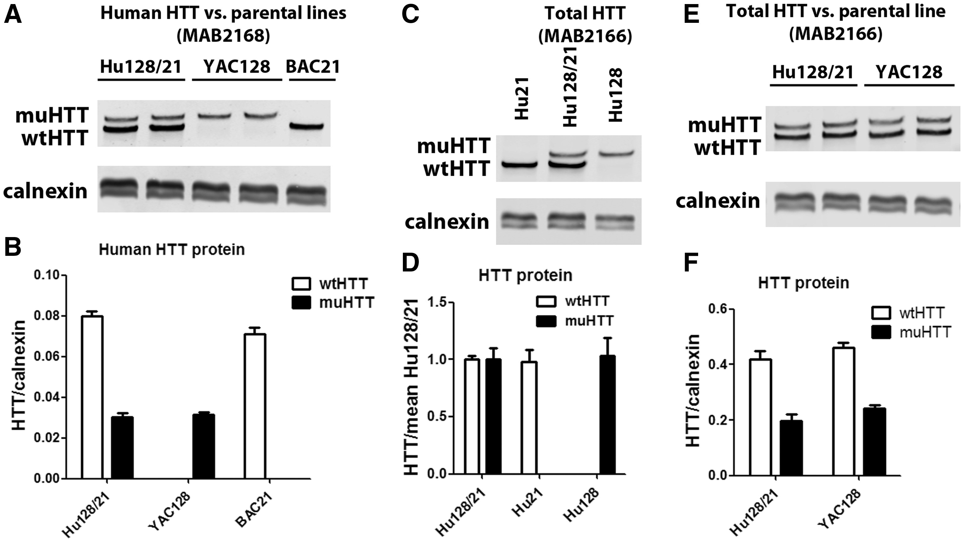
Figure 1 Cortical HTT protein levels in Hu128/21 mice. Total protein was isolated from cortices of 4-month-old animals ...
Notes:
Figure 1 Cortical HTT protein levels in Hu128/21 mice. Total protein was isolated from cortices of 4-month-old animals and assessed for HTT levels by allelic separation immunoblotting. (A, B) Human HTT in Hu128/21 brain was compared with the founder lines, YAC128 and BAC21 demonstrating no changes in transgenic protein after humanization. (C, D) Total HTT levels were compared in Hu128/21, Hu21 and Hu128 mice demonstrating no change in HTT levels after interbreeding. (E, F) Total HTT levels in Hu128/21 were compared with YAC128 mice demonstrating that the ratio of wt and muHTT in these two lines is similar. (A, C, E) Representative immunoblots. (B, D, F) Quantitation from an number of four animals per genotype.
Unless provided in the caption above, the following copyright applies to the content of this slide: © The Author 2017. Published by Oxford University Press. All rights reserved. For Permissions, please email: journals.permissions@oup.com

Slide 2
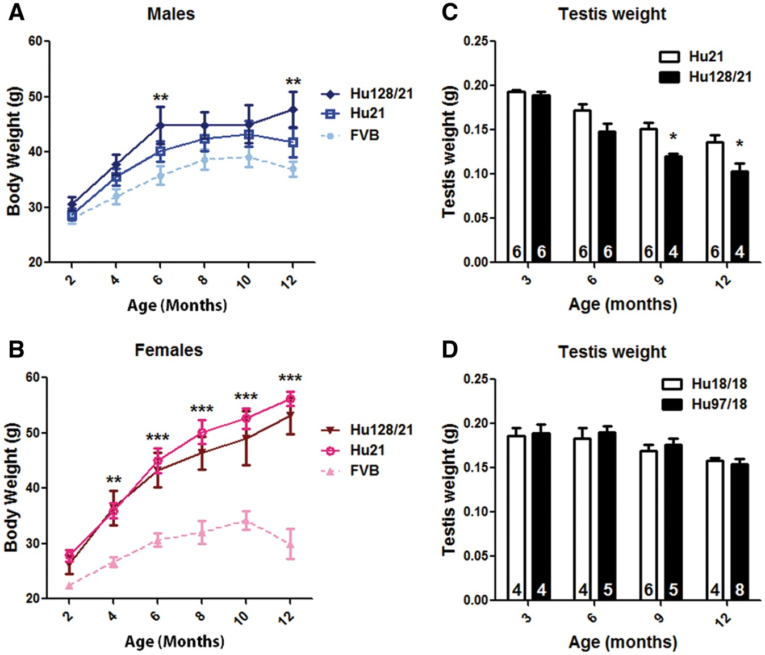
Figure 2 Hu128/21 mice display weight gain and testicular degeneration. Mice were weighed at 2-month intervals from 2 ...
Notes:
Figure 2 Hu128/21 mice display weight gain and testicular degeneration. Mice were weighed at 2-month intervals from 2 to 12 months of age. (A) Male Hu128/21 mice were significantly heavier than age matched historical FVB mice (14) at 6 and 12 months of age. (B) Female Hu21 and Hu128/21 mice displayed greater magnitude weight gain than males and were significantly heavier than age matched FVB mice from 4 months of age. Post-perfusion testis was weighed at the indicated ages. (C) Testis weight declines with age in both Hu21 and Hu128/21 mice, but decline is greater in Hu128/21 mice leading to significantly smaller testis from 9 months of age. (D) Testis weight declines with age in both Hu18/18 and Hu97/18 mice. No effects of genotype were noted. *Different from Hu21, *P < 0.05, **P < 0.01, ***P < 0.001.
Unless provided in the caption above, the following copyright applies to the content of this slide: © The Author 2017. Published by Oxford University Press. All rights reserved. For Permissions, please email: journals.permissions@oup.com

Slide 3
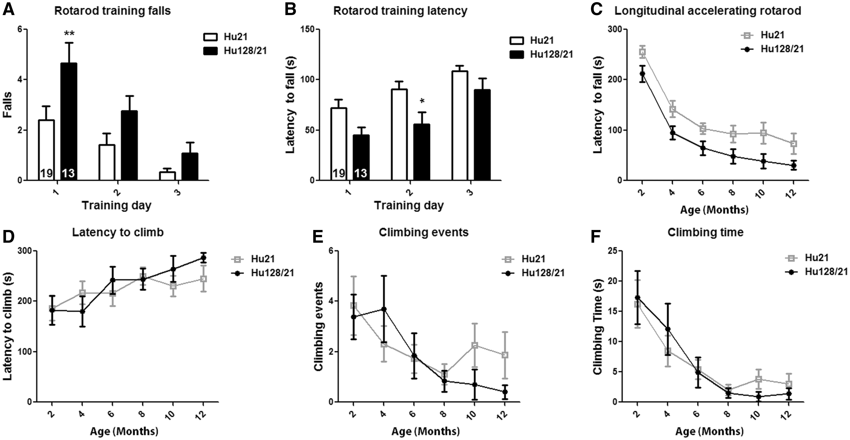
Figure 3 Hu128/21 mice display progressive motor deficits. Motor performance was evaluated longitudinally at 2-month ...
Notes:
Figure 3 Hu128/21 mice display progressive motor deficits. Motor performance was evaluated longitudinally at 2-month intervals from 2 to 12 months of age using the (A–C) accelerating rotarod and (D–F) spontaneous climbing tests. (A, B) When compared with Hu21 mice, Hu128/21 (A) fell more frequently and (B) had a reduced latency to the first fall during training on a fixed speed rotarod. (C) Longitudinal rotarod performance of both genotypes progressively declined. Although there was a significant effect of genotype by two-way-ANOVA (P < 0.0001), this difference failed to reach significance by post hoc analysis at any time point. (D–F) Both genotypes of mice displayed progressive decline in spontaneous climbing during a 5 min exploration of an inverted wire mesh pencil holder as measured by (D) latency to begin climbing, (E) climbing events and (F) total time spent climbing. No effect of genotype was observed for any of these measures. *Different from Hu21, *P < 0.05, **P < 0.01.
Unless provided in the caption above, the following copyright applies to the content of this slide: © The Author 2017. Published by Oxford University Press. All rights reserved. For Permissions, please email: journals.permissions@oup.com

Slide 4
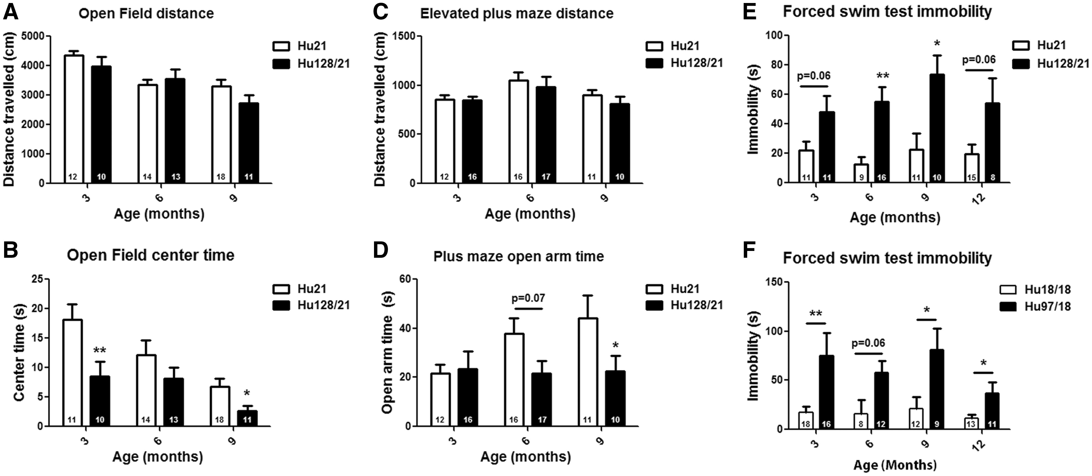
Figure 4 Hu128/21 mice display anxiety- and depressive-like behaviors. (A, B) Mice were evaluated during exploration ...
Notes:
Figure 4 Hu128/21 mice display anxiety- and depressive-like behaviors. (A, B) Mice were evaluated during exploration of a brightly lit open field at the indicated ages. (A) Exploratory activity of both genotypes declined with age. However, no genotypic differences were observed. (B) When compared twith Hu21 mice, Hu218/21 mice displayed anxiety-like behavior spending significantly less time in the center of the open field at 3 and 9 months of age with a trend toward reduced center time at 6 months of age. (C, D) Mice were evaluated during exploration of an elevated plus maze at the indicated ages. (C) Exploratory activity of both genotypes was similar at all evaluated ages. (D) When compared with Hu21 mice, Hu128/21 mice displayed anxiety-like behavior spending significantly less time in the open arms at 9 months of age with a strong trend toward less open arm time observed at 6 months of age. (E, F) Mice were evaluated during forced swimming at the indicated ages. (E) When compared with Hu21 littermates, Hu128/21 mice displayed non-progressive depressive-like behavior, spending significantly more time immobile at 6 and 9 months of age with strong trends toward more time immobile noted at 3 and 12 months of age. (F) When compared with Hu18/18 littermates, Hu97/18 mice displayed non-progressive depressive-like behavior, spending significantly more time immobile at 3, 9 and 12 months of age with strong trends toward more time immobile noted at 6 months of age. Data for Hu97/18 line at 12 months of age were previously reported in (14) and is included here to allow direct comparison. *Different from Hu21 or Hu18/18 same age, *P < 0.05, **P < 0.01.
Unless provided in the caption above, the following copyright applies to the content of this slide: © The Author 2017. Published by Oxford University Press. All rights reserved. For Permissions, please email: journals.permissions@oup.com

Slide 5
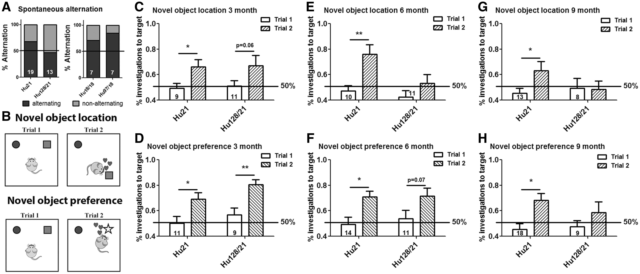
Figure 5 Hu128/21 mice display progressive spatial and object recognition learning deficits. (A) Four-month-old mice ...
Notes:
Figure 5 Hu128/21 mice display progressive spatial and object recognition learning deficits. (A) Four-month-old mice were evaluated in the spontaneous alternation test of spatial learning. Hu21 mice showed a preference for entering the previously unexplored arm, while Hu128/21 mice showed no arm preference, indicating impaired spatial learning. Hu18/18 and Hu97/18 mice both preferentially entered the unexplored arm, indicating no deficit in this paradigm. Mice were tested at the indicated ages in the (B) novel object location test of spatial learning and the novel object preference test of object recognition. (C, D) At 3 months of age both genotypes of mice show a preference for the target object, (C) the one in the new location or (D) the novel object, indicating intact spatial learning and object recognition at this age. (E, F) At 6 months of age Hu21 mice perform both tasks well, while Hu128/21 mice display (E) disrupted spatial learning but (F) intact object recognition. (G, H) At 9 months of age Hu21 mice perform both tasks, indicating intact learning, which Hu128/21 display deficits in both tasks, indicating impaired spatial learning and object recognition. *Difference between indicated columns, *P < 0.05, **P < 0.01.
Unless provided in the caption above, the following copyright applies to the content of this slide: © The Author 2017. Published by Oxford University Press. All rights reserved. For Permissions, please email: journals.permissions@oup.com

Slide 6
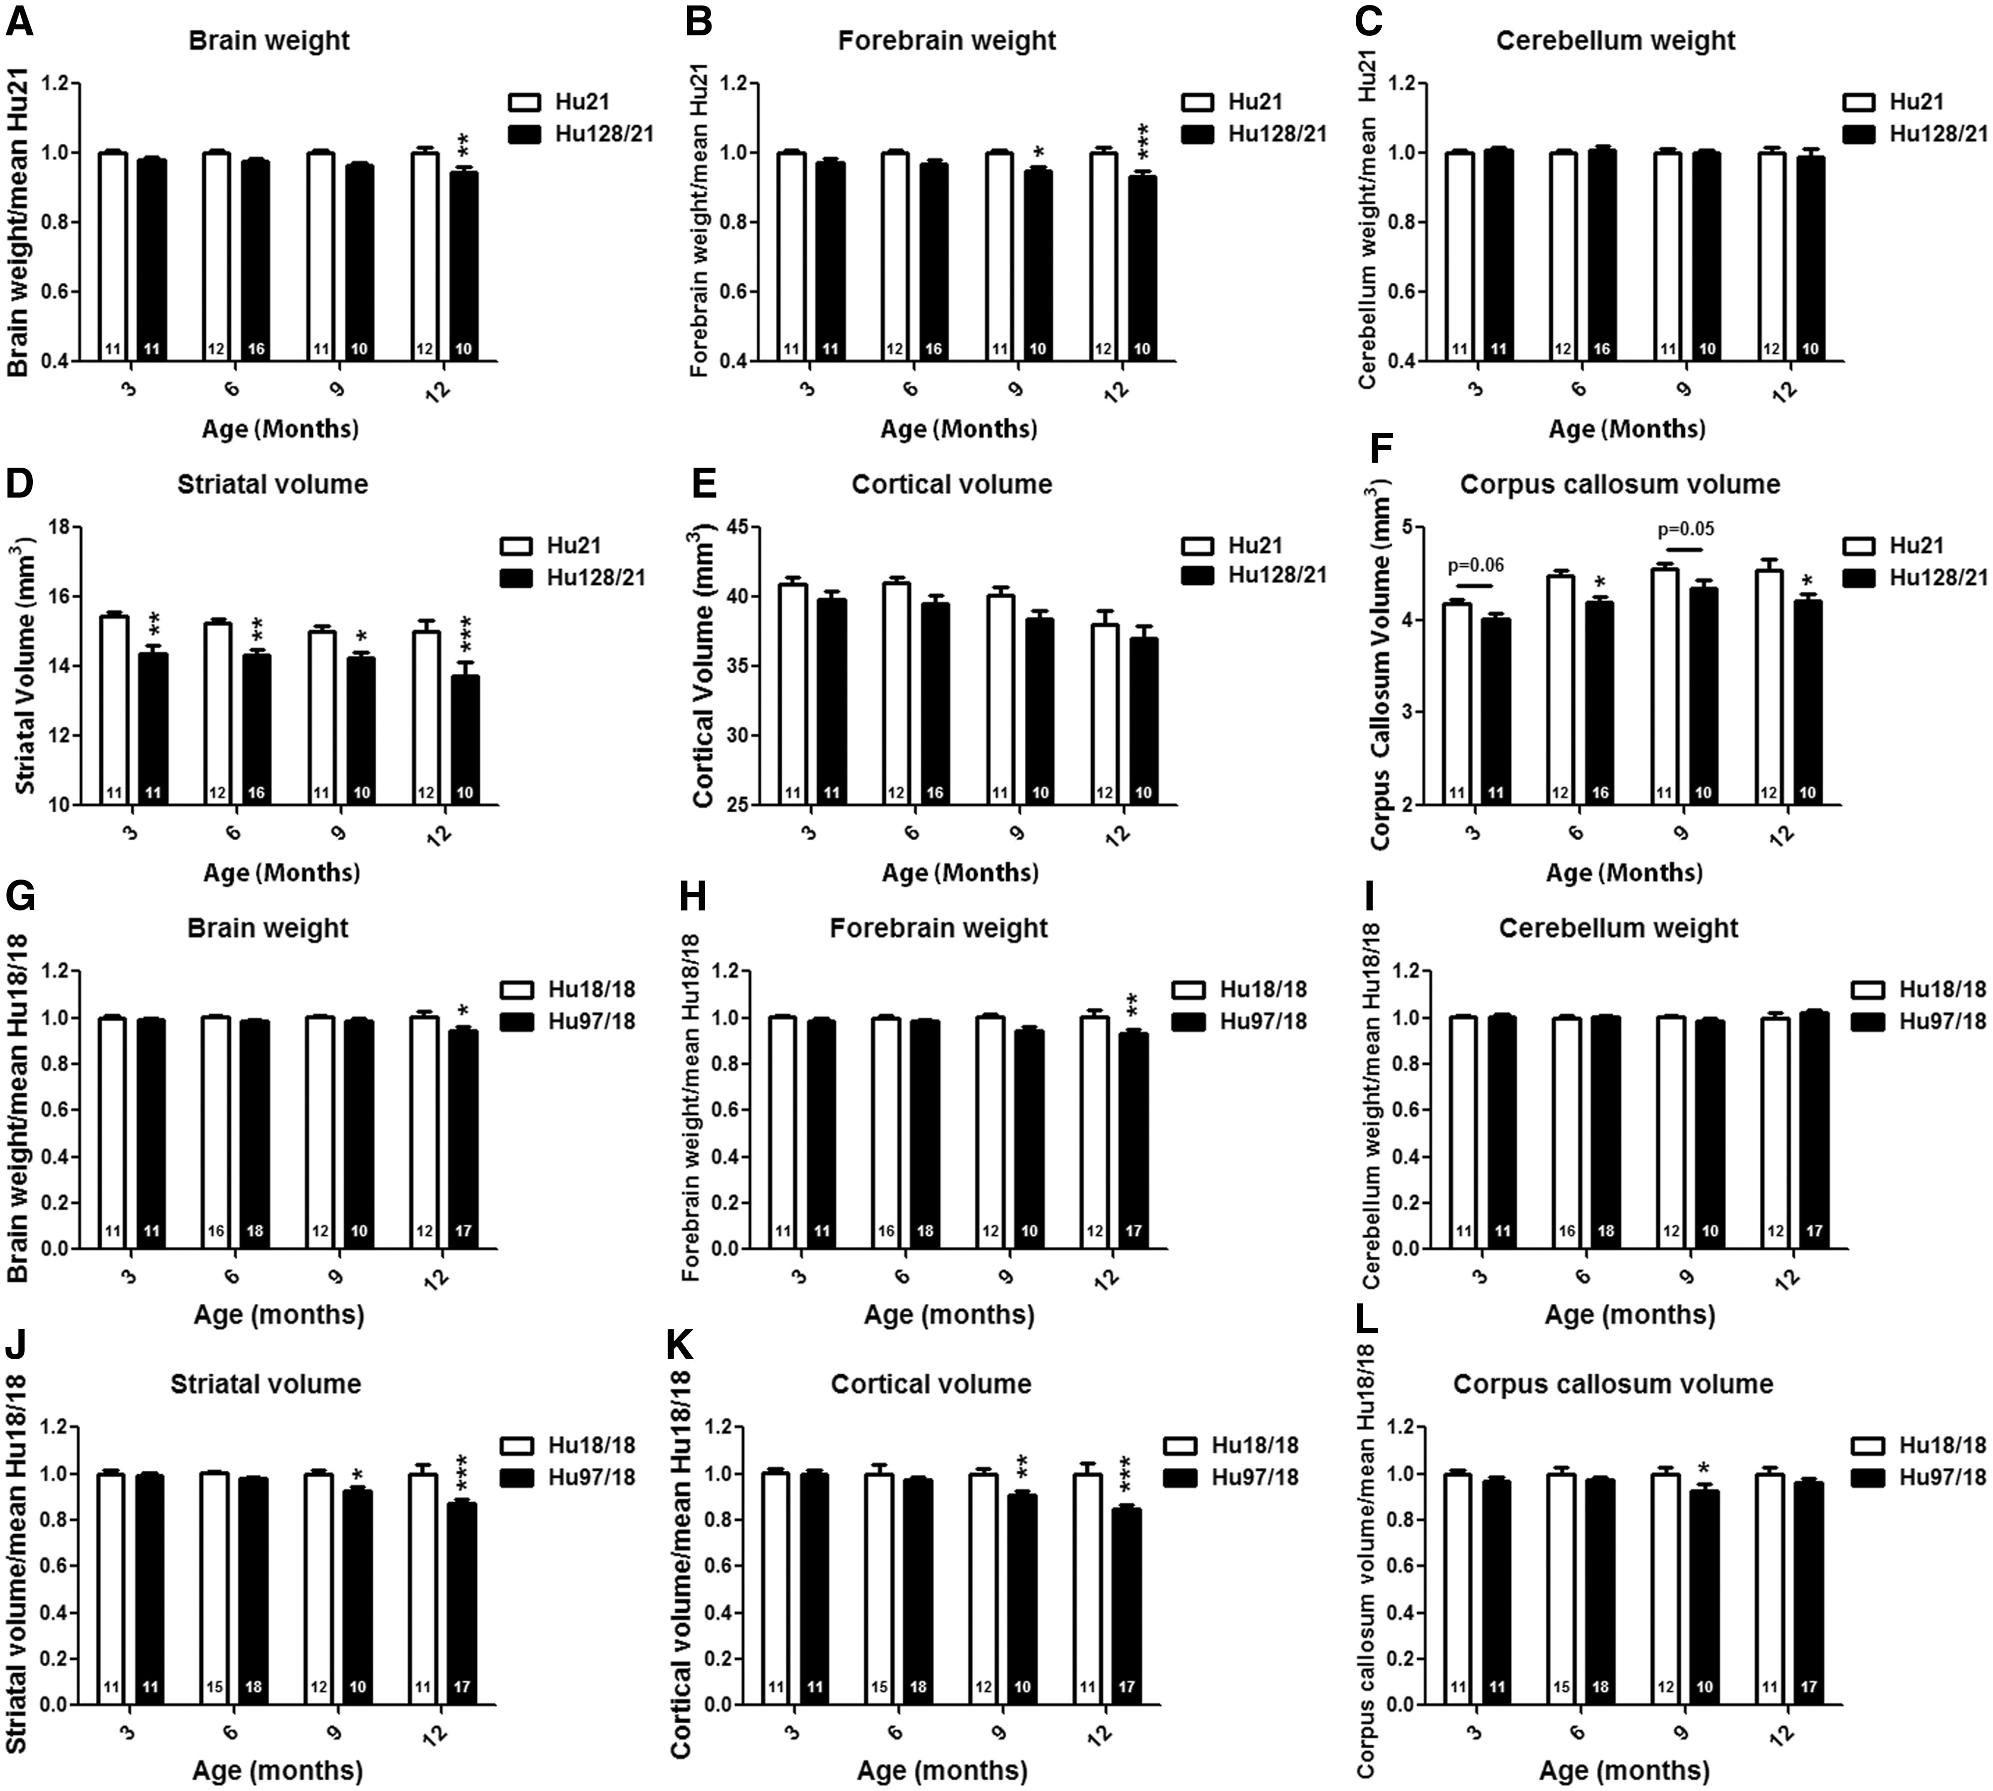
Figure 6 Hu128/21 mice display forebrain specific atrophy. Weights and structure volumes were assessed at 3, 6, 9 and ...
Notes:
Figure 6 Hu128/21 mice display forebrain specific atrophy. Weights and structure volumes were assessed at 3, 6, 9 and 12 months of age. When compared with Hu21 control mice, Hu128/21 mice displayed reduced (A) total brain weight at 12 months of age and (B) forebrain weight from 9 months of age. (C) Cerebellum weight was not different between the genotypes. (D) Hu128/21 mice displayed striatal volume reduction from 3 months of age, the earliest time point evaluated. (E) There was a consistent trend toward reduced cortical volume at all ages, and a significant effect of genotype by two-way-ANOVA (P = 0.0071), but this failed to reach post hoc significance. (F) When compared with Hu21 brain, corpus callosum volume was significantly reduced in Hu128/21 brain at 6 and 12 months of age, with a trend toward reduction noted at 3 and 9 months of age. When compared with Hu18/18 control mice, Hu97/18 mice displayed reduced (G) total brain weight and (H) forebrain weight at 12 months of age. (I) Cerebellum weight was not different between the genotypes. Hu97/18 mice displayed significantly reduced (J) striatal volume and (K) cortical volume from 9 months of age. (L) When compared with Hu18/18 brain, corpus callosum volume was significantly reduced in Hu97/18 brain at 9 months of age, with a trend toward reduction noted at 12 months of age. Data for Hu97/18 line at 12 months of age were previously reported in (14) and is included here to allow direct comparison. *Different from Hu21 or Hu18/18 same age, *P < 0.05, **P < 0.01, ***P < 0.001.
Unless provided in the caption above, the following copyright applies to the content of this slide: © The Author 2017. Published by Oxford University Press. All rights reserved. For Permissions, please email: journals.permissions@oup.com

Slide 7
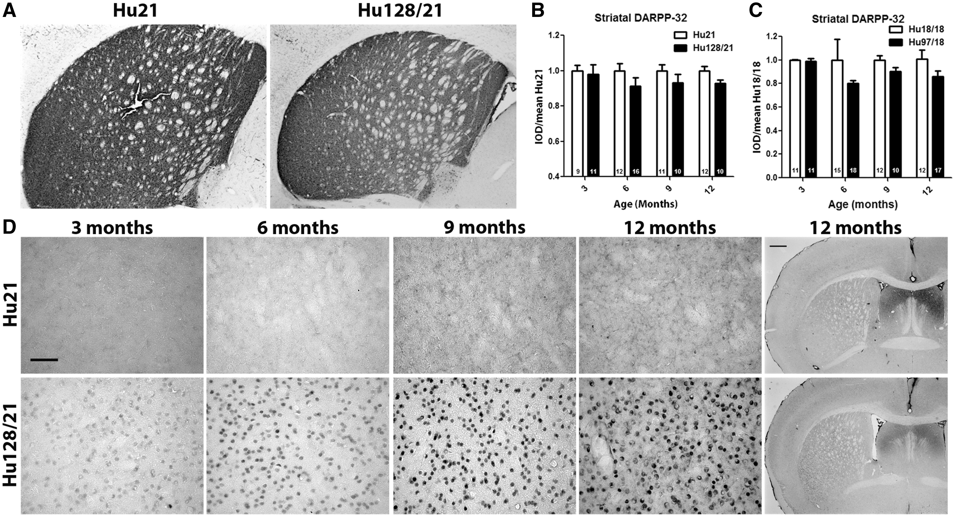
Figure 7 Hu128/21 display HD-like histological changes in the brain. (A,B) DARPP-32 immunoreactivity was assessed at ...
Notes:
Figure 7 Hu128/21 display HD-like histological changes in the brain. (A,B) DARPP-32 immunoreactivity was assessed at 3, 6, 9 or 12 months of age by integrated optical density. (A) representative mid-striatal micrographs of Hu21 and Hu128/21 DARPP-32 stained brains at 12 months of age. (B) When compared with Hu21 controls, Hu128/21 mice display reduced striatal DARPP-32 (genotype effect P = 0.0456). This difference failed to reach post hoc significance at any age, but a trend toward reduction was noted at 6, 9 and 12 months of age. (C) When compared with Hu18/18 controls, Hu97/18 mice display reduced striatal DARPP-32 (genotype effect P = 0.0135). This difference failed to reach post hoc significance at any age, but a trend toward reduction was noted at 6, 9 and 12 months of age. Data for Hu97/18 line at 12 months of age was previously reported in (14) and is included here to allow direct comparison. (D) Hu128/21 mice display progressive deposition of striatal EM48 positive muHTT inclusions. Diffuse nuclear staining is apparent by 3 months of age and becomes progressively more intense with age. By 9 months of age, robust striatal inclusions are present. Inclusion deposition was also noted in cortex. Scale bars = 50 µm high magnification images and 500 µm low magnification images.
Unless provided in the caption above, the following copyright applies to the content of this slide: © The Author 2017. Published by Oxford University Press. All rights reserved. For Permissions, please email: journals.permissions@oup.com

Slide 8
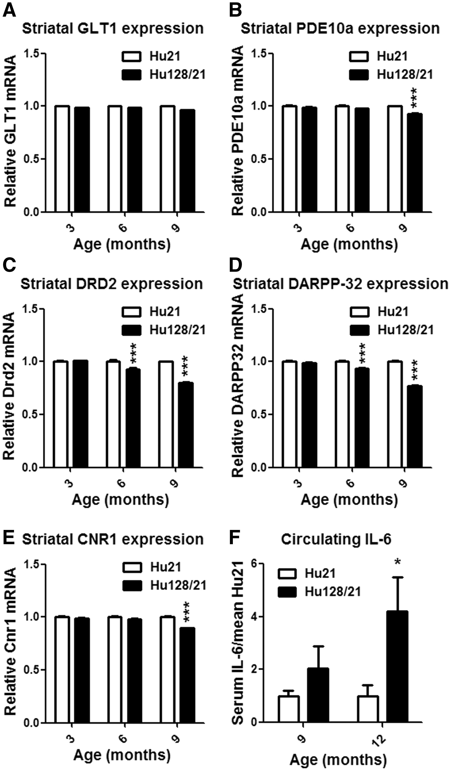
Figure 8 Hu128/21 mice display HD-like striatal gene expression changes and increased circulating IL-6. (A–E) Striatal ...
Notes:
Figure 8 Hu128/21 mice display HD-like striatal gene expression changes and increased circulating IL-6. (A–E) Striatal gene expression was assessed through qRT-PCR at the indicated ages. (A) There was no effect of genotype on GLT1 expression. (B) Hu128/21 mice displayed a modest but significant reduction in striatal PDE10a expression at 9 months of age. (C, D) D2 dopamine receptor and DARPP-32 expression was progressively reduced in Hu128/21 striata from 6 months of age. (E) A modest but significant reduction in striatal CNR1 expression was noted in 9-month old Hu128/21 mice. (F) Serum IL-6 was quantified by MSD at the indicated ages. A trend toward increased circulating IL-6 was noted at 9 months of age with a significant increase at 12 months of age. *Different from Hu21 same age, *P < 0.05, **P < 0.01, ***P < 0.001.
Unless provided in the caption above, the following copyright applies to the content of this slide: © The Author 2017. Published by Oxford University Press. All rights reserved. For Permissions, please email: journals.permissions@oup.com

Slide 9
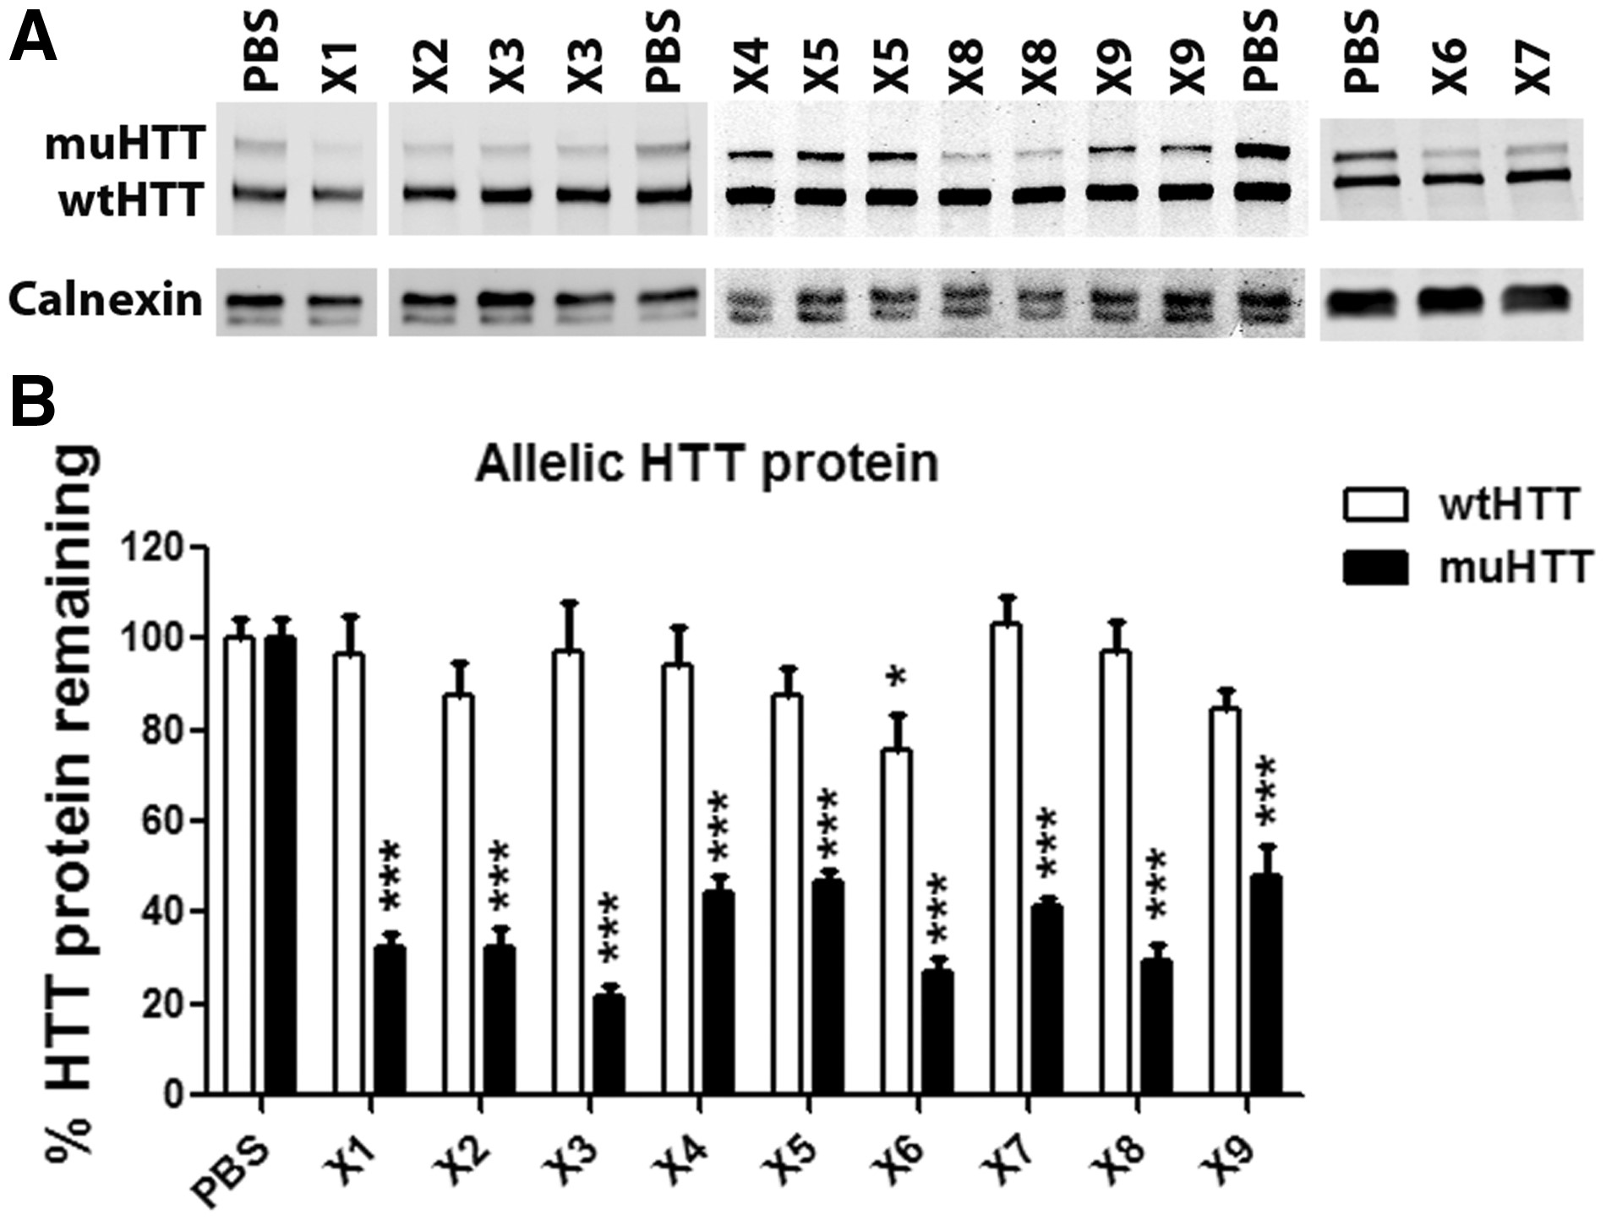
Figure 9 Single dose screen of C HTT haplogroup ASOs in Hu128/21 brain. 300 µg of ASO was delivered by unilateral ICV ...
Notes:
Figure 9 Single dose screen of C HTT haplogroup ASOs in Hu128/21 brain. 300 µg of ASO was delivered by unilateral ICV bolus injection to 6-week-old Hu128/21 mice. Four weeks later protein was isolated from a 2 mm coronal section from each hemisphere and evaluated for HTT protein by allelic separation immunoblotting. HTT levels were normalized to calnexin from the same sample as a loading control and then to the same allele from PBS injected animals on the same membrane. (A) Representative blot images. (B) Quantification of both hemispheres from an N of four animals per ASO. *Different from same allele PBS-treated animals, *P < 0.05, ***P < 0.001.
Unless provided in the caption above, the following copyright applies to the content of this slide: © The Author 2017. Published by Oxford University Press. All rights reserved. For Permissions, please email: journals.permissions@oup.com

Slide 10
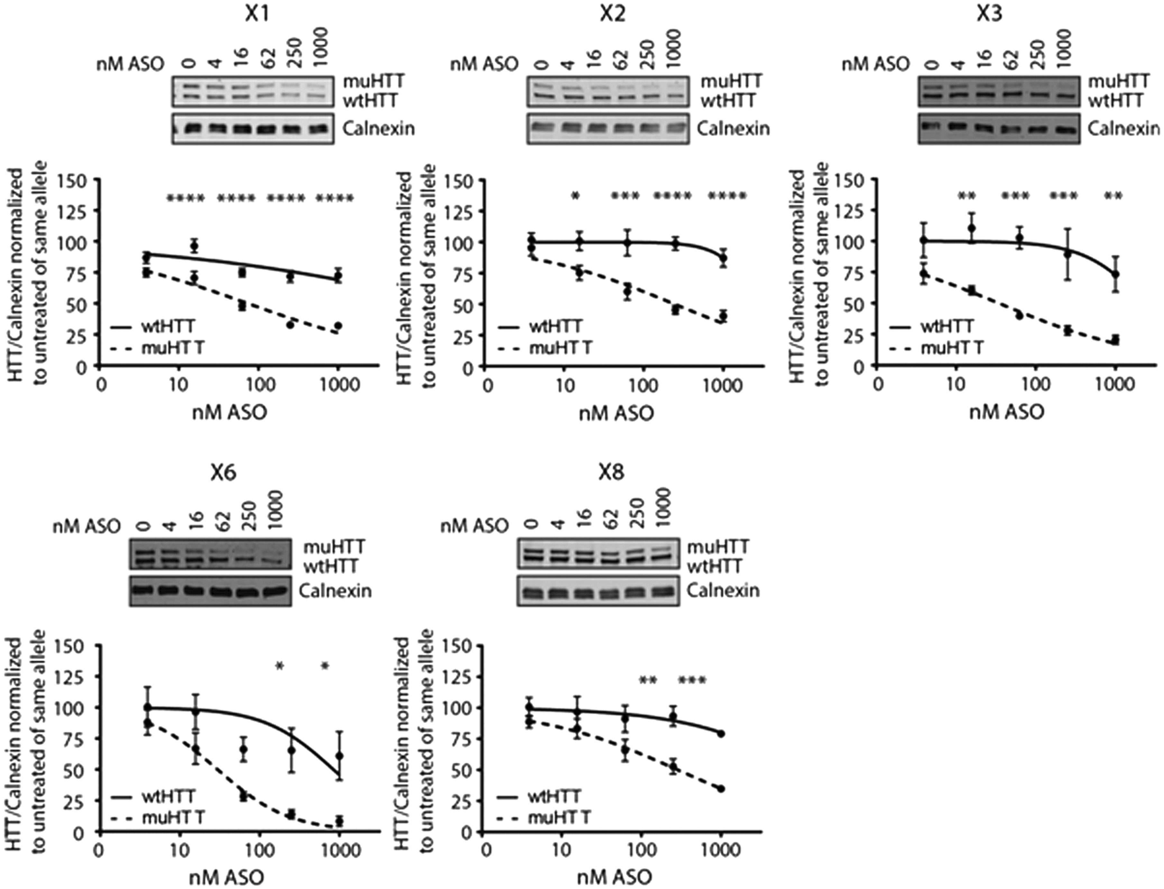
Figure 10 Dose response of C HTT haplogroup ASOs in primary Hu128/21 neurons. Primary Hu128/21 neurons were treated ...
Notes:
Figure 10 Dose response of C HTT haplogroup ASOs in primary Hu128/21 neurons. Primary Hu128/21 neurons were treated with the 5 most potent ASOs (>60%KD in vivo) at 4–1000 nM for 6 days. HTT KD was evaluated by allelic separation immunoblotting. Each HTT allele was normalized to the loading control calnexin and then to the same allele for the untreated sample. Representative images are shown for each ASO. Number of 4–12 per data point. Data are presented as mean ± SEM. Two-way ANOVA with Bonferroni post hoc test was performed. *Different from same allele untreated neurons, *P < 0.05, **P < 0.01, ***P < 0.001 and ****P < 0.0001.
Unless provided in the caption above, the following copyright applies to the content of this slide: © The Author 2017. Published by Oxford University Press. All rights reserved. For Permissions, please email: journals.permissions@oup.com

