Slide 1
FIG. 1. Oligonucleotide sequences. The target sequence in exon 3 of the HPRT locus is shown as a duplex and ...
Notes:
FIG. 1. Oligonucleotide sequences. The target sequence in exon 3 of the HPRT locus is shown as a duplex and underlined. AD3-hprtPM ASO is designed to bind complementarily to the nontranscribed strand, except a single-mismatched base (bold lowercase). Control oligonucleotide has no sequence similarity to the HPRT locus.
Unless provided in the caption above, the following copyright applies to the content of this slide: © The Author 2012. Published by Oxford University Press on behalf of the Society of Toxicology. All rights reserved. For permissions, please email: journals.permissions@oup.com

Slide 2
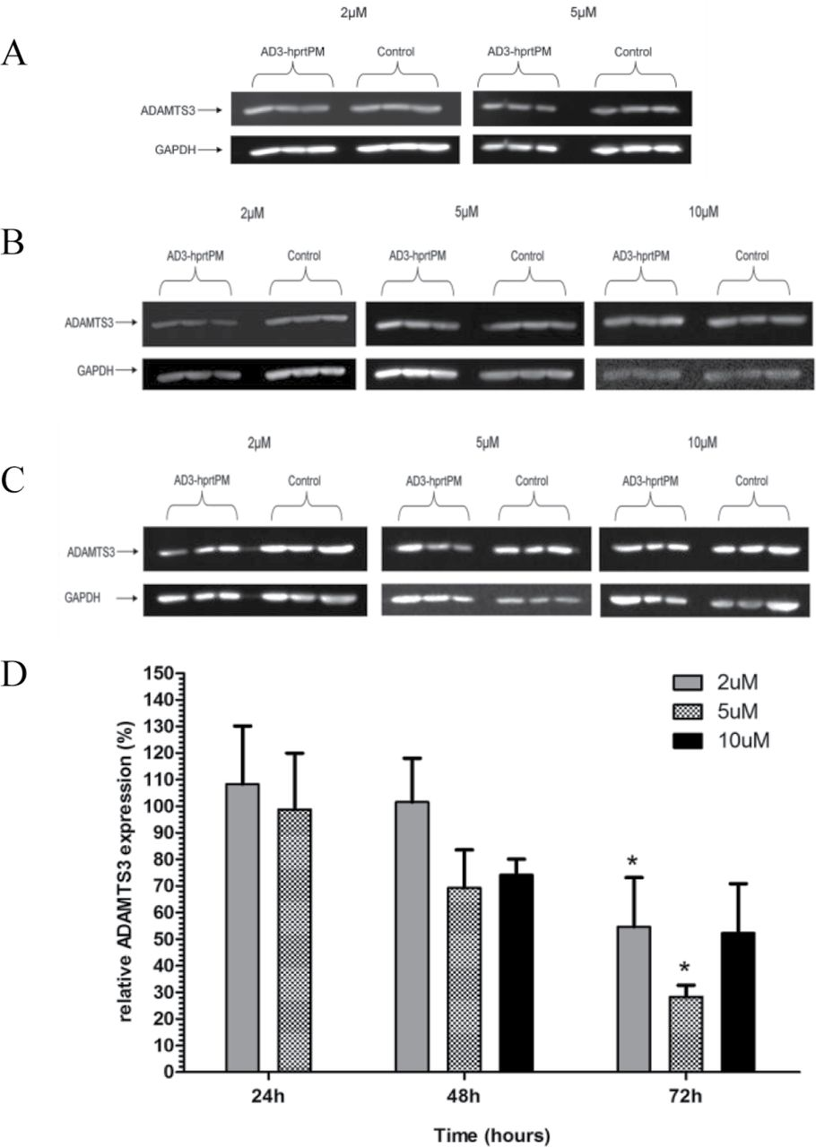
FIG. 2. Antisense activity of AD3-hprtPM oligonucleotide. TK6 cells were treated with 2, 5, or 10μM AD3-hprtPM or ...
Notes:
FIG. 2. Antisense activity of AD3-hprtPM oligonucleotide. TK6 cells were treated with 2, 5, or 10μM AD3-hprtPM or control oligonucleotide. ADAMTS3 protein expression at (A) 24, (B) 48, and (C) 72h was determined by immunoblot. ADAMTS3 expression was quantified by densitometry and corrected for GAPDH-loading control. ADAMTS3 protein expression following AD3-hprtPM treatment was normalized to control oligonucleotide treatment at the respective time and dose (D). Data represent mean ± SD of three independent treatments. ADAMTS3 protein expression from AD3-hprtPM treatment is compared with control oligonucleotide at the same dose and time using a two-way Student’s t-test. *p < 0.05.
Unless provided in the caption above, the following copyright applies to the content of this slide: © The Author 2012. Published by Oxford University Press on behalf of the Society of Toxicology. All rights reserved. For permissions, please email: journals.permissions@oup.com

Slide 3
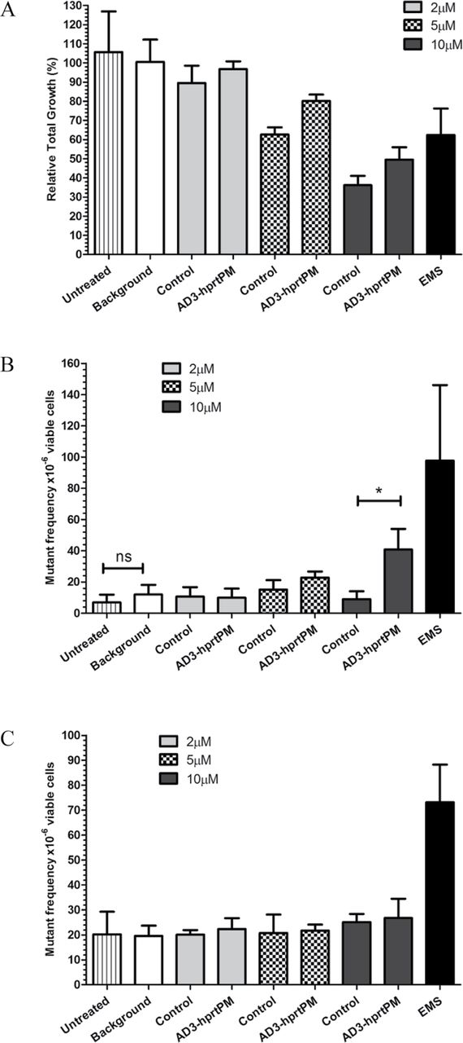
FIG. 3. Genotoxicity of AD3-hprtPM in a HR repair–induced system. Human TK6 cells were pretreated with 0.2 μg/ml MMS ...
Notes:
FIG. 3. Genotoxicity of AD3-hprtPM in a HR repair–induced system. Human TK6 cells were pretreated with 0.2 μg/ml MMS for 24h to induce the HR repair pathway. The untreated group measures the cytotoxic/genotoxic effect of the MMS pretreatment. The spontaneous mutant frequency following MMS pretreatment was determined as background. EMS (5 μg/ml) was used as a positive genotoxin. Cytotoxicity below the minimum accepted 20% RTG is not evident following treatment of TK6 cells with 2, 5, or 10μM oligonucleotide (A). AD3-hprtPM–induced a dose-dependent increase in HPRT mutants relative to control oligonucleotide (B). AD3-hprtPM oligonucleotide failed to induce mutation at the nontargeted TK locus (C). Data represent mean ± SD of three independent treatments. *p < 0.05 using two-way Student’s t-test.
Unless provided in the caption above, the following copyright applies to the content of this slide: © The Author 2012. Published by Oxford University Press on behalf of the Society of Toxicology. All rights reserved. For permissions, please email: journals.permissions@oup.com

Slide 4
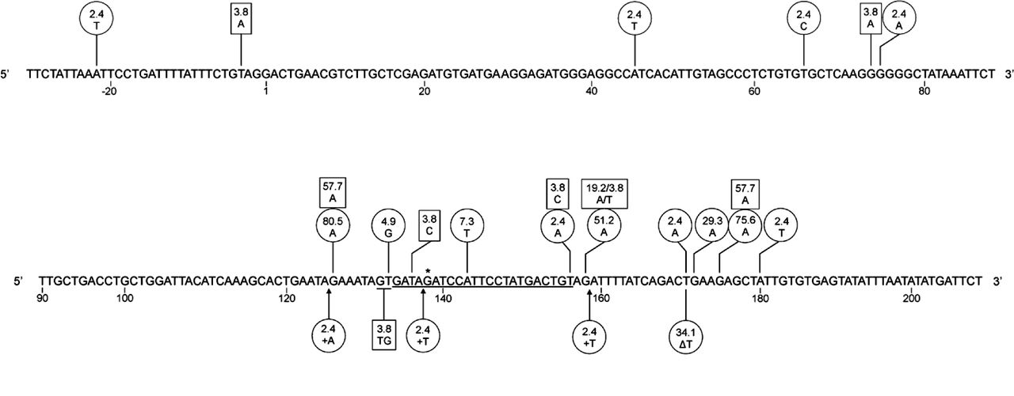
FIG. 4. Distribution of AD3-hprtPM–mediated mutation in exon 3 of the HPRT locus. Sequences are numbered from the ...
Notes:
FIG. 4. Distribution of AD3-hprtPM–mediated mutation in exon 3 of the HPRT locus. Sequences are numbered from the first base of exon 3 (1–164). The AD3-hprtPM target sequence is underlined from position 134–156. “*” above guanine (position 138) indicates the site of the mismatched base in AD3-hprtPM, where G > T transversion mutation was predicted. Numbers and letters within a circle represent the frequency (%) and type of mutation from 41 AD3-hprtPM–induced HPRT mutant clones, whereas those in a square are from 29 control oligonucleotide-induced HPRT mutant clones. “+” indicates an insertion and “∆” indicates a deletion.
Unless provided in the caption above, the following copyright applies to the content of this slide: © The Author 2012. Published by Oxford University Press on behalf of the Society of Toxicology. All rights reserved. For permissions, please email: journals.permissions@oup.com

Slide 5
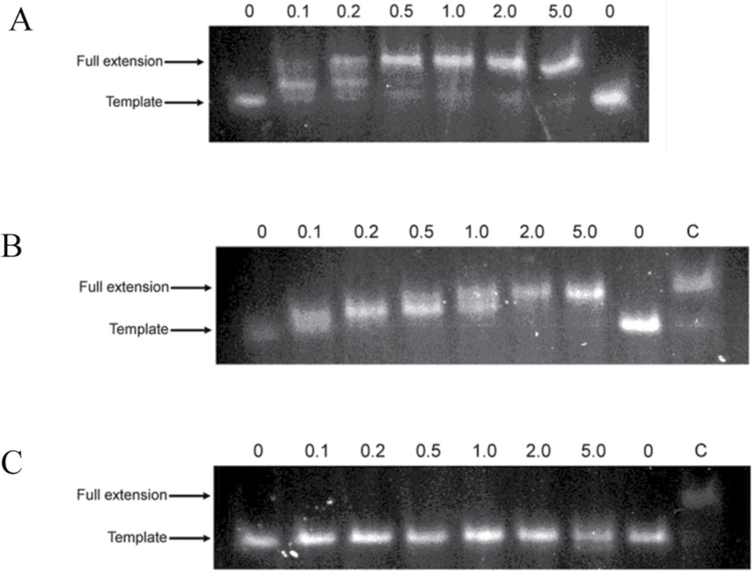
FIG. 5. Efficiency of nucleotide analogue incorporation into a primed DNA template. Two complementary oligonucleotide ...
Notes:
FIG. 5. Efficiency of nucleotide analogue incorporation into a primed DNA template. Two complementary oligonucleotide strands (25 and 30 nt) were annealed together to produce an overhang of five thymidine nucleotides. The ability to extend the short strand by five nucleotides is used as the marker for incorporation of nucleotide. The values above each lane are dose of nucleotide analogue (μM). Full extension of the primed template was found to occur in a 10-min reaction with 0.5μM dATP (A). Incorporation of the phosphorothioate nucleotide analogue, dATPαS, was in a 20-min reaction at 2μM (B). Here, dATP (5μM) was used as a positive control (lane C) to reference an extended template. DNA polymerase failed to incorporate the nucleotide analogue, 2΄OMe-ATP, into the primed template in a 60-min reaction (C).
Unless provided in the caption above, the following copyright applies to the content of this slide: © The Author 2012. Published by Oxford University Press on behalf of the Society of Toxicology. All rights reserved. For permissions, please email: journals.permissions@oup.com

Slide 6
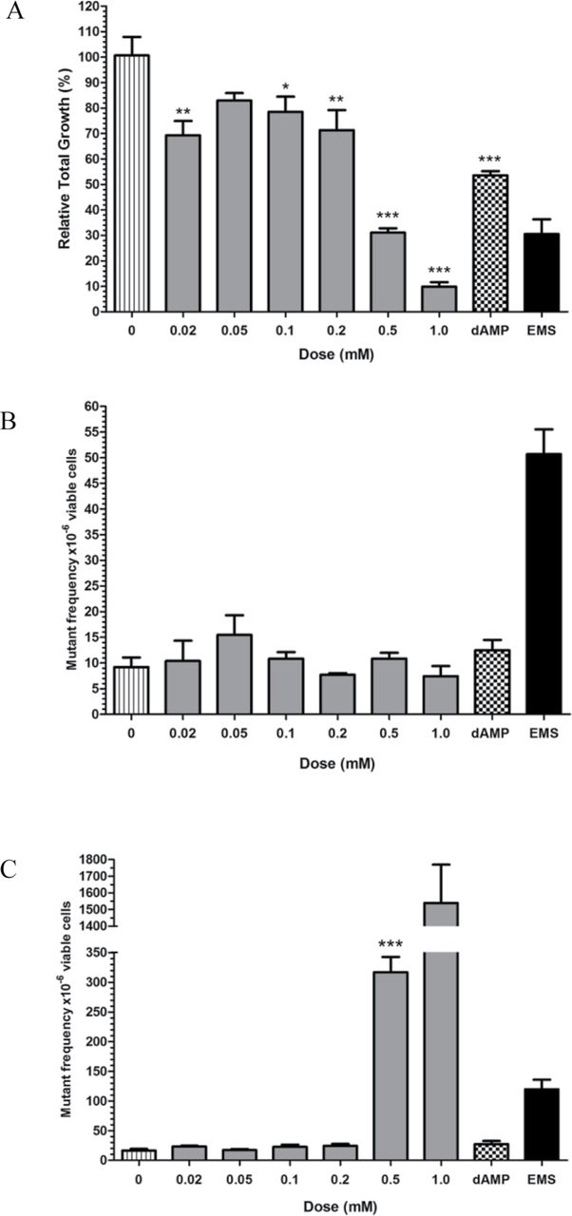
FIG. 6. Genotoxicity of dAMPαS nucleotide analogue incorporation into genomic DNA. Human TK6 cells were treated with ...
Notes:
FIG. 6. Genotoxicity of dAMPαS nucleotide analogue incorporation into genomic DNA. Human TK6 cells were treated with nucleotide analogue dAMPαS from 20µM up to 1mM for 24h. As a nucleotide control, TK6 cells were also treated with 1mM dAMP. The zero dose is the negative control (solvent). EMS (5 μg/ml) was used as a positive genotoxin. For mutation assays, RTG above 20% are considered acceptable; only treatment with 1mM dAMPαS (10% RTG) was below this threshold (A). Mutation at the HPRT locus was not observed (B). However, treatment with dAMPαS resulted in a dose-dependent increase in TK mutants up to 96-fold above control (C). The unmodified nucleotide, dAMP (1mM), induced the TK mutant frequency ~1.7-fold (C). *p < 0.05, **p < 0.01, and ***p < 0.001 using one-way ANOVA with Dunnett’s post hoc test compared with control.
Unless provided in the caption above, the following copyright applies to the content of this slide: © The Author 2012. Published by Oxford University Press on behalf of the Society of Toxicology. All rights reserved. For permissions, please email: journals.permissions@oup.com

