Slide 1
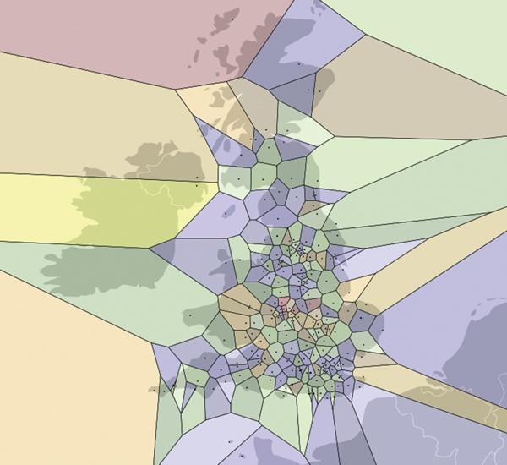
1: Kyle Willett's map of the UK in terms of your distance from the nearest astronomy group: the smaller the ...
Notes:
1: Kyle Willett's map of the UK in terms of your distance from the nearest astronomy group: the smaller the tile, the closer you are to astronomy.
Unless provided in the caption above, the following copyright applies to the content of this slide: © 2014 Royal Astronomical Society

Slide 2
2: Hack days tend to harness creativity of all sorts, in this case marrying the Mars Express dataset with the ...
Notes:
2: Hack days tend to harness creativity of all sorts, in this case marrying the Mars Express dataset with the internet meme Nyan Cat.
Unless provided in the caption above, the following copyright applies to the content of this slide: © 2014 Royal Astronomical Society

Slide 3
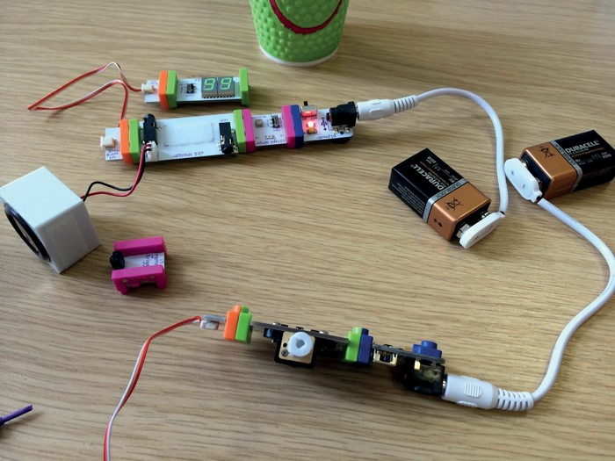
3: The littleBits exoplanet detector and cup orrery built by Edward Gomez and Robert Simpson.
Notes:
3: The littleBits exoplanet detector and cup orrery built by Edward Gomez and Robert Simpson.
Unless provided in the caption above, the following copyright applies to the content of this slide: © 2014 Royal Astronomical Society

Slide 4
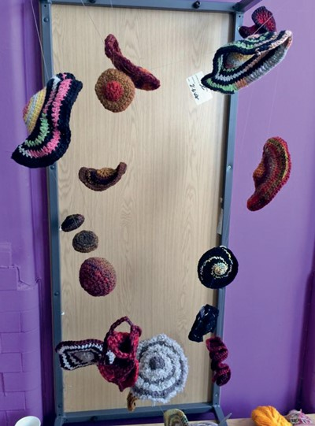
4: Galaxy cluster knitted by Jane Greaves and many others.
Notes:
4: Galaxy cluster knitted by Jane Greaves and many others.
Unless provided in the caption above, the following copyright applies to the content of this slide: © 2014 Royal Astronomical Society

