Slide 1
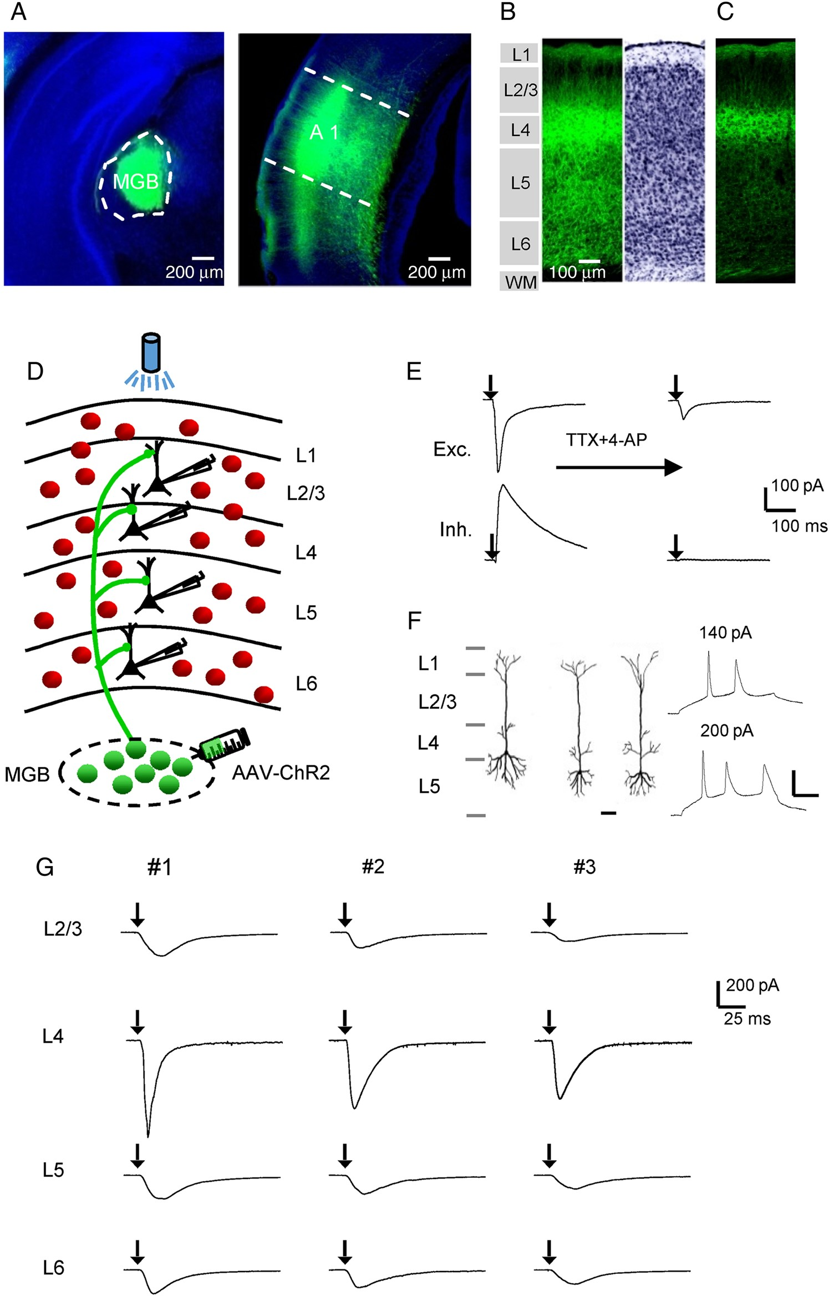
Figure 1. Laminar distribution of thalamocortical axons and functional examination of thalamocortical innervation. (A) ...
Notes:
Figure 1. Laminar distribution of thalamocortical axons and functional examination of thalamocortical innervation. (A) Left, fluorescence image of the AAV-ChR2-EYFP injection site. The MGB is outlined. Blue, fluorescent nissl staining. Right, image of fluorescent axons in the auditory cortical area. A1 is outlined. The injection was performed on a P35 mouse and images were obtained at P56. (B) Laminar distribution of thalamocortical axons in the A1, with cytoarchitecturally defined cortical layers shown (left). Right, inverted image of fluorescent nissl staining. (C) Image of thalamocortical axons with a lower exposure level. Note that fluorescent cell bodies are absent in deep layers. Scale is the same as in (B). (D) Schematic graph showing laminar specific recordings from pyramidal neurons (black) in slices from GAD2-Cre;Ai14 mice, where inhibitory neurons are labeled by red fluorescence. Blue light was applied onto the entire auditory cortical area to stimulate thalamic axons expressing ChR2. (E) Excitatory (top) and inhibitory (bottom) postsynaptic currents (EPSC and IPSC respectively) of an example pyramidal neuron evoked by a 3-ms pulse of blue light (with onset marked by the arrow), recorded in the normal external solution (left) and after perfusing in TTX and 4-AP (right). (F) Left, reconstructed morphologies of 3 recorded cells, which confirmed that they were pyramidal cells. Scale: 50 µm. Right, membrane potential/spike responses of a pyramidal cell to current injections at 2 different levels. Scale: 20 mV and 50 ms. (G) Optically evoked monosynaptic EPSCs (averaged) of sample pyramidal neurons recorded in different layers of the same slice (vertically arranged). Three example slices (#1–#3) are shown. Black arrow marks the onset of photostimulation.
Unless provided in the caption above, the following copyright applies to the content of this slide: © The Author 2015. Published by Oxford University Press. All rights reserved. For Permissions, please e-mail: journals.permissions@oup.com

Slide 2
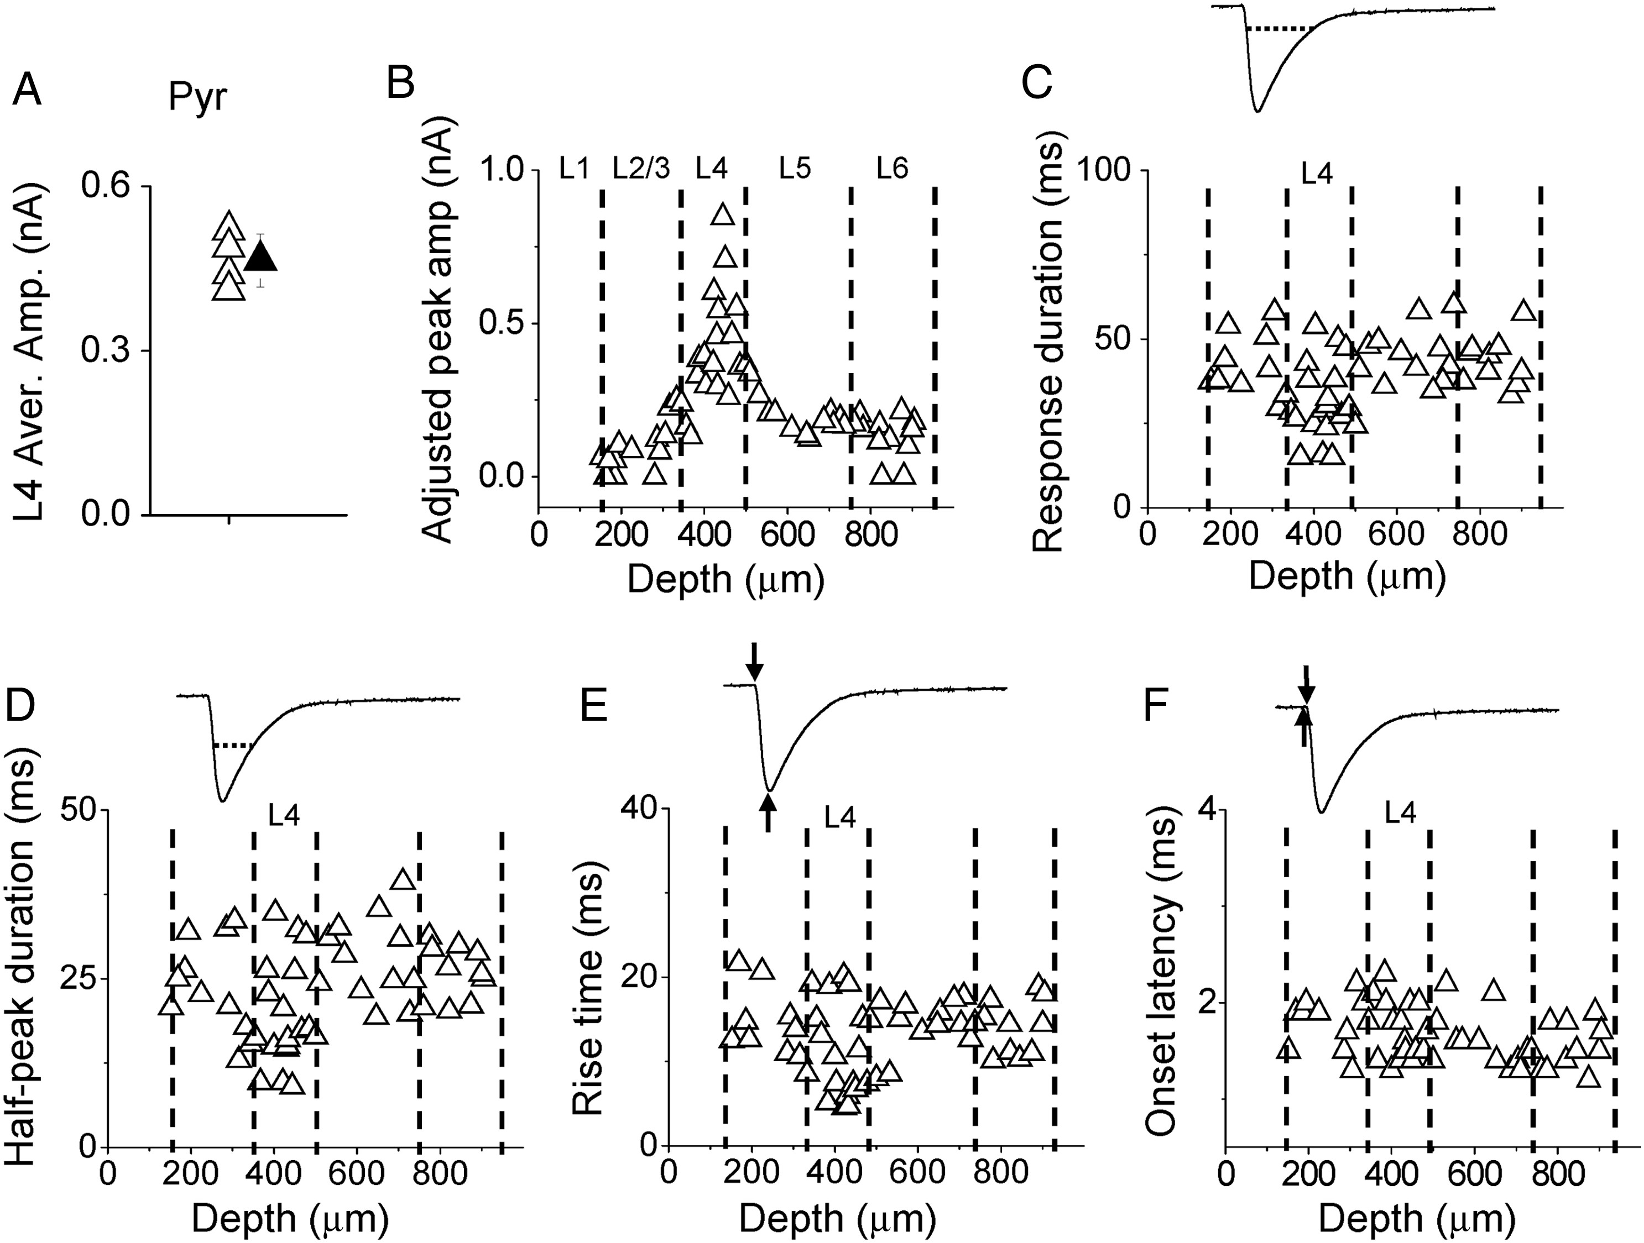
Figure 2. Laminar pattern of thalamocortical responses in A1 pyramidal neurons. (A) Average amplitudes of ...
Notes:
Figure 2. Laminar pattern of thalamocortical responses in A1 pyramidal neurons. (A) Average amplitudes of thalamocortical responses in L4 pyramidal neurons in 4 slices (open triangle) and their mean value (solid triangle, bar = SD). This global mean value could be used as a reference to calculate the adjusted amplitude for each recorded cell. (B) Distribution of adjusted peak amplitudes along cortical depth. Each data point represents one cell (n = 56 pyramidal cells from 4 slices). Recordings were made in the presence of TTX and 4-AP. Dotted lines indicate estimated boundaries between layers. (C) Distribution of response durations along cortical depth. Top inset, an example response trace showing that the duration was measured at the level of 10% of peak amplitude (marked by the dotted line). (D) Distribution of half-peak durations. Top inset, the dotted line shows that the duration was measured at the level of 50% of peak amplitude. (E) Distribution of response rise times. Top inset, the first arrow indicates the onset of the thalamocortical response, and the second arrow indicates the peak response. The interval between the 2 arrows defines the rise time. (F) Distribution of response onset latencies. Top inset, the first arrow indicates the onset of photostimulation, and the second arrow indicates the time when the response amplitude exceeds the average baseline by 2 SDs. The interval between the 2 arrows defines the onset latency.
Unless provided in the caption above, the following copyright applies to the content of this slide: © The Author 2015. Published by Oxford University Press. All rights reserved. For Permissions, please e-mail: journals.permissions@oup.com

Slide 3
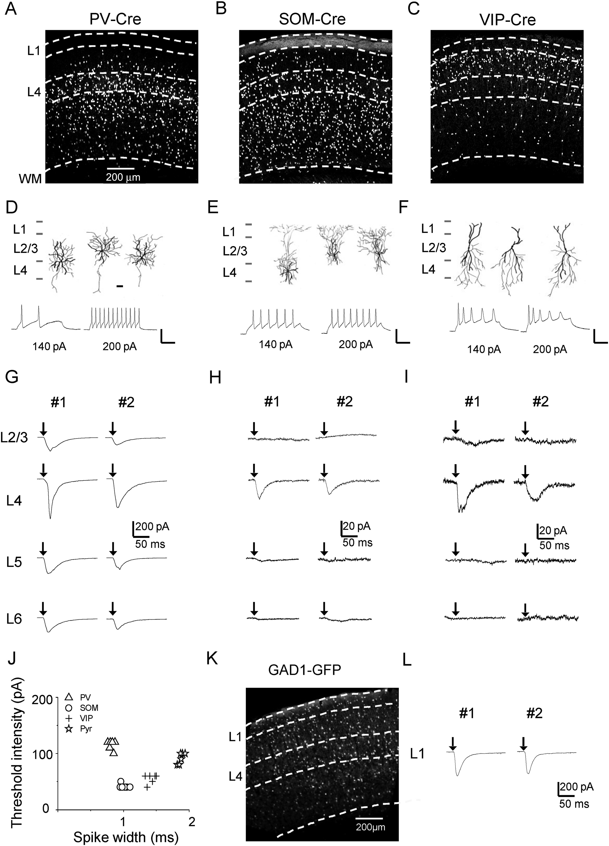
Figure 3. Thalamocortical innervation of A1 inhibitory neurons. (A) Fluorescence image of labeled PV neurons in the A1 ...
Notes:
Figure 3. Thalamocortical innervation of A1 inhibitory neurons. (A) Fluorescence image of labeled PV neurons in the A1 of a PV-Cre;Ai14 mouse. (B) Fluorescence image of an A1 slice from a SOM-Cre;Ai14 mouse. (C) Image of an A1 slice from a VIP-Cre;Ai14 mouse. (D) Top, reconstructed morphologies (dark for dendrites, gray for axons) of 3 recorded PV neurons. Scale: 50 µm. Bottom, sample membrane potential/spike responses of a PV cell to current injections at 2 different levels. Scale: 50 pA and 50 ms. (E) Morphology and intrinsic spiking property for SOM neurons. (F) Morphology and intrinsic spiking property for VIP neurons. (G) Monosynaptic EPSCs recorded in sample PV cells in different layers of the same slice. Two example slices are shown. (H) EPSCs of example SOM neurons. (I) EPSCs of example VIP neurons. (J) Plot of threshold intensity of current injections that produce spikes vs. spike width for 4 types of neuron. Spike width was measured at the half-peak level above the spike threshold. (K) Fluorescence image of an A1 slice from a GAD1-GFP mouse. (L) EPSCs of example L1 inhibitory neurons recorded in 2 slices.
Unless provided in the caption above, the following copyright applies to the content of this slide: © The Author 2015. Published by Oxford University Press. All rights reserved. For Permissions, please e-mail: journals.permissions@oup.com

Slide 4
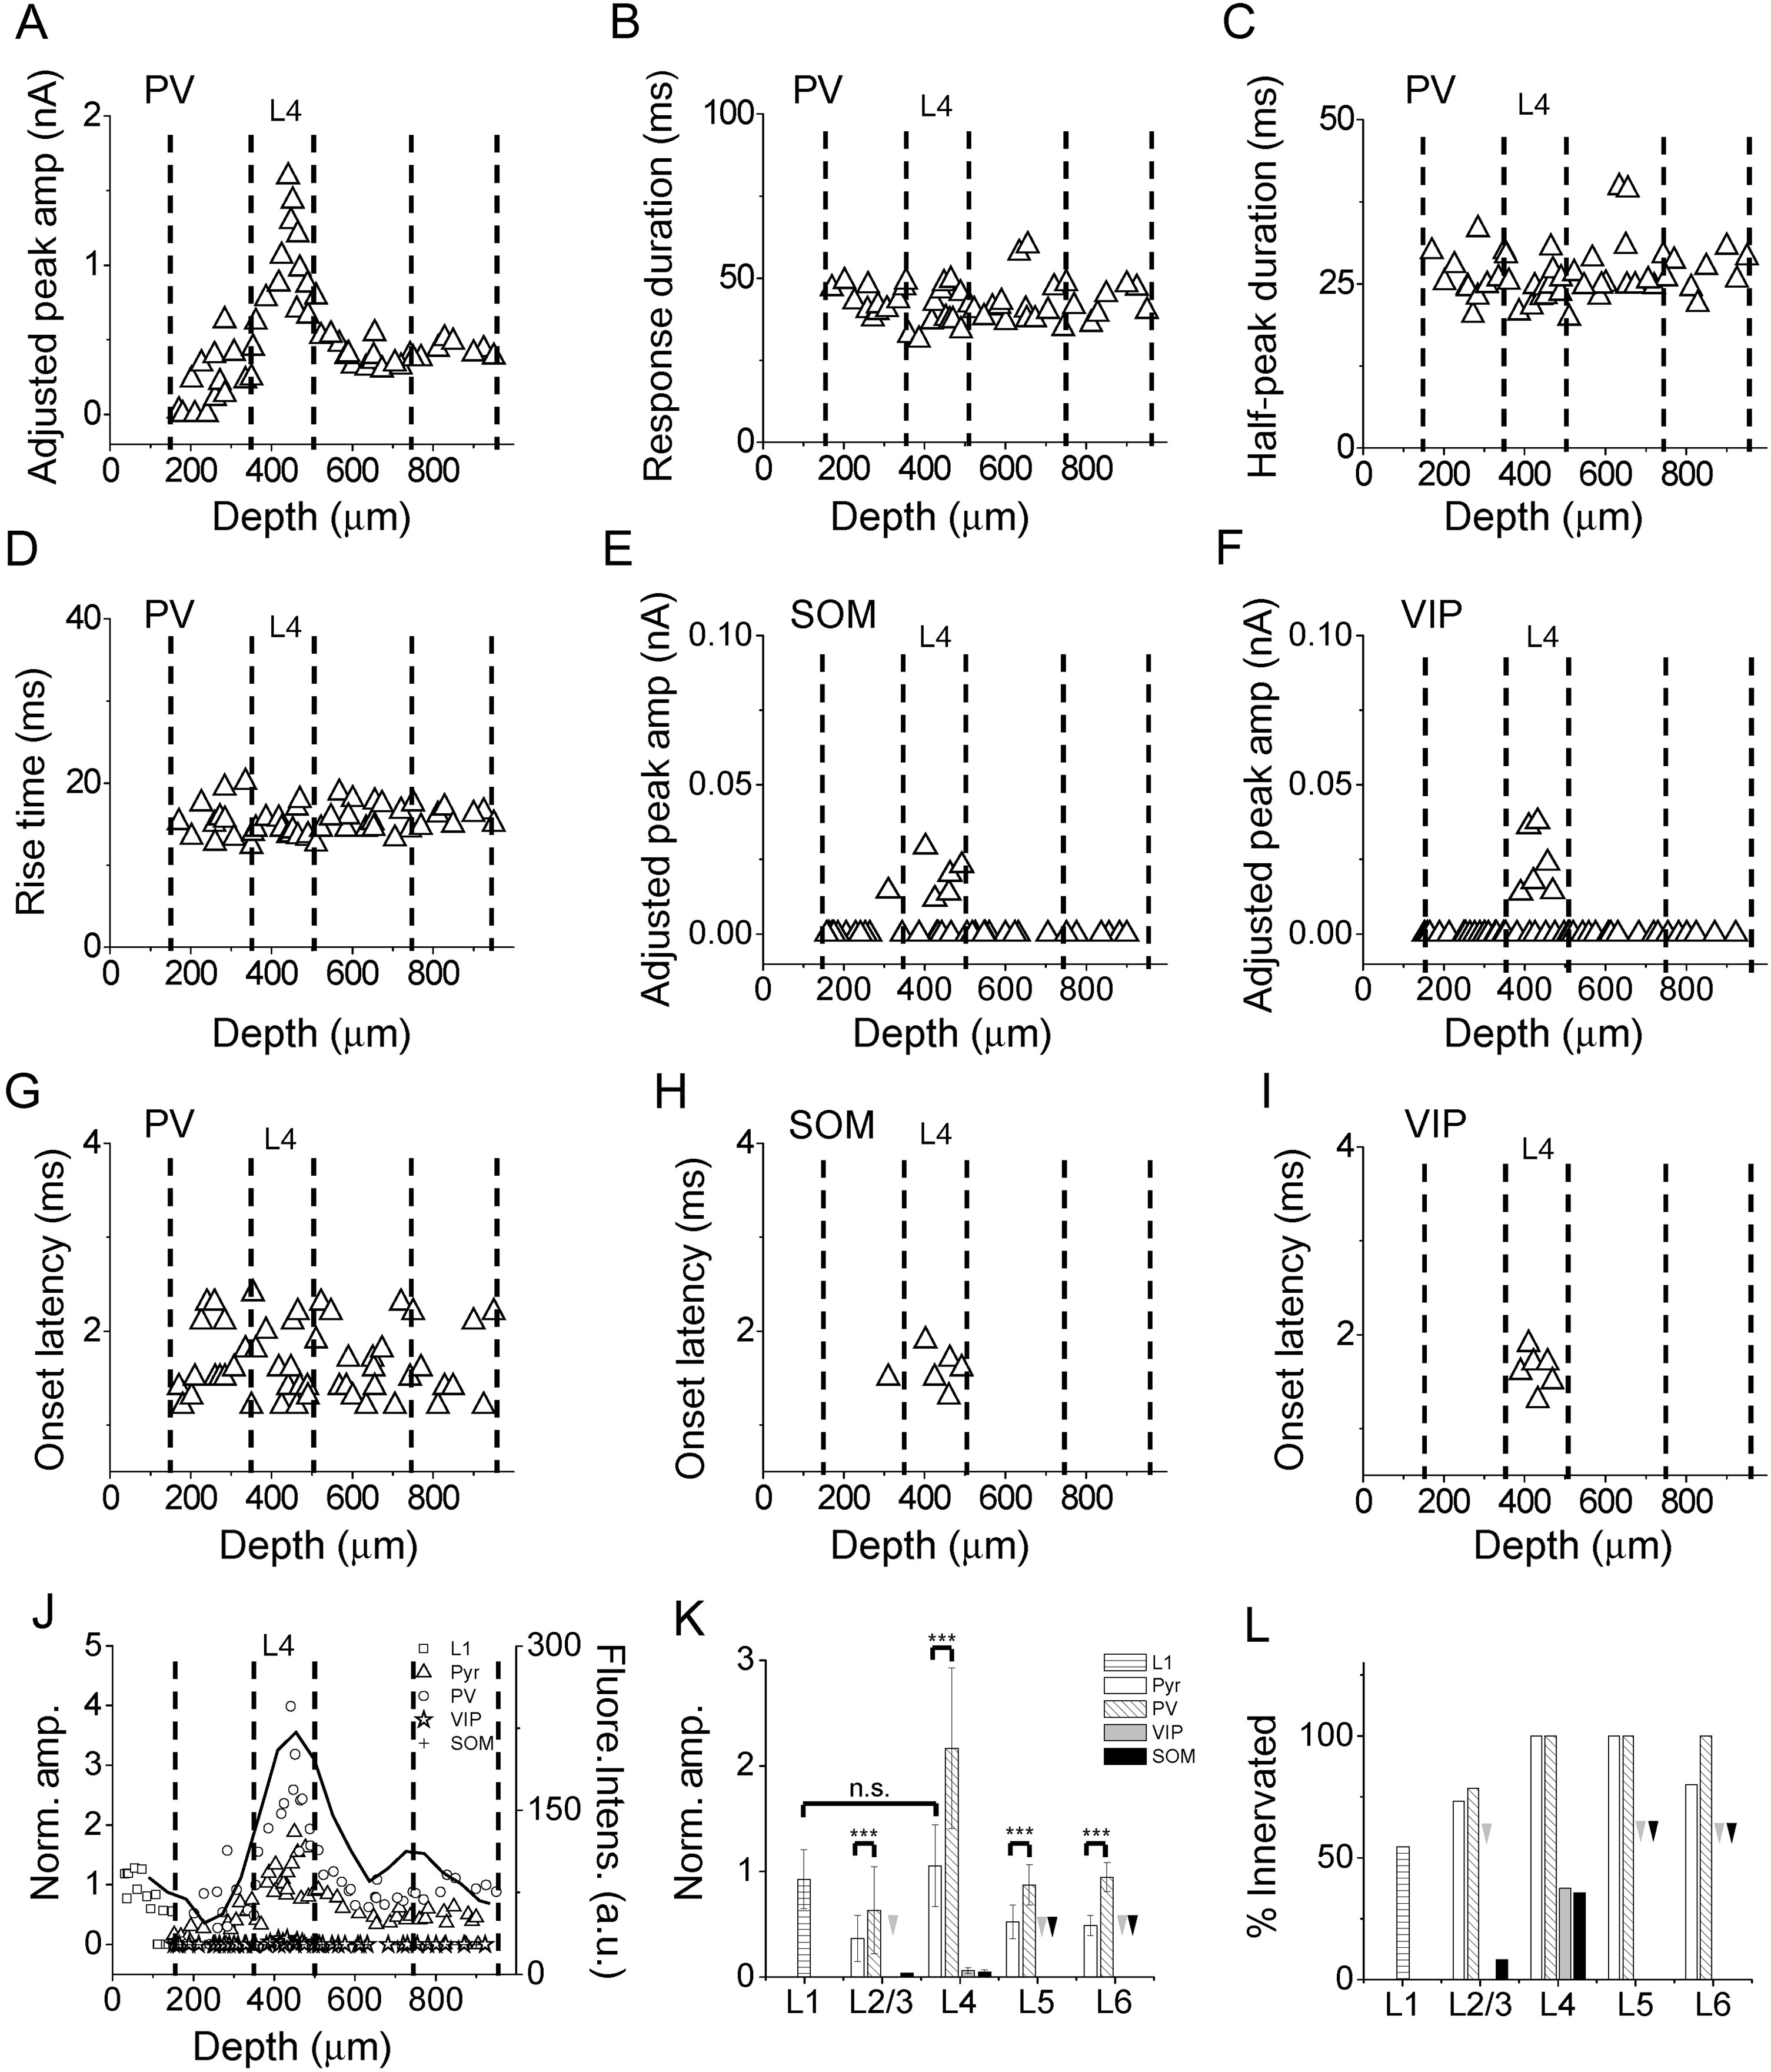
Figure 4. Laminar patterns of thalamocortical responses in A1 inhibitory neurons. (A) Distribution of adjusted peak ...
Notes:
Figure 4. Laminar patterns of thalamocortical responses in A1 inhibitory neurons. (A) Distribution of adjusted peak amplitudes of thalamocortical responses recorded in PV neurons along cortical depth. Each data point represents one cell. (B) Distribution of response durations of thalamocortical responses in PV neurons. F = 0.499, P = 0.685, ANOVA test. (C) Distribution of half-peak durations for PV neurons. F = 0.877, P = 0.461, ANOVA test. (D) Distribution of response rise times for PV neurons. F = 0.851, P = 0.474, ANOVA test. (E) Distribution of adjusted peak amplitudes for SOM neurons. (F) Distribution of adjusted peak amplitudes for VIP neurons. (G) Distribution of onset latencies for PV neurons. F = 1.579, P = 0.207, ANOVA test. (H) Distribution of onset latencies for SOM neurons. (I) Distribution of onset latencies for VIP neurons. (J) Normalized amplitudes for different cell types. The adjusted amplitudes were normalized to the global average amplitude of L4 excitatory neuron responses. The black curve represents the laminar distribution of fluorescence intensity (in arbitrary unit) of thalamocortical axon fibers. (K) Average normalized peak amplitudes of different cell types in different layers. Arrows point to zero values. ***P < 0.001, t-test. (L) Percentage of cells exhibiting thalamocortical responses. Arrows point to zero values. L1 cell (12/ 22); Pyramidal cell (11/15 in L2/3; 18/18 in L4; 12/12 in L5; 8/10 in L6); PV cell (11/14 in L2/3;13/13 in L4; 15/15 in L5; 8/8 in L6); VIP cell (0/17 in L2/3; 6/16 in L4; 0/10 in L5; 0/6 in L6); SOM cell (1/12 in L2/3; 5/14 in L4; 0/10 in L5; 0/6 in L6).
Unless provided in the caption above, the following copyright applies to the content of this slide: © The Author 2015. Published by Oxford University Press. All rights reserved. For Permissions, please e-mail: journals.permissions@oup.com

Slide 5
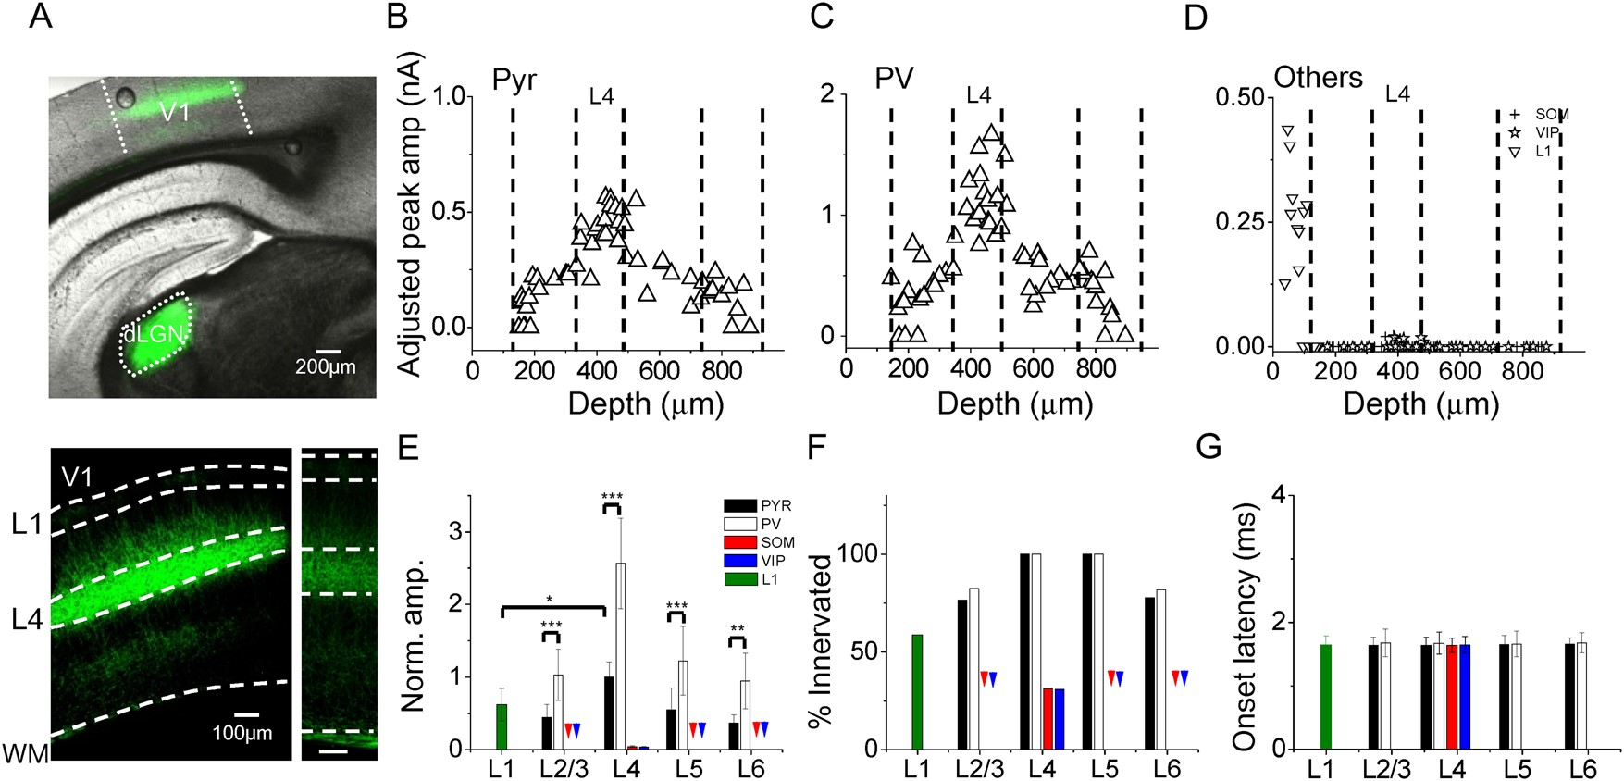
Figure 5. Laminar patterns of thalamocortical innervation of V1 neurons. (A) Top, superimposed fluorescence and bright ...
Notes:
Figure 5. Laminar patterns of thalamocortical innervation of V1 neurons. (A) Top, superimposed fluorescence and bright field image of a brain slice showing ChR2 expression in the injected site (dLGN) and in the V1. Bottom, enlarged image of the V1 showing the fluorescent thalamic axons. Bottom right, image obtained with a lower level of exposure to show that there were no retrogradely labeled cell bodies. Scale: 100 µm. (B) Distribution of adjusted peak amplitudes for pyramidal neurons across cortical depth. F = 34.553, P = 0.000, ANOVA test. P < 0.001 between L4 and L2/3, P < 0.001 between L4 and L5, P < 0.001 between L4 and L6, post hoc test. (C) Distribution of adjusted response amplitudes for PV neurons. F = 23.180, P = 0.000, ANOVA test. P < 0.001 between L4 and L2/3, P < 0.001 between L4 and L5, P < 0.001 between L4 and L6, post hoc test. (D) Distribution of adjusted response amplitudes for other neuronal types. (E) Average normalized amplitudes for different cell types in different layers of V1. Arrows point to zero values. ***P < 0.001, **P < 0.01, *P < 0.05, t-test. (F) Percentage of cells exhibiting thalamocortical responses. Arrows point to zero values. L1 cell (10/17); Pyramidal cell (15/19 in L2/3; 19/19 in L4; 8/8 in L5; 7/9 in L6); PV cell (14/17 in L2/3; 15/15 in L4; 15/15 in L5; 9/11 in L6); SOM cell (0/12 in L2/3; 5/15 in L4; 0/7 in L5; 0/5 in L6); VIP cell (0/5 in L2/3; 4/9 in L4; 0/9 in L5; 0/5 in L6). (G) Average onset latencies for different cell types in different layers. F = 0.112, P = 0.978, ANOVA test.
Unless provided in the caption above, the following copyright applies to the content of this slide: © The Author 2015. Published by Oxford University Press. All rights reserved. For Permissions, please e-mail: journals.permissions@oup.com

Slide 6
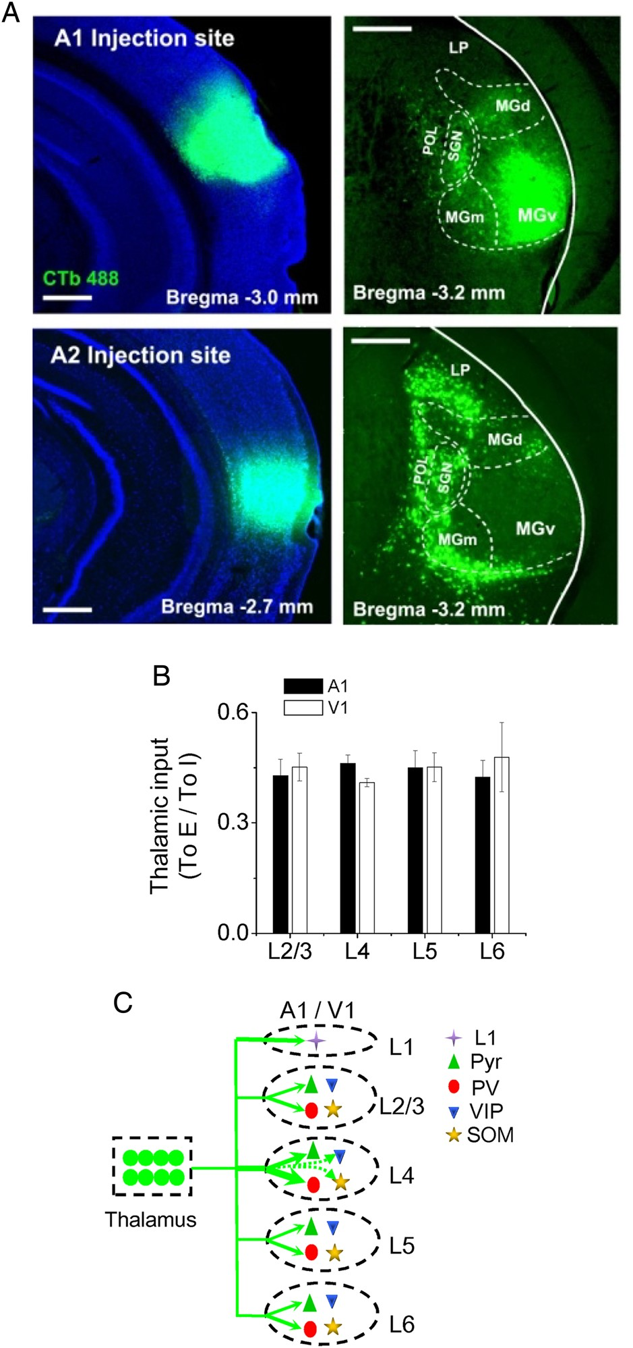
Figure 6. Summary of thalamocortical innervation of A1 and V1 neurons. (A) Top, image of CTb fluorescence in the ...
Notes:
Figure 6. Summary of thalamocortical innervation of A1 and V1 neurons. (A) Top, image of CTb fluorescence in the injected site (in A1) (left) and retrogradely labeled neurons in the thalamus. Boundaries for some thalamic divisions are marked. Scale: 500 µm. LP: lateral posterior nucleus. SG: suprageniculate nucleus. POL: posterior limiting nucleus. MGd, MGm, MGv: dorsal, medial, and ventral part of the MGB respectively. (B) Ratio of strength of thalamocortical innervation of a pyramidal vs. a PV cell in the same layer. Average values were obtained by bootstrap sampling (1000 times, see Materials and Methods). Bar = SD. There are no significant differences between any 2 layers in either A1 or V1 (ANOVA test). (C) Schematic graph to summarize thalamocortical innervation patterns in the A1 and V1. The thickness of the green arrow indicates the innervation strength. Arrows with dashed lines represent the weakest connections.
Unless provided in the caption above, the following copyright applies to the content of this slide: © The Author 2015. Published by Oxford University Press. All rights reserved. For Permissions, please e-mail: journals.permissions@oup.com

