Slide 1
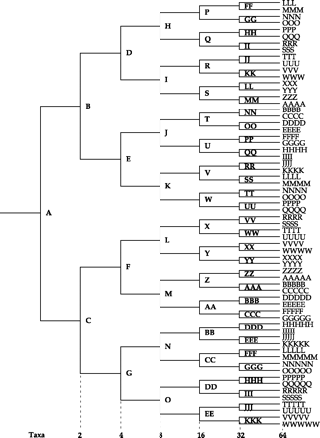
FIG. 1.— Node-naming convention for simulated trees.
Notes:
FIG. 1.— Node-naming convention for simulated trees.
Unless provided in the caption above, the following copyright applies to the content of this slide: Molecular Biology and Evolution vol. 22 no. 3 © Society for Molecular Biology and Evolution 2004; all rights reserved.

Slide 2
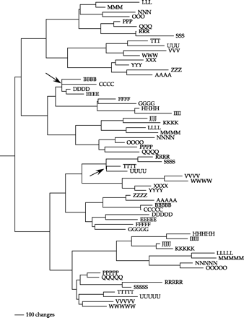
FIG. 2.— Phylogram of a typical true tree of 64 taxa with an average of 250 changes (accepted mutations) per branch.
Notes:
FIG. 2.— Phylogram of a typical true tree of 64 taxa with an average of 250 changes (accepted mutations) per branch.
Unless provided in the caption above, the following copyright applies to the content of this slide: Molecular Biology and Evolution vol. 22 no. 3 © Society for Molecular Biology and Evolution 2004; all rights reserved.

