Slide 1
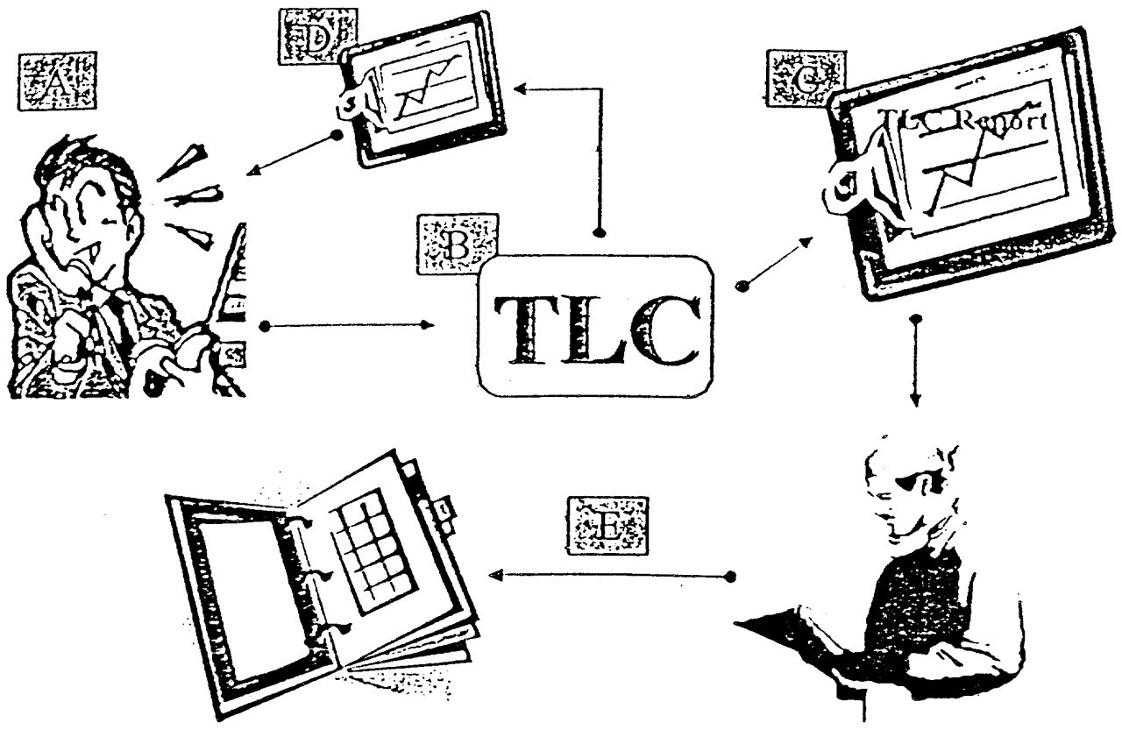
Figure 1 Overview of TLC functions. The patient initiates the process by telephoning TLC (A). TLC carries out a ...
Notes:
Figure 1 Overview of TLC functions. The patient initiates the process by telephoning TLC (A). TLC carries out a conversation with the patient and stores information provided by the patient in a database (B). TLC issues patient reports to the patient's physician or other provider (C) and to the patient (D). The physician reads the report, and it is placed in the patient's medical record (E), whether this is paper or electronic.
Unless provided in the caption above, the following copyright applies to the content of this slide: American Medical Informatics Association

Slide 2
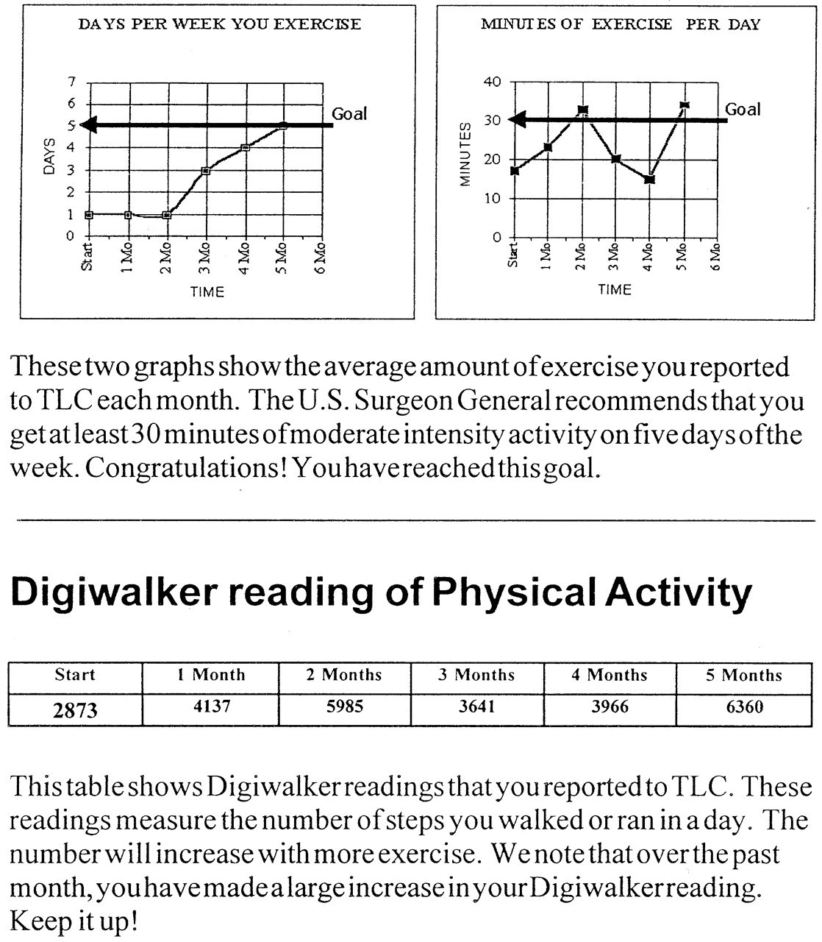
Figure 2 Sample patient report for TLC-ACT. This is an example of a patient report for TLC-ACT, an application for ...
Notes:
Figure 2 Sample patient report for TLC-ACT. This is an example of a patient report for TLC-ACT, an application for promoting physical activity. The upper two graphs display the patient's average level of physical activity per month. The graph on the left plots the average number of days per week that the patient was active. The graph on the right depicts the average number of minutes of activity per active day. The graph at the bottom of the page displays the average pedometer readings reported by the patient.
Unless provided in the caption above, the following copyright applies to the content of this slide: American Medical Informatics Association

Slide 3
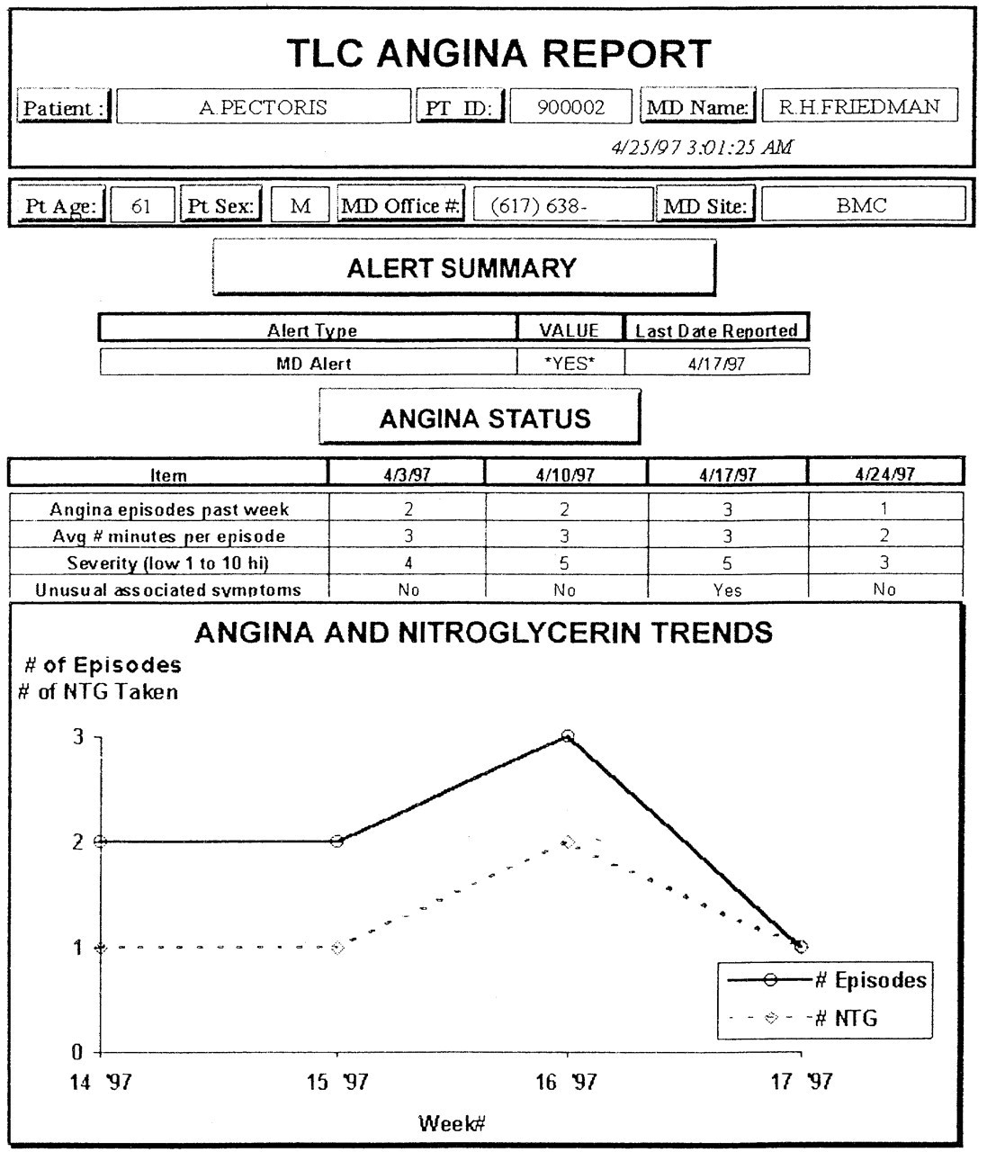
Figure 3 Sample physician report from TLC-Angina. This is a contrived example of a report to a physician who is caring ...
Notes:
Figure 3 Sample physician report from TLC-Angina. This is a contrived example of a report to a physician who is caring for a patient with angina pectoris. The Alert Summary indicates if and when the patient last had an urgent problem for which an alert report was sent to the physician. Angina Status summarizes basic information about the patient's angina from the most recent four TLC calls. Angina and Nitroglycerin Trends display the number of the angina episodes and nitroglycerin tablets reported per week since the patient started using TLC. The numbers on the X-axis are the week numbers (1-52) for the year 1997. Thus, 14′ 97 means the 14th 1997.
Unless provided in the caption above, the following copyright applies to the content of this slide: American Medical Informatics Association

Slide 4
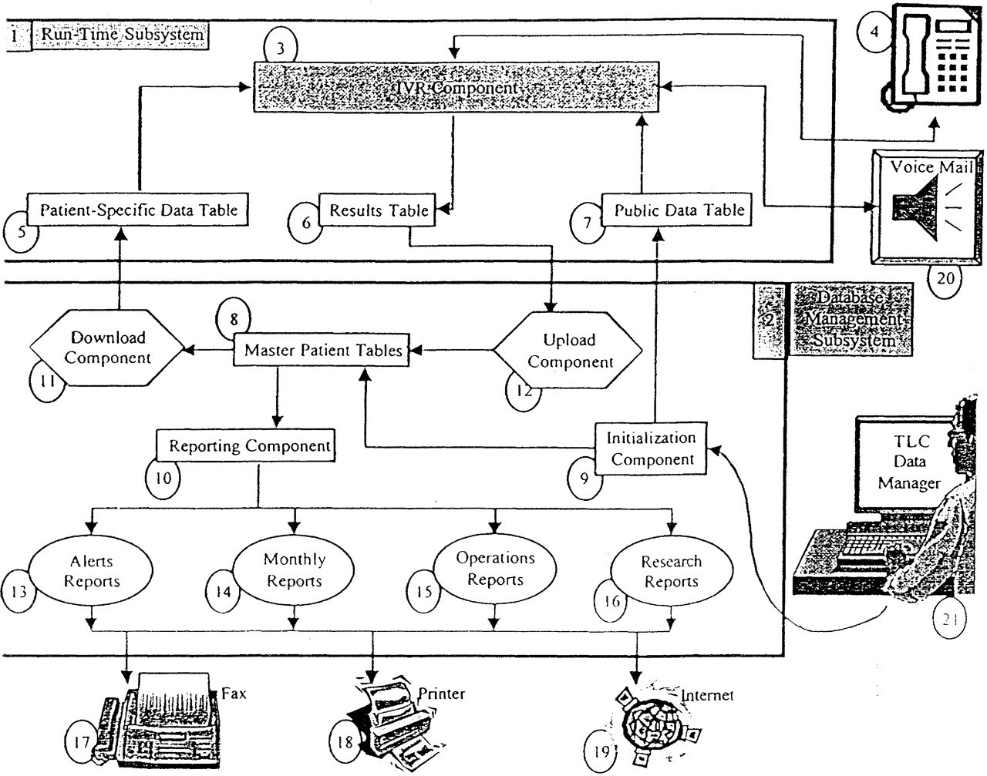
Figure 4 Schematic Diagram of TLC System Architecture and Processing.
Notes:
Figure 4 Schematic Diagram of TLC System Architecture and Processing.
Unless provided in the caption above, the following copyright applies to the content of this slide: American Medical Informatics Association

Slide 5
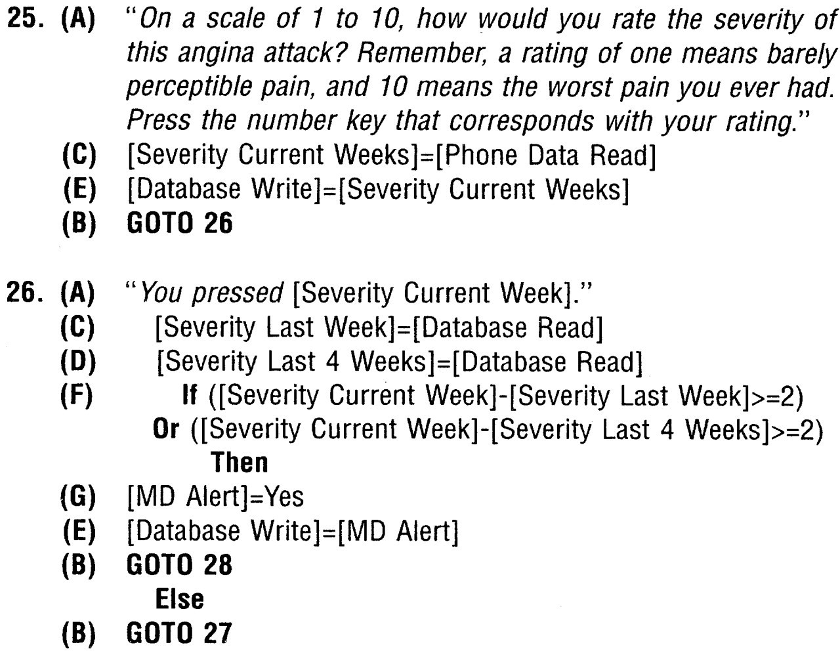
Figure 5 Part of the programmed script for TLC-Angina. This example represents “segments” 25-26 of a script that ...
Notes:
Figure 5 Part of the programmed script for TLC-Angina. This example represents “segments” 25-26 of a script that totals 120 “segments.” The material in quotations (A) is the English language script spoken by TLC. The numbers to the left of the script are labels to identify the “segment” location of each script segment. GOTO statements (B) control the flow of the conversation from segment to segment. Phrases surrounded by square brackets are system variables. Data are collected from a patient response (depressing a key on the telephone keypad) to a TLC question (C). Data can also be accessed from the TLC database (D) or stored in the database (E). Conditional statements are embedded within the script (E) and can control the flow of the conversation as well as determine what data are stored or retrieved from the database. Some data stored (G) trigger other actions: in this case, an immediate report to the patient's physician.
Unless provided in the caption above, the following copyright applies to the content of this slide: American Medical Informatics Association

