Slide 1
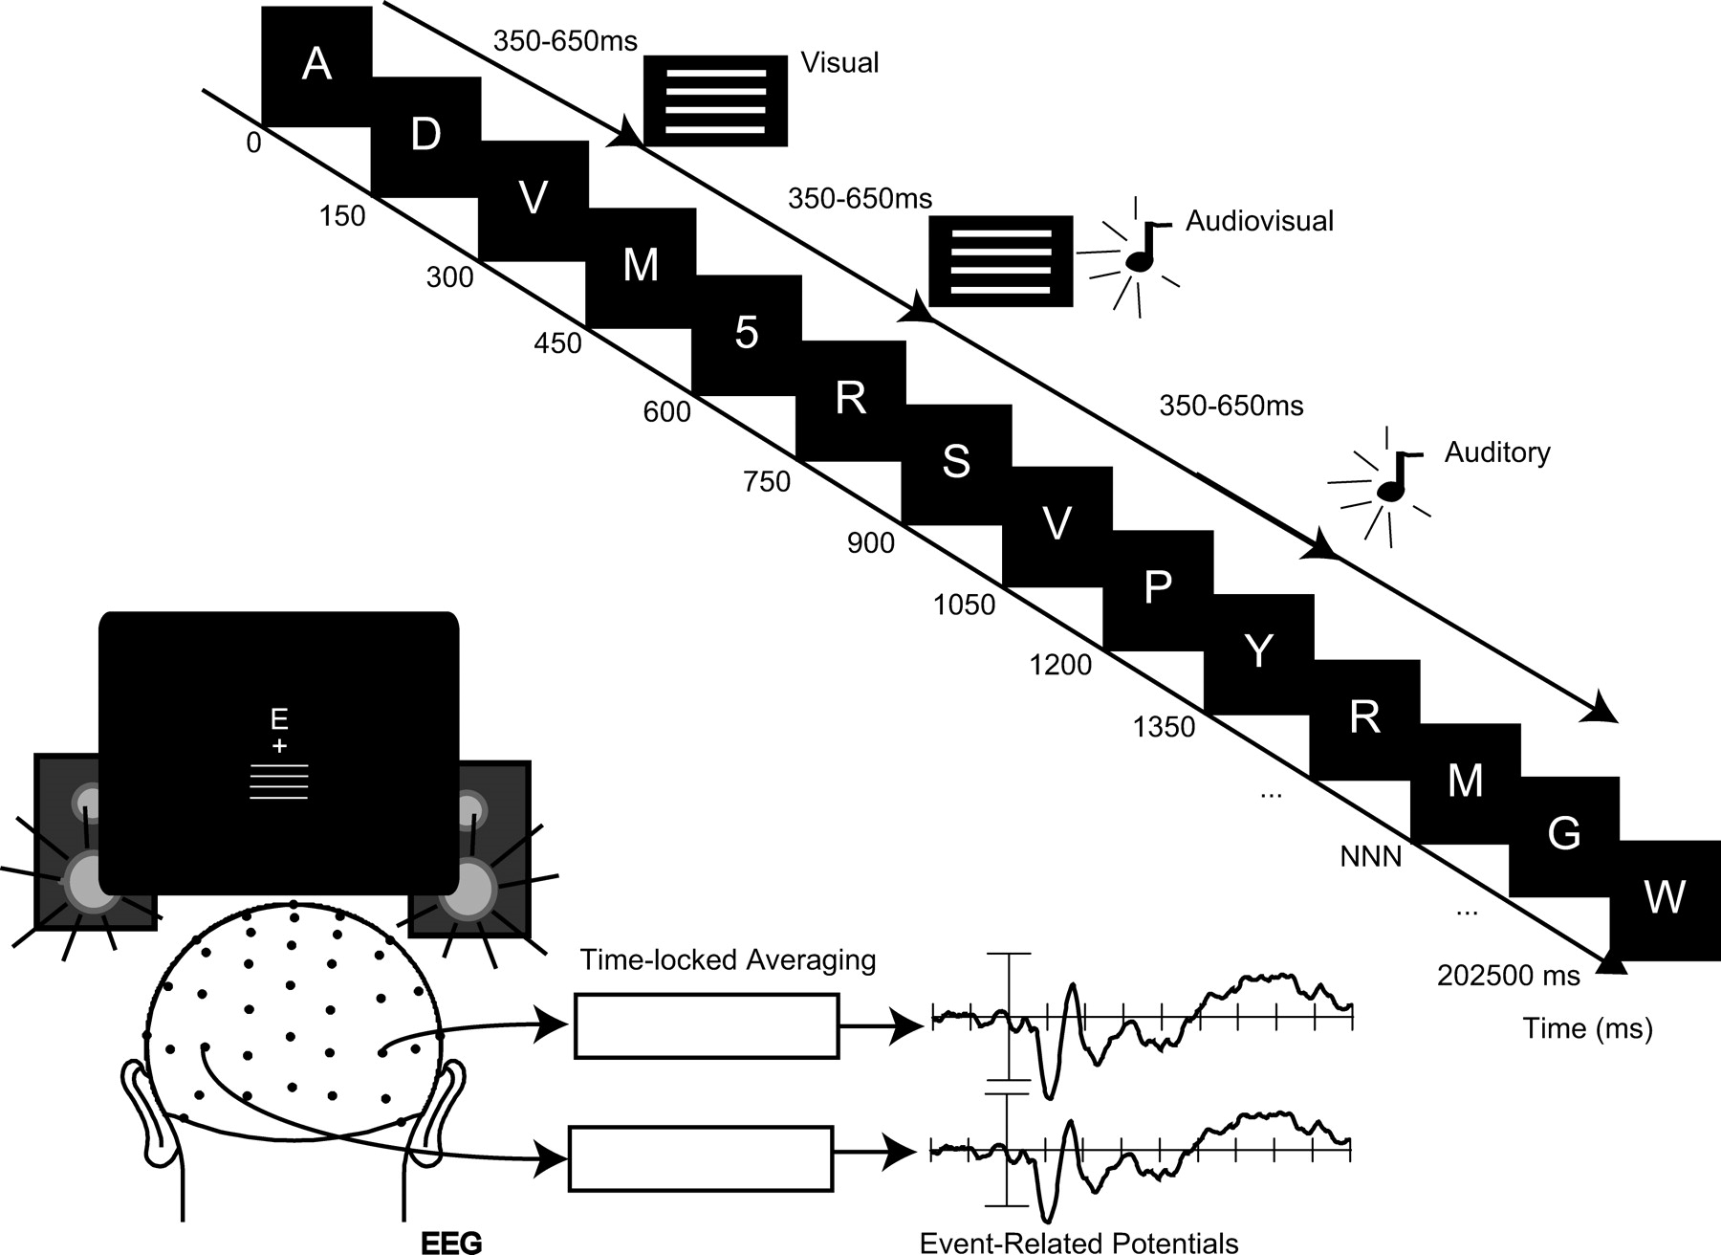
Figure 1. General layout of the task. An RSVP stream of letters was presented just above fixation. Concurrently, at ...
Notes:
Figure 1. General layout of the task. An RSVP stream of letters was presented just above fixation. Concurrently, at random (i.e., temporally jittered) moments in time, with an SOA of 350–650, visual, auditory, or audiovisual stimuli were presented in random order slightly below fixation. Stimulus presentation was such that each stimulus started completely randomly with respect to the onset of the letters in the RSVP stream.
Unless provided in the caption above, the following copyright applies to the content of this slide: © The Author 2006. Published by Oxford University Press. All rights reserved. For permissions, please e-mail: journals.permissions@oxfordjournals.org

Slide 2
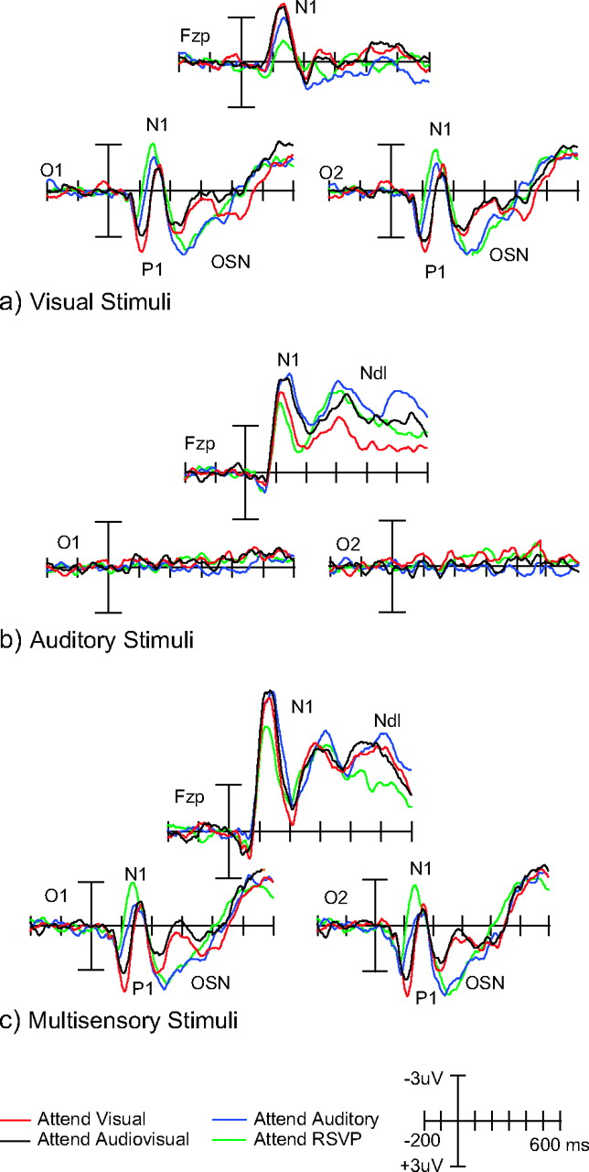
Figure 2. Summary of attention effects. (a) Attention effects on the unisensory visual stimuli. At the occipital ...
Notes:
Figure 2. Summary of attention effects. (a) Attention effects on the unisensory visual stimuli. At the occipital channels, a clear enhancement of the P1 component could be seen for the attend visual condition and to a somewhat lesser degree also for the attend audiovisual condition. Although there appeared to be an N1 effect that followed an inverse pattern to that of the P1 effect, peak-to-peak amplitude testing showed that this effect on the unisensory visual stimuli was not significant, and the N1 shifts appeared therefore to be largely determined by the amplitude of the preceding time-extended P1 effects. Attended stimuli (attend visual and attend audiovisual) were further characterized by an occipital selection negativity between 220 and 350 ms. (b) Attention effects on the auditory stimuli consisted of an enhancement of the N1 component for the attend auditory and attend audiovisual conditions. (c) Attention effects on the multisensory stimuli. These effects consisted largely of a combination of visual and auditory effects.
Unless provided in the caption above, the following copyright applies to the content of this slide: © The Author 2006. Published by Oxford University Press. All rights reserved. For permissions, please e-mail: journals.permissions@oxfordjournals.org

Slide 3
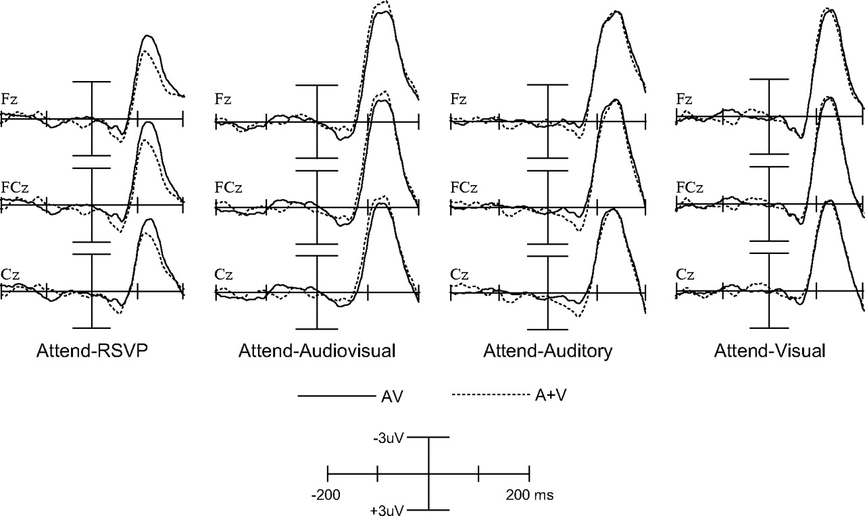
Figure 3. Multisensory integration by attention interactions on the frontocentral P50 and N1 components. P50 components ...
Notes:
Figure 3. Multisensory integration by attention interactions on the frontocentral P50 and N1 components. P50 components for the multisensory stimuli were significantly larger in the attend audiovisual condition than for the summed unisensory responses, but this effect was reversed for the attend RSVP condition. Although the figure suggests an effect in the attend auditory condition, this effect was not statistically significant.
Unless provided in the caption above, the following copyright applies to the content of this slide: © The Author 2006. Published by Oxford University Press. All rights reserved. For permissions, please e-mail: journals.permissions@oxfordjournals.org

Slide 4
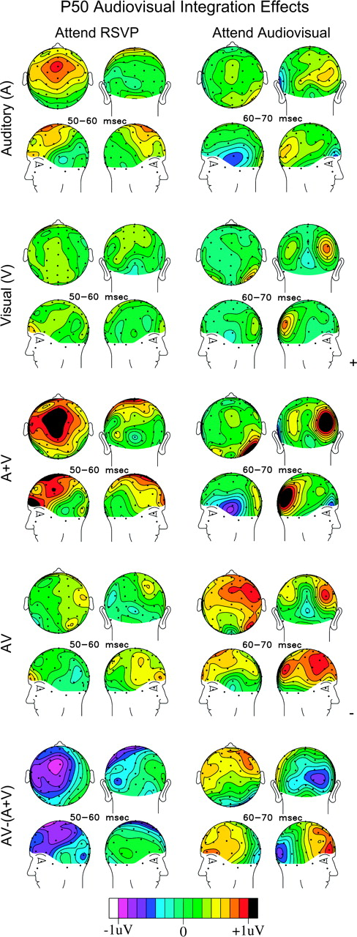
Figure 4. Scalp topographies of the P50 components in the attend RSVP and attend audiovisual conditions.
Notes:
Figure 4. Scalp topographies of the P50 components in the attend RSVP and attend audiovisual conditions.
Unless provided in the caption above, the following copyright applies to the content of this slide: © The Author 2006. Published by Oxford University Press. All rights reserved. For permissions, please e-mail: journals.permissions@oxfordjournals.org

Slide 5
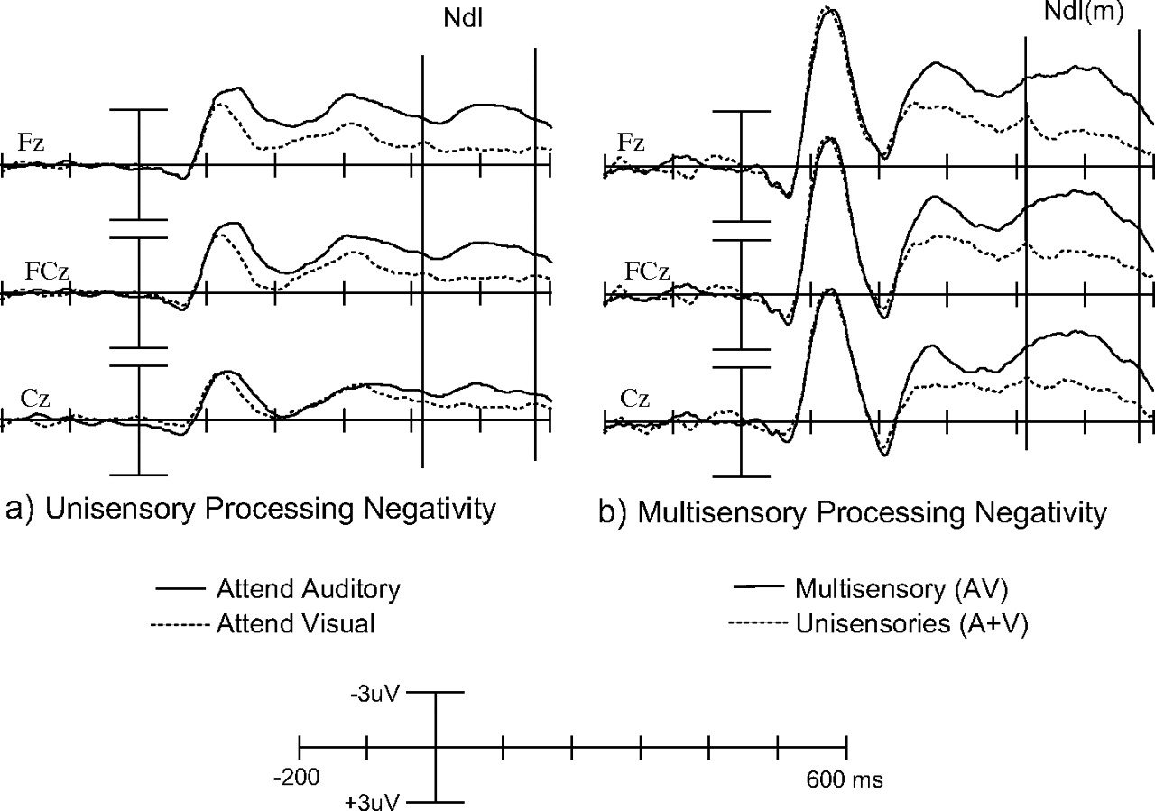
Figure 5. ERP waveforms for the unisensory and multisensory late processing negativities (Ndl). (a) Unisensory ...
Notes:
Figure 5. ERP waveforms for the unisensory and multisensory late processing negativities (Ndl). (a) Unisensory processing negativity obtained by contrasting ERPs to auditory stimuli in the attend auditory and attend visual conditions. (b) Multisensory processing negativity obtained by contrasting AV and [A + V] stimuli in the attend visual conditions. See main text for details.
Unless provided in the caption above, the following copyright applies to the content of this slide: © The Author 2006. Published by Oxford University Press. All rights reserved. For permissions, please e-mail: journals.permissions@oxfordjournals.org

Slide 6
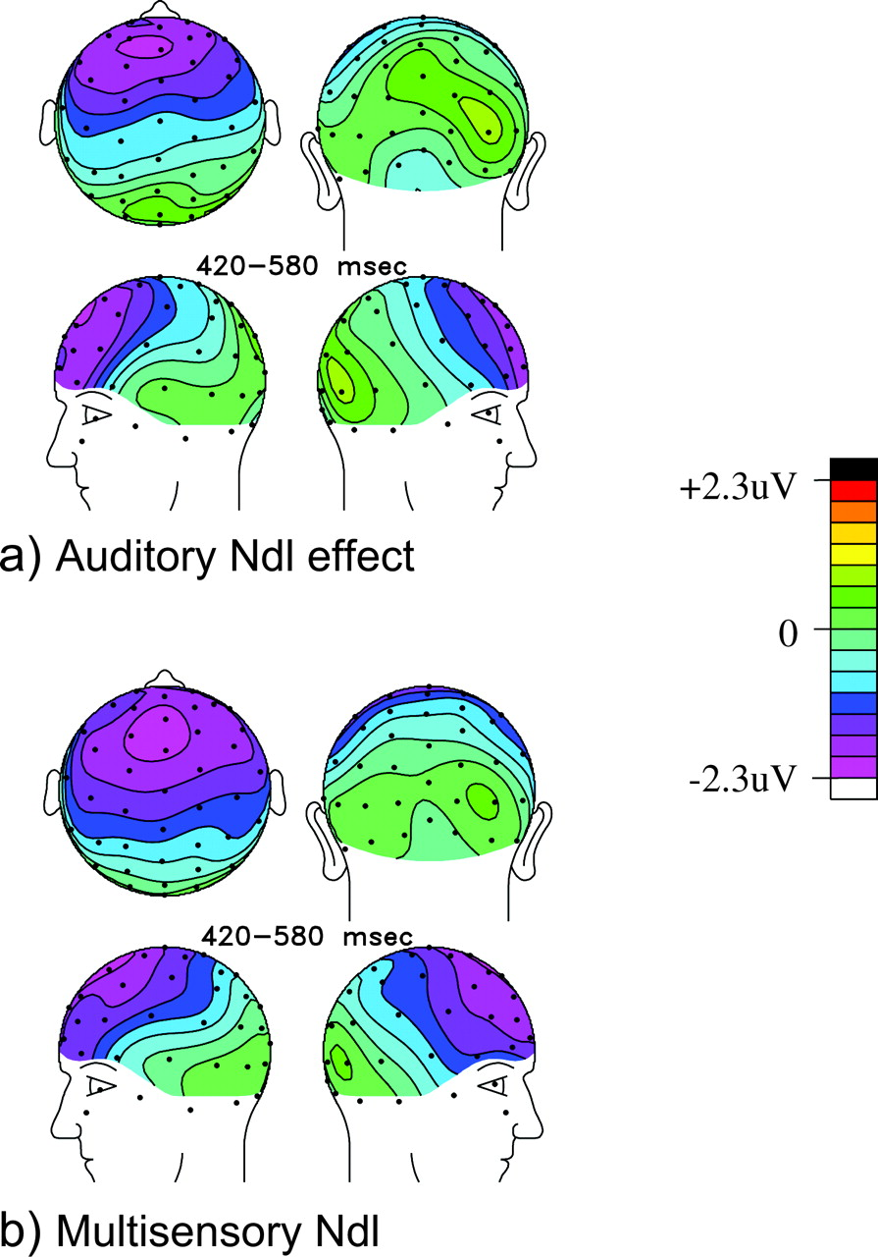
Figure 6. Scalp topographies of the unisensory and multisensory processing negativities depicted in Figure 5.
Notes:
Figure 6. Scalp topographies of the unisensory and multisensory processing negativities depicted in Figure 5.
Unless provided in the caption above, the following copyright applies to the content of this slide: © The Author 2006. Published by Oxford University Press. All rights reserved. For permissions, please e-mail: journals.permissions@oxfordjournals.org

