Slide 1
Figure 1 Example of Towel Reuse Sign (Experiment 1)
Notes:
Figure 1 Example of Towel Reuse Sign (Experiment 1)
Unless provided in the caption above, the following copyright applies to the content of this slide: © 2008 by JOURNAL OF CONSUMER RESEARCH, Inc.

Slide 2
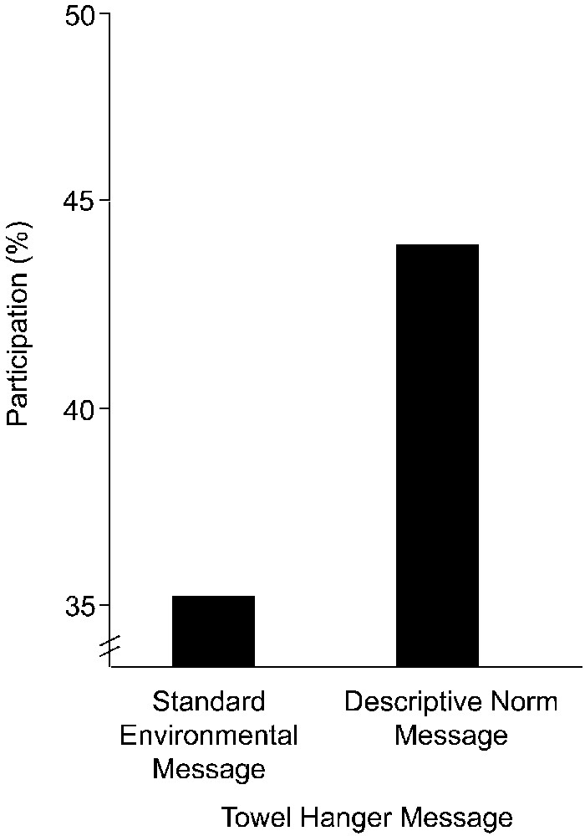
Figure 2 Towel Reuse Rates as a Function of Sign in Room (Experiment 1)
Notes:
Figure 2 Towel Reuse Rates as a Function of Sign in Room (Experiment 1)
Unless provided in the caption above, the following copyright applies to the content of this slide: © 2008 by JOURNAL OF CONSUMER RESEARCH, Inc.

Slide 3
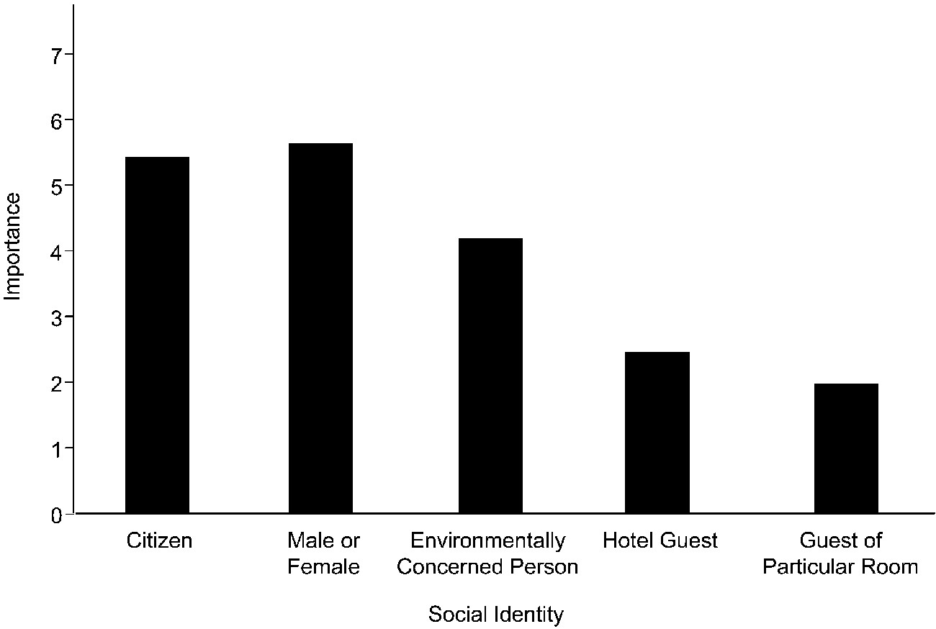
Figure 3 Importance of Social Identities (Experiment 2)
Notes:
Figure 3 Importance of Social Identities (Experiment 2)
Unless provided in the caption above, the following copyright applies to the content of this slide: © 2008 by JOURNAL OF CONSUMER RESEARCH, Inc.

Slide 4
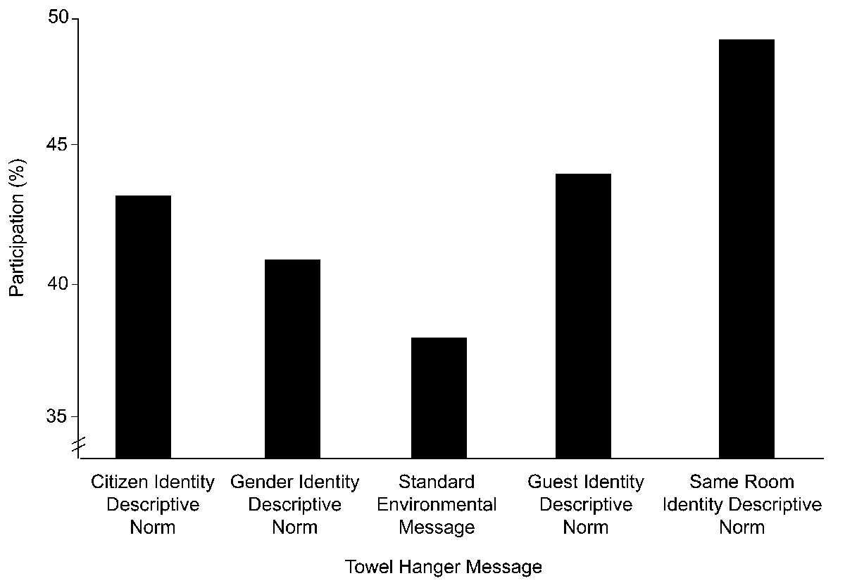
Figure 4 Towel Reuse Rates as a Function of Sign in Room (Experiment 2)
Notes:
Figure 4 Towel Reuse Rates as a Function of Sign in Room (Experiment 2)
Unless provided in the caption above, the following copyright applies to the content of this slide: © 2008 by JOURNAL OF CONSUMER RESEARCH, Inc.

