Slide 1
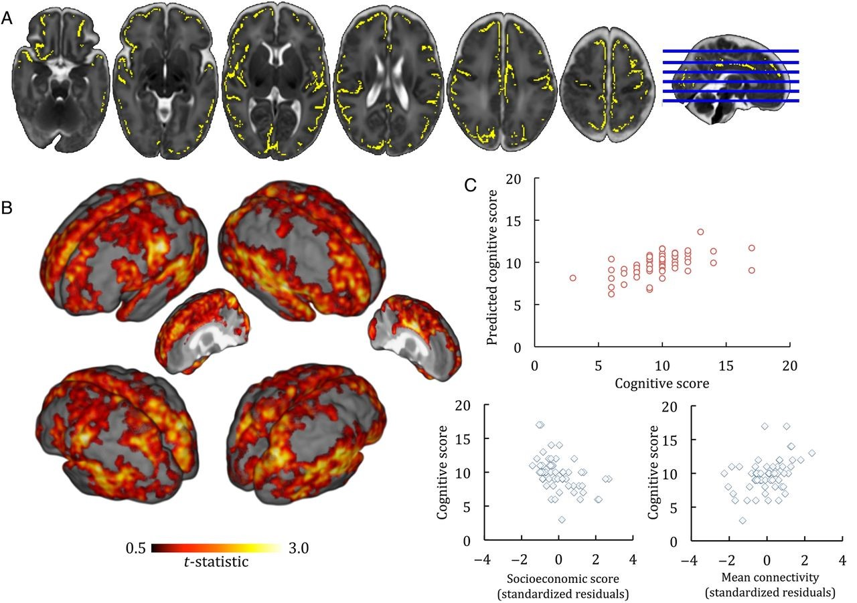
Figure 1. Thalamocortical connectivity and cognition. (A) Regions where thalamocortical connectivity at term equivalent ...
Notes:
Figure 1. Thalamocortical connectivity and cognition. (A) Regions where thalamocortical connectivity at term equivalent age was correlated to cognition at 2 years, P < 0.05 adjusted for GA at birth, PMA at scan, and parental socioeconomic group, are shown in yellow. (B) Surface renderings showing the t-statistic of each significant voxel in A. (C) Full model fit (top) and semi-partial correlation plots (bottom) showing the relationship between cognitive score at 2 years, parental socioeconomic status and mean connectivity. Socioeconomic score and mean connectivity are adjusted for each other and GA at birth.
Unless provided in the caption above, the following copyright applies to the content of this slide: © The Author 2015. Published by Oxford University PressThis is an Open Access article distributed under the terms of the Creative Commons Attribution License (http://creativecommons.org/licenses/by/4.0/), which permits unrestricted reuse, distribution, and reproduction in any medium, provided the original work is properly cited.

Slide 2
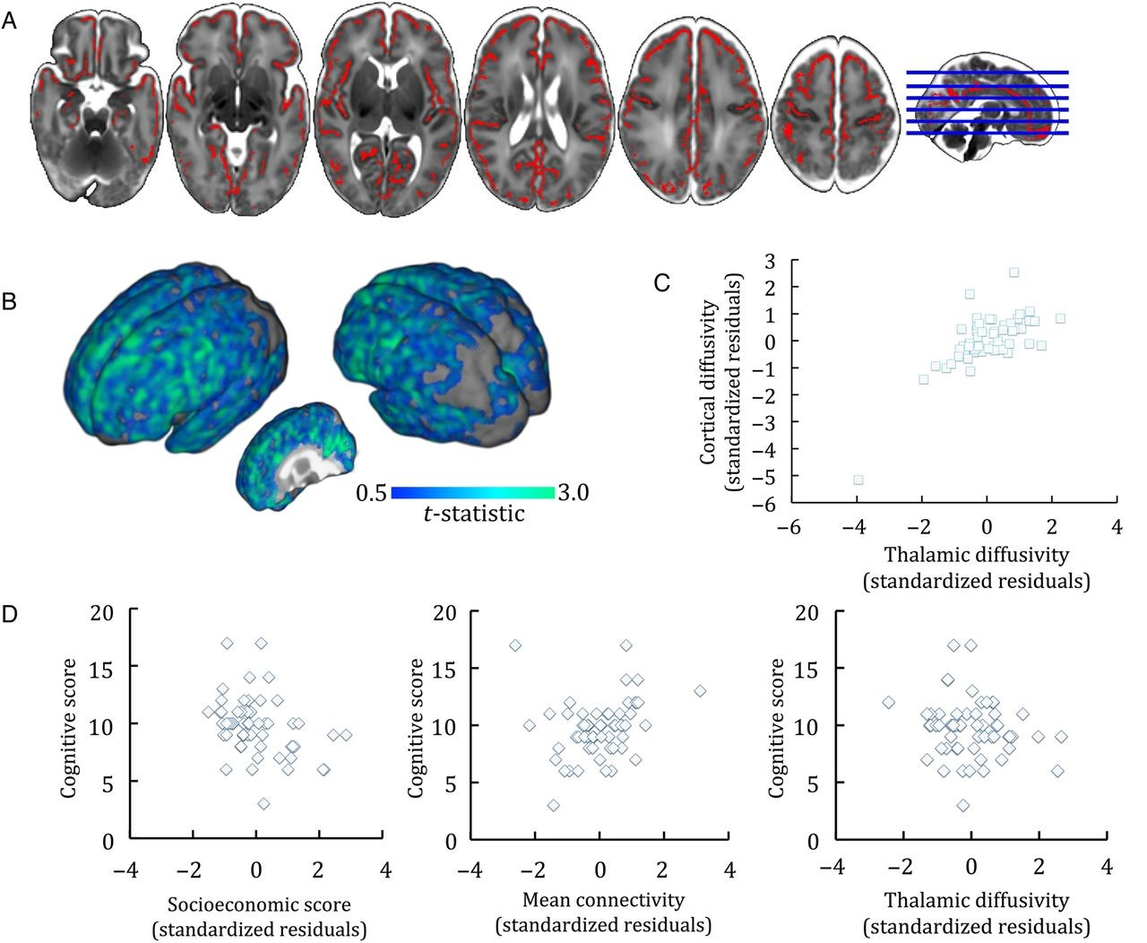
Figure 2. Gray matter mean diffusivity and cognition. (A) Regions where cortical diffusivity was correlated to ...
Notes:
Figure 2. Gray matter mean diffusivity and cognition. (A) Regions where cortical diffusivity was correlated to cognition at 2 years, P < 0.01 adjusted for GA at birth, PMA at scan and parental socioeconomic group, are shown in red. (B) surface rendering of the t-statistic of each significant voxel in A. (C) correlation between mean cortical diffusivity and thalamic diffusivity, corrected for GA at birth and age at scan. (D) Semi-partial correlation plots showing the relationships between cognitive score, parental socioeconomic status (of note a higher SES denotes a lower socioeconomic group), mean thalamocortical connectivity and mean thalamic diffusivity.
Unless provided in the caption above, the following copyright applies to the content of this slide: © The Author 2015. Published by Oxford University PressThis is an Open Access article distributed under the terms of the Creative Commons Attribution License (http://creativecommons.org/licenses/by/4.0/), which permits unrestricted reuse, distribution, and reproduction in any medium, provided the original work is properly cited.

