Slide 1
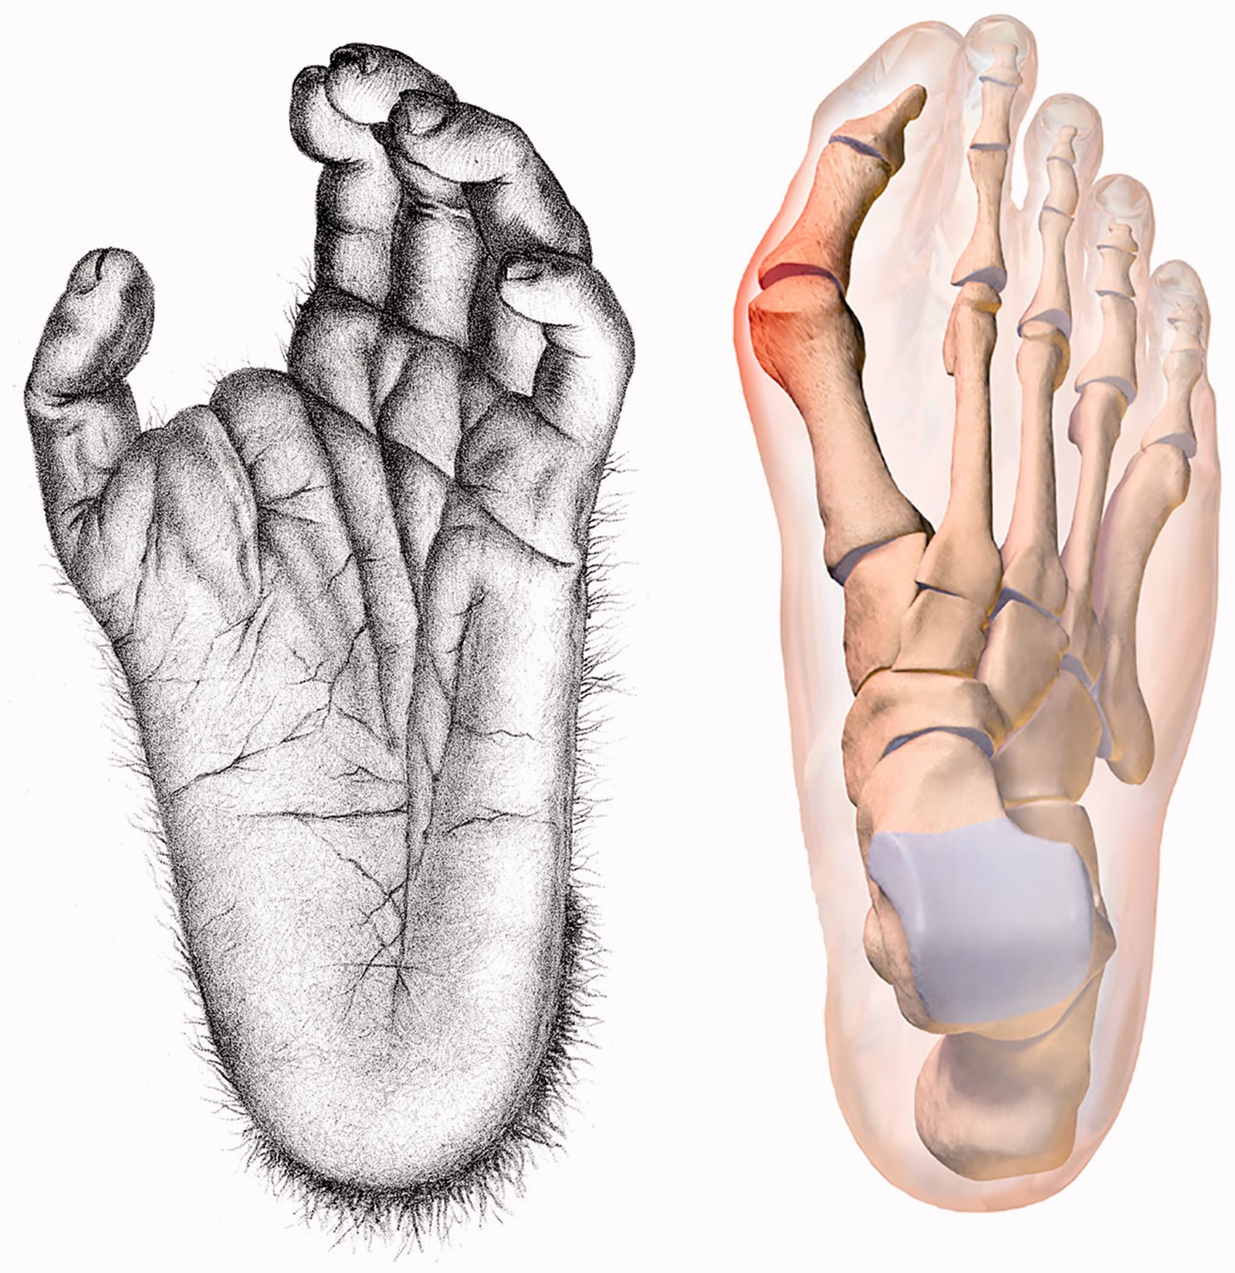
Figure 1. Grasping primate foot with abducent hallux (left); hallux valgus in humans (right) Note the orientation of ...
Notes:
Figure 1. Grasping primate foot with abducent hallux (left); hallux valgus in humans (right) Note the orientation of the plantar surface in the chimpanzee’s abducent hallux
Unless provided in the caption above, the following copyright applies to the content of this slide: © The Author(s) 2017. Published by Oxford University Press on behalf of the Foundation for Evolution, Medicine, and Public Health.This is an Open Access article distributed under the terms of the Creative Commons Attribution License (http://creativecommons.org/licenses/by/4.0/), which permits unrestricted reuse, distribution, and reproduction in any medium, provided the original work is properly cited.

Slide 2
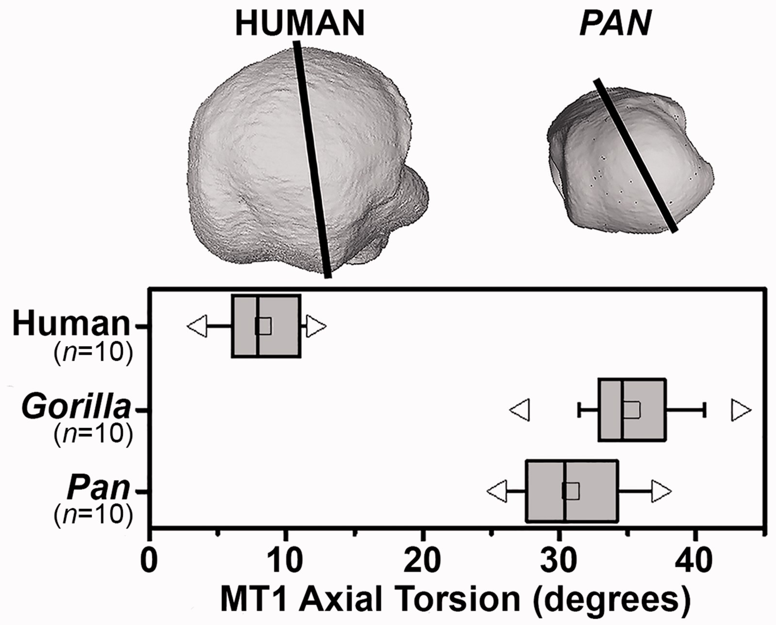
Figure 2. Axial torsion of first metatarsal heads in humans, gorillas and chimpanzees normalized by the basal ...
Notes:
Figure 2. Axial torsion of first metatarsal heads in humans, gorillas and chimpanzees normalized by the basal dorso-plantar axis. Medial is to the left in upper image
Unless provided in the caption above, the following copyright applies to the content of this slide: © The Author(s) 2017. Published by Oxford University Press on behalf of the Foundation for Evolution, Medicine, and Public Health.This is an Open Access article distributed under the terms of the Creative Commons Attribution License (http://creativecommons.org/licenses/by/4.0/), which permits unrestricted reuse, distribution, and reproduction in any medium, provided the original work is properly cited.

