Slide 1
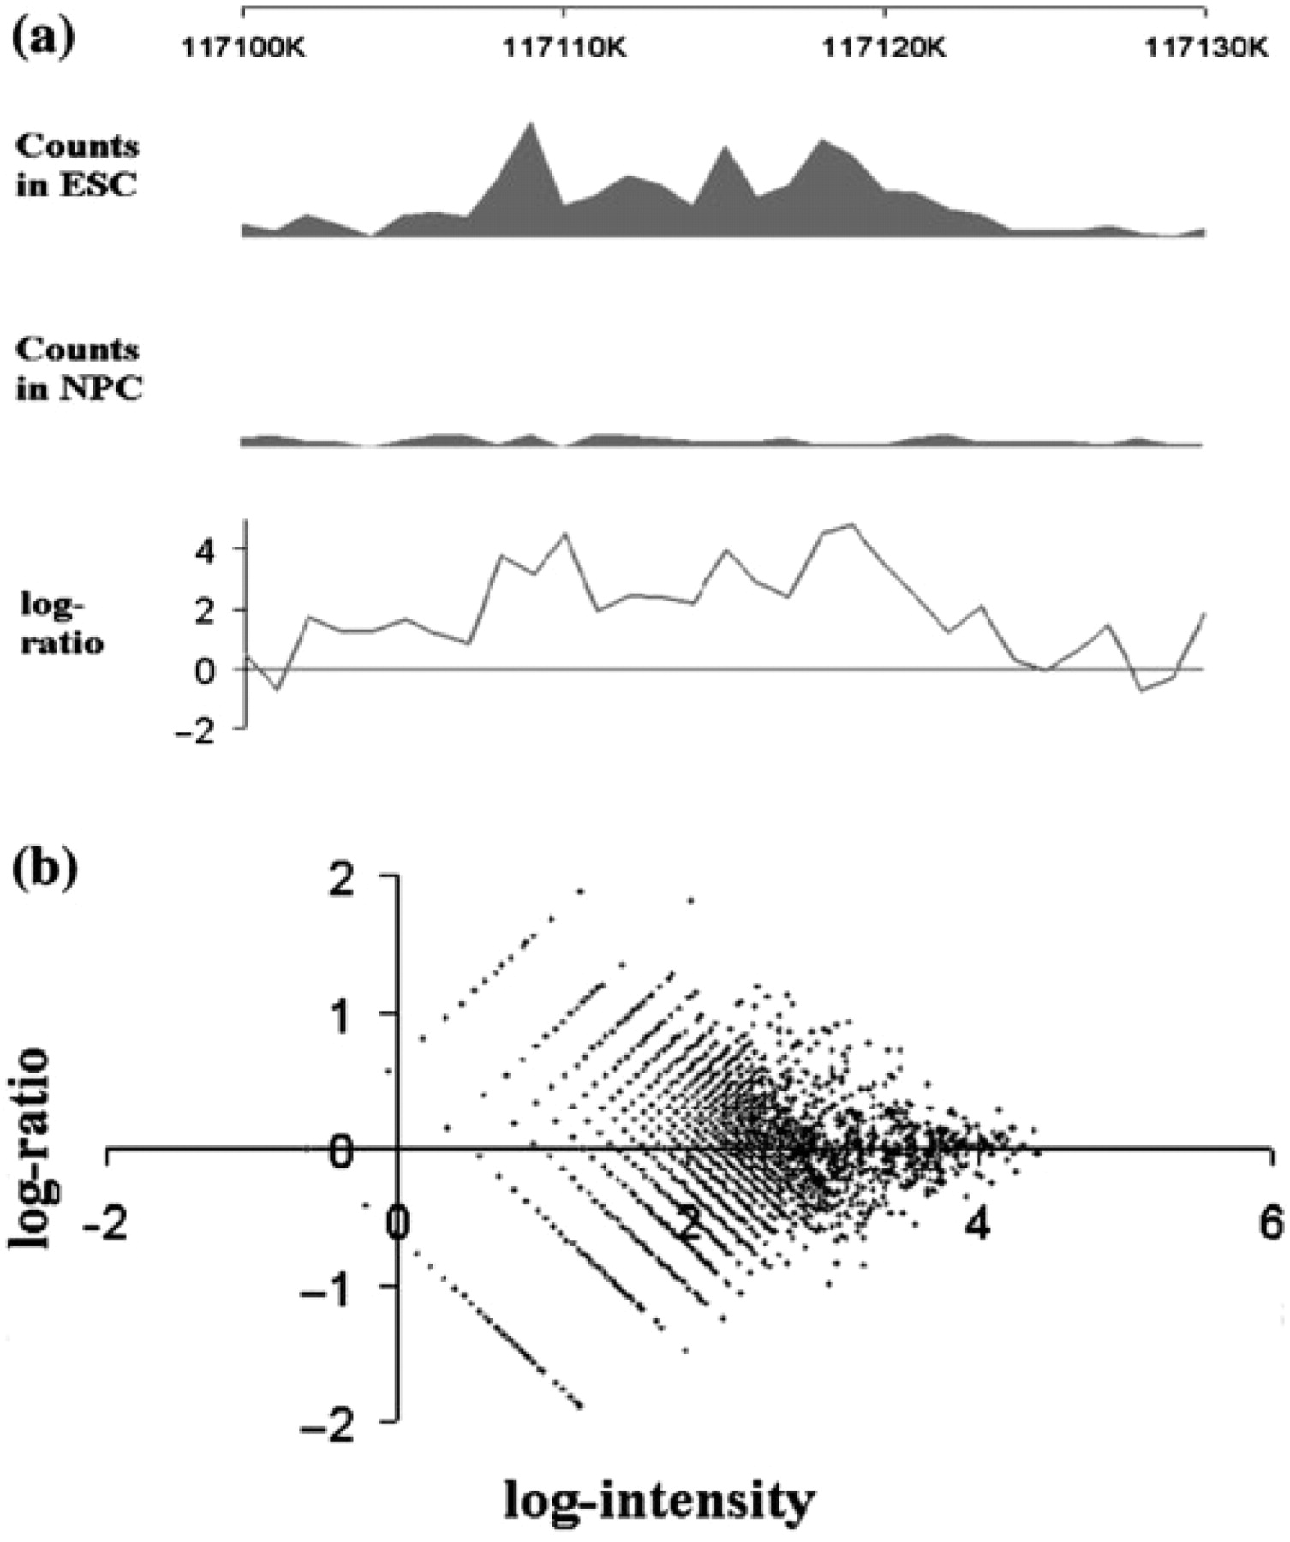
Fig. 1. (a) An example of the log-ratio estimation of H3K27me3 intensity between mouse ESC and NPC. Bin size set to ...
Notes:
Fig. 1. (a) An example of the log-ratio estimation of H3K27me3 intensity between mouse ESC and NPC. Bin size set to be 1k; displayed genomic region range from chr14:117 100 000 to 117 130 000; data retrieved from Mikkelsen et al.'s (2007) dataset; (b) An RI-plot for chromosome 19 in K27 data.
Unless provided in the caption above, the following copyright applies to the content of this slide: © The Author 2008. Published by Oxford University Press. All rights reserved. For Permissions, please email: journals.permissions@oxfordjournals.org

Slide 2
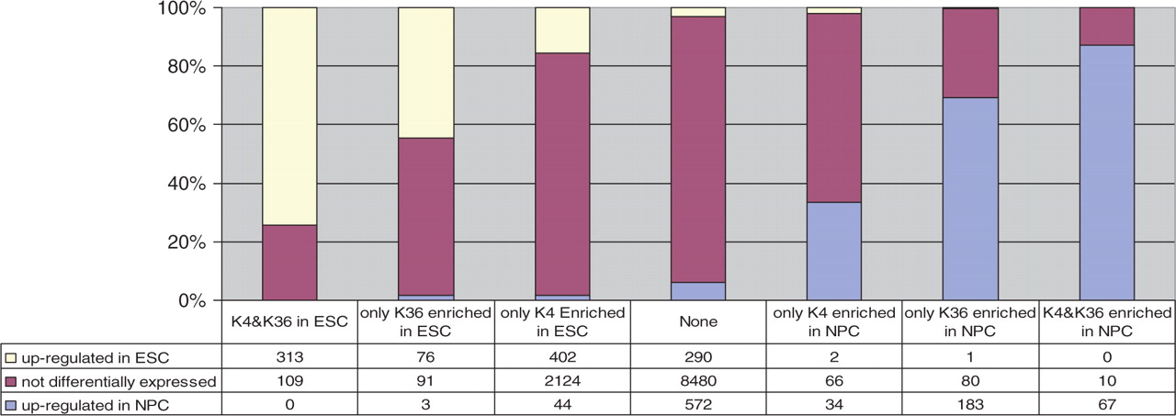
Fig. 2. Combinatorial effect of H3K4me3 and H3K36me3 on gene expression between ESC and NPC. Up/down-regulations were ...
Notes:
Fig. 2. Combinatorial effect of H3K4me3 and H3K36me3 on gene expression between ESC and NPC. Up/down-regulations were determined by the criterion of 4-fold change.
Unless provided in the caption above, the following copyright applies to the content of this slide: © The Author 2008. Published by Oxford University Press. All rights reserved. For Permissions, please email: journals.permissions@oxfordjournals.org

