Slide 1
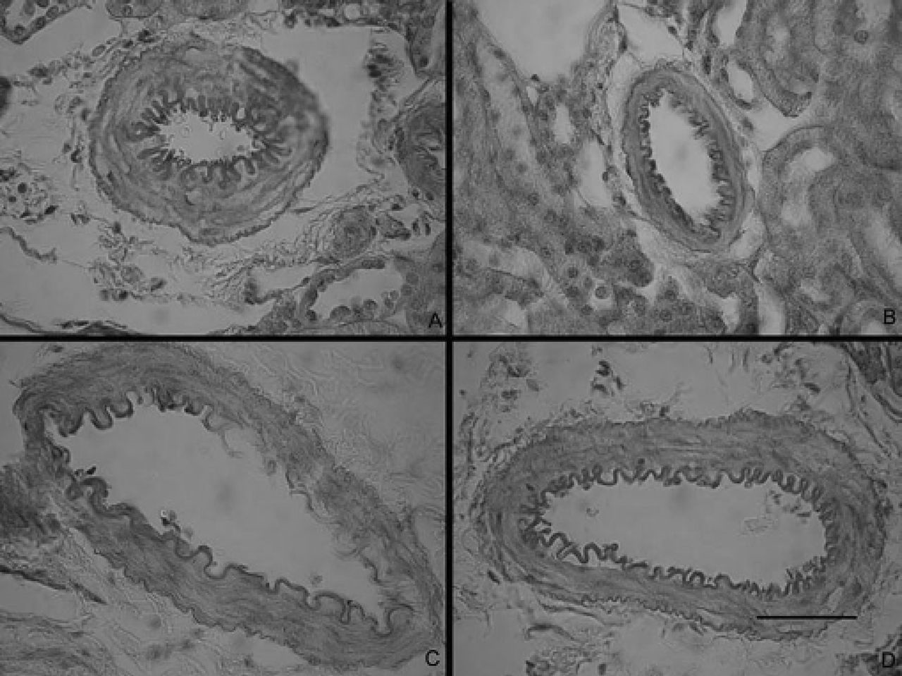
Figure 1. Representative images of renal small arteries. SHRSP rats were treated with (a) vehicle or (b) sulforaphane ...
Notes:
Figure 1. Representative images of renal small arteries. SHRSP rats were treated with (a) vehicle or (b) sulforaphane (10 μmol/kg) for 4 months and 5 μm thick sections of kidneys were stained with PAS and hematoxylin staining. Age matched SD rats were also treated the same way: with (c) vehicle or (d) sulforaphane. The bar represents 50 μm. PAS, periodic acid Schiff; SD, Sprague Dawley; SHRSP, spontaneously hypertensive stroke-prone.
Unless provided in the caption above, the following copyright applies to the content of this slide: © American Journal of Hypertension, Ltd. 2012

Slide 2
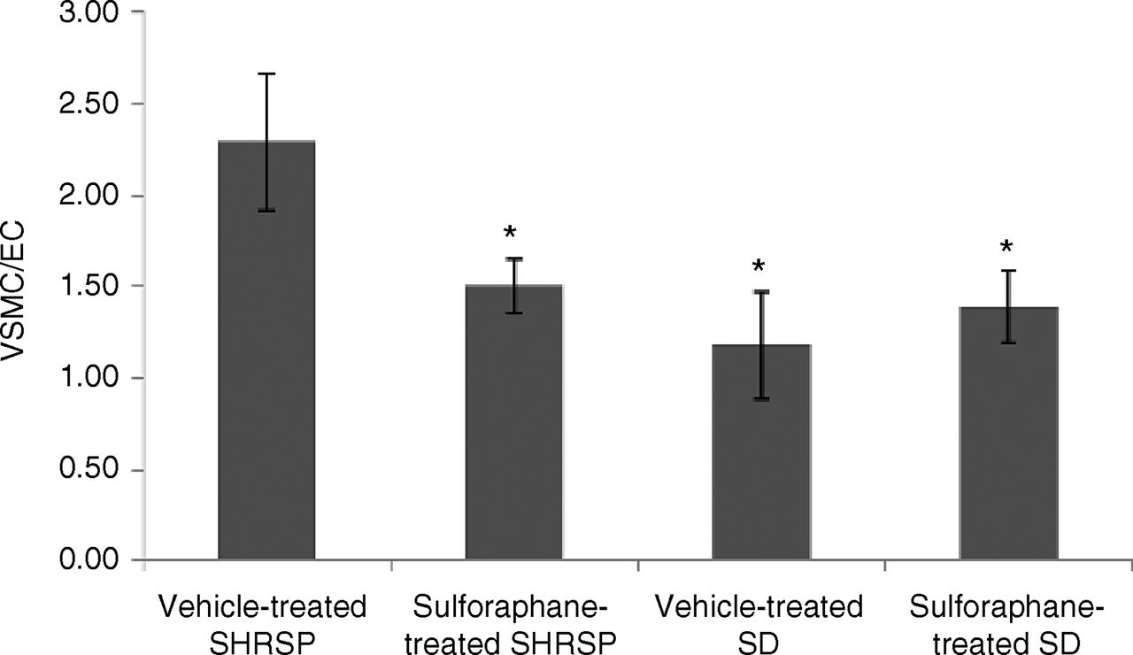
Figure 2. Vascular smooth muscle cell numbers normalized to endothelial cell numbers. Photomicrographs of PAS and ...
Notes:
Figure 2. Vascular smooth muscle cell numbers normalized to endothelial cell numbers. Photomicrographs of PAS and hematoxylin stained renal small arteries were taken from vehicle-treated or sulforaphane-treated SHRSP or SD rat paraffin-embedded kidney sections. Nuclei were counted using Image J software (NIH). Each nucleus was assumed to represent one cell. Bar values are mean ± s.e.m. *P < 0.05. PAS, periodic acid Schiff; SD, Sprague Dawley; SHRSP, spontaneously hypertensive stroke-prone; VSMC/EC; ratio of vascular smooth muscle cell numbers to endothelial cell numbers.
Unless provided in the caption above, the following copyright applies to the content of this slide: © American Journal of Hypertension, Ltd. 2012

Slide 3
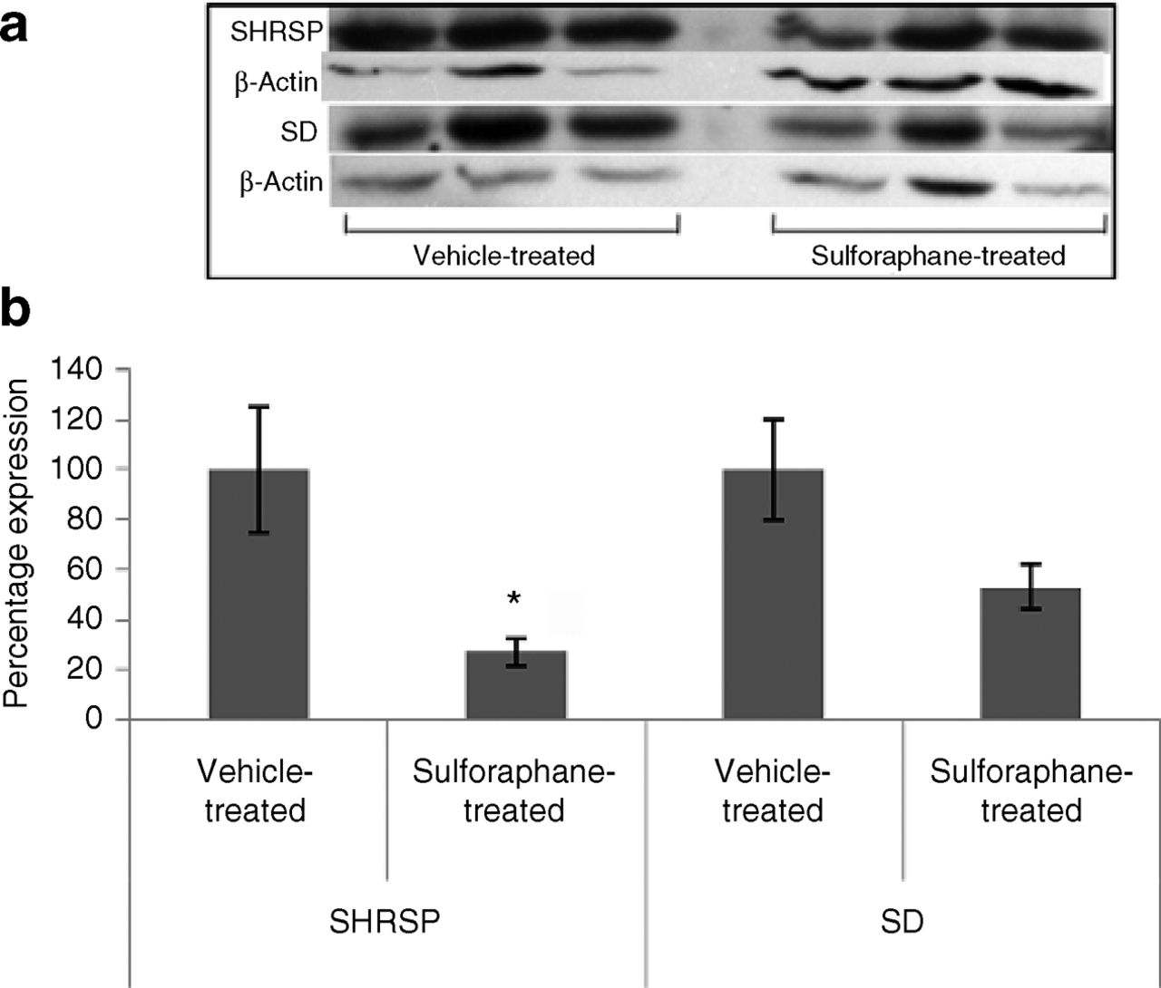
Figure 3. Nitrated proteins in SHRSP and SD kidneys. (a) Nitrated protein expression in kidneys of corn oil vehicle or ...
Notes:
Figure 3. Nitrated proteins in SHRSP and SD kidneys. (a) Nitrated protein expression in kidneys of corn oil vehicle or sulforaphane-treated SHRSP or SD rats. Bands represent a 45 kDa protein. (b) Bars represent percentage change in expression compared to the vehicle-treated group of the same strain. Band density was normalized to β-actin as loading control. Bar values are given as mean ± s.e.m. *P < 0.05. SD, Sprague Dawley; SHRSP, spontaneously hypertensive stroke-prone.
Unless provided in the caption above, the following copyright applies to the content of this slide: © American Journal of Hypertension, Ltd. 2012

Slide 4
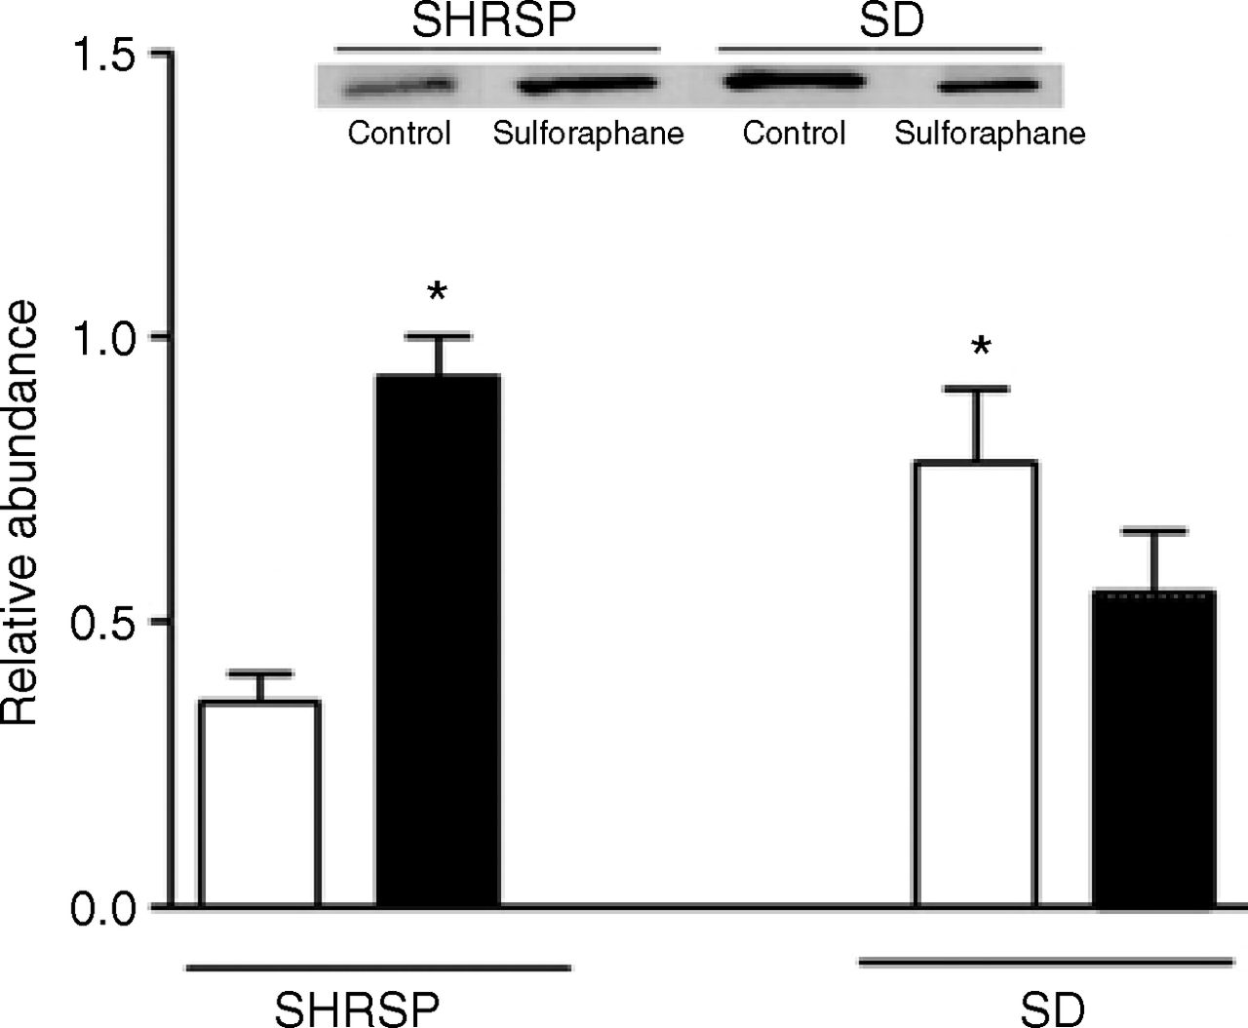
Figure 4. Western blot data for γ-glutamyl-cysteine ligase catalytic subunit in kidneys of SHRSP and SD rats given corn ...
Notes:
Figure 4. Western blot data for γ-glutamyl-cysteine ligase catalytic subunit in kidneys of SHRSP and SD rats given corn oil vehicle or sulforaphane in corn oil. The top of the figure gives a representative blot. The lower part of the figure gives quantitative information (means ± s.e.m., n = 3/group) of the amount of protein present normalized to actin. *P < 0.05. SD, Sprague Dawley; SHRSP, spontaneously hypertensive stroke-prone.
Unless provided in the caption above, the following copyright applies to the content of this slide: © American Journal of Hypertension, Ltd. 2012

