Slide 1
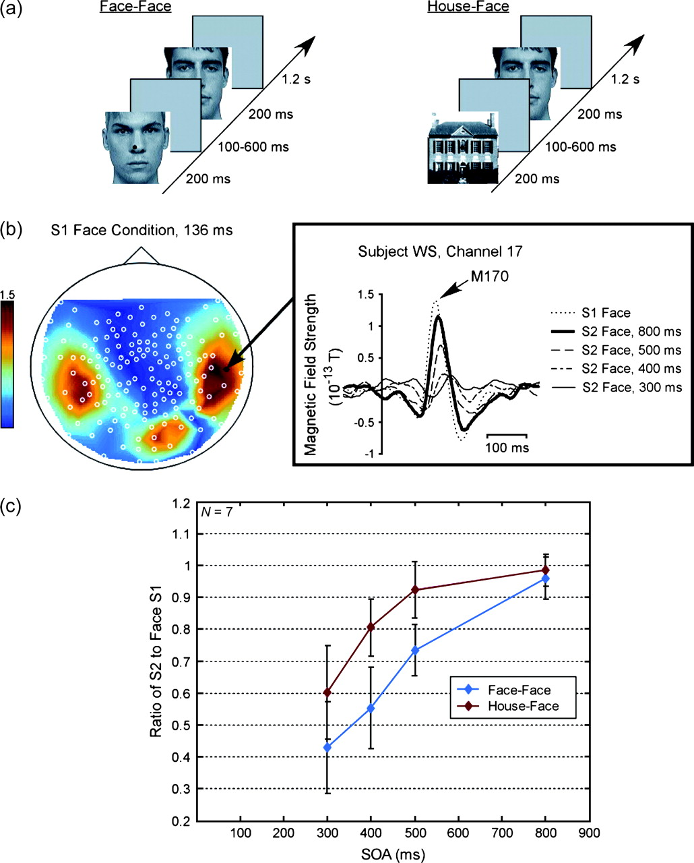
Figure 2 Double-pulse adaptation as a function of SOA. (a) Schematic of an individual trial for the face–face and ...
Notes:
Figure 2 Double-pulse adaptation as a function of SOA. (a) Schematic of an individual trial for the face–face and house–face conditions. (b) An example of the M170 response in a single subject. Scalp distribution of the M170 response to the unadapted S1 face condition is shown to the left; the color bar indicates magnetic field strength in 10−13 T. The bilateral occipitotemporal dipoles that characterize the M170 are clearly visible. To the right, the response at a single sensor (indicated by arrow) is plotted for the S2 face conditions. Note that the polarity of the waveform has been reversed for ease of comprehension. (c) Adaptation of the M170 response as a function of SOA and stimulus category, averaged from 7 subjects. Adaptation increases significantly with decreasing SOA, but the amount of adaptation also appears to depend on the S1 category (face vs. house).
Unless provided in the caption above, the following copyright applies to the content of this slide: © The Author 2006. Published by Oxford University Press. All rights reserved. For permissions, please e-mail: journals.permissions@oxfordjournals.org

Slide 2
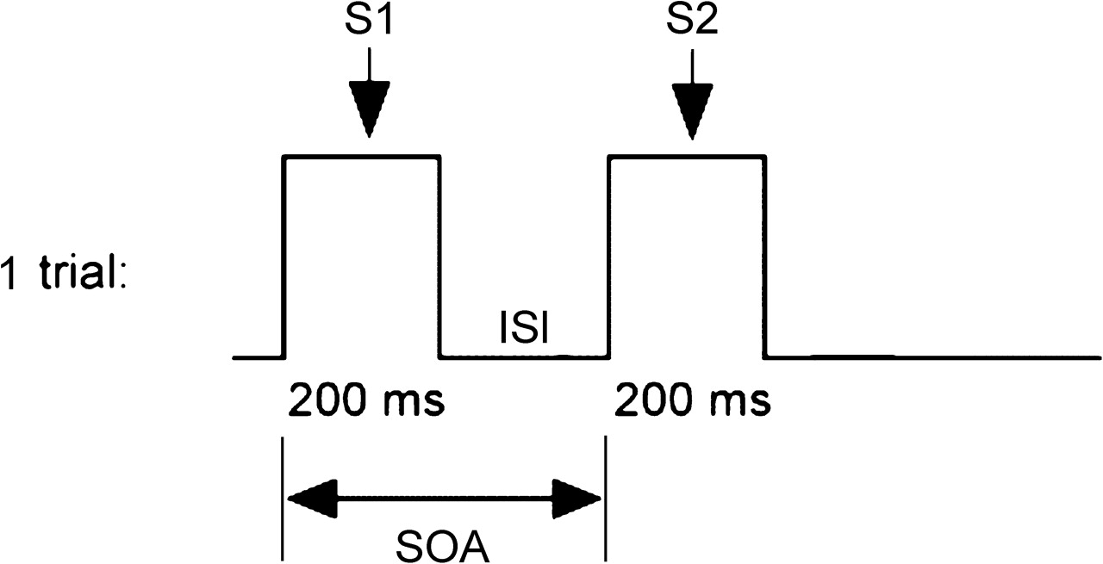
Figure 1 Schematic of the double-pulse adaptation paradigm designed by Jeffreys (1996). Each trial consists of the ...
Notes:
Figure 1 Schematic of the double-pulse adaptation paradigm designed by Jeffreys (1996). Each trial consists of the presentation of 2 stimuli (S1 and S2), with an ISI.
Unless provided in the caption above, the following copyright applies to the content of this slide: © The Author 2006. Published by Oxford University Press. All rights reserved. For permissions, please e-mail: journals.permissions@oxfordjournals.org

Slide 3
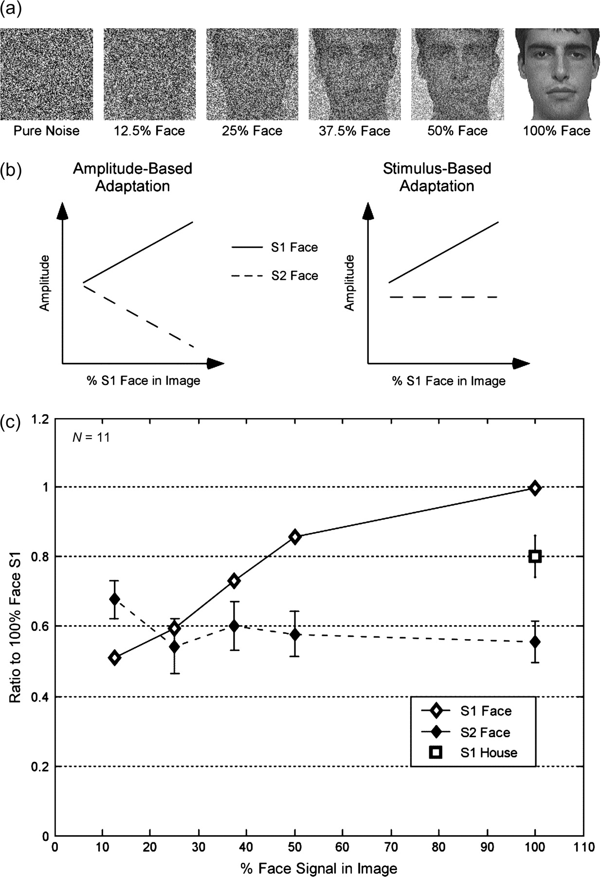
Figure 4 Double-pulse adaptation as a function of face signal in the S1 image. (a) Sample images, depicting the levels ...
Notes:
Figure 4 Double-pulse adaptation as a function of face signal in the S1 image. (a) Sample images, depicting the levels of white noise used to manipulate S1 amplitude. (b) Predictions: if adaptation is amplitude dependent (left), the amount of adaptation should increase with increasing S1 amplitude (hence, the amplitude of the S2 response should decrease). If adaptation is stimulus dependent (right), adaptation should remain constant across noise levels. (c) Actual results: with decreasing face signal in the image, the response to the S1 face condition (open diamond) decreases to below the level of the S1 house response (open square). Yet the S2 face response (filled diamond) remains roughly constant across all noise levels, indicating that adaptation depends on the stimulus category rather than amplitude of the S1 response. SOA was fixed at 400 ms.
Unless provided in the caption above, the following copyright applies to the content of this slide: © The Author 2006. Published by Oxford University Press. All rights reserved. For permissions, please e-mail: journals.permissions@oxfordjournals.org

Slide 4
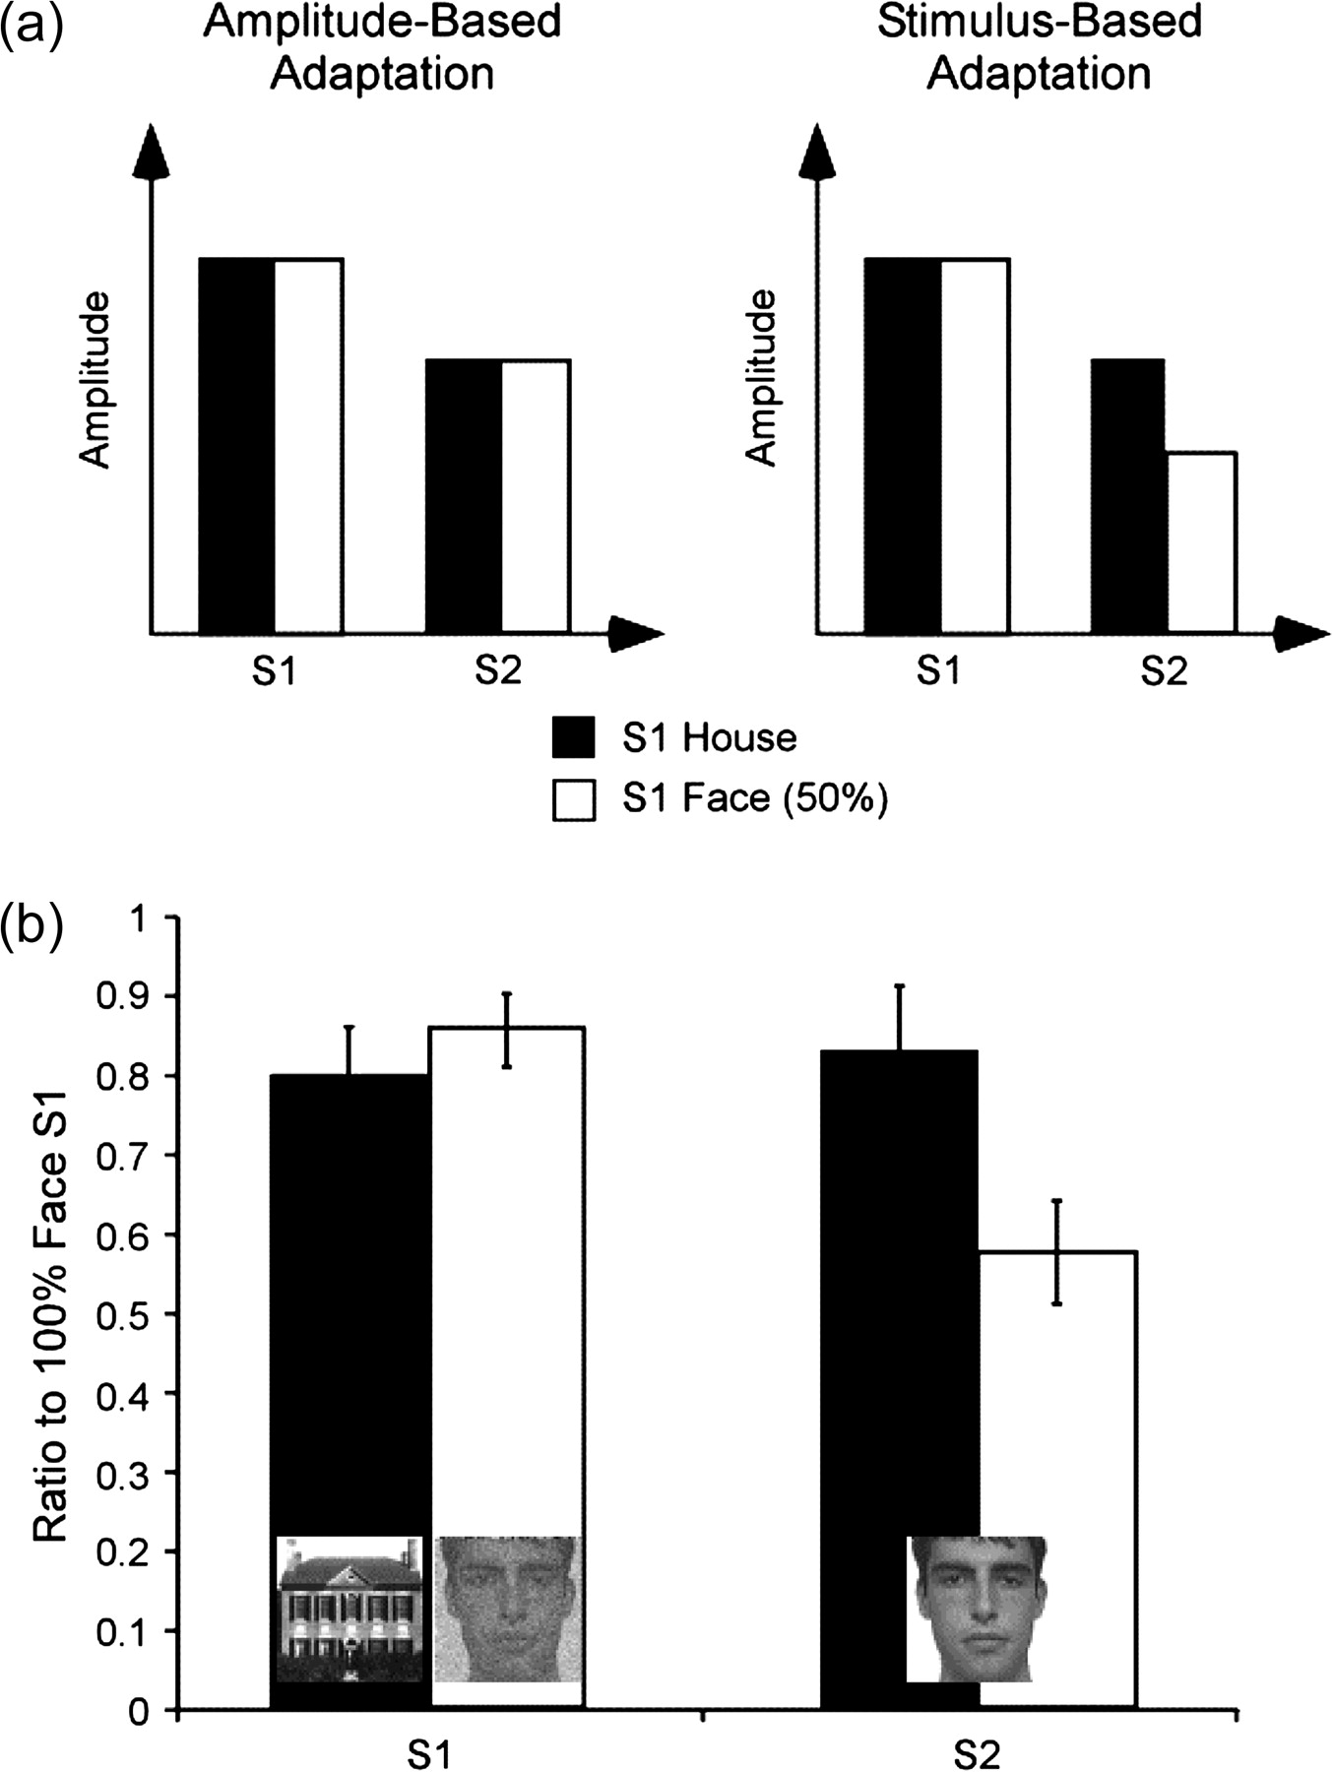
Figure 5 Direct comparison of the magnitude of adaptation to face and house stimuli of equal S1 amplitude. (a) ...
Notes:
Figure 5 Direct comparison of the magnitude of adaptation to face and house stimuli of equal S1 amplitude. (a) Predictions: if adaptation is amplitude dependent (left), S1 stimuli that elicit M170 responses of equal amplitude should produce equivalent adaptation of the S2 response, regardless of the S1 stimulus category. If adaptation is stimulus selective, there should be greater adaptation of the S2 response by faces, even if the S1 amplitude to faces is no greater than that to houses. (b) Actual results: S1 faces produce significantly greater adaptation than houses, even though the S1 responses to face and house stimuli are equivalent in amplitude. This further supports a stimulus-selective account of double-pulse adaptation at the M170.
Unless provided in the caption above, the following copyright applies to the content of this slide: © The Author 2006. Published by Oxford University Press. All rights reserved. For permissions, please e-mail: journals.permissions@oxfordjournals.org

Slide 5
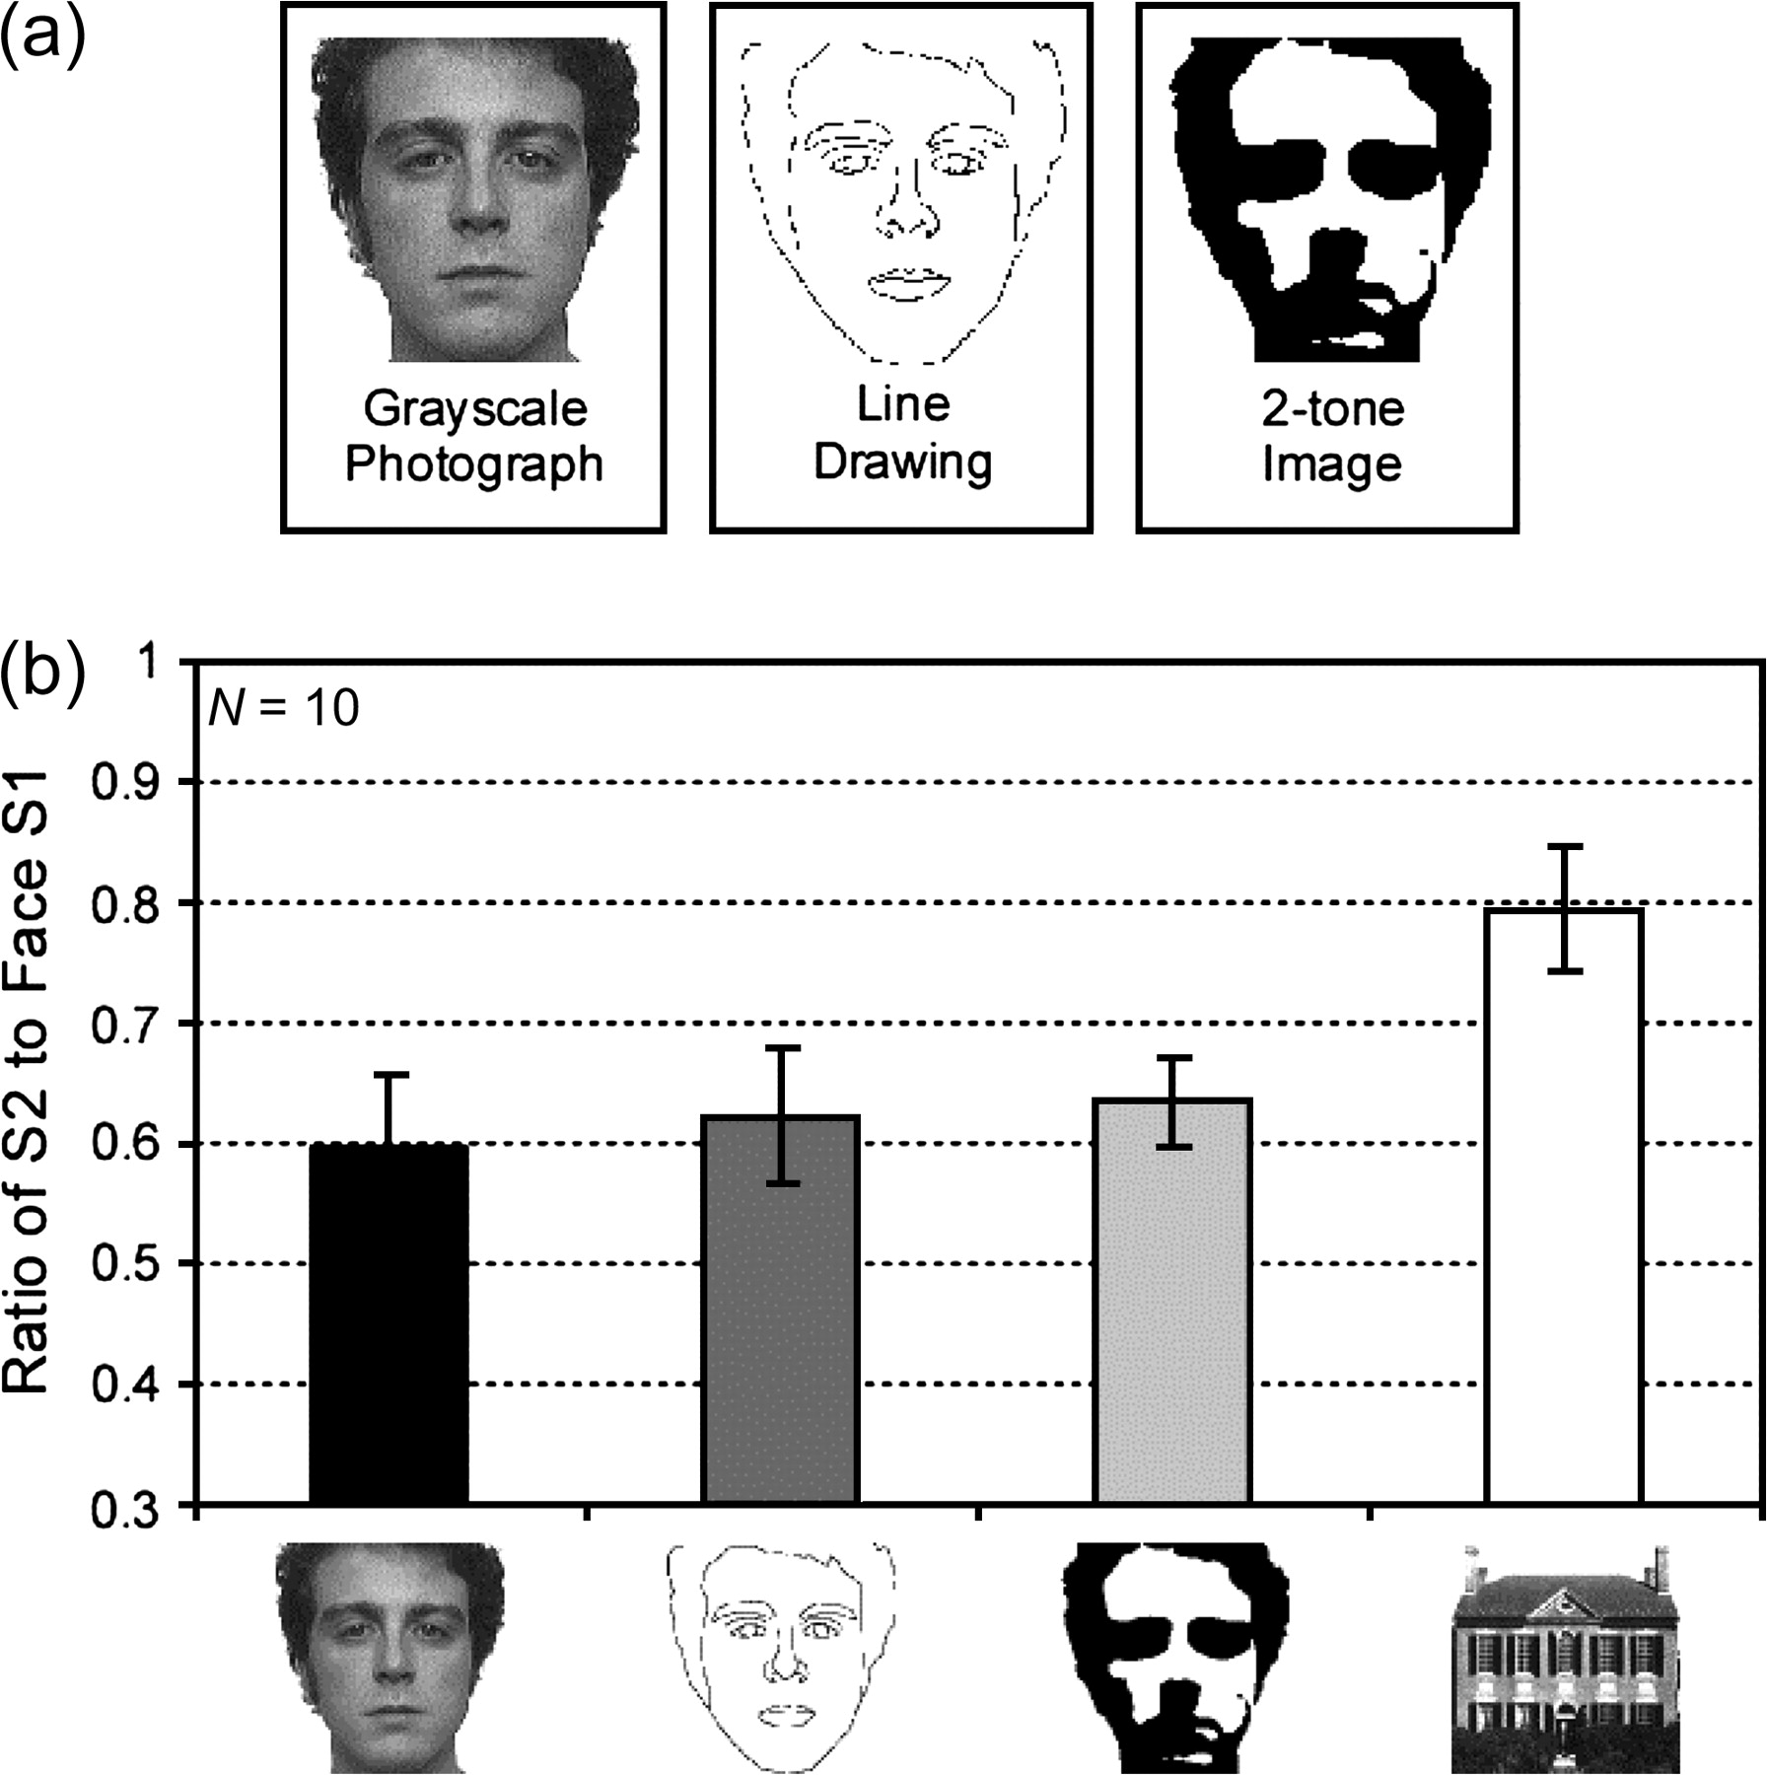
Figure 3 Double-pulse adaptation as a function of information in the S1 image. (a) Sample images depicting the 3 types ...
Notes:
Figure 3 Double-pulse adaptation as a function of information in the S1 image. (a) Sample images depicting the 3 types of face representations used in the experiment. Although line drawings and 2-tone images are clearly recognizable as faces, they share few of the physical attributes present in the grayscale photograph stimuli. (b) Average data from 10 subjects. SOA was fixed at 400 ms. Despite the different physical stimulus properties of grayscale photographs, line drawings, and 2-tone images, all 3 types of face stimuli produce equal adaptation of the response to a 2nd grayscale face stimulus. Thus, adaptation cannot be explained by low-level habituation to the shared physical attributes of face stimuli.
Unless provided in the caption above, the following copyright applies to the content of this slide: © The Author 2006. Published by Oxford University Press. All rights reserved. For permissions, please e-mail: journals.permissions@oxfordjournals.org

