Slide 1
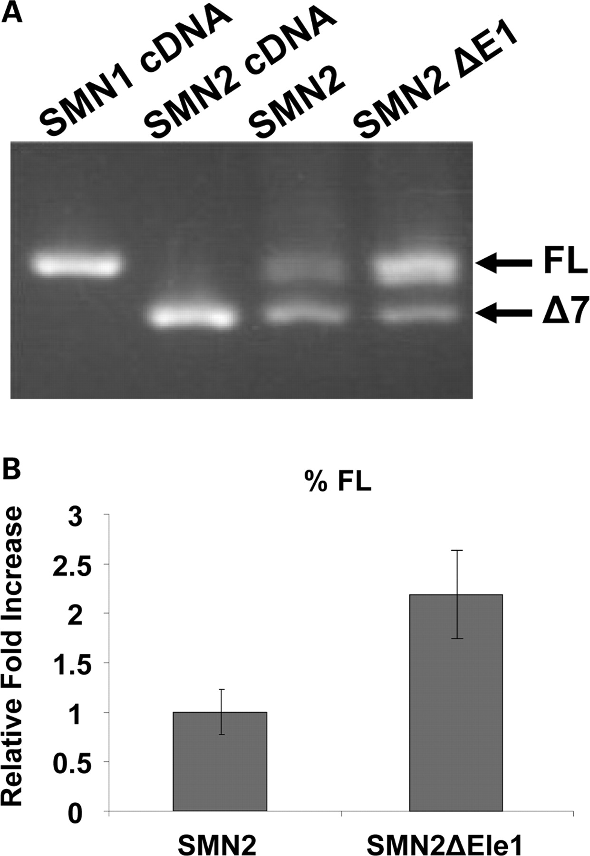
Figure 1. E1 is a negative regulator of SMN 2 exon 7 inclusion. ( A ) RT–PCR of SMN minigenes (1 µg) transfected into ...
Notes:
Figure 1. E1 is a negative regulator of SMN 2 exon 7 inclusion. ( A ) RT–PCR of SMN minigenes (1 µg) transfected into HeLa cells, and total RNA was isolated after 24 h of transfection. Bands of exon 7 and Δ7 are shown by the use of previously published SMN minigene-specific primers. ( B ) Quantification of RT–PCR performed in triplicate on transfected cells utilizing a Cy3 fluorescent primer pair specific to SMN minigene; independent experiments repeated three times. This quantification shows an ∼2-fold increase of splicing to exon 7 when E1 is deleted. P -value ≤ 0.009.
Unless provided in the caption above, the following copyright applies to the content of this slide: © The Author 2009. Published by Oxford University Press. All rights reserved. For Permissions, please email: journals.permissions@oxfordjournals.org

Slide 2
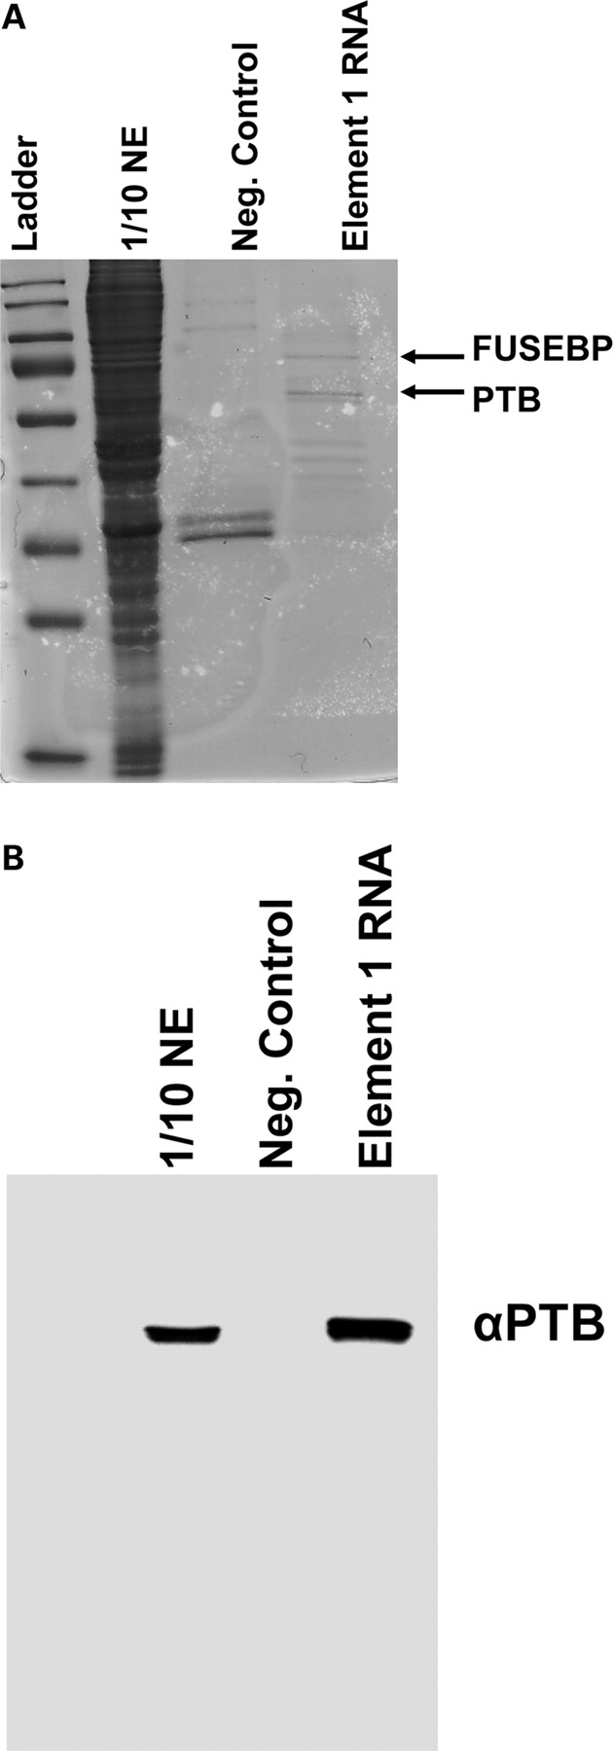
Figure 2. Identification of PTB and FUSE-BP proteins bound to E1. ( A ) RNA affinity chromatography with subsequent ...
Notes:
Figure 2. Identification of PTB and FUSE-BP proteins bound to E1. ( A ) RNA affinity chromatography with subsequent Coommassie blue stain identified at least two specific proteins interacting with E1 but not with control RNA. The indicated bands were excised from the gel, and MALDI-TOF identified PTB and FUSE-BP as the two unique bands. ( B ) Confirmation of PTB interaction with E1. RNA-protein affinity chromatography was performed, and the western blot was developed using an anti-PTB-specific antibody. PTB specifically interacts with E1 RNA and not with the negative control RNA.
Unless provided in the caption above, the following copyright applies to the content of this slide: © The Author 2009. Published by Oxford University Press. All rights reserved. For Permissions, please email: journals.permissions@oxfordjournals.org

Slide 3
Figure 3. Schematic of E1-specific bifunctional RNAs. The organization of the bifunctional RNA is illustrated with the ...
Notes:
Figure 3. Schematic of E1-specific bifunctional RNAs. The organization of the bifunctional RNA is illustrated with the split antisense domain targeting the sequences flanking E1, with the non-specific linker sequence and three tandem repeats of high-affinity exonic splice enhancer sequences for either hTra2β1 or SF2/ASF. In addition, the schematic indicates the orientation of the U7-sm-opt sequence found on the plasmid-derived bifunctional RNAs.
Unless provided in the caption above, the following copyright applies to the content of this slide: © The Author 2009. Published by Oxford University Press. All rights reserved. For Permissions, please email: journals.permissions@oxfordjournals.org

Slide 4
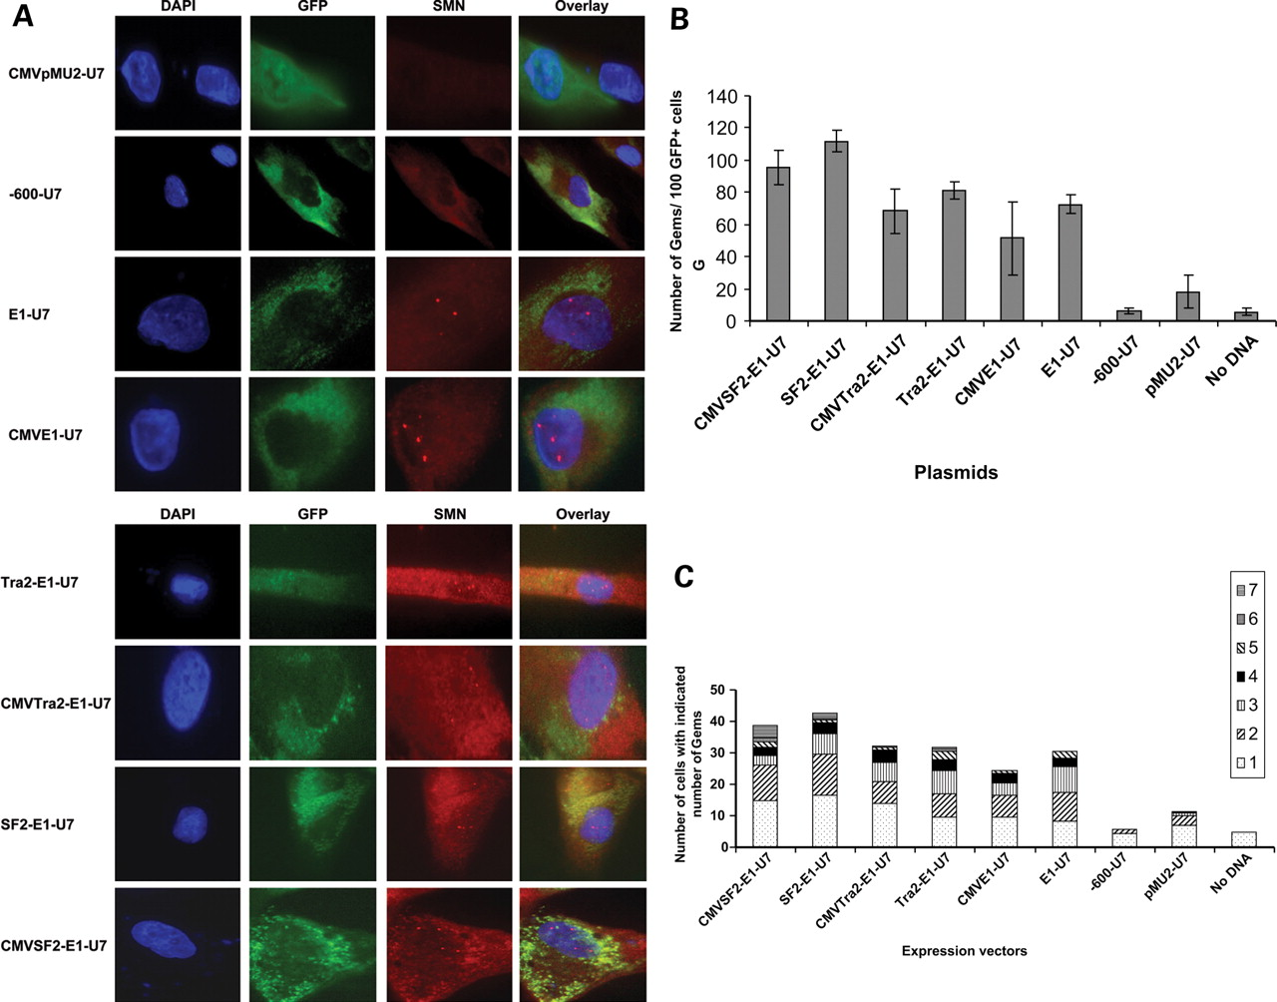
Figure 4. Increase in SMN protein in the presence of plasmid expressed bifunctional RNAs. ( A ) SMA type 1 fibroblasts ...
Notes:
Figure 4. Increase in SMN protein in the presence of plasmid expressed bifunctional RNAs. ( A ) SMA type 1 fibroblasts (3813 cells) were transiently transfected with 1 µg of plasmid DNA producing the indicated RNAs. Cells were incubated for 48 h and an immunoflourescence was performed. Unless indicated as the CMV promoter, the U6 promoter is driving RNA expression. Transfected cells are identified by GFP expression. Pictures are of representative cells found for each sample. ( B ) 3813 cells transfected with plasmids were randomly selected and gem numbers compiled. A total of 100 GFP-positive cells were observed and SMN-positive foci in the nucleus were counted ( n = 3 and error bars are ±STD). ( C ) Gem data compiled and now expressed as the number of SMN-positive gems per nucleus ( n = 3).
Unless provided in the caption above, the following copyright applies to the content of this slide: © The Author 2009. Published by Oxford University Press. All rights reserved. For Permissions, please email: journals.permissions@oxfordjournals.org

Slide 5
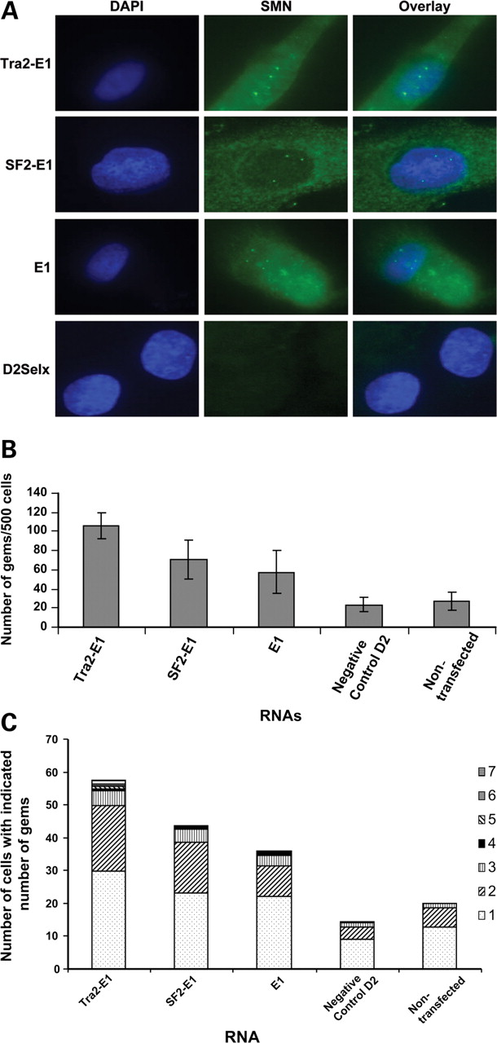
Figure 5. Increase in SMN expression after the transfection of 2′- O -methyl-modified bifunctional RNAs. ( A ) SMA ...
Notes:
Figure 5. Increase in SMN expression after the transfection of 2′- O -methyl-modified bifunctional RNAs. ( A ) SMA type 1 fibroblasts (3813 cells) were transiently transfected with 100 ng of 2′- O -methyl bifunctional RNAs for 48 h. Immunoflourescence staining was performed and images are of representative cells. ( B ) Five hundred 3813 cells were randomly counted ( n = 4) and the total gem number shown (error bars are ±STD). ( C ) Gem data compiled and expressed as the number of gems per nucleus ( n = 4).
Unless provided in the caption above, the following copyright applies to the content of this slide: © The Author 2009. Published by Oxford University Press. All rights reserved. For Permissions, please email: journals.permissions@oxfordjournals.org

Slide 6
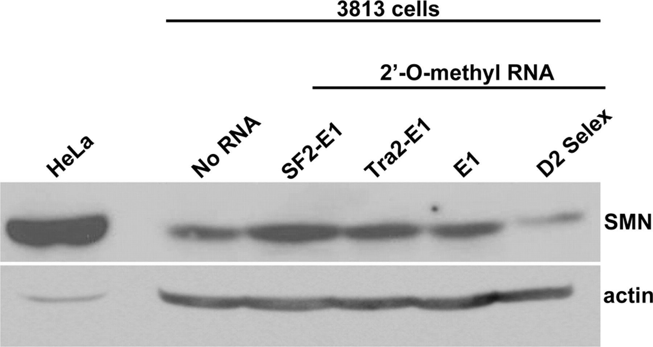
Figure 6. 2′- O -methyl bifunctional RNAs increased total SMN protein levels in SMA fibroblasts. Subconfluent 3813 ...
Notes:
Figure 6. 2′- O -methyl bifunctional RNAs increased total SMN protein levels in SMA fibroblasts. Subconfluent 3813 cells were transfected with 100 ng of the indicated RNAs and subsequently incubated for 48 h. Relative SMN protein levels were determined by western blot. HeLa cellular extracts were included as a size control.
Unless provided in the caption above, the following copyright applies to the content of this slide: © The Author 2009. Published by Oxford University Press. All rights reserved. For Permissions, please email: journals.permissions@oxfordjournals.org

Slide 7
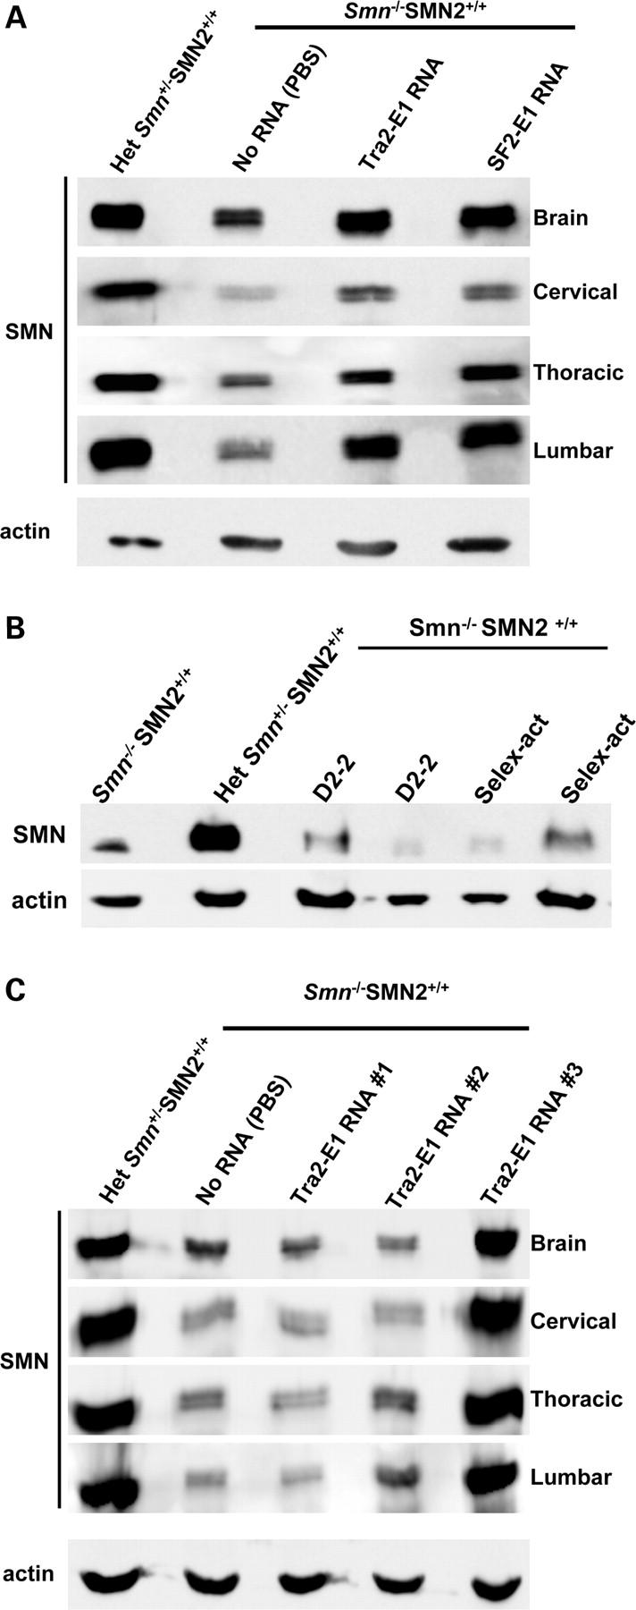
Figure 7. ICV injection of 2′- O -methyl bifunctional RNAs increases SMN protein levels throughout the CNS. ( A ) ...
Notes:
Figure 7. ICV injection of 2′- O -methyl bifunctional RNAs increases SMN protein levels throughout the CNS. ( A ) Post-natal day (PND) 2 SMA mice were ICV-injected with 4 µg of the modified bifunctional RNAs, SF2-E1 and Tra2-E1 or PBS. Indicated tissues were isolated 24 h after injections. Western blots were done in quadruplicate, and a representative blot is shown. Multiple mice were injected and tested [Tra2-E1 ( n = 13); SF2-E1 ( n = 10), data not shown]. ( B ) Control RNAs do not elevate SMN protein levels. Four micrograms of modified control RNAs were delivered via ICV injection into PND 2 SMA mice and brain tissue was isolated 24 h post-injection. SMN protein levels were observed by western blot, which were done in triplicate, and a representative blot is shown. D2-2 and Selex-act are the two previously described RNAs, corresponding to an SMN intron 7 antisense (D2-2) or three tandem repeats of an in vitro affinity-determined binding motif for hnRNP-A1 (Selex-act). ( C ) ICV injection of Tra2-E1-modified bifunctional RNA increases SMN protein levels 5 days after a single injection. 2 PND SMA mice were ICV-injected with 4 µg of Tra2-E1 RNA. Five days following injection, the indicated tissues were harvested and SMN western blot performed. Western blots were done in quadruplicate and representative blot is shown.
Unless provided in the caption above, the following copyright applies to the content of this slide: © The Author 2009. Published by Oxford University Press. All rights reserved. For Permissions, please email: journals.permissions@oxfordjournals.org

Slide 8
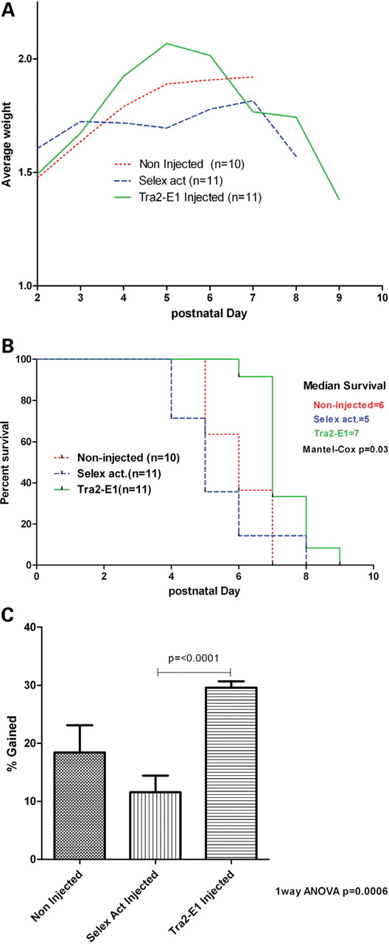
Figure 8. ICV injection of 2′- O -methyl bifunctional RNA increases weight in a severe mouse model of SMA. ( A ) 2 PND ...
Notes:
Figure 8. ICV injection of 2′- O -methyl bifunctional RNA increases weight in a severe mouse model of SMA. ( A ) 2 PND severe mice were ICV-injected on PND 2, 4 with 6 µg of either Tra2-E1 or Selex activation RNA. Mice were weighed everyday post-first injection and graphed. ( B ) Kaplan–Meier survival curve depicts a trend towards increased life expectancy for Tra2-E1-injected mice (Mantel–Cox P = 0.03). ( C ) Percent weight gained post-first injection until maximal weight was graphed. Tra2-E1-injected mice showed a significant weight gain from birth to peak over non-injected and a negative control (Selex act) injected (one-way ANOVA P = 0.0006). There is a significant difference between Tra2-E1- and Selex act-injected mice ( t -test P = < 0.0001).
Unless provided in the caption above, the following copyright applies to the content of this slide: © The Author 2009. Published by Oxford University Press. All rights reserved. For Permissions, please email: journals.permissions@oxfordjournals.org

