Slide 1
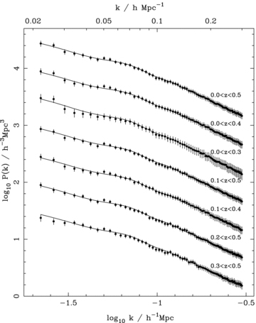
Figure 1 Average power spectra recovered from the LN catalogues (solid lines) compared with the data power spectra ...
Notes:
Figure 1 Average power spectra recovered from the LN catalogues (solid lines) compared with the data power spectra (solid circles with 1σ errors) for the six samples in Table 1. The errors on the data were calculated from the diagonal elements of the covariance matrix calculated from these LN catalogues. The power spectra have been offset by 0.5 dex for clarity, with the upper power spectrum having the correct normalization.
Unless provided in the caption above, the following copyright applies to the content of this slide: © 2009 The Authors. Journal compilation © 2009 RAS

Slide 2
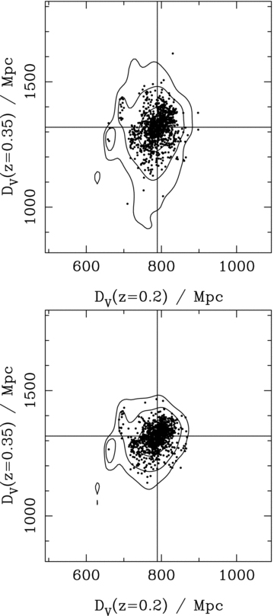
Figure 2 Average likelihood contours recovered from the analysis of three power spectra (top panel) and six power ...
Notes:
Figure 2 Average likelihood contours recovered from the analysis of three power spectra (top panel) and six power spectra (bottom panel) measured from 1000 LN density fields. Contours are plotted for , corresponding to two-parameter confidence of 68, 95 and 99 per cent for a Gaussian distribution. Contours were calculated after increasing the errors on the power spectrum band powers as described in the text. Solid circles mark the locations of the likelihood maxima closest to the true cosmology. We have plotted the likelihood surface as a function of DV(z)/Mpc, for fixed rs(zd) = 154.7 Mpc, to show distance errors if the comoving sound horizon is known perfectly. The values of DV for our input cosmology are shown by the vertical and horizontal solid lines.
Unless provided in the caption above, the following copyright applies to the content of this slide: © 2009 The Authors. Journal compilation © 2009 RAS

Slide 3
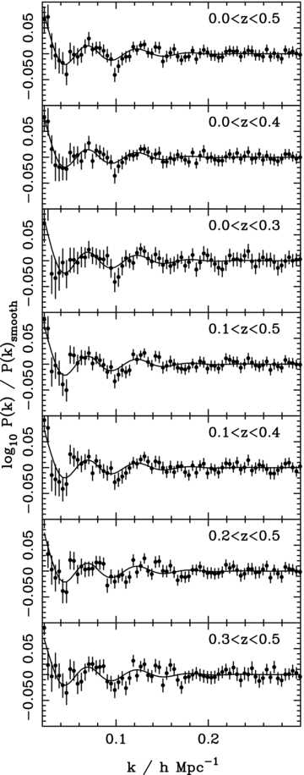
Figure 3 BAO recovered from the data for each of the redshift slices (solid circles with 1σ errors). These are ...
Notes:
Figure 3 BAO recovered from the data for each of the redshift slices (solid circles with 1σ errors). These are compared with BAO in our default ΛCDM model (solid lines).
Unless provided in the caption above, the following copyright applies to the content of this slide: © 2009 The Authors. Journal compilation © 2009 RAS

Slide 4
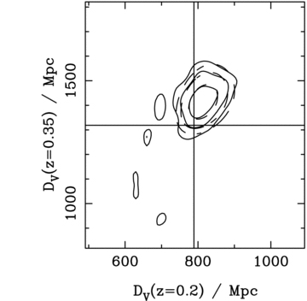
Figure 4 Likelihood contour plots for fits of two D_{V}(z) cubic spline nodes at z= 0.2 and z= 0.35, ...
Notes:
Figure 4 Likelihood contour plots for fits of two DV(z) cubic spline nodes at z= 0.2 and z= 0.35, calculated for our default analysis using six power spectra, uber-calibration, a fixed BAO damping scale of Ddamp= 10 h−1 Mpc and for all SDSS and non-overlapping 2dFGRS data. Solid contours are plotted for , which for a multivariate Gaussian distribution with two degrees of freedom correspond to 68, 95 and 99 per cent confidence intervals. Likelihoods were adjusted to match these Gaussian confidence intervals as described in Section 5. We have plotted the likelihood surface as a function of DV(z)/Mpc, for fixed rs(zd) = 154.7 Mpc, to show distance errors if the comoving sound horizon is known perfectly. We also show a multivariate Gaussian fit to this likelihood surface (dashed contours). The values of DV for a flat ΛCDM cosmology with Ωm= 0.25, h= 0.72 and Ωbh2= 0.0223 are shown by the vertical and horizontal solid lines.
Unless provided in the caption above, the following copyright applies to the content of this slide: © 2009 The Authors. Journal compilation © 2009 RAS

Slide 5
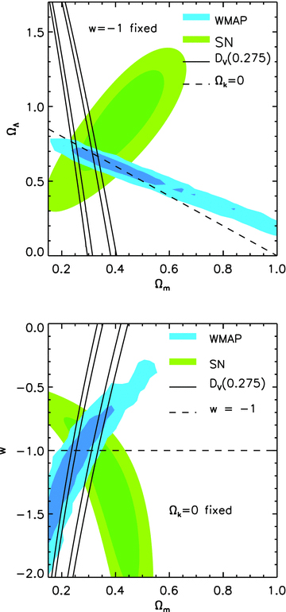
Figure 5 Cosmological constraints on ΛCDM cosmologies (upper panel) and flat CDM models where we allow w to vary ...
Notes:
Figure 5 Cosmological constraints on ΛCDM cosmologies (upper panel) and flat CDM models where we allow w to vary (lower panel), from WMAP5 (blue), Union SN (green) and our constraint on rs/DV(0.275) (solid contours). Contours are plotted for , corresponding to 68 and 95 per cent confidence intervals. The dashed lines show flat models (upper panel) and Λ models (lower panel).
Unless provided in the caption above, the following copyright applies to the content of this slide: © 2009 The Authors. Journal compilation © 2009 RAS

Slide 6
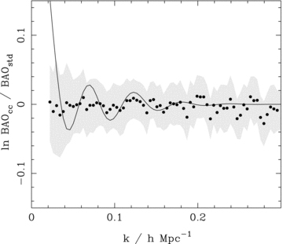
Figure 6 The log ratio of the BAO recovered from the SDSS LRG power spectrum to the power spectrum of the halo ...
Notes:
Figure 6 The log ratio of the BAO recovered from the SDSS LRG power spectrum to the power spectrum of the halo catalogue derived from the LRG sample as described by Reid et al. (2009b) (solid circles). For comparison we plot the BAO expected for a flat ΛCDM model with Ωm= 0.25, h= 0.72 and Ωbh2= 0.0223 (solid line), and the errors on each measurement (grey shaded region). There are no oscillatory features induced by the cluster-collapse procedure, and the scatter is well within the errors.
Unless provided in the caption above, the following copyright applies to the content of this slide: © 2009 The Authors. Journal compilation © 2009 RAS

Slide 7
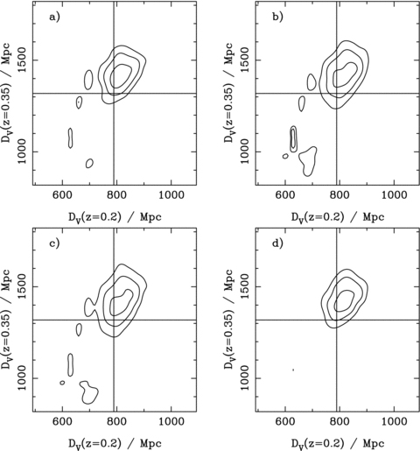
Figure 7 As Fig. 4, but now considering results from four choices of catalogue: (a) all SDSS and non-overlapping ...
Notes:
Figure 7 As Fig. 4, but now considering results from four choices of catalogue: (a) all SDSS and non-overlapping 2dFGRS data, (b) excluding both the early SDSS data and 2dFGRS, (c) excluding the 2dFGRS and (d) excluding the early SDSS data.
Unless provided in the caption above, the following copyright applies to the content of this slide: © 2009 The Authors. Journal compilation © 2009 RAS

Slide 8
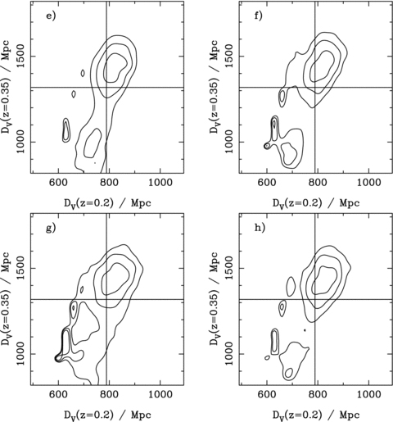
Figure 8 Likelihood contour plots as in Fig. 4, for the SDSS data, excluding the early data and the 2dFGRS, but now ...
Notes:
Figure 8 Likelihood contour plots as in Fig. 4, for the SDSS data, excluding the early data and the 2dFGRS, but now calculated for (e) fit to three power spectra, (f) old rather than uber-calibration, (g) allowing the BAO damping scale to vary with a simple Gaussian prior Ddamp= 10 ± 5 h−1 Mpc and (h) randomized galaxy redshifts used to give the expected radial galaxy distribution.
Unless provided in the caption above, the following copyright applies to the content of this slide: © 2009 The Authors. Journal compilation © 2009 RAS

Slide 9
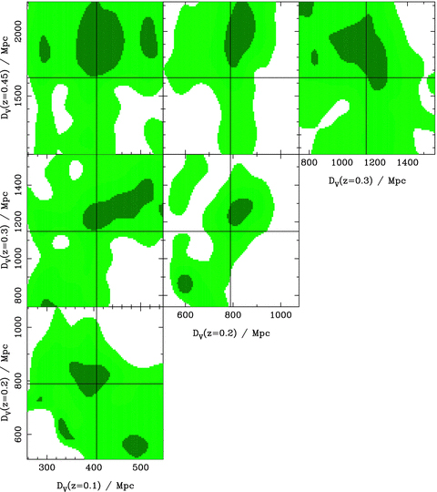
Figure 9 Contour plots showing slices through the likelihood for four D_{V}(z) cubic spline nodes at z= 0.1, ...
Notes:
Figure 9 Contour plots showing slices through the likelihood for four DV(z) cubic spline nodes at z= 0.1, z= 0.2, z= 0.3 and z= 0.45, calculated for our default analysis using six power spectra, uber-calibration and a fixed BAO damping scale of Ddamp= 10 h−1 Mpc. Shaded regions are plotted for , which for a multivariate Gaussian distribution with two degrees of freedom correspond to 68, 95 and 99 per cent confidence intervals. Likelihoods were adjusted to match these Gaussian confidence intervals as described in Section 5. In each panel, the nodes that are not shown were fixed at the default ΛCDM (Ωm= 0.25, ΩΛ= 0.75) values. We use shaded regions in this plot to show the likelihood surface, compared with the contours in Figs 7 and 8 because the likelihood surface is more complicated with four nodes, and the shading helps to distinguish peaks from troughs.
Unless provided in the caption above, the following copyright applies to the content of this slide: © 2009 The Authors. Journal compilation © 2009 RAS

Slide 10
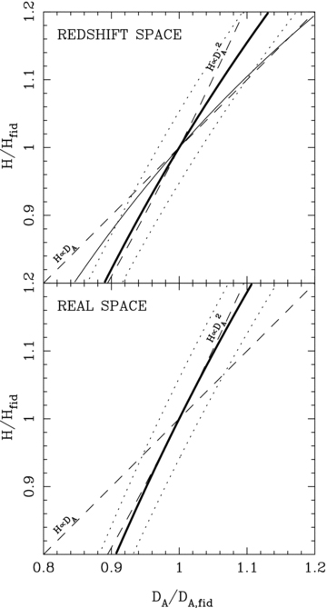
Figure 10 The expected shift recovered from an analysis of the BAO position in a spherically averaged galaxy power ...
Notes:
Figure 10 The expected shift recovered from an analysis of the BAO position in a spherically averaged galaxy power spectrum, if there are radial and angular distortions induced by assuming an incorrect cosmology when analysing the data. The thick solid contour shows no residual shift, while the dotted contours show a 1 per cent shift. For comparison we plot the expected behaviour for an isotropic power spectrum H(z) ∝D2A, and for an increased importance of the radial distortion H(z) ∝DA (dashed lines). The top panel approximates redshift space, by weighting the power in the spherical average by (1 +βμ2)2, with β= 0.25, matching that expected for the SDSS LRGs, while the bottom panel does not include this weighting. For comparison, the thin solid contour in the top panel marks no residual shift for data with β= 1, showing that we should expect the radial signal to increase in importance for such a sample.
Unless provided in the caption above, the following copyright applies to the content of this slide: © 2009 The Authors. Journal compilation © 2009 RAS

Slide 11
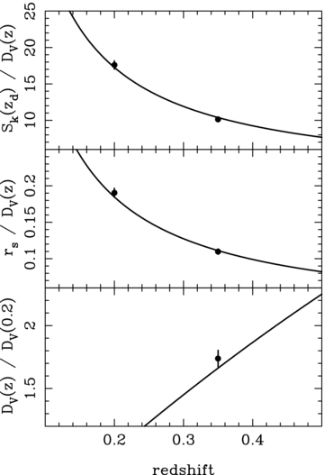
Figure 11 The BAO constraints (solid circles with 1σ errors), compared with the best-fitting ΛCDM model. The three ...
Notes:
Figure 11 The BAO constraints (solid circles with 1σ errors), compared with the best-fitting ΛCDM model. The three panels show different methods of using the data to constrain models.
Unless provided in the caption above, the following copyright applies to the content of this slide: © 2009 The Authors. Journal compilation © 2009 RAS

Slide 12
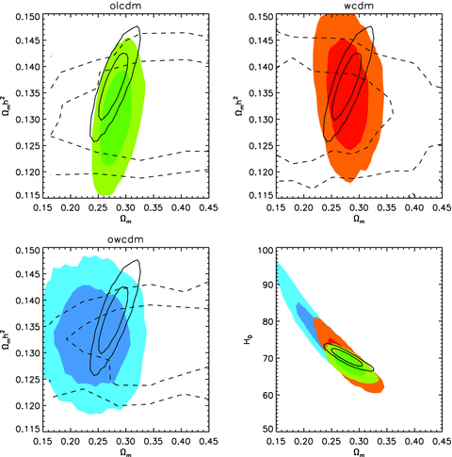
Figure 12 WMAP 5+BAO constraints on Ω_{m}h², Ω_{m} and H₀ for ΛCDM (solid black ...
Notes:
Figure 12 WMAP 5+BAO constraints on Ωmh2, Ωm and H0 for ΛCDM (solid black contours), oΛCDM (shaded green contours), wCDM (shaded red contours) and owCDM (shaded blue contours) models. Throughout, the solid contours show WMAP5+LRGΛCDM constraints. The first three panels show WMAP5-only constraints (dashed contours) and WMAP5+BAO constraints (coloured contours) in the Ωmh2–Ωm plane as the model is varied. In the lower right, we show all constraints from WMAP5+BAO for all four models in the Ωm–H0 plane, which lie within the tight Ωmh2≈ 0.133 ± 0.006WMAP5-only constraints.
Unless provided in the caption above, the following copyright applies to the content of this slide: © 2009 The Authors. Journal compilation © 2009 RAS

Slide 13
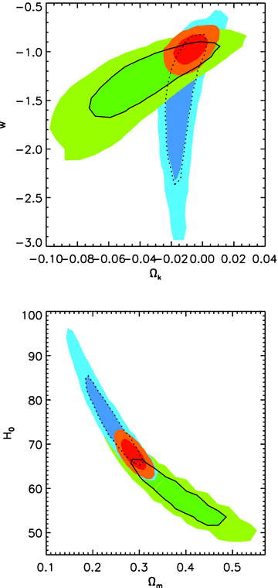
Figure 13 For the owCDM model, we compare the constraints from WMAP5+BAO (blue contours), WMAP5+SN (green contours) and ...
Notes:
Figure 13 For the owCDM model, we compare the constraints from WMAP5+BAO (blue contours), WMAP5+SN (green contours) and WMAP5+BAO+SN (red contours). Dashed and solid contours highlight the 68 per cent confidence intervals for the WMAP5+BAO and WMAP5+SN models, respectively.
Unless provided in the caption above, the following copyright applies to the content of this slide: © 2009 The Authors. Journal compilation © 2009 RAS

Slide 14
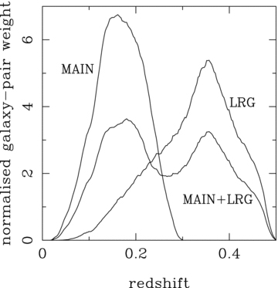
Figure A1 The redshift dependence of galaxy pair-weights for the SDSS DR7 LRG and main galaxy samples, and from the ...
Notes:
Figure A1 The redshift dependence of galaxy pair-weights for the SDSS DR7 LRG and main galaxy samples, and from the combination of the two. These curves were calculated assuming a flat ΛCDM cosmology with Ωm= 0.25, h= 0.72 and Ωbh2= 0.0223.
Unless provided in the caption above, the following copyright applies to the content of this slide: © 2009 The Authors. Journal compilation © 2009 RAS

Slide 15
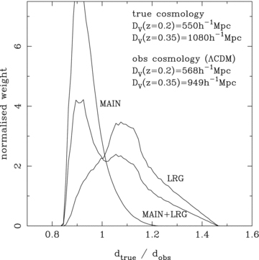
Figure A2 Galaxy pair-weights for the SDSS DR7 LRG and main galaxy samples, and from the combination of the two, as a ...
Notes:
Figure A2 Galaxy pair-weights for the SDSS DR7 LRG and main galaxy samples, and from the combination of the two, as a function of comoving distance shifts. These were calculated assuming that a flat ΛCDM cosmology with Ωm= 0.25, h= 0.72 and Ωbh2= 0.0223 was used to analyse the data, while the BAO are present in a true cosmological model with the distance–redshift relation defined by a cubic spline in DV(z) with nodes at z= 0.2 and z= 0.35, with amplitude as shown in the plot.
Unless provided in the caption above, the following copyright applies to the content of this slide: © 2009 The Authors. Journal compilation © 2009 RAS

Slide 16
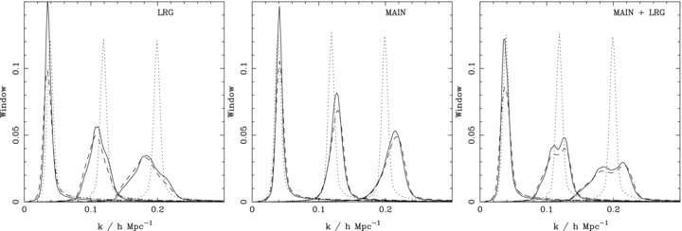
Figure A3 Window functions for three values of k, calculated for the SDSS LRG, main galaxy and combined catalogues. ...
Notes:
Figure A3 Window functions for three values of k, calculated for the SDSS LRG, main galaxy and combined catalogues. Dotted lines represent the windows for our fiducial ΛCDM cosmology. The solid and dashed lines show the window functions, if the true cosmology were different, but the data were analysed assuming that the fiducial ΛCDM cosmology is correct. The solid lines were calculated using the procedure outlined in this Appendix. Dashed lines were calculated using the Monte Carlo procedure of Percival et al. (2007c).
Unless provided in the caption above, the following copyright applies to the content of this slide: © 2009 The Authors. Journal compilation © 2009 RAS

