Slide 1
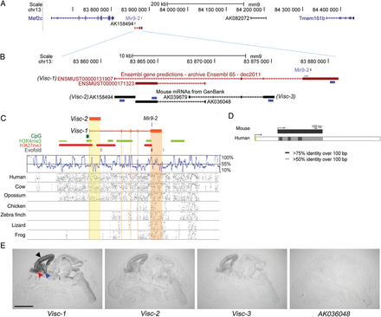
Figure 1. Genomic organization, conservation, and expression of the Visc locus. (A) The genomic region of mouse ...
Notes:
Figure 1. Genomic organization, conservation, and expression of the Visc locus. (A) The genomic region of mouse chromosome 13 (adapted from the UCSC Genome Browser), to scale, showing the relative position of Visc-2 (AK158494). (B) Expanded view of the Visc locus, to scale. Blue boxes indicate the relative positions of the riboprobes used. Note that the major transcriptional start site in a human neuroblastoma cell line (SK-N-BE) lies 410 nucleotides from the miR-9-2 stem loop structure as shown (Laneve et al. 2010). (C) Expanded view of the Visc locus including H3K4me3 (green) and H3K27me3 (red) chromatin marks (Mikkelsen et al. 2007) and Evofold predictions of RNA secondary structures (dark grey). A SinicView conservation plot based on a 21-vertebrate sequence alignment is shown using mouse as the reference sequence, and Gmaj views of alignments between mouse and the indicated species’ sequences are also shown. (D) Conservation of the human Visc-2 orthologue (AK125167). The TSS (arrows) and percentage sequence identity are indicated. (E) In situ hybridization against serial E16.5 wild-type mouse head sections shows the expression of lncRNAs in the Visc region. Visc-1 is the most highly expressed, with hybridization to the telencephalon (black arrowhead), latero-caudal migratory path from the basal telencephalon to the striatum (blue arrowhead) and the RMS to the OB (red arrowhead). Visc-2 and Visc-3 (AK039679) expression share a virtually identical localization, although their levels of expression are lower. Expression of the lncRNA AK036048, on the opposite strand to Visc-2, is not detectable. Scale bar: 2 mm.
Unless provided in the caption above, the following copyright applies to the content of this slide: © The Author 2014. Published by Oxford University PressThis is an Open Access article distributed under the terms of the Creative Commons Attribution License (http://creativecommons.org/licenses/by/4.0/), which permits unrestricted reuse, distribution, and reproduction in any medium, provided the original work is properly cited.

Slide 2
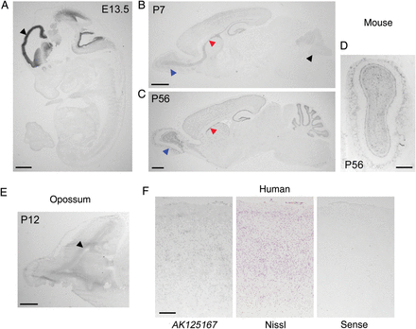
Figure 2. Developmental expression of Visc-2 and orthologous lncRNAs in the brain. (A) In situ hybridization of E13.5 ...
Notes:
Figure 2. Developmental expression of Visc-2 and orthologous lncRNAs in the brain. (A) In situ hybridization of E13.5 wild-type mouse embryos demonstrates localized expression of Visc-2 in the telencephalon (black arrowhead). By P7, (B) expression is most prominent in the SVZ and OB (red and blue arrowheads, respectively), but also in the cerebellar granule cell layer (black arrowheads). Expression appears lower at P56 (C), but is still clearly localized to the proliferative regions of the SVZ and OB (red and blue arrowheads, respectively). A coronal view of the OB from a P56 wild-type brain is also shown (D). (E) Expression of the opossum orthologue of Visc-2 was detected in the telencephalic ventricular zone (arrowhead) at P12. (F) Expression of the human Visc-2 orthologue AK125167 in the human fetal cortex compared with an adjacent Nissl-stained section and a section hybridized using a sense (negative control) riboprobe. Scale bars: 1 mm in (A–C and E); 0.5 mm in (D and F).
Unless provided in the caption above, the following copyright applies to the content of this slide: © The Author 2014. Published by Oxford University PressThis is an Open Access article distributed under the terms of the Creative Commons Attribution License (http://creativecommons.org/licenses/by/4.0/), which permits unrestricted reuse, distribution, and reproduction in any medium, provided the original work is properly cited.

Slide 3
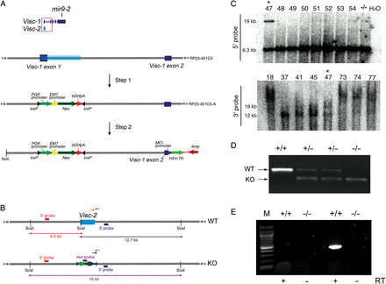
Figure 3. Generation of a Visc-2 knockout mouse. (A) Overview of the generation of a Visc-targeting transgenic mouse ...
Notes:
Figure 3. Generation of a Visc-2 knockout mouse. (A) Overview of the generation of a Visc-targeting transgenic mouse constructs using BAC recombineering. The BAC RP23-451C5 encompasses both Visc-1 exons 1 and 2 (dark blue) and Visc-2 (light blue). In step 1, this region was replaced by components of the pL452 vector (including the PGK eukaryotic-derived and EM7 prokaryotic-derived promoters that drive expression of the neomycin drug-resistance gene [Neo]) followed by the bovine growth hormone polyadenylation tail (bGHpA) to produce the modified BAC RP23-451C5-A. In step 2, the region of interest was subcloned into vector pL253 to create the Visc-2 knockout targeting construct. This vector includes a polyoma enhancer promoter (MCI) driving expression of herpes simplex virus thymidine kinase (HSV-TK) with ampicillin (Amp) selection. (B) Mouse genomic region encompassing targeted region in wild-type and Visc-2 knockout illustrating the probes for Southern blotting screening are indicated by red and blue boxes, respectively. Primers for PCR-based genotyping of the 2 alleles are shown as green and orange (Visc-2+/+ [WT, wild-type]); and green and black arrows (Visc-2−/− [KO, knockout]). (C) 5′ and 3′ Southern blot screens showing positive homologous recombinant (indicated by asterisk, clone number 47), using ScaI restriction enzyme digestion of genomic DNA from targeted ES cells. (D) Genotyping of DNA extracted from Visc-2+/+, Visc-2+/−, and Visc-2−/− mice. (E) RT–PCR of Visc-2 from E16.5 whole-brain cDNA confirming the absence of the transcript in Visc-2−/− mice. Control reactions in the absence of reverse transcriptase (-RT) during cDNA preparation are also shown. M, 100 bp marker.
Unless provided in the caption above, the following copyright applies to the content of this slide: © The Author 2014. Published by Oxford University PressThis is an Open Access article distributed under the terms of the Creative Commons Attribution License (http://creativecommons.org/licenses/by/4.0/), which permits unrestricted reuse, distribution, and reproduction in any medium, provided the original work is properly cited.

Slide 4
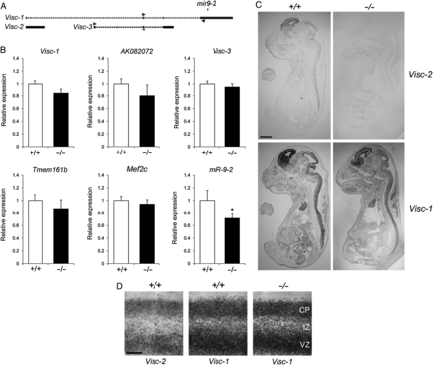
Figure 4. Expression analysis of protein-coding and noncoding transcripts expressed in close proximity to the Visc-2 ...
Notes:
Figure 4. Expression analysis of protein-coding and noncoding transcripts expressed in close proximity to the Visc-2 locus. (A) Detail of the Visc region, to scale, showing a relative position of the primers used for qRT–PCR. (B) Quantitative RT–PCR from E16.5 Visc-2+/+ and Visc-2−/− whole brain. There was no significant difference between genotypes in the expression of protein-coding genes (Tmem161b [P = 0.14] and Mef2c [P = 0.26]), or the noncoding transcripts AK082072 (P = 0.21), Visc-1 (P = 0.17), or Visc-3 (P = 0.34); however, a significant reduction in the expression of miR-9-2 was observed (*P = 0.032; ANOVA). All data are shown ±SEM. (C and D) In situ hybridization using riboprobes specific for Visc-1 and Visc-2 at E16.5 showing loss of Visc-2 expression in Visc-2−/− whole embryos (C) and the developing cortex (D), but no disruption in the expression level or distribution of Visc-1 in knockout mice. Scale bars: 2 mm in (C) and 0.25 mm in (D).
Unless provided in the caption above, the following copyright applies to the content of this slide: © The Author 2014. Published by Oxford University PressThis is an Open Access article distributed under the terms of the Creative Commons Attribution License (http://creativecommons.org/licenses/by/4.0/), which permits unrestricted reuse, distribution, and reproduction in any medium, provided the original work is properly cited.

Slide 5
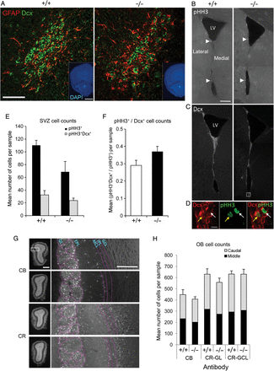
Figure 5. Neuroanatomical screening of the adult SVZ, RMS, and OB in Visc-2^{−/−} mice. (A) Representative ...
Notes:
Figure 5. Neuroanatomical screening of the adult SVZ, RMS, and OB in Visc-2−/− mice. (A) Representative confocal micrographs of the RMS illustrate the lack of colocalization between GFAP (red) and Dcx (green) cells indicative of normal structural integrity in both Visc-2+/+ (+/+) and Visc-2−/− (−/−) animals. Scale bar: 50 μm. (Insets) DAPI-counterstained images indicating the position of the RMS, as shown in (A), respectively. Scale bar: 1 mm. (B) Montaged fluorescence micrographs showing the distribution of dividing cells within the SVZ in Visc-2+/+ and Visc-2−/− mice. White arrowheads indicate example pHH3+ cells, which were largely located within the lateral wall of the lateral ventricle. Scale bar: 200 μm. (C) Montaged fluorescence micrographs showing the migratory neuroblast population within the SVZ, as shown by Dcx staining along the (mainly lateral) ventricular surface. LV, lateral ventricle. (D) Coexpression of pHH3 and Dcx labeling of the region indicated by the box in (C); cytoplasmic Dcx (red) staining of the neuroblasts, nuclear (green) staining of the proliferating cells. The merged image shows a coexpressing (yellow arrow) and a noncoexpressing (white arrow) cell. Scale bar: 10 μm. (E) Quantification of SVZ populations showed no significant difference in pHH3+ (P = 0.073) and pHH3+Dcx+ (P = 0.27) cells between genotypes or (F) proportion of pHH3+ cells that were co-labeled with Dcx (P = 0.14). Data are shown ±SEM. (G) Representative DAPI-counterstained fluorescence micrographs of sections taken from the mid-region of the OB from Visc-2+/+ and Visc-2−/− mice; boxes show the position of the higher magnification images. The CB+ cells mainly populated the glomerular layer (GL), whereas the CR+ cells were mainly located in the GL and granule cell layers (GCLs). EPL, external plexiform layer; MCL, mitral cell layer; IPL, internal plexiform layer. Scale bar: 200 μm. (H) Quantification of CB+ and CR+ cells from both the caudal and middle regions of the OB showed no significant changes in the numbers (overall P = 0.41) or laminar distribution of cells (overall CR+− GL, P = 0.29; overall CR+− GCL, P = 0.98) between genotypes (overall CR+− GL, P = 0.29; overall CR+− GCL, P = 0.98). Data are shown ±SEM.
Unless provided in the caption above, the following copyright applies to the content of this slide: © The Author 2014. Published by Oxford University PressThis is an Open Access article distributed under the terms of the Creative Commons Attribution License (http://creativecommons.org/licenses/by/4.0/), which permits unrestricted reuse, distribution, and reproduction in any medium, provided the original work is properly cited.

Slide 6
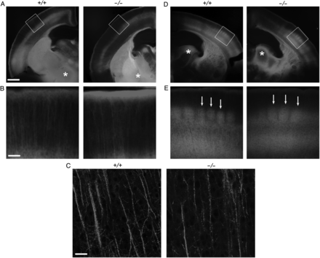
Figure 6. Carbocyanine dye tracing of cortical layer 5 and thalamocortical projections in Visc-2^{−/−} mice. P7 ...
Notes:
Figure 6. Carbocyanine dye tracing of cortical layer 5 and thalamocortical projections in Visc-2−/− mice. P7 Visc2+/+ (+/+) and Visc2−/− (−/−) brains were PFA-fixed and DiI crystals were placed into the cerebral peduncle (asterisks in A) or the ventrobasal complex of the thalamus (asterisks in D), followed by 6 weeks of incubation. Microscopy of coronal sections indicates that the same population of layer 5 projection neurons was backlabeled in both Visc2+/+ and Visc2−/− brains (A), and both populations showed similar apical dendrites reaching to the marginal zone with a terminal tuft (B). The structure of the apical dendrites of the backlabeled layer 5 neurons was also similar in mice of both genotypes (C). Tracing from ventrobasal complex of the thalamus (asterisks in D) revealed thalamocortical projections reaching the cortex along similar trajectories and formed a characteristic periphery-related pattern within layer 4 of the barrel cortex in both Visc2+/+ and Visc2−/− mice (arrows in E). Panels in (B) and (E) were taken from the regions indicated with boxes in (A) and (D), respectively. Scale bars: 0.5 mm in (A and D), 100 μm in (B and E), 25 μM in (C).
Unless provided in the caption above, the following copyright applies to the content of this slide: © The Author 2014. Published by Oxford University PressThis is an Open Access article distributed under the terms of the Creative Commons Attribution License (http://creativecommons.org/licenses/by/4.0/), which permits unrestricted reuse, distribution, and reproduction in any medium, provided the original work is properly cited.

Slide 7
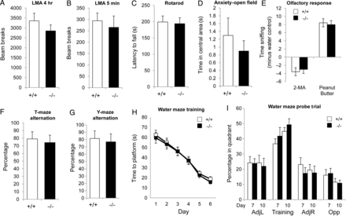
Figure 7. Behavioral characterization of Visc-2 knockout mice. No significant difference in performance between adult ...
Notes:
Figure 7. Behavioral characterization of Visc-2 knockout mice. No significant difference in performance between adult male Visc-2+/+ and Visc-2−/− mice (N = 12 for each genotype) was identified in any of the behavioral paradigms chosen. The test battery included assays of: (A) LMA over (A) 4 h (P = 0.57) and (B) 5 min (P = 0.31), (C) motor function on a rotarod (P = 0.85), (D) anxiety based on time in the center of a circular open field (P = 0.47), (E) olfactory response to aversive (2-methylbutyric acid; P = 0.16) or attractive (peanut butter; P = 0.26) scents compared with water, (F) short-term spatial memory in a T-maze (P = 0.27), and (G) spatial novelty in a Y-maze (P = 0.58). In the Morris water maze, there was no difference in (H), the reduction in time taken to locate the hidden platform after 6 days (genotype × day P = 0.49; ANOVA). (I) For the probe trial, the time spent in the same quadrant of the pool where the platform had been previously been located (training quadrant) compared with quadrants either side (adj L and adj R) or opposite (Opp) after 7 and 10 days of training is shown. Although mice of both genotypes spent more time in the training quadrant, there was also no significant improvement between genotypes in performance between probe trials (genotype × day P = 0.062; ANOVA). All data are shown ±SEM.
Unless provided in the caption above, the following copyright applies to the content of this slide: © The Author 2014. Published by Oxford University PressThis is an Open Access article distributed under the terms of the Creative Commons Attribution License (http://creativecommons.org/licenses/by/4.0/), which permits unrestricted reuse, distribution, and reproduction in any medium, provided the original work is properly cited.

