Slide 1
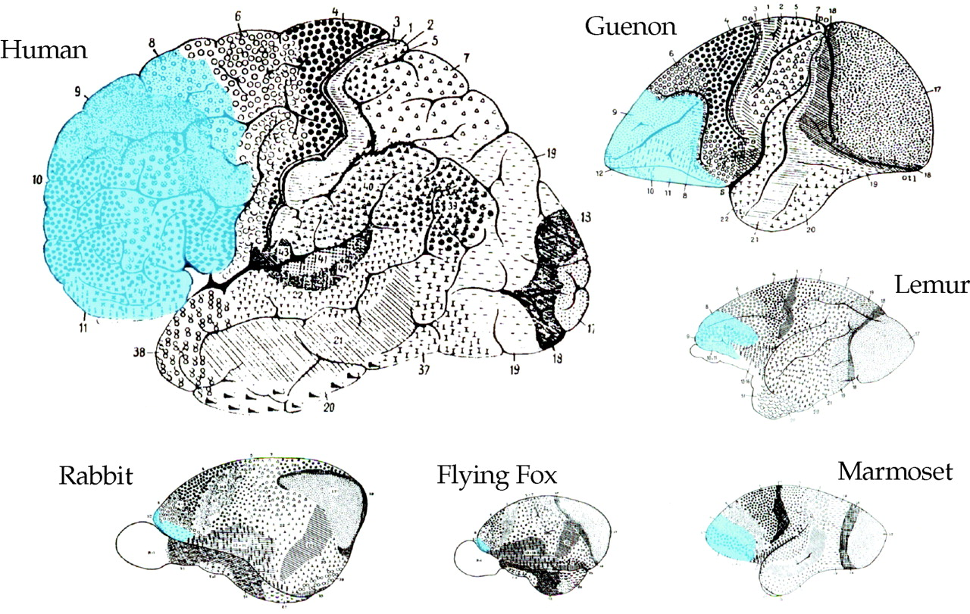
Figure 1. Schematics illustrating relative differences in cortical organization in selected mammalian ...
Notes:
Figure 1. Schematics illustrating relative differences in cortical organization in selected mammalian species, modified from Garey’s (Garey, 1994) translation of Brodmann’s (Brodmann, 1909) work. In humans, granular prefrontal cortex (blue) occupies 29% of the total cortex, considerably more than in the guenon (11.1%), lemur (8.3%), marmoset (8.9%), flying fox (2.3%) and rabbit (2.2%) (Brodmann, 1913).
Unless provided in the caption above, the following copyright applies to the content of this slide:

Slide 2
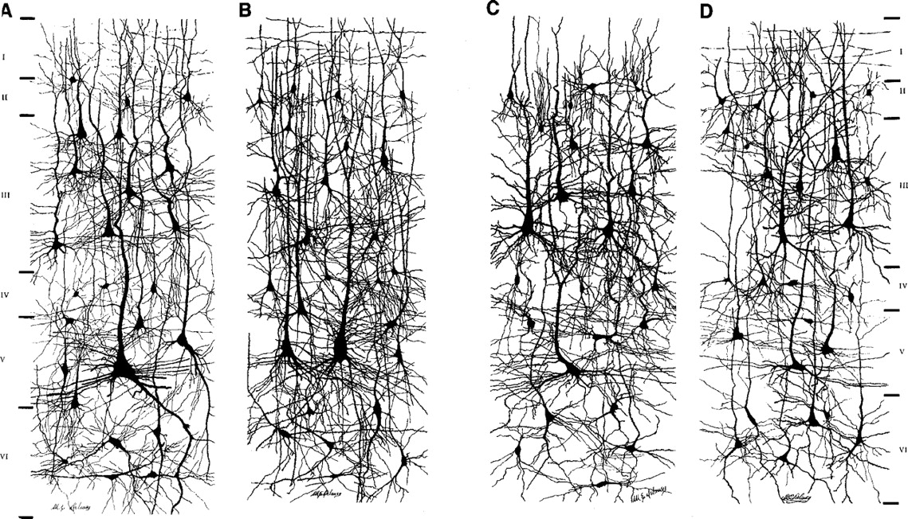
Figure 2. Drawings of cortical neurons in (A) the crown of lobulus paracentralis, (B) the posterior wall of ...
Notes:
Figure 2. Drawings of cortical neurons in (A) the crown of lobulus paracentralis, (B) the posterior wall of gyrus centralis anterior, (C) the crown of gyrus frontalis superior and (D) the anterior wall of gyrus centralis posterior, highlighting interareal differences in pyramidal cell structure in the human brain (modified from Conel, 1959).
Unless provided in the caption above, the following copyright applies to the content of this slide:

Slide 3
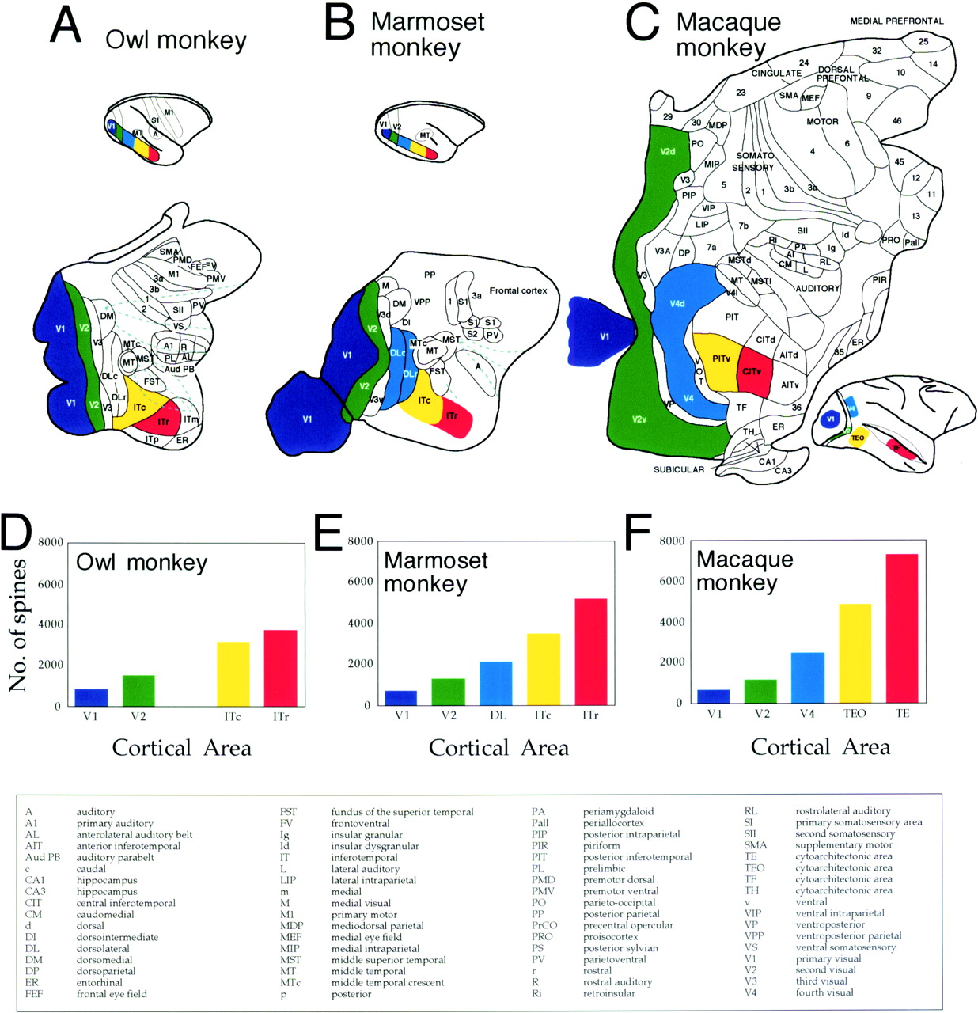
Figure 3. Schematics illustrating cortical organization in the (A) owl monkey, (B) marmoset monkey and (C) ...
Notes:
Figure 3. Schematics illustrating cortical organization in the (A) owl monkey, (B) marmoset monkey and (C) macaque monkey. Although cytoarchitecture, myeloarchitecture, patterns of connectivity and neuronal response properties provide a basis for distinguishing cortical areas, their number, location and nomenclature remain controversial (for reviews, see Kaas, 1997; Rosa, 1997; Zeki, 2003). Graphs (D–F) illustrate differences in the total number of spines in the basal dendritic arbour of the ‘average’ layer III pyramidal cell in the primary visual area (V1, purple), the second visual area (V2, green), the fourth visual area (V4 or DL, blue), cytoarchitectonic area TEO (PIT or ITc, yellow) and cytoarchitectonic area TE (CIT or ITr, red). The numbers of spines within the dendritic arbours were determined by combining data from the Sholl analysis and spine density counts (see Elston, 2001). Figure modified from Elston (2003b).
Unless provided in the caption above, the following copyright applies to the content of this slide:

Slide 4
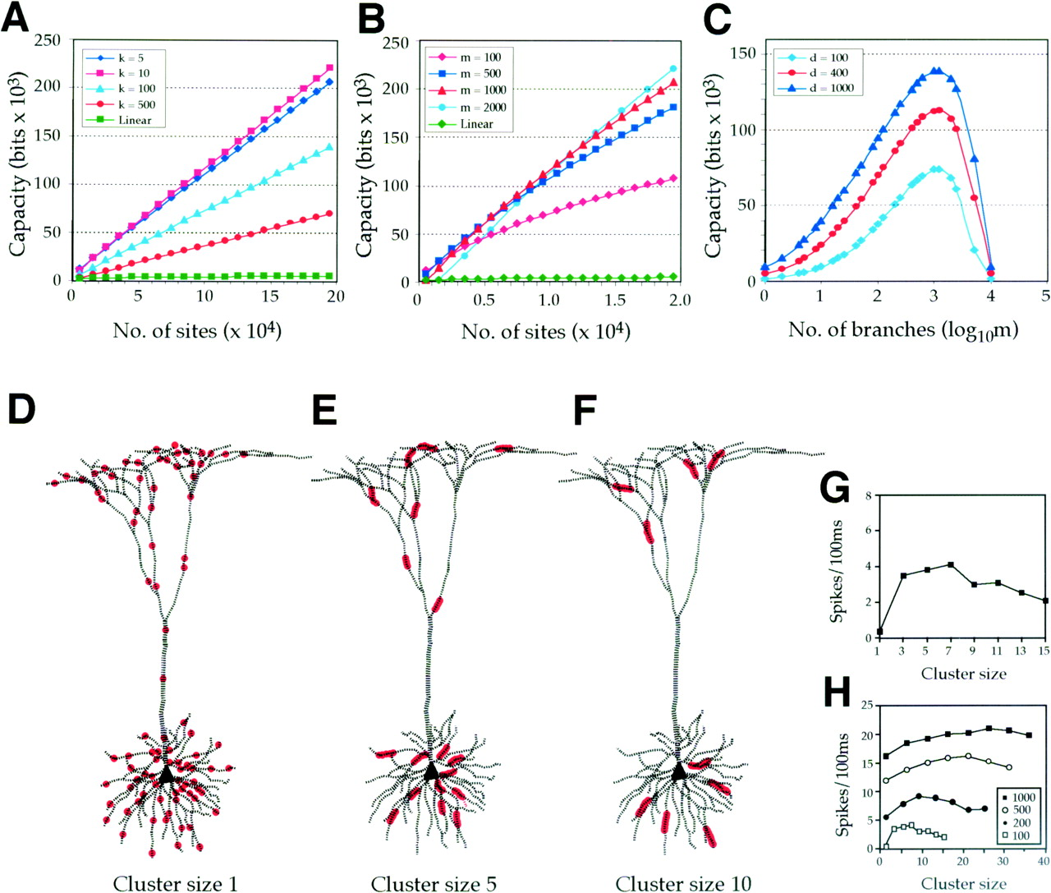
Figure 4. The capacity (measured in bits) of a cell of fixed branch length, or branch count, increases with ...
Notes:
Figure 4. The capacity (measured in bits) of a cell of fixed branch length, or branch count, increases with an increase in the number of sites. Cells of different branch length (k) and branch count (m) are illustrated in (A) and (B), respectively. An increase in either of these variables results in increasing capacity with an increase in the number of sites. The capacity of a cell of fixed size (C) increases to a peak with an increase in the number of branches, before decreasing to values expected by linear models. (D–F) Drawings of the same pyramidal cell with a fixed number of synchronously active excitatory inputs (red circles) distributed throughout the dendritic arbour in different cluster sizes. (G) Plot of baseline cell activity versus cluster size, illustrating the different saturation levels for cells receiving different numbers of synchronously active excitatory inputs. (H) Increasing the number of inputs (with a set cluster size) also increases the number of spike discharges. Adapted from Mel (1993) and Poirazi and Mel (2001).
Unless provided in the caption above, the following copyright applies to the content of this slide:

Slide 5
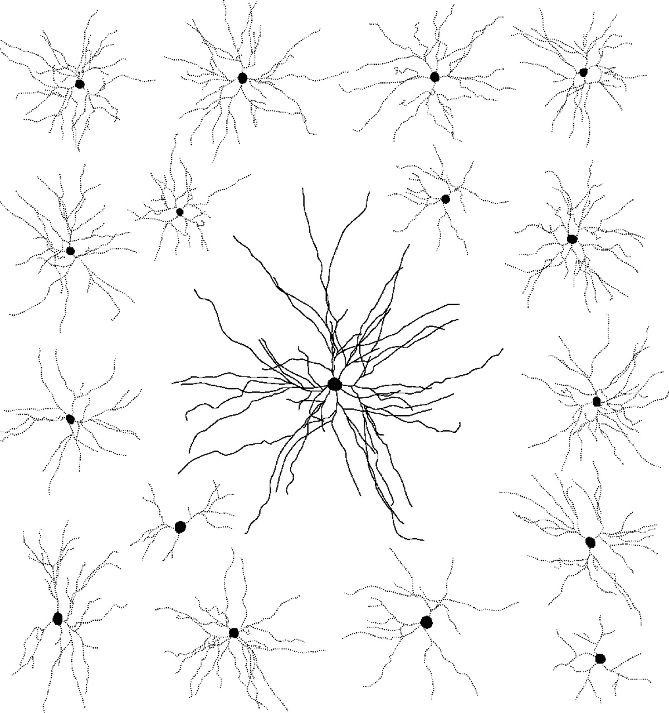
Figure 5. Scale drawings of the basal dendritic arbours (in the tangential plane) of layer III pyramidal ...
Notes:
Figure 5. Scale drawings of the basal dendritic arbours (in the tangential plane) of layer III pyramidal cells of the prefrontal cortex (black) and the primary visual area (V1, grey) of the macaque monkey. Prefrontal cells are, on average, up to 16 times more spinous than those in V1 (see Elston, 2000). As each dendritic spine receives at least one excitatory input, cells in area 12 potentially integrate 16 times more excitatory inputs than those in V1.
Unless provided in the caption above, the following copyright applies to the content of this slide:

Slide 6
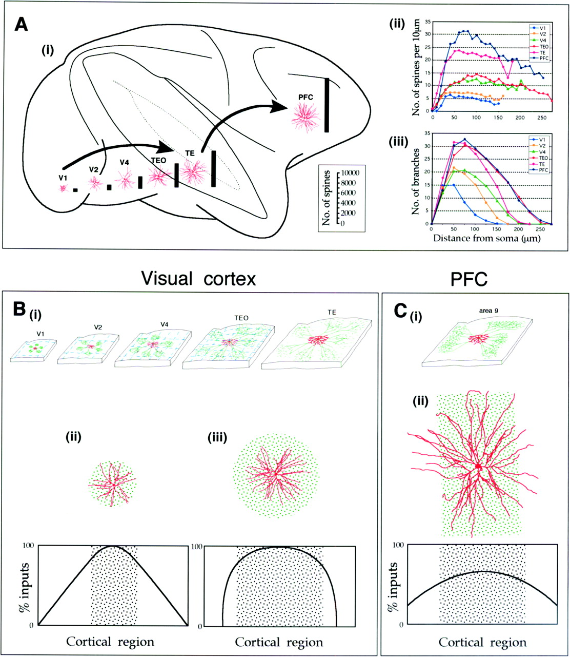
Figure 6. (A) Schematic of (i) the macaque brain illustrating one of many pathways to prefrontal cortex (e.g. ...
Notes:
Figure 6. (A) Schematic of (i) the macaque brain illustrating one of many pathways to prefrontal cortex (e.g. Wilson et al., 1993; Rao et al., 1997; Ó Scalaidhe et al., 1997). Neurons in the primary visual area (V1), second visual area (V2), fourth visual area (V4), cytoarchitectonic areas TEO and TE and prefrontal cortex (PFC, Walker’s area 12) are illustrated to show differences in the size and branching patterns of their basal dendritic arbours. The number of individual dendritic spines, the site of excitatory inputs, found in the basal dendritic arbour of the ‘average’ layer III pyramidal cell in each area is illustrated (solid bars). Note there is a progressive increase in the putative number of excitatory inputs that project to individual pyramidal cells with anterior progression through these areas. Plots of (ii) the spine density and (iii) branching patterns illustrate marked variation between populations of neurons in the different cortical areas (for a review, see Elston and DeFelipe, 2002). (B) Schematics of cortical slices in V1, V2, V4 and TEO (i) illustrating how the progressive increase in size of the basal dendritic arbours (red cells) coupled with visuotopic compression (dashed blue lines) result in a >100-fold difference in the receptive field properties of neurons between V1 and TEO (ii). The progressive increase in the horizontal extent of these intrinsic clusters (green dashed lines) through these areas results in an even greater proportion of the visuotopic representation being sampled by individual neurons, which may account for the 1000-fold difference in receptive field size determined by electrophysiological recording in V1 and TEO. We suggest that the size of the dendritic arbours and intrinsic axonal projections in inferotemporal cortex are essential for global aspects of visual processing such as object recognition. Despite differences in the size of both the axon clusters and the size of the basal dendritic arbours in these areas, both have approximately the same dimension in each area (ii), resulting in specialized sampling geometry (for a review, see Malach, 1994). In area TE, however, the intrinsic projections are more widespread and more diffuse (iii), resulting in a different sampling geometry (note that receptive fields of neurons in TE are so large that this area is not topographically organized; the receptive field of many neurons includes almost the entire field of view). (C) Schematics of a cortical slice taken from PFC (i) illustrating the widespread stripe-like intrinsic projections in PFC (as reported in area 9). In PFC, the basal dendritic arbours are larger than the width of the intrinsic stripes (ii), potentially resulting in more complex connectivity within cortex through greater convergence to individual neurons. Moreover, pyramidal cells in PFC may be characterized by different sampling strategies according to the axis of the intrinsic axon stripes.
Unless provided in the caption above, the following copyright applies to the content of this slide:

Slide 7
Figure 7. Plots of the estimates of the total number of spines in the basal dendritic arbour of the ‘average’ ...
Notes:
Figure 7. Plots of the estimates of the total number of spines in the basal dendritic arbour of the ‘average’ pyramidal cell in occipitotemporal (grey) and prefrontal cortex (black) in the owl monkey, marmoset monkey, macaque monkey and human. The spine count increases with anterior progression through occipitotemporal cortex in all species. The prefrontal pyramidal cell phenotype, however, differs markedly between species. In the New World marmoset and owl monkeys, the prefrontal pyramidal cell has relatively few spines, whereas in Old World macaque monkeys and humans it is extremely spinous. Data taken from Elston et al. (1999a,b, 2001) and Elston (2003d).
Unless provided in the caption above, the following copyright applies to the content of this slide:

