Slide 1
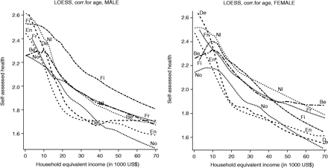
Figure 1 The form of the relationship between household equivalent income ('000 dollars, PPP-adjusted) and ...
Notes:
Figure 1 The form of the relationship between household equivalent income ('000 dollars, PPP-adjusted) and self-assessed health. Key: Be, Belgium; De, Denmark; En, England; Fi, Finland; Fr, France; Nl, The Netherlands; No, Norway
Unless provided in the caption above, the following copyright applies to the content of this slide: Published by Oxford University Press on behalf of the International Epidemiological Association © The Author 2004; all rights reserved.

