Slide 1
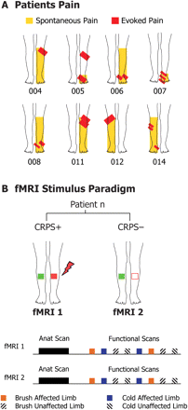
Fig. 1 (A) Maps of region affected in lower extremity for each subject. The spatial extent of spontaneous (yellow) ...
Notes:
Fig. 1 (A) Maps of region affected in lower extremity for each subject. The spatial extent of spontaneous (yellow) and evoked (red) pain for each subject as determined during the initial clinical evaluation. (B) Paradigm. The experimental paradigm for functional imaging. Subjects underwent two scanning sessions: Scan 1 with the pain (CRPS+ state) and Scan 2 without the pain (CRPS− state). For each scanning session, the area most sensitive to presented stimuli was identified prior to the scans. During each functional scan, cold or brush stimuli were applied to these areas on the affected (red) and unaffected mirror region (green) limbs. Stimuli were presented in a semi-randomized fashion.
Unless provided in the caption above, the following copyright applies to the content of this slide: © The Author (2008). Published by Oxford University Press on behalf of the Guarantors of Brain. All rights reserved. For Permissions, please email: journals.permissions@oxfordjournals.org

Slide 2
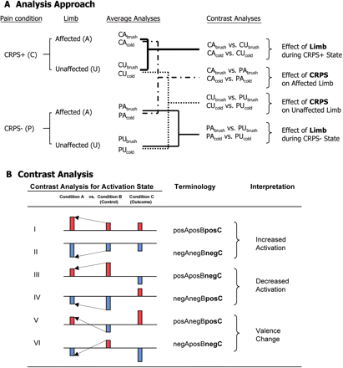
Fig. 2 (A) Analysis approach. Flow chart of the analyses performed for the CRPS⁺ and CRPS⁻ ...
Notes:
Fig. 2 (A) Analysis approach. Flow chart of the analyses performed for the CRPS+ and CRPS− conditions, including generation of average maps for affected and unaffected states (for brush and cold) and contrast analyses. These contrast analyses allowed for the determination of effects of limb on CRPS state and effects of CRPS state on limb. (B) Contrast analyses. The six (I–VI) outcomes for comparison of Condition A (affected) to Condition B (control). The Condition C (outcome) is defined as noted under ‘Terminology’. Each outcome falls under one of the following categories: Increased response, decreased response or valence change (see text).
Unless provided in the caption above, the following copyright applies to the content of this slide: © The Author (2008). Published by Oxford University Press on behalf of the Guarantors of Brain. All rights reserved. For Permissions, please email: journals.permissions@oxfordjournals.org

Slide 3
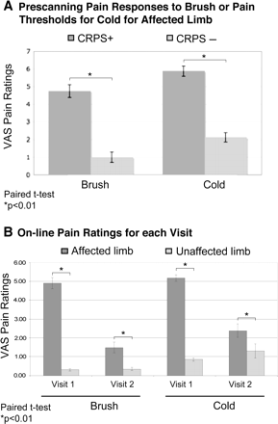
Fig. 3 Psychophysical measures. (A) Pre-scanning group VAS pain ratings: VAS ratings (0–10; ± SEM) for cold stimuli ...
Notes:
Fig. 3 Psychophysical measures. (A) Pre-scanning group VAS pain ratings: VAS ratings (0–10; ± SEM) for cold stimuli and brush stimuli collected prior to scanning, during the CRPS+ (Visit 1) and CRPS− state (Visit 2). (B) Group VAS pain ratings during the functional scans: Average (± SEM) maximal pain ratings by the eight subjects for brush and cold for affected versus unaffected limb for Visit 1 and Visit 2.
Unless provided in the caption above, the following copyright applies to the content of this slide: © The Author (2008). Published by Oxford University Press on behalf of the Guarantors of Brain. All rights reserved. For Permissions, please email: journals.permissions@oxfordjournals.org

Slide 4
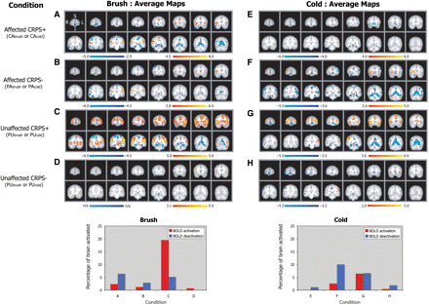
Fig. 4 Average activation maps. Serial coronal sections showing significantly increased (red) and decreased (blue) ...
Notes:
Fig. 4 Average activation maps. Serial coronal sections showing significantly increased (red) and decreased (blue) BOLD responses for brush and cold applied to the affected or unaffected limb during the CRPS+ or CRPS− state. Conditions (e.g. affected limb CRPS+) are arranged in rows, with columns for Brush (A–D) or Cold (E–H). S = superior, I = inferior, L = ipsilateral to stimulation (left hemisphere in unflipped brains), R = contralateral to stimulation (right hemisphere in unflipped brains). See ‘Methods’ section for details. The histograms below show the percentage of significant positive and negative voxels relative to the brain. The letters on the x-axis correspond with each of the figures above.
Unless provided in the caption above, the following copyright applies to the content of this slide: © The Author (2008). Published by Oxford University Press on behalf of the Guarantors of Brain. All rights reserved. For Permissions, please email: journals.permissions@oxfordjournals.org

Slide 5
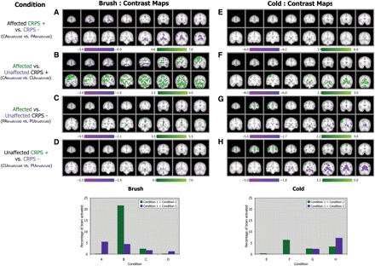
Fig. 5 Contrast activation maps (standard method). Serial coronal sections through the brain for each contrast shown ...
Notes:
Fig. 5 Contrast activation maps (standard method). Serial coronal sections through the brain for each contrast shown on the left for brush (A–D) and cold (E–H). S = superior, I = inferior, L = ipsilateral to stimulation (left hemisphere in un-flipped brains), R = contralateral to stimulation (right hemisphere in un-flipped brains). See ‘Methods’ section for details. The histograms below show total activation for positive and negative voxels activated as a percentage of total brain activation. The letters on the x-axis correspond with each of the figures above. Compare with contrast maps (Figs 6 and 7) that take into account ‘increased response’, ‘decreased response’ and ‘valence change’.
Unless provided in the caption above, the following copyright applies to the content of this slide: © The Author (2008). Published by Oxford University Press on behalf of the Guarantors of Brain. All rights reserved. For Permissions, please email: journals.permissions@oxfordjournals.org

Slide 6
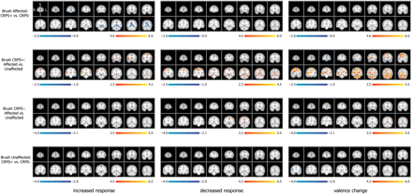
Fig. 6 Contrast maps for brush: increased and decreased responses, and valence change. Contrast analyses (arranged ...
Notes:
Fig. 6 Contrast maps for brush: increased and decreased responses, and valence change. Contrast analyses (arranged in rows) for increased activation (left panels), decreased activation (middle panels) and valence change (right panels). The statistical thresholds are shown below each figure for condition A condition B (red-yellow). Note that each bar has different z values that were defined for threshold of activation using GMM (see text). S = superior, I = inferior, L = ipsilateral to stimulation (left hemisphere in un-flipped brains), R = contralateral to stimulation (right hemisphere in un-flipped brains). See ‘Methods’ section for details.
Unless provided in the caption above, the following copyright applies to the content of this slide: © The Author (2008). Published by Oxford University Press on behalf of the Guarantors of Brain. All rights reserved. For Permissions, please email: journals.permissions@oxfordjournals.org

Slide 7
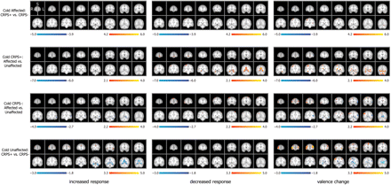
Fig. 7 Contrast maps for cold: increased and decreased responses and valence change. Contrast analyses (arranged in ...
Notes:
Fig. 7 Contrast maps for cold: increased and decreased responses and valence change. Contrast analyses (arranged in rows) for increased activation (left panels), decreased activation (middle panels) and valence change (right panels). The statistical thresholds are shown below each figure for condition A condition B (red-yellow). Note that each bar has different z values that were defined for threshold of activation using GMM (see text). S = superior, I = inferior, L = ipsilateral to stimulation (left hemisphere in un-flipped brains), R = contralateral to stimulation (right hemisphere in un-flipped brains). See ‘Methods’ section for details.
Unless provided in the caption above, the following copyright applies to the content of this slide: © The Author (2008). Published by Oxford University Press on behalf of the Guarantors of Brain. All rights reserved. For Permissions, please email: journals.permissions@oxfordjournals.org

