Slide 1
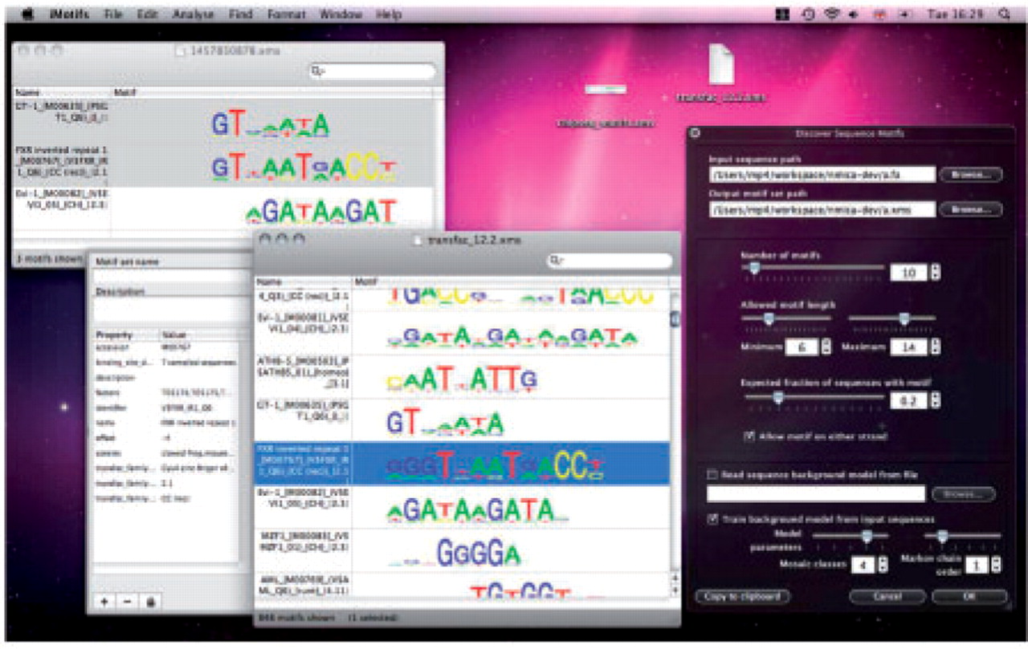
Fig. 1. iMotifs can present motif sets and alignments. It integrates with the OS X desktop's previewing functionality ...
Notes:
Fig. 1. iMotifs can present motif sets and alignments. It integrates with the OS X desktop's previewing functionality and includes a number of analysis tools including an integrated NestedMICA motif inference tool.
Unless provided in the caption above, the following copyright applies to the content of this slide: © The Author(s) 2010. Published by Oxford University Press.This is an Open Access article distributed under the terms of the Creative Commons Attribution Non-Commercial License (http://creativecommons.org/licenses/by-nc/2.5), which permits unrestricted non-commercial use, distribution, and reproduction in any medium, provided the original work is properly cited.

