Slide 1
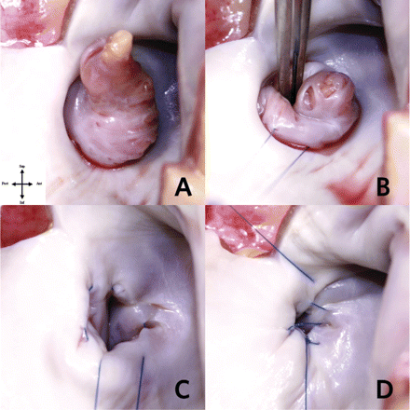
Figure 1: Internal view of the left atrium that shown the LAA in anatomic human specimen. For better understanding, the ...
Notes:
Figure 1: Internal view of the left atrium that shown the LAA in anatomic human specimen. For better understanding, the left pulmonary veins are excised.
Unless provided in the caption above, the following copyright applies to the content of this slide: © The Author 2011. Published by Oxford University Press on behalf of the European Association for Cardio-Thoracic Surgery. All rights reserved

Slide 2
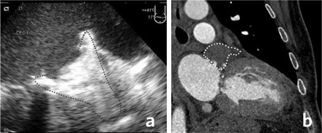
Figure 2: Transesophageal echocardiogram (a) and cardiac computed tomography (b) demonstrating complete occlusion of ...
Notes:
Figure 2: Transesophageal echocardiogram (a) and cardiac computed tomography (b) demonstrating complete occlusion of the left atrial appendage.
Unless provided in the caption above, the following copyright applies to the content of this slide: © The Author 2011. Published by Oxford University Press on behalf of the European Association for Cardio-Thoracic Surgery. All rights reserved

