Slide 1
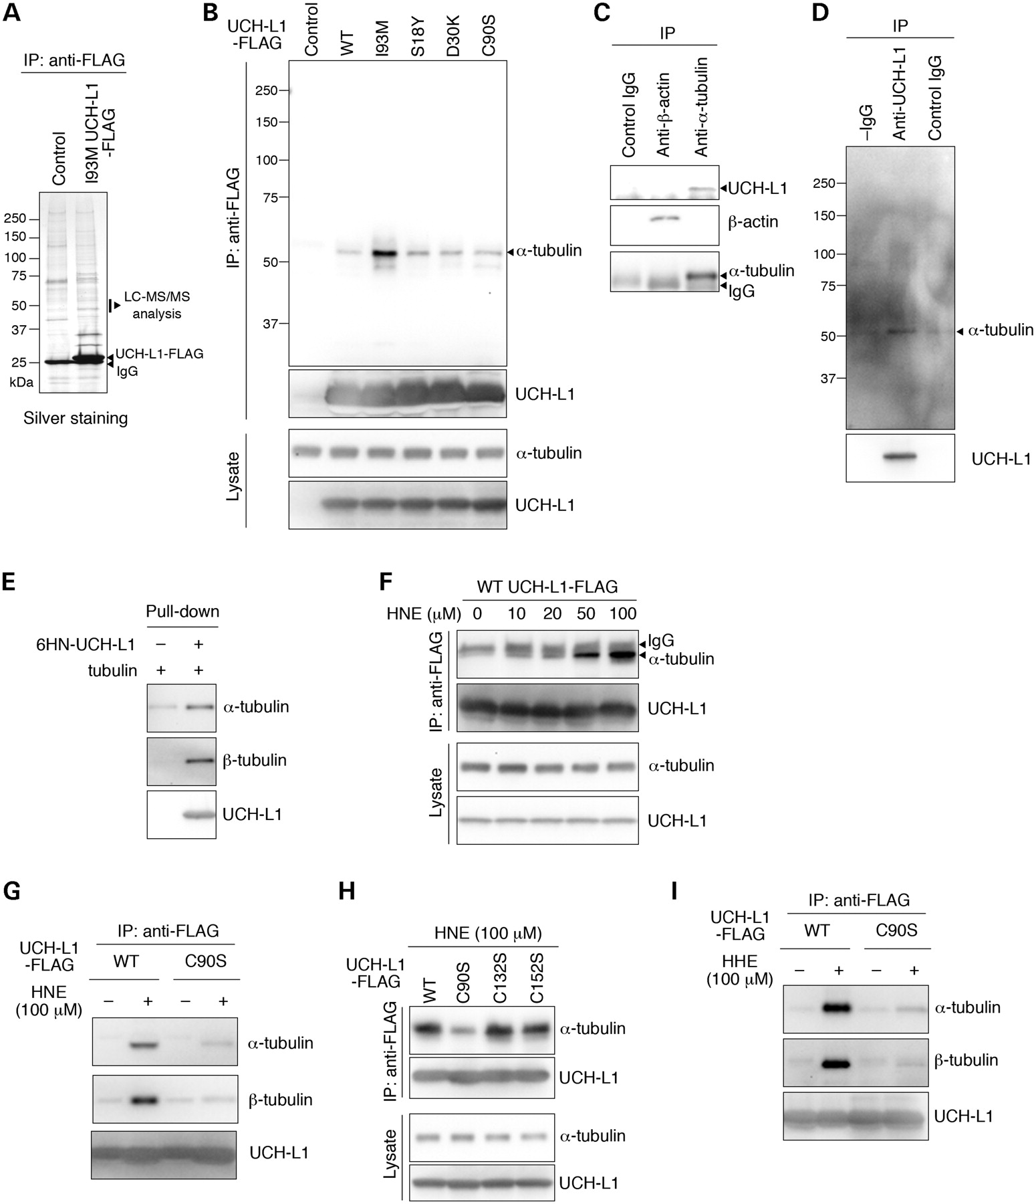
Notes:
Unless provided in the caption above, the following copyright applies to the content of this slide: © The Author 2008. Published by Oxford University Press. All rights reserved. For Permissions, please email: journals.permissions@oxfordjournals.org

