Slide 1
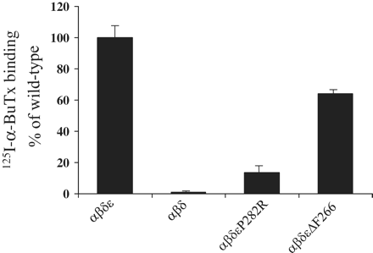
Figure 1 Expression of AChR containing mutant ε-subunits on the surface of HEK 293 cells. HEK 293 cells transfected ...
Notes:
Figure 1 Expression of AChR containing mutant ε-subunits on the surface of HEK 293 cells. HEK 293 cells transfected with complementary DNA for wild-type, αβδ AChR alone (n = 7) or with αβδ plus either p.εΔF266 (n = 7) or p.εP282R (n = 3) mutants. 125I-α-bungarotoxin was bound to the surface of intact cells and levels of AChR containing ε-subunits determined following immunoprecipitation with an anti-ε-subunit-specific antibody. Results are normalized against 125I-α-bungarotoxin to wild-type αβδε AChR and represent the mean ± SD (error bars for wild-type are included to show consistency between experiments).
Unless provided in the caption above, the following copyright applies to the content of this slide: © The Author (2012). Published by Oxford University Press on behalf of the Guarantors of Brain. All rights reserved. For Permissions, please email: journals.permissions@oup.com

Slide 2
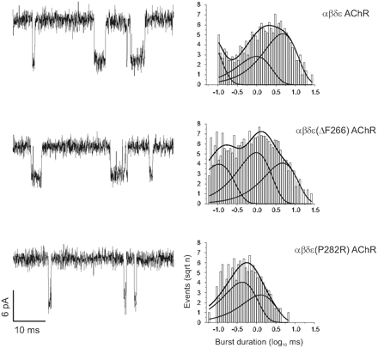
Figure 2 Burst duration of the mutant ε-subunit channels. Left: Example traces of AChR activity recorded, 500 nM ...
Notes:
Figure 2 Burst duration of the mutant ε-subunit channels. Left: Example traces of AChR activity recorded, 500 nM acetylcholine in patch pipette, from cells transfected with wild-type αβδε AChR (top) or αβδε(ΔF266) AChR (middle) or αβδε(P282R) AChR (bottom). Downward deflections indicate channel opening events; scale bars are identical for each trace. Right: Example burst duration histograms fitted by the sum of two or three exponential functions. For these examples exponential τ values and proportion of burst were as follows: wild-type: τ1: 0.05 ms (39.6%); τ2: 0.99 ms (21.6%); τ3: 4.68 ms (38.8%); 894 bursts. p.εΔF266: τ1: 0.11 ms (30.1%); τ2: 1.00 ms (39.0%); τ3: 4.75 ms (31.0%); 1521 bursts. p.εP282R: τ1: 0.43 ms (59.4%); τ2: 1.29 ms (40.6%); 692 bursts.
Unless provided in the caption above, the following copyright applies to the content of this slide: © The Author (2012). Published by Oxford University Press on behalf of the Guarantors of Brain. All rights reserved. For Permissions, please email: journals.permissions@oup.com

Slide 3
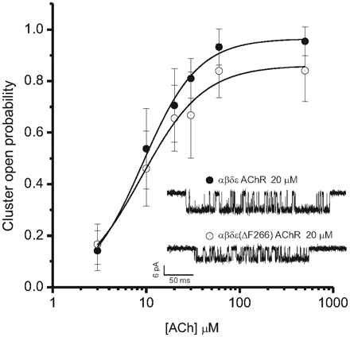
Figure 3 Cluster open probability of εΔF266 channels. Cluster open probability (mean ± SD) is plotted versus pipette ...
Notes:
Figure 3 Cluster open probability of εΔF266 channels. Cluster open probability (mean ± SD) is plotted versus pipette acetylcholine (ACh) concentration, filled circles are αβδε AChR channels and empty circles are αβδε(ΔF266) AChR channels. Insert is example traces of clusters recorded at 20 µM acetylcholine. Data are from 2 to 6 patches per concentration and are the mean of between 83 and 788 clusters. Data were fit by the logistic function with minimum fixed at zero. EC50 for each channel type was determined as 9.2 ± 0.7 µM for αβδε AChR and 9.0 ± 1.15 µM for αβδε(ΔF266) AChR.
Unless provided in the caption above, the following copyright applies to the content of this slide: © The Author (2012). Published by Oxford University Press on behalf of the Guarantors of Brain. All rights reserved. For Permissions, please email: journals.permissions@oup.com

Slide 4
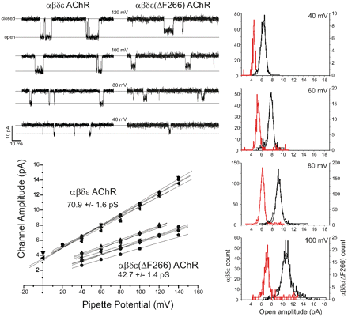
Figure 4 Single-channel conductance is reduced by deletion mutant p.εΔF266. Top left: Example traces from αβδε AChR ...
Notes:
Figure 4 Single-channel conductance is reduced by deletion mutant p.εΔF266. Top left: Example traces from αβδε AChR and αβδε(ΔF266) AChR transfected cells. Pipette potential was held at potential indicated. Scale bar refers to both sets of example traces. Right: Open channel amplitude histograms at pipette potential of 40, 60, 80 and 100 mV. Red traces are αβδε(ΔF266) AChR. Each set of openings were fit by a single Gaussian population. Bottom left: The relationship between pipette potential and single-channel amplitude. Amplitude of channel events >1 ms in duration were averaged for each potential (40 mV, 80 mV, 100 mV and 120 mV) for each patch, error bars are less than size of symbol. For each patch a linear fit of the data was applied, giving the single-channel conductance for each patch. Mean ± SEM conductance indicated are from six and eight patches, respectively.
Unless provided in the caption above, the following copyright applies to the content of this slide: © The Author (2012). Published by Oxford University Press on behalf of the Guarantors of Brain. All rights reserved. For Permissions, please email: journals.permissions@oup.com

Slide 5
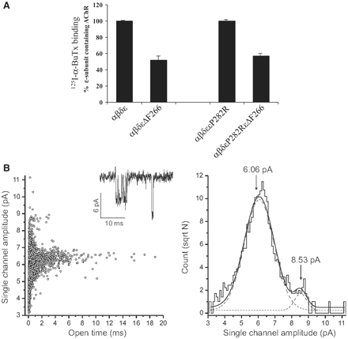
Figure 5 Co-expression of αβδεP282R and αβδεΔF266 does not inhibit αβδε(ΔF266) expression or function. (A) αβδεP282R ...
Notes:
Figure 5 Co-expression of αβδεP282R and αβδεΔF266 does not inhibit αβδε(ΔF266) expression or function. (A) αβδεP282R AChR were co-expressed in HEK 293 cells in combination with either wild-type or αβδε(ΔF266) and 48 h following transfection the level of cell-surface bound 125I-α-bungarotoxin (BuTx) precipitated by an ε-subunit-specific antibody was determined. Results are normalized against 125I-α-bungarotoxin to wild-type αβδε AChR, or wild-type plus αβδεP282R AChR and represent the mean ± SD of three independent transfections (error bars for wild-type are included to show consistency between experiments). (B) Left: Scatter plot of all channel openings >0.1 ms from HEK 293 cells transfected with αβδεP282R and αβδεΔF266 AChR subunits. Two open populations can be identified; the great majority of openings form a population with longer open times (αβδεΔF266) while the minority population has comparatively brief open times (αβδεP282R). Right: Open channel amplitude histogram; data were fit by two Gaussian populations with mean amplitude of 6.06 and 8.53 pA.
Unless provided in the caption above, the following copyright applies to the content of this slide: © The Author (2012). Published by Oxford University Press on behalf of the Guarantors of Brain. All rights reserved. For Permissions, please email: journals.permissions@oup.com

Slide 6
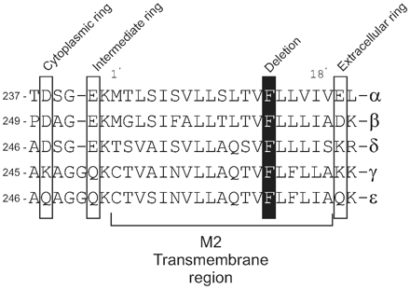
Figure 6 Alignment of AChR subunits through the M2 transmembrane domain. Human AChR subunit sequences are aligned and ...
Notes:
Figure 6 Alignment of AChR subunits through the M2 transmembrane domain. Human AChR subunit sequences are aligned and phenylalanine 266, which is conserved in all subunits, is highlighted in black. Cytoplasmic, intermediate and extracellular rings which influence channel conductance are indicated.
Unless provided in the caption above, the following copyright applies to the content of this slide: © The Author (2012). Published by Oxford University Press on behalf of the Guarantors of Brain. All rights reserved. For Permissions, please email: journals.permissions@oup.com

Slide 7
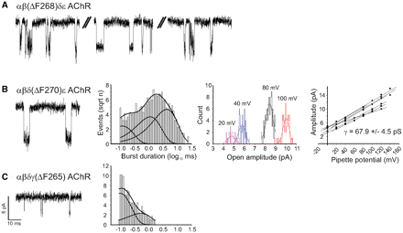
Figure 7 Effect of deleting equivalent residues in the M2 transmembrane domain of other AChR subunits. (A) Example ...
Notes:
Figure 7 Effect of deleting equivalent residues in the M2 transmembrane domain of other AChR subunits. (A) Example traces of αβ(ΔF268)δε AChR recordings, included are example of ‘flickery’ openings and regular full amplitude openings. (B) Example trace of αβδ(ΔF270)ε AChR recordings (left), an example of a burst duration histogram fit by a sum of three exponentials, τ1: 0.12 ms (22.4%); τ2: 1.15 ms (34.1%); τ3: 4.34 ms (43.5%); 1088 bursts (centre) and relationship between single-channel amplitude and pipette holding potential, an example of the open channel amplitude histogram at pipette potential of 20, 40, 80 and 100 mV is shown with the linear fit of the data showing the single-channel conductance (right, n = 7). (C) Example traces of αβδγ(ΔF265) AChR recordings and burst duration histogram fit by the sum of two exponentials; τ1: 0.10 ms (73.7%); τ2: 0.54 ms (26.4%); 653 bursts. Scale bars apply to all example traces.
Unless provided in the caption above, the following copyright applies to the content of this slide: © The Author (2012). Published by Oxford University Press on behalf of the Guarantors of Brain. All rights reserved. For Permissions, please email: journals.permissions@oup.com

