Slide 1
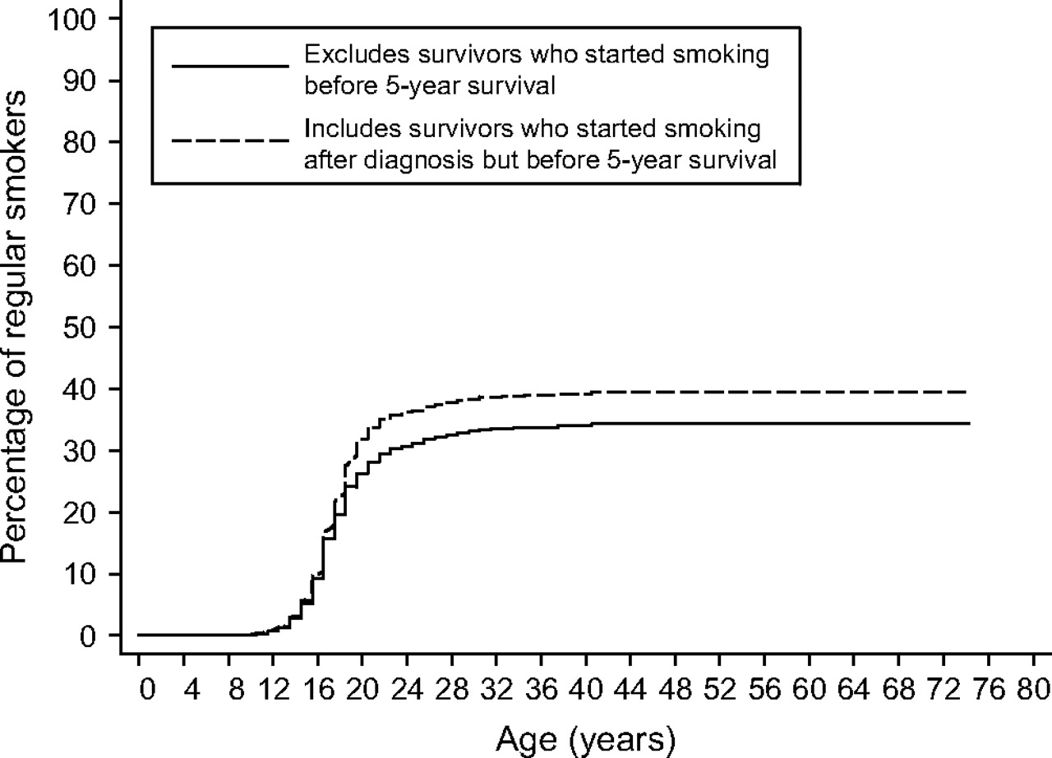
Figure 1 Actuarial percentages of ever regular smokers by age at initiation of smoking.
Notes:
Figure 1 Actuarial percentages of ever regular smokers by age at initiation of smoking.
Unless provided in the caption above, the following copyright applies to the content of this slide: © The Author 2008. Published by Oxford University Press.

