Slide 1
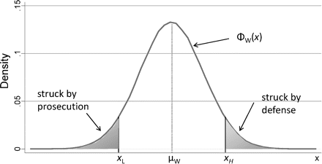
FIGURE I The Distribution of x for White Jurors in Pool This distribution characterizes the ex ante likelihood of ...
Notes:
FIGURE I The Distribution of x for White Jurors in Pool This distribution characterizes the ex ante likelihood of conviction for white potential jurors. Jurors with higher values of x are more likely to convict, and thus the defense will use their peremptory challenges to strike jurors in the upper tail, whereas the prosecution will strike jurors in the lower tail.
Unless provided in the caption above, the following copyright applies to the content of this slide: © The Author(s) 2012. Published by Oxford University Press, on the behalf of President and Fellows of Harvard College. All rights reserved. For Permissions, please email: journals.permissions@oup.com.

Slide 2
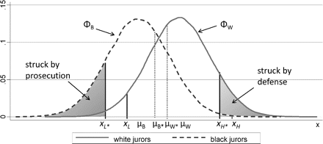
FIGURE II The Distribution of x for White and Black Jurors in Pool This figure shows how the truncation points will ...
Notes:
FIGURE II The Distribution of x for White and Black Jurors in Pool This figure shows how the truncation points will change when black jurors are added to the pool. Based on our main empirical results, these black and white juror distributions might illustrate the situation for a black defendant. Compared to Figure I, where there were only white potential jurors, adding black jurors to the pool shifts the truncation points toward the location of the black distribution to xH* and xL*.
Unless provided in the caption above, the following copyright applies to the content of this slide: © The Author(s) 2012. Published by Oxford University Press, on the behalf of President and Fellows of Harvard College. All rights reserved. For Permissions, please email: journals.permissions@oup.com.

Slide 3
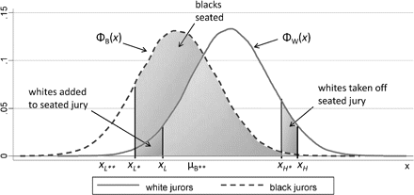
FIGURE III The Impact of Adding Black Jurors to the Jury Pool. This figure represents the same situation as Figure II ...
Notes:
FIGURE III The Impact of Adding Black Jurors to the Jury Pool. This figure represents the same situation as Figure II but explicitly shows the direct and indirect effect of adding black jurors to the pool. A direct effect occurs because those blacks with values of x between the truncation points xH* and xL* will be seated on the jury. An indirect effect occurs because the distribution of potential jurors shifts to the left when black jurors are added to the pool. This means the prosecution will not be able to remove as many white jurors in the lower tail as before, and the defense can now strike more white jurors in the upper tail. As a result, adding black jurors to the pool results in whites from the upper tail of the distribution being replaced on the seated jury by whites from the lower tail.
Unless provided in the caption above, the following copyright applies to the content of this slide: © The Author(s) 2012. Published by Oxford University Press, on the behalf of President and Fellows of Harvard College. All rights reserved. For Permissions, please email: journals.permissions@oup.com.

