Slide 1
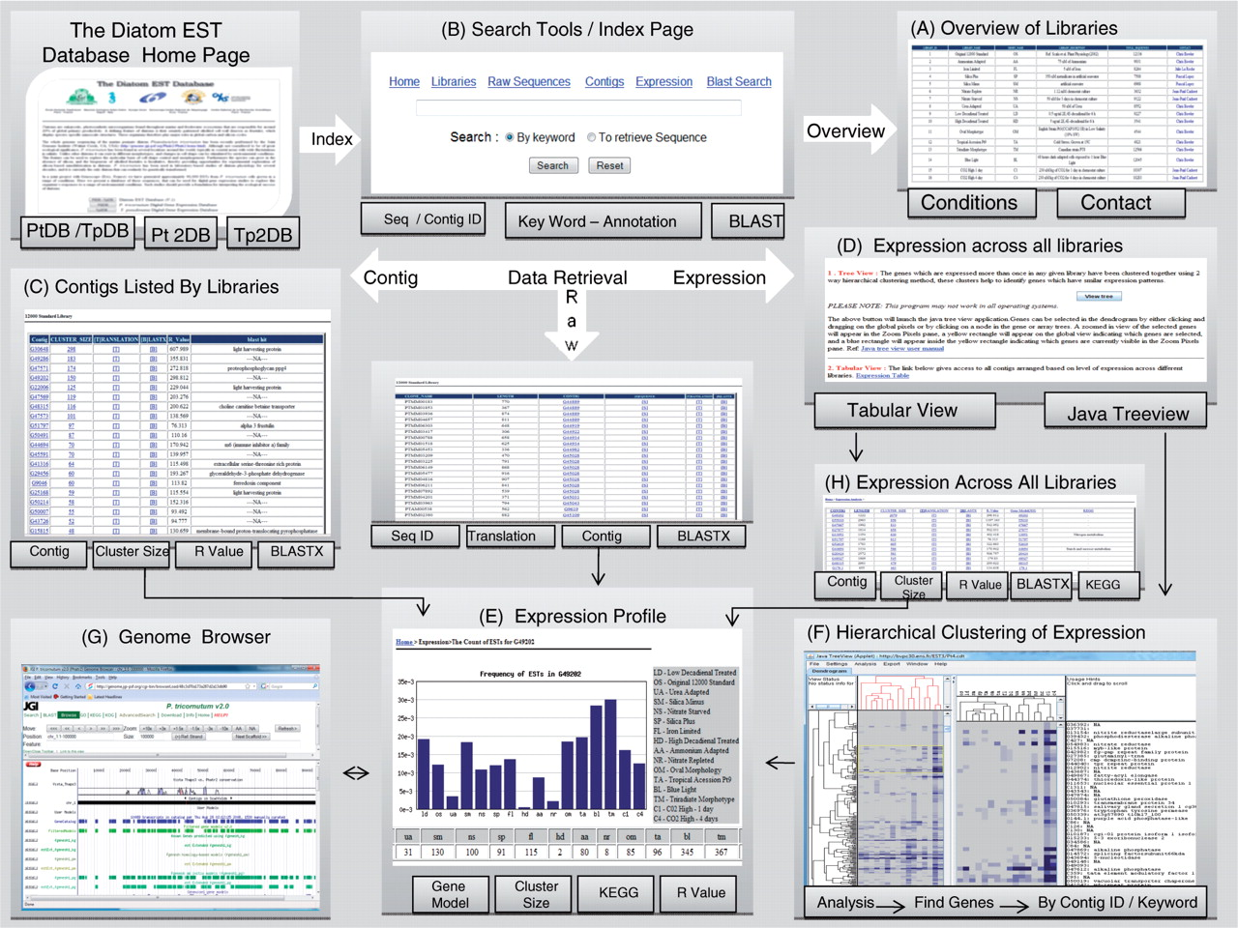
Figure 1. Overview of the updated Diatom EST Database.
Notes:
Figure 1. Overview of the updated Diatom EST Database.
Unless provided in the caption above, the following copyright applies to the content of this slide: © 2008 The Author(s)This is an Open Access article distributed under the terms of the Creative Commons Attribution Non-Commercial License (http://creativecommons.org/licenses/by-nc/2.0/uk/) which permits unrestricted non-commercial use, distribution, and reproduction in any medium, provided the original work is properly cited.

