Slide 1
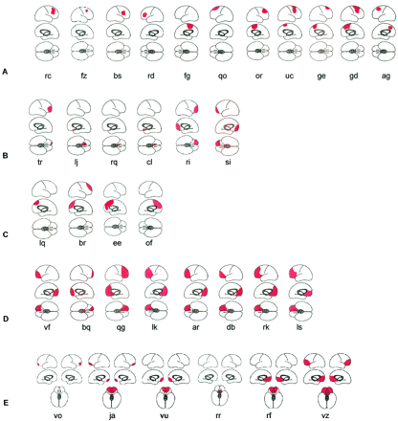
Fig. 1 Brain maps showing lesion sites. (A) Unilateral dorsolateral or dorsolateral and ‘other medial’ ...
Notes:
Fig. 1 Brain maps showing lesion sites. (A) Unilateral dorsolateral or dorsolateral and ‘other medial’ lesions (see C below). (B) Unilateral orbital lesions (some had additional lateral lesions outside the dorsolateral region). (C) Medial BA 9 and ‘affective division’ of anterior cingulate cortex (ACC) lesions (see Fig. 2). (D) Medial BA 9/ACC and orbital lesions. Most also had ‘other medial’ and dorsolateral lesions. (E) Bilateral orbital lesions. Some also had bilateral ACC lesions.
Unless provided in the caption above, the following copyright applies to the content of this slide:

Slide 2
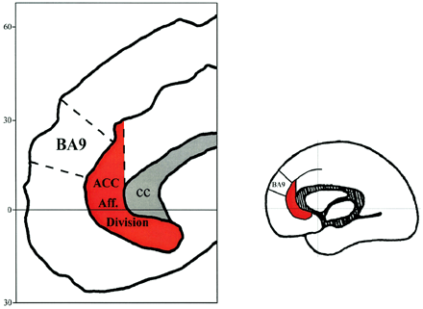
Fig. 2 (Left) The ‘affective division’ (ventral region) of the ACC (after and modified from Bushet al., ...
Notes:
Fig. 2 (Left) The ‘affective division’ (ventral region) of the ACC (after and modified from Bushet al., 2000). (Right) The corresponding region is indicated on the medial surface of the standard brain map used in Fig. 1, as well as the position of medial BA 9. Aff = affective; ACC = anterior cingulate cortex; CC = corpus callosum.
Unless provided in the caption above, the following copyright applies to the content of this slide:

Slide 3
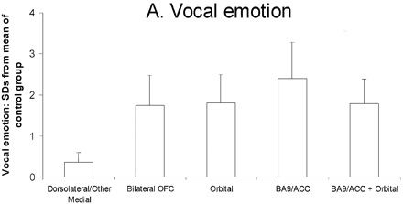
Fig. 3 (A) Vocal emotion: effects of unilateral prefrontal excisions. Patients with either orbital lesions or ...
Notes:
Fig. 3 (A) Vocal emotion: effects of unilateral prefrontal excisions. Patients with either orbital lesions or with lesions in medial BA 9/ACC (‘affective’ anterior cingulate cortex) or with lesions in both of these regions were impaired at identifying non‐verbal vocal emotional sounds. Patients with medial lesions outside BA 9/ACC, or with dorsolateral lesions or with both (dorsolateral/other medial group) performed normally. (B) Voice discrimination. Performance of the same patient groups (as in A) on a test in which they were required to discriminate between pairs of unfamiliar voices. No group was impaired. (C) Environmental sounds. Performance of the same patient groups (as in A and B) on a test in which they were required to identify everyday sounds. No patient group was impaired.
Unless provided in the caption above, the following copyright applies to the content of this slide:

Slide 4
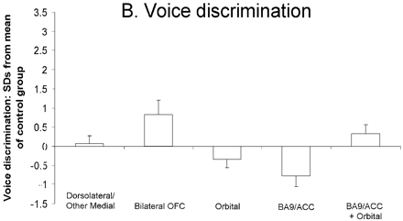
Fig. 3 (A) Vocal emotion: effects of unilateral prefrontal excisions. Patients with either orbital lesions or ...
Notes:
Fig. 3 (A) Vocal emotion: effects of unilateral prefrontal excisions. Patients with either orbital lesions or with lesions in medial BA 9/ACC (‘affective’ anterior cingulate cortex) or with lesions in both of these regions were impaired at identifying non‐verbal vocal emotional sounds. Patients with medial lesions outside BA 9/ACC, or with dorsolateral lesions or with both (dorsolateral/other medial group) performed normally. (B) Voice discrimination. Performance of the same patient groups (as in A) on a test in which they were required to discriminate between pairs of unfamiliar voices. No group was impaired. (C) Environmental sounds. Performance of the same patient groups (as in A and B) on a test in which they were required to identify everyday sounds. No patient group was impaired.
Unless provided in the caption above, the following copyright applies to the content of this slide:

Slide 5
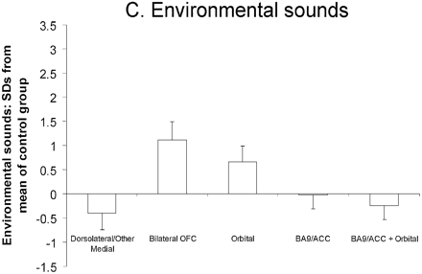
Fig. 3 (A) Vocal emotion: effects of unilateral prefrontal excisions. Patients with either orbital lesions or ...
Notes:
Fig. 3 (A) Vocal emotion: effects of unilateral prefrontal excisions. Patients with either orbital lesions or with lesions in medial BA 9/ACC (‘affective’ anterior cingulate cortex) or with lesions in both of these regions were impaired at identifying non‐verbal vocal emotional sounds. Patients with medial lesions outside BA 9/ACC, or with dorsolateral lesions or with both (dorsolateral/other medial group) performed normally. (B) Voice discrimination. Performance of the same patient groups (as in A) on a test in which they were required to discriminate between pairs of unfamiliar voices. No group was impaired. (C) Environmental sounds. Performance of the same patient groups (as in A and B) on a test in which they were required to identify everyday sounds. No patient group was impaired.
Unless provided in the caption above, the following copyright applies to the content of this slide:

Slide 6
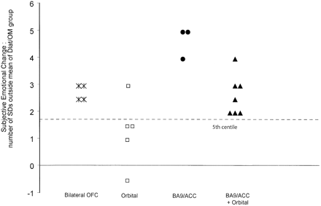
Fig. 4 Subjective emotional change. The total scores of patients with unilateral and with bilateral lesions ...
Notes:
Fig. 4 Subjective emotional change. The total scores of patients with unilateral and with bilateral lesions are shown in terms of the number of SDs by which these differed from the mean of the dorsolateral/other medial group (i.e. those with dorsolateral lesions or with medial lesions outside medial BA 9/ACC or with both).
Unless provided in the caption above, the following copyright applies to the content of this slide:

Slide 7
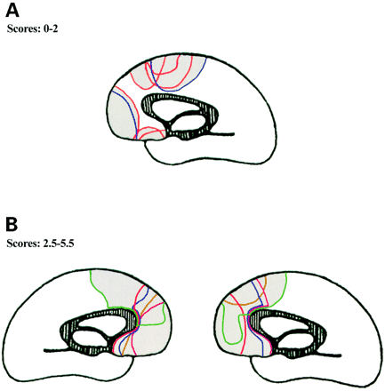
Fig. 5 Subjective emotional change. (A) Scores 0–2: medial lesions of those with scores from 0–2. The ...
Notes:
Fig. 5 Subjective emotional change. (A) Scores 0–2: medial lesions of those with scores from 0–2. The unilateral medial lesions of those with total scores of from 0–2 are superimposed. Six had right‐sided (shown in red) and two had left‐sided lesions (shown in blue), but all are shown together on the medial aspect of a right hemisphere. The region which was spared by these lesions corresponds approximately to medial BA 9 and anterior cingulate cortex (ACC) (i.e. the ventral ‘affective division’ of the ACC; Bushet al., 2000). (B) Scores 2.5–5.5: medial lesions of those with scores from 2.5–5.5. The unilateral medial lesions of those who scored from 2.5–5.5 are superimposed, separately for the five patients with right and for the five patients with left‐sided lesions. Medial BA 9 and/or ACC was included in all of those with medial lesions who reported marked changes. Colour Left‐sided Right‐sided Green OF EE Red RK BQ Blue LS LK Brown DB LQ Pink VK QV
Unless provided in the caption above, the following copyright applies to the content of this slide:

Slide 8
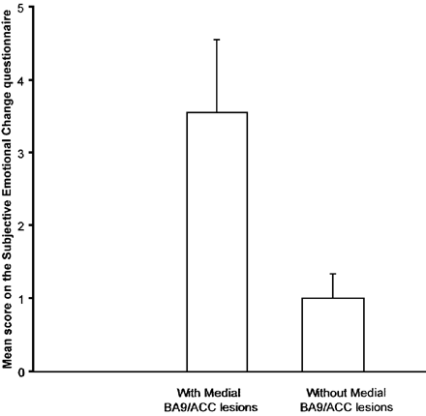
Fig. 6 Subjective emotional change questionnaire. Total amount of change in the experience of emotion ...
Notes:
Fig. 6 Subjective emotional change questionnaire. Total amount of change in the experience of emotion reported by patients with unilateral excisions. The figure shows the mean total score for patients whose lesions encroached upon medial BA 9/ anterior cingulate cortex (ACC) (i.e. ventral ‘affective division’ of the ACC) (n = 10). Also shown is the total mean score for patients without lesions in these medial BA 9/ACC regions (n = 13).
Unless provided in the caption above, the following copyright applies to the content of this slide:

Slide 9
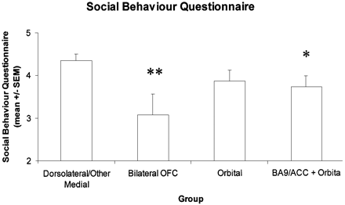
Fig. 7 Social behaviour questionnaire. The mean score (± SEM) over 12 questions in the Social behaviour ...
Notes:
Fig. 7 Social behaviour questionnaire. The mean score (± SEM) over 12 questions in the Social behaviour questionnaire given by the informants for the different patient groups. The maximum score was five, and the minimum score was 0. **P = 0.0015 with respect to the dorsolateral/other medial (DLat/OM) group. * P<0.05 with respect to the DLat/OM group.
Unless provided in the caption above, the following copyright applies to the content of this slide:

